Slide 1
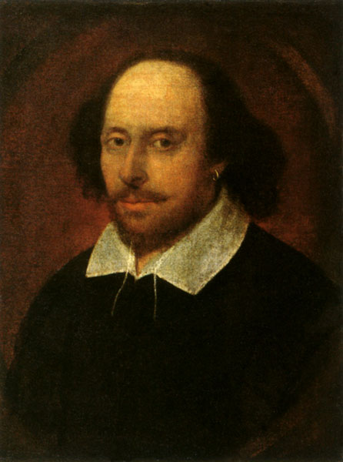

William Shakespeare
(1564- 1616)

Slide 2
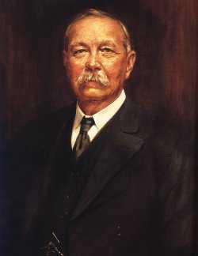
Sir Arthur Conan Doyle
(1859 - 1930)

Slide 3
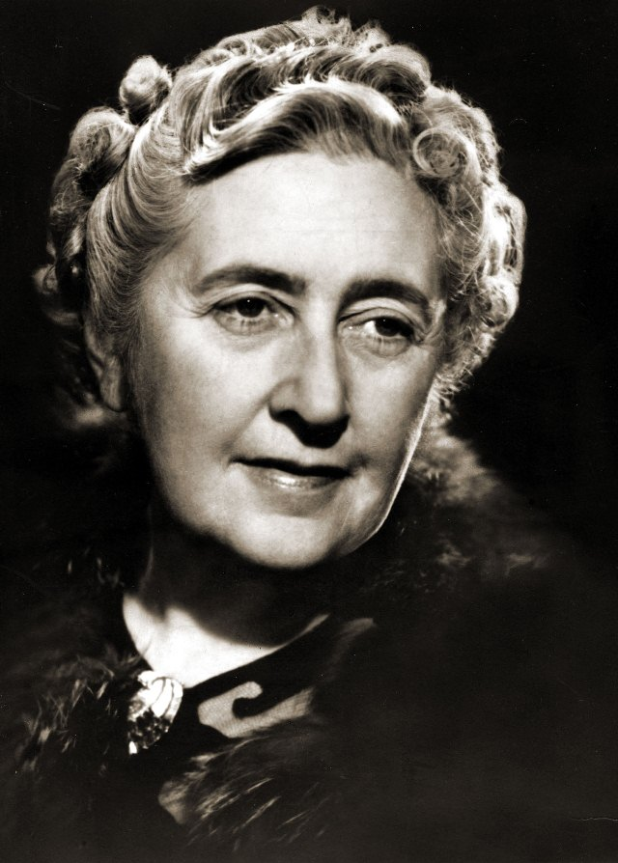
Agatha Christie
(1890-1976)

Slide 4
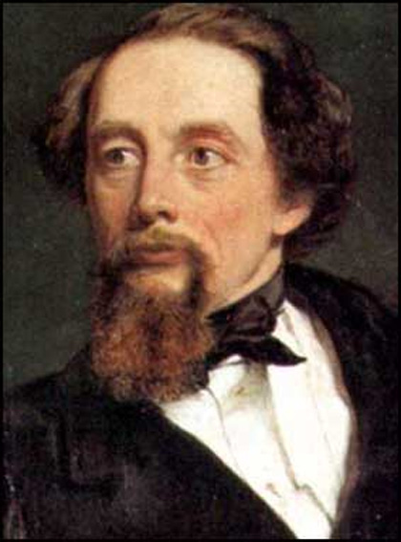
Charles Dickens
(1812-1870)

Slide 5
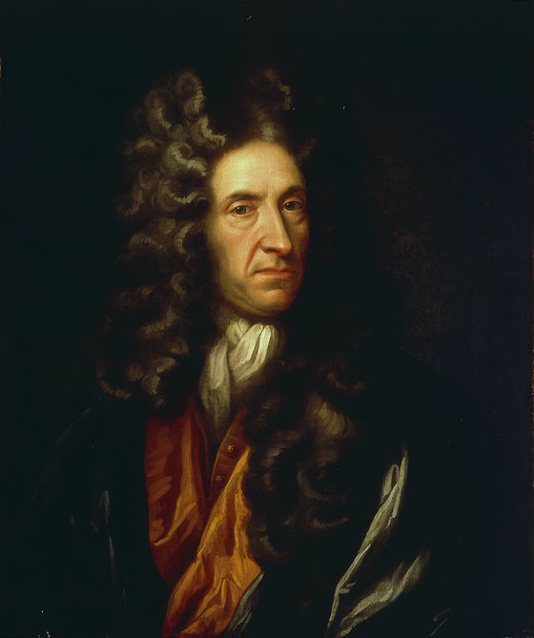
Daniel Defoe
(1660 1731)

Slide 6
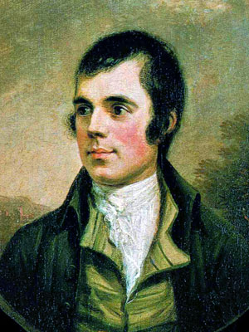
Robert Burns
(1759-1796)

Slide 7
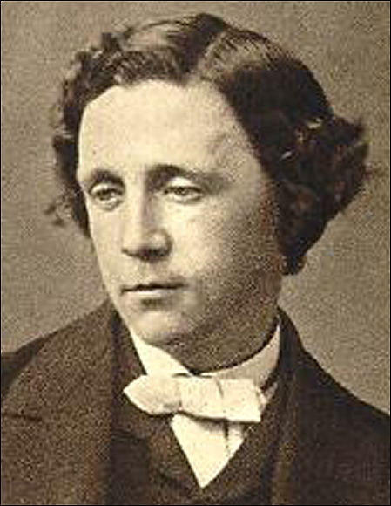
Lewis Carroll
(1832-1898)

Slide 8
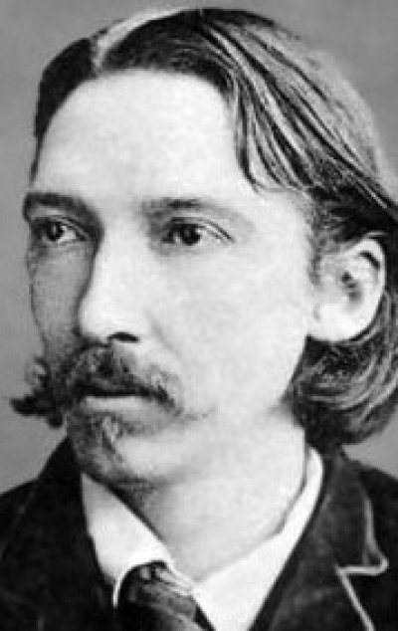
Robert Louis Stevenson
(1850-1894)

Slide 9
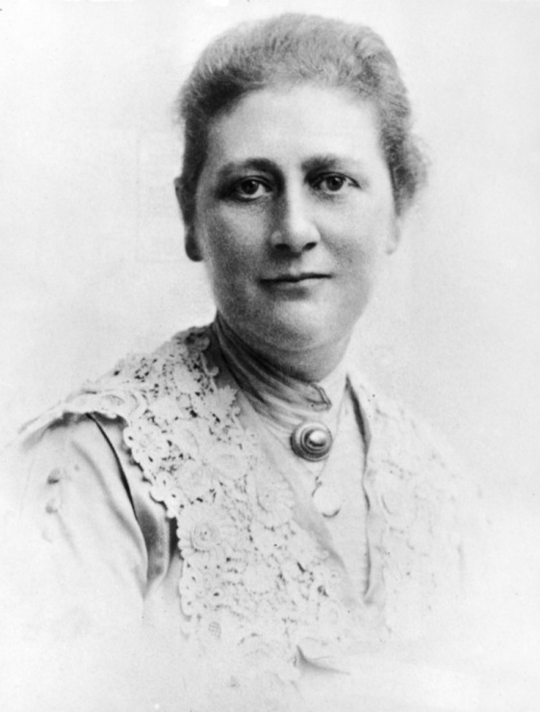
Beatrix Potter
(1866–1943)

Slide 10
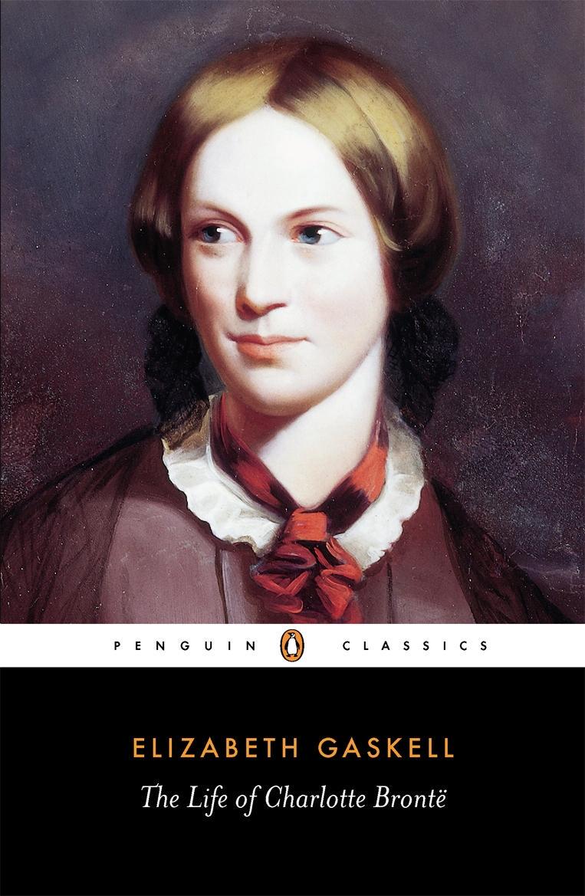
Charlotte Bronte
(1816–1855)

