Slide 1

The 1st of February.
How is the weather in…?
Notes:
The 31st of January.

Slide 2
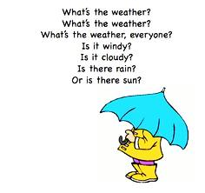
What’s the weather?
Notes:
What’s the weather?

Slide 3
New words
sunny [ˈsʌnɪ]-солнечный
cloudy [ˈklaʊdɪ]-облачный
windy [ˈwɪndɪ]-ветреный
foggy [ˈfɔgɪ]-туманный
rainy [ˈreɪnɪ]-длждливый
snowy [ˈsnəʊɪ]-снежный
stormy [ˈstɔːmɪ]-грозовой
degree [dɪˈgriː]-градус
spring [sprɪŋ]-весна
autumn [ˈɔːtəm]-осень
winter [ˈwɪntə]-зима
summer [ˈsʌmə]-лето
Notes:
New words

Slide 4
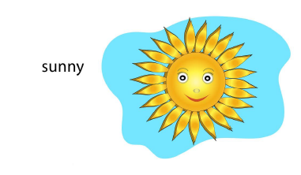
What’s the weather?
Notes:
What’s the weather?

Slide 5
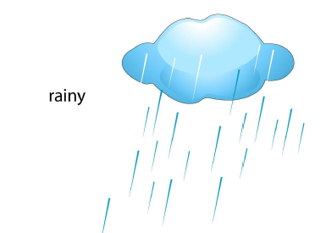
What’s the weather?
Notes:
What’s the weather?

Slide 6
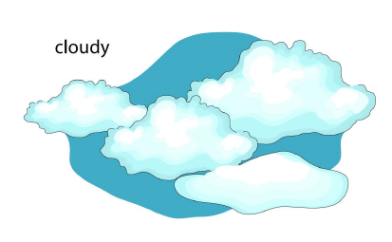
What’s the weather?
Notes:
What’s the weather?

Slide 7
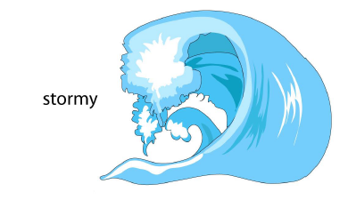
What’s the weather?
Notes:
What’s the weather?

Slide 8
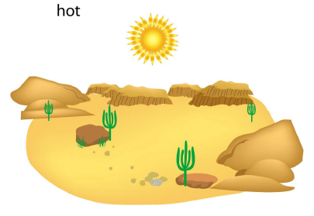
What’s the weather?
Notes:
What’s the weather?

Slide 9
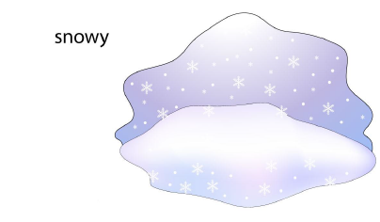
What’s the weather?
Notes:
What’s the weather?

Slide 10
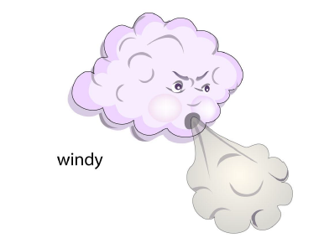
What’s the weather?
Notes:
What’s the weather?

Slide 11
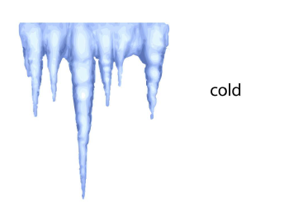
What’s the weather?
Notes:
What’s the weather?

Slide 12
SEASONS
Notes:
SEASONS

Slide 13
Answer the questions.
Ответьте на вопросы.
1. What is the weather like in Kazakhstan?
2. What is the weather like in London in summer?
3. How is the weather in Astana today?
5. What kind of weather do you like?
6. Do you like snowy weather? Why?
7. What weather do you like in spring?

Slide 14
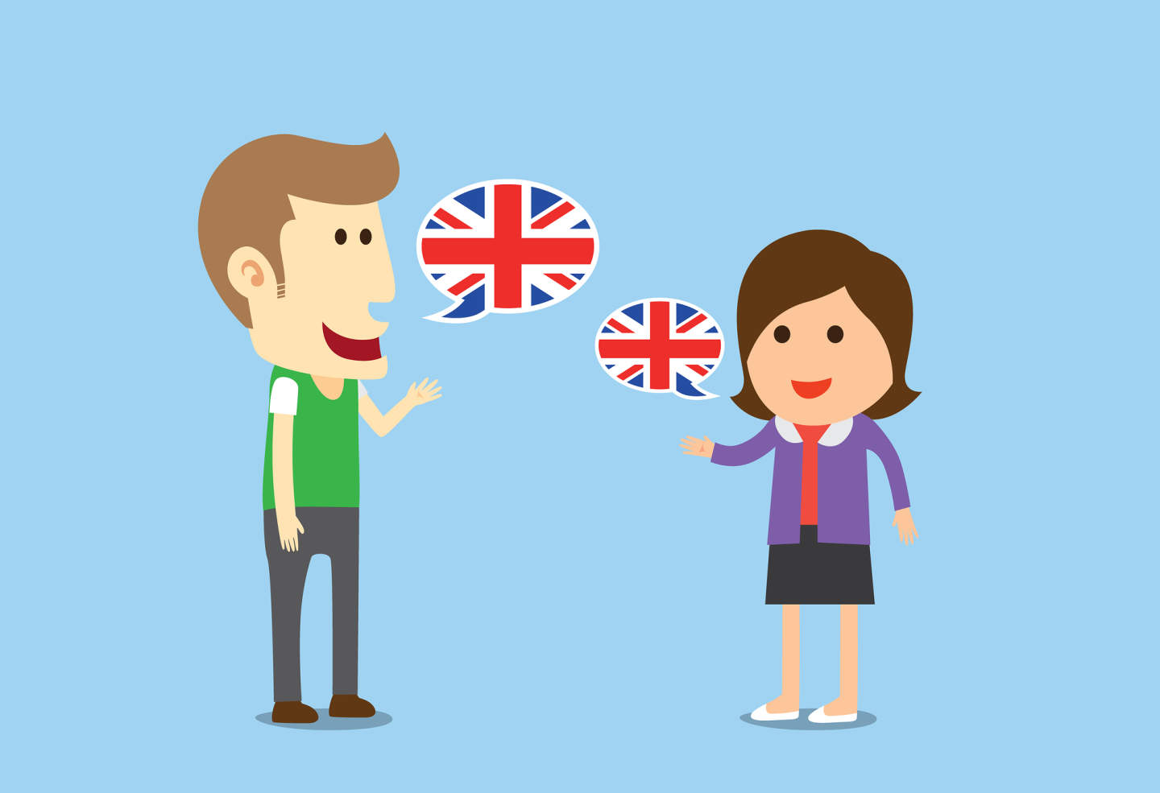
Dialogues. Work in pairs.
Notes:
Dialogues. Work in pairs.

Slide 15
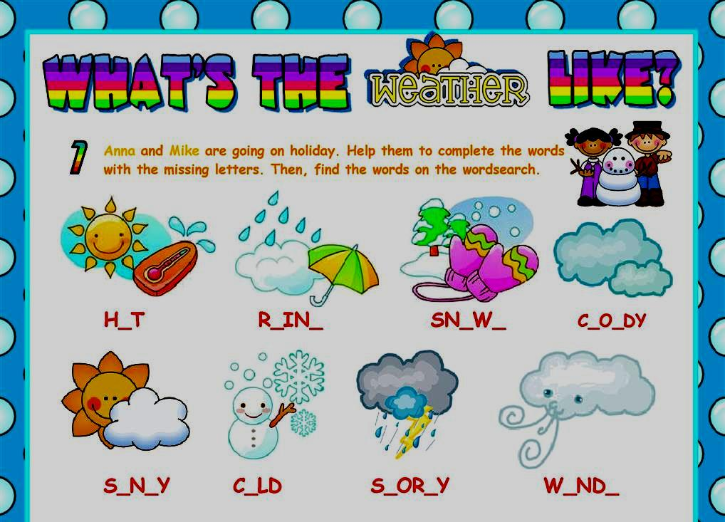

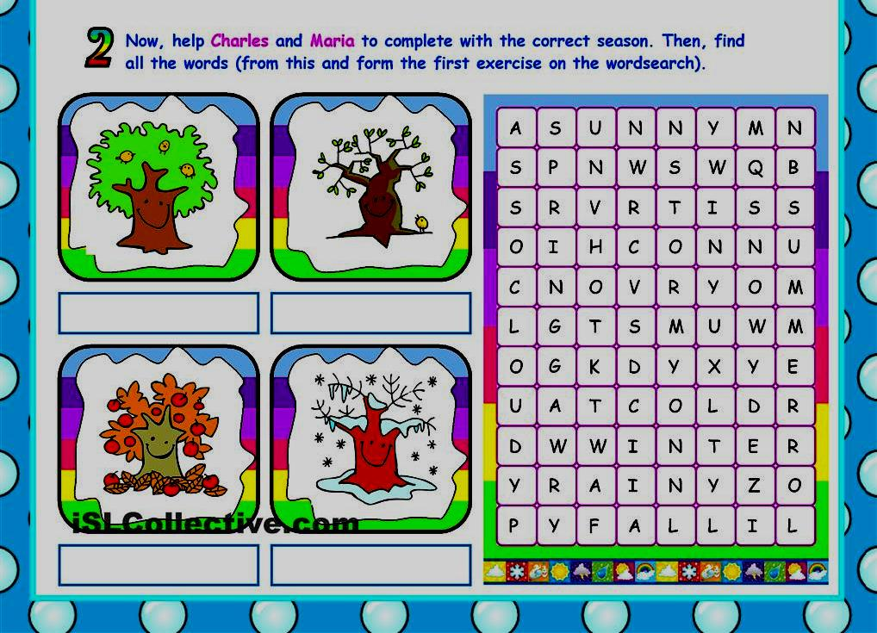
Work in groups.
Notes:
Dialogues. Work in pairs.

Slide 16
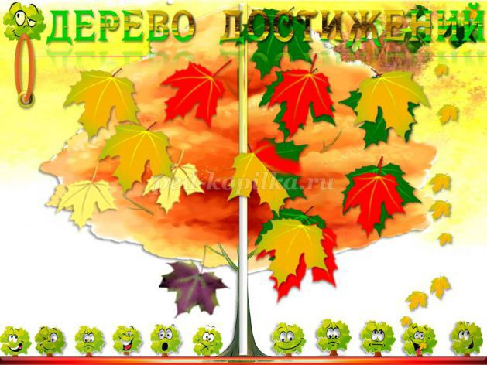
Reflection

Slide 17
Homework
Crossword,
to learn by
heart new words.
Notes:
Crossword, to learn by heart new words.

