Slide 1

Present Perfect
vs.
Past Simple
The presentation is made
by teacher Julia Apt,
gymnasium 74, St. Petersburg, Russia
www.JuliaApt.blogspot.ru
Юлия Ефимовна Апт,
гимназия №74, г. С-Петербург
2013

Slide 2
Learn the rule
Repeat after the teacher

Slide 3

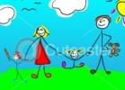
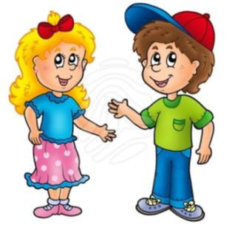
Present Perfect
Look! I have drawn a picture.
Past Simple
I drew a picture yesterday.

Slide 4
Open the brackets and put the verbs in the correct form. Use Present Perfect or Past Simple.

Slide 5

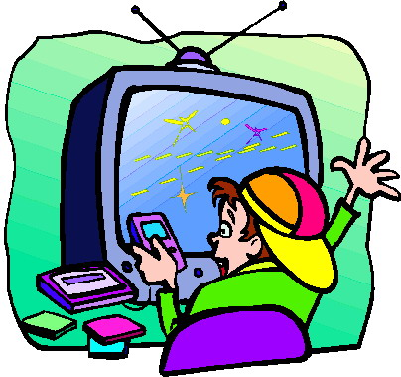

I am happy because my mother has bought me a new computer game.
I am happy because my mother (buy) me a new computer game.
Check
next

Slide 6
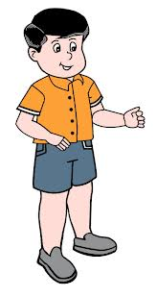


What game she (buy) you? –
She (buy) me a Star Wars game.
What game did she buy you? – She bought me
a Star Wars game.
Check
next

Slide 7
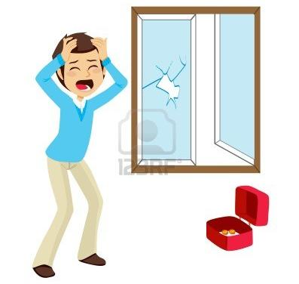

I have broken the window!
I (break) the window!
Check
next

Slide 8
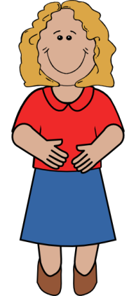
How did you break it? –
I played football.
How you (break) it? –
I (play) football.
Check
next

Slide 9
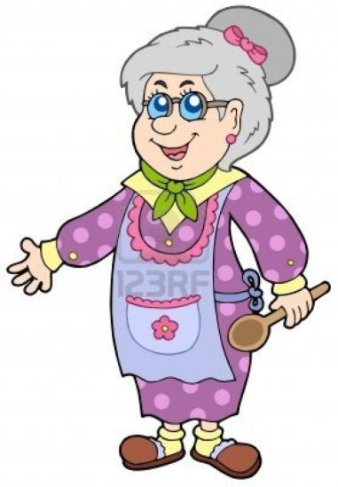
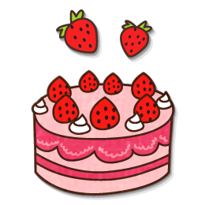
Children, come here!
I have made a cake.
Children, come here!
I (make) a cake.
Check
next

Slide 10
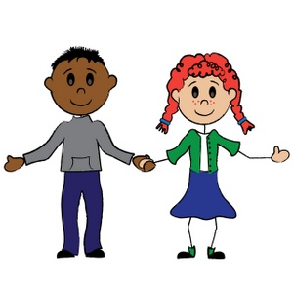


What cake did you make? –
I made a strawberry cake.
What cake you (make)? –
I (make) a strawberry cake.
Check
next

Slide 11
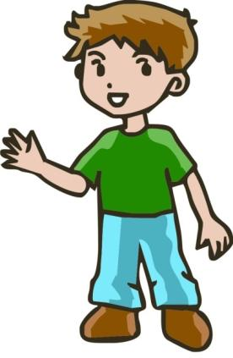
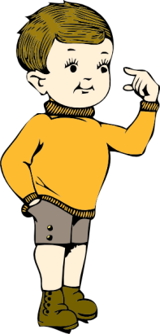

Have you ever been to America? – Yes, I have.
You ever (be) to America? –
Yes, I … .
Check
next

Slide 12

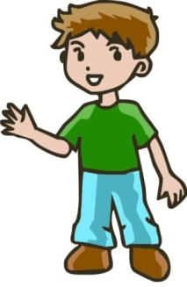

When were you there? –
I went to America 2 years
ago.
When you (be) there? –
I (go) to America 2 years ago.
Check
next

Slide 13
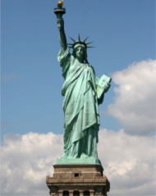

What you (see) in America? –
I (see) the Statue of Liberty.
What did you see in
America? – I saw the Statue of Liberty.
Check
next

Slide 14
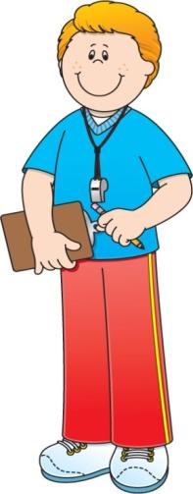
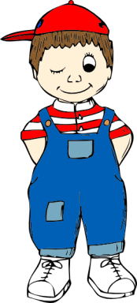

Have you ever played baseball? – Yes, I have.
You ever (play) baseball? – Yes, I … .
Check
next

Slide 15
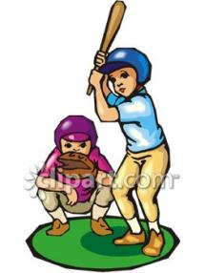


When you (play) it? – My American friend (visit) me last summer and we (play) together.
When did you play it? – My American friend visited me last summer and we played together.
Check
next

Slide 16
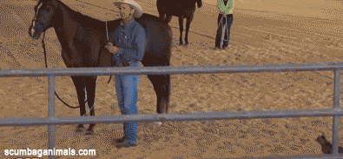
Help! A cat (to frighten)
my horse.
Help! A cat has frightened
my horse.
Check
next

Slide 17
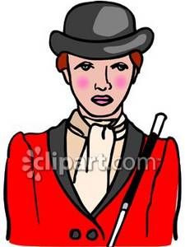
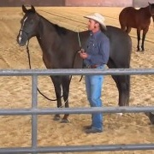
I’m sorry, sir. He is a circus cat. Yesterday we (teach) him to jump up on a horse.
I’m sorry, sir. He is a circus cat. Yesterday we taught him to jump up on a horse.
Check
next

Slide 18
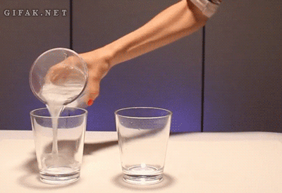
The water (to turn) black.
The water has turned
black.
Check
next

Slide 19
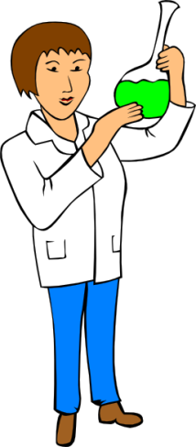
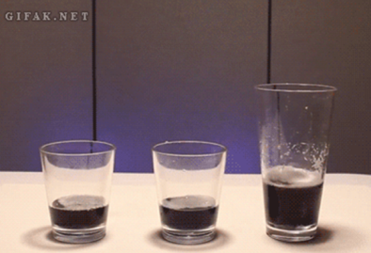
We put something special
in it to make it turn black.
We (put) something special in it to make it turn black.
Check
next

Slide 20

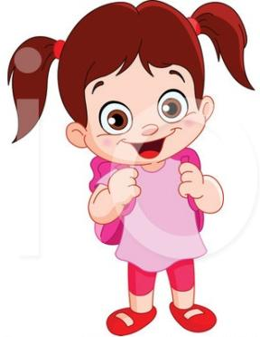
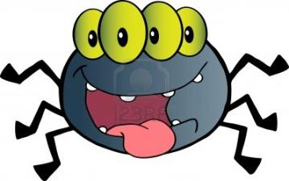
You ever (take) a picture
of a monster with four
eyes?
Have you ever taken
a picture of a monster
with four eyes?
Check
next

Slide 21
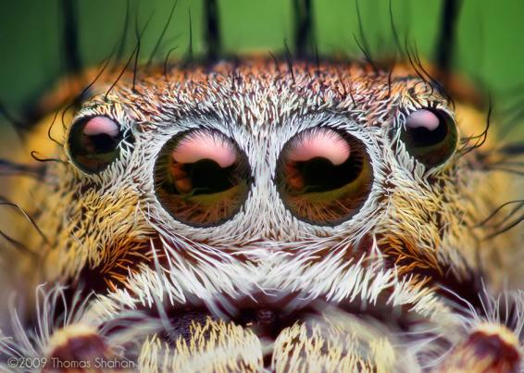
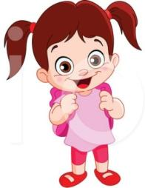
You know, yes. I (take) this picture on my summer holidays. Don’t be afraid, it’s a spider.
You know, yes. I took this picture on my summer holidays. Don’t be afraid, it’s a spider.
Check
by Thomas Shahan http://thomasshahan.com
next

Slide 22
Resources
www.picgifs.com
www.fotosearch.com
www.hasloo.com
www.shutterstock.com
www.123rf.com
www.clker.com
www.downloadclipart.net
www.acclaimclipart.com
www.clipartguide.com
www.AsVector.com
www.ace-clipart.com
www.canstockphoto.com
www.scumbaganimals.com
www.gifak.net
www.depositphotos.com
www.illustrationsof.com
www.cartooncliparts.com
http://thomasshahan.com

