Slide 1

Good morning, good morning,
good morning to you
good morning, good morning,
I am glad to see you.

Slide 2
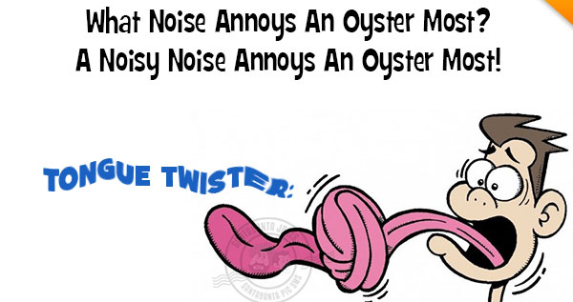
Language Workout

Slide 3
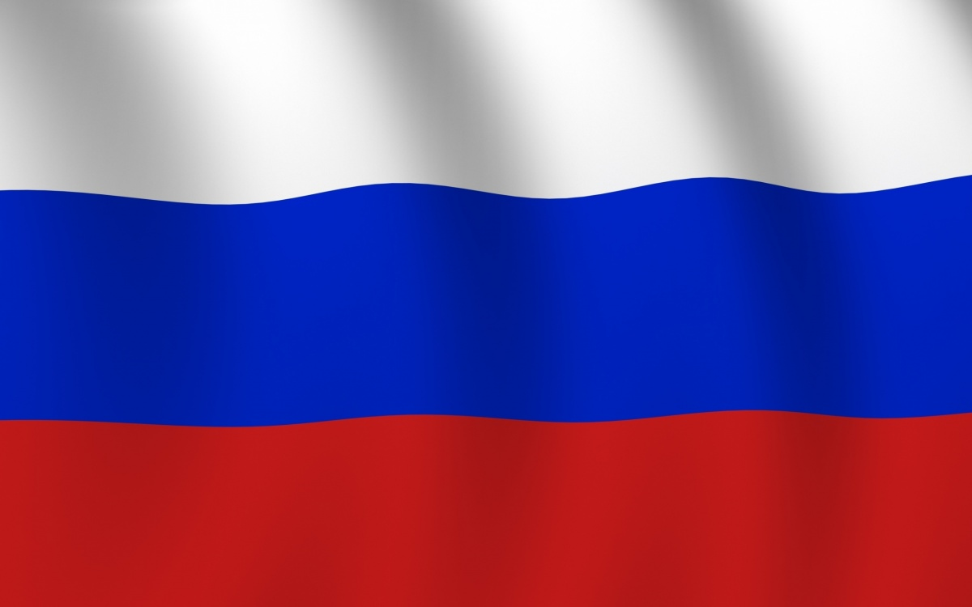
Name the Country

Slide 4
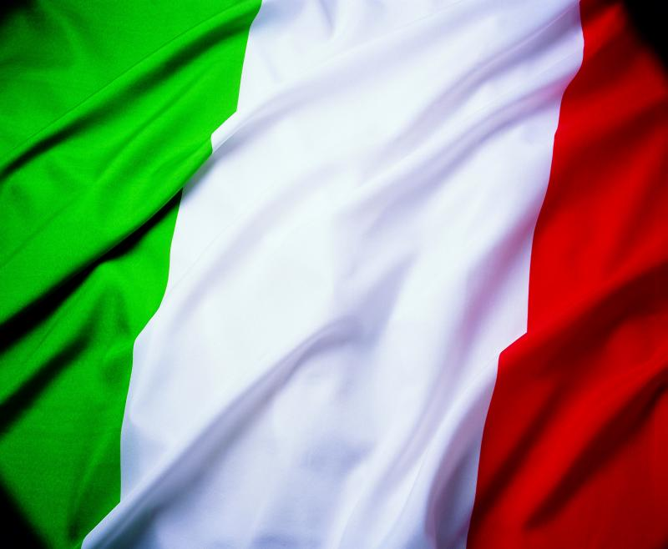
Name the Country

Slide 5
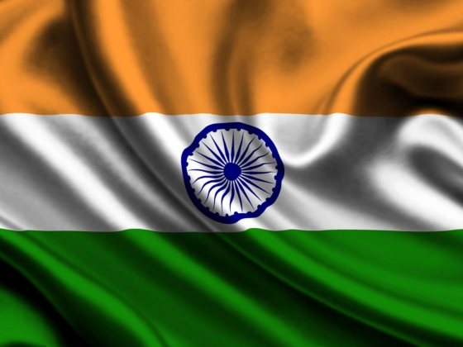
Name the Country

Slide 6

Name the Country

Slide 7

Name the Country

Slide 8
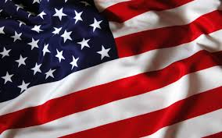
Name the Country

Slide 9

Name the Country

Slide 10

Name the Country

Slide 11
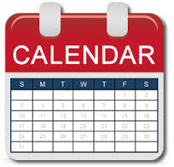
In What Month?
New Year holiday
Christmas day
Defender of the Fatherland Day
International Women's Day
National Flag Day
Spring and Labour Day
Victory Day
Russia Day
Unity Day
Maslenitsa

Slide 12
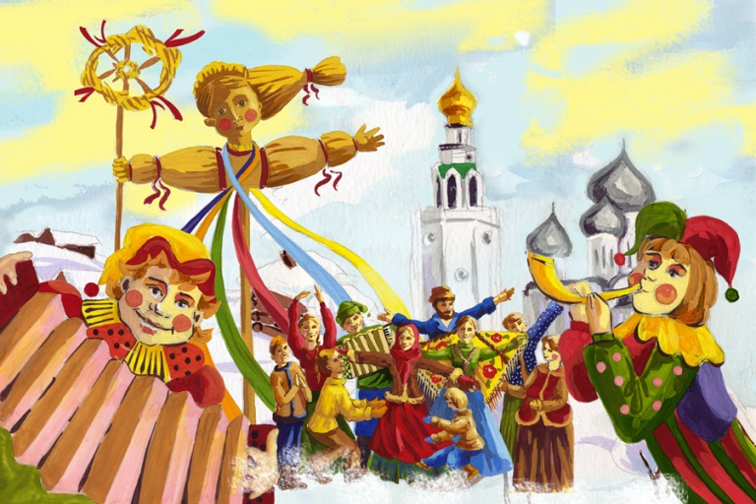
Maslenitsa

Slide 13
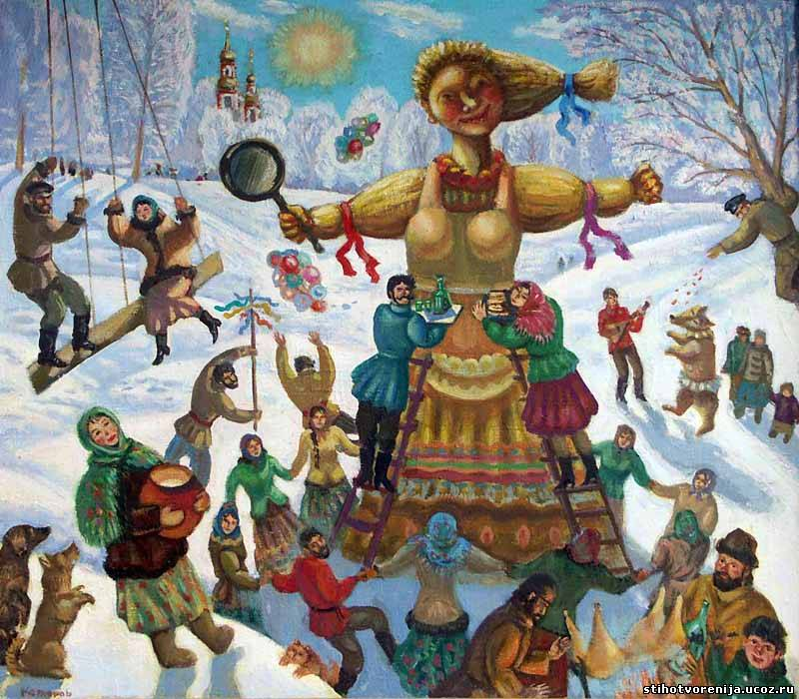
Group Projects:
1) Historians
2) Farmers
3) Cooks

Slide 14
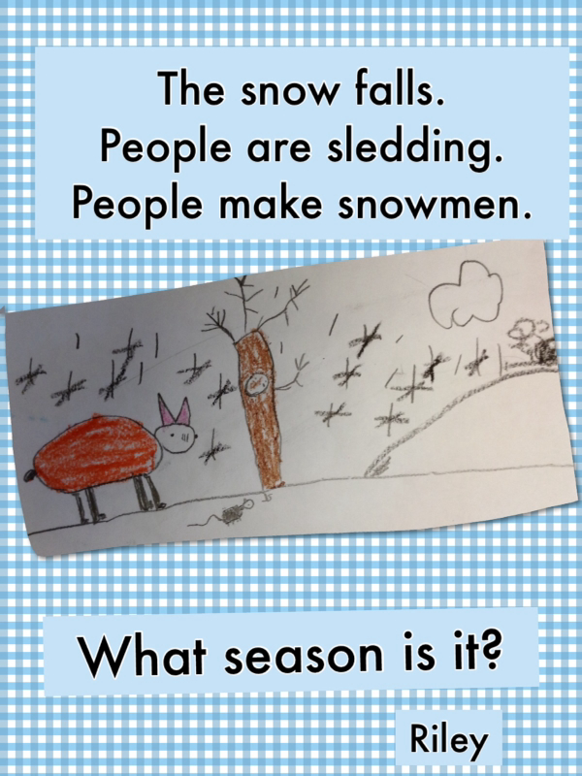
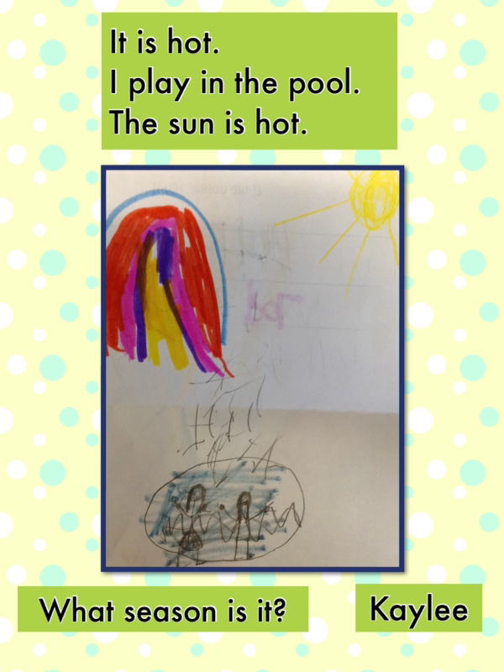
Riddle Time!

Slide 15
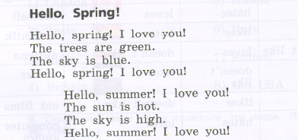

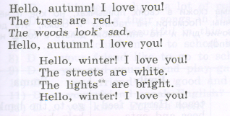
Let’s Read a Poem!

Slide 16
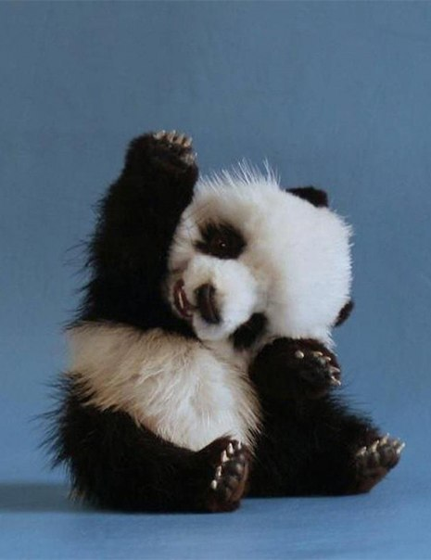
Bye-Bye!

