Slide 1
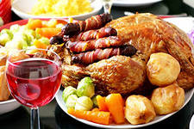
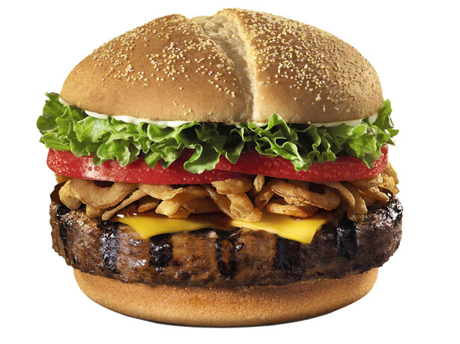

HEALTHY AND UNHEALTHY
FOOD

Slide 2
Learn
REVISE
Develop
Bring up

Slide 3
Healthy food | Unhealthy food
CHEESE FISH FRUIT MEAT MILK ORANGE JUICE | BURGER CHIPS COLA HOT DOG ICE-CREAM KEBAB

Slide 4
 | Always | Usually | Often | Some times | Never
Pizza
Cereal
Eggs
Sandwich
Fruit
Tea
Coffee
Milk

Slide 5
100% | ALWAYS
80% | USUALLY
50% | OFTEN
30% | SOMETIMES
0% | NEVER

Slide 6
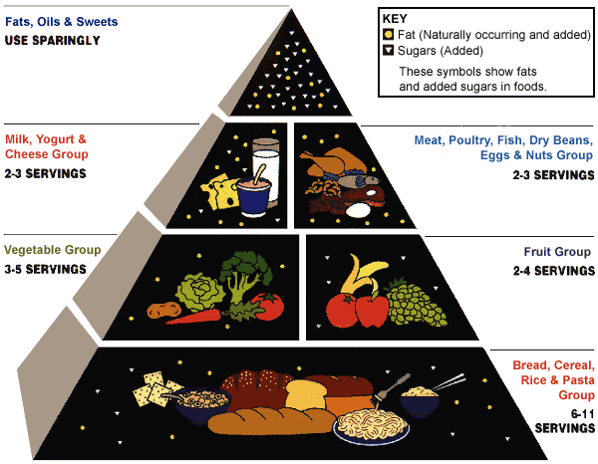

Slide 7


Can I help you?
What would you like?
Would you like anything to drink?
Anything else?
With or without sugar?
Large or small?
How much is it?
Thank you.
Welcome.

Slide 8
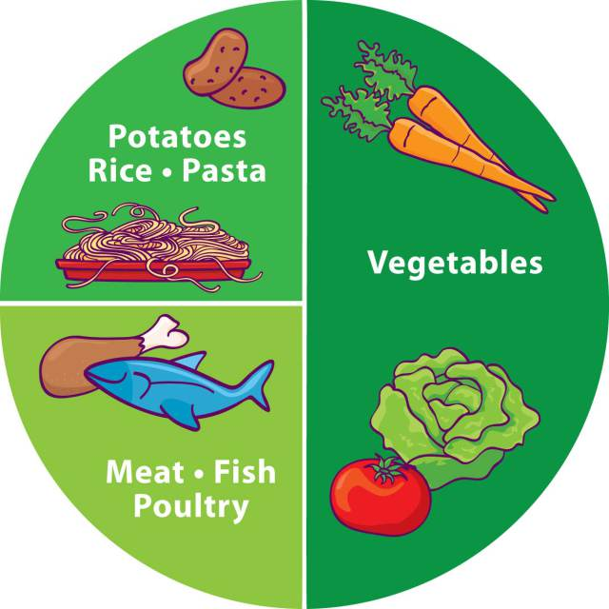
You | should shouldn’t | drink a lot of water;
 |  | eat lots of fruit;
 |  | eat hamburgers and pizzas because they are bad for our health
 |  | drink milk because it gives us energy and it’s good for our teeth;
 |  | eat too many biscuits.
 |  | overeat

