Slide 1
Hello!!!

Slide 2
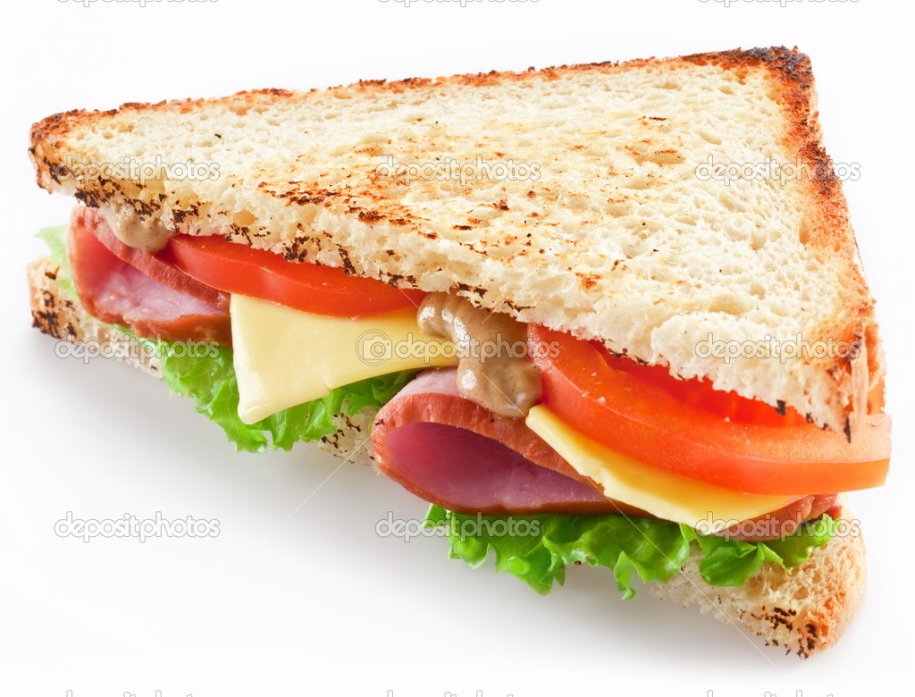
sandwich

Slide 3

ice cream

Slide 4

sausages

Slide 5
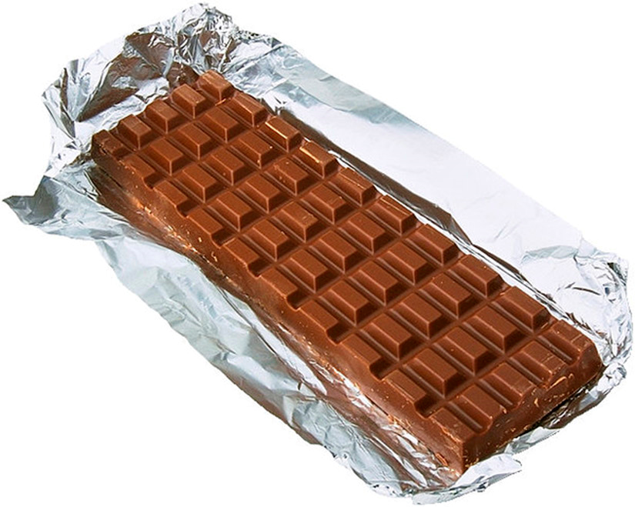
chocolate

Slide 6
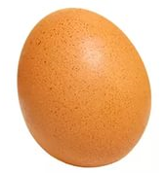
egg

Slide 7

orange juice

Slide 8

apple juice

Slide 9
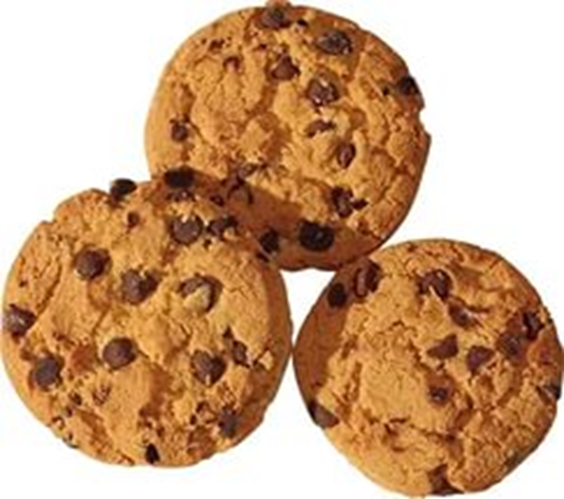
biscuits

Slide 10
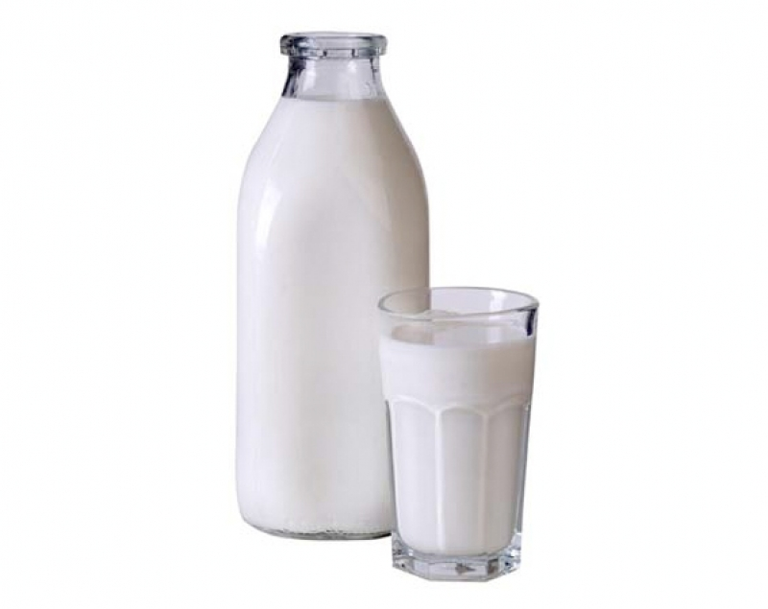
milk

Slide 11
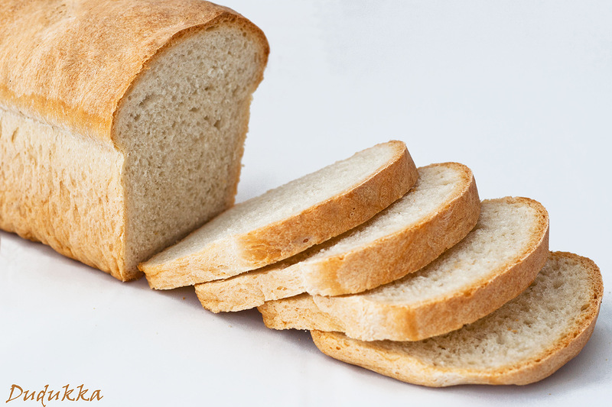
bread

Slide 12

cheese

Slide 13
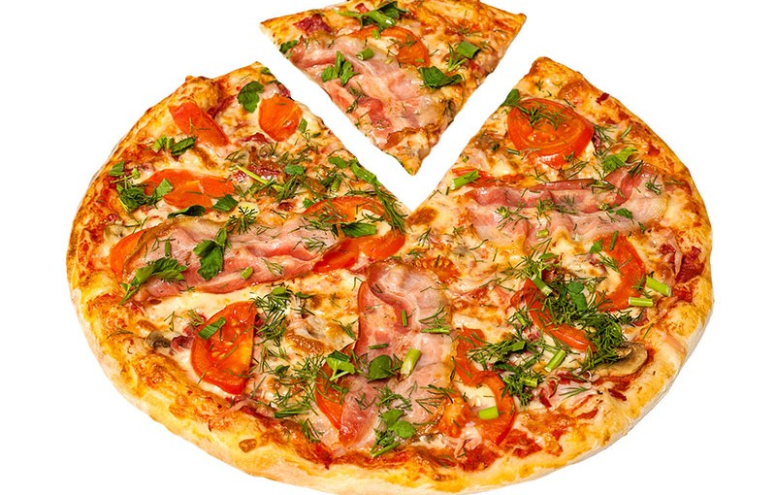
pizza

Slide 14

tea

Slide 15

soup

Slide 16

coffee

Slide 17
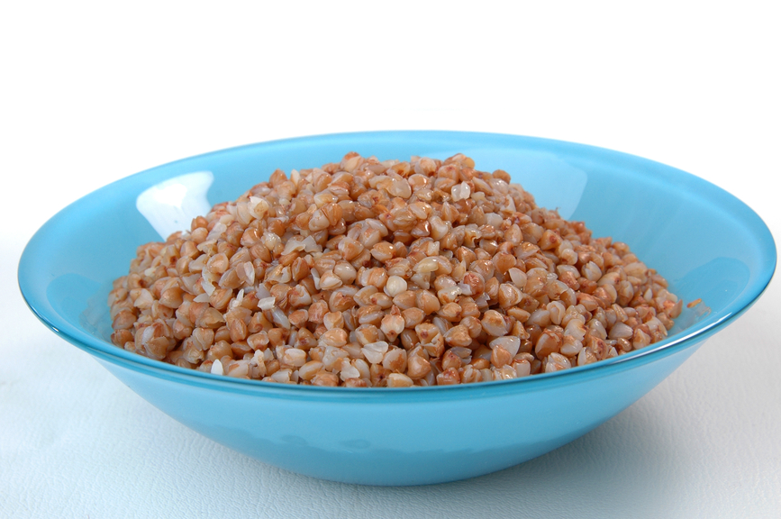
porrige

Slide 18

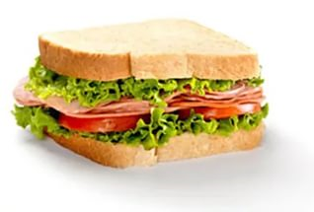
I have a sandwich and juice.

Slide 19


I have milk and biscuits.

Slide 20

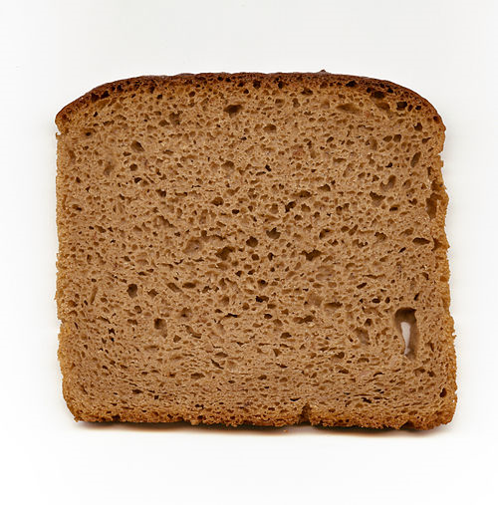
I have soup and bread.

Slide 21


I have porridge and tea.

Slide 22
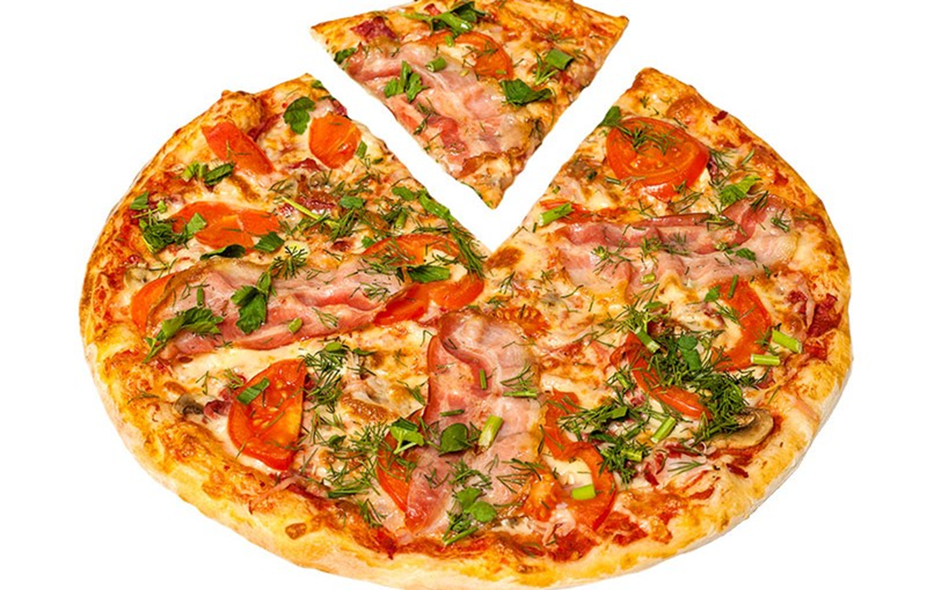

I have pizza and coffee.

Slide 23
GOOD BYE!

