Slide 1
Halloween

Slide 2
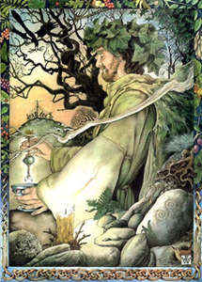
Halloween’s origins date back hundreds of years to the Druid festival or Samhain, Lord of the Dead and Prince of Darkness.

Slide 3
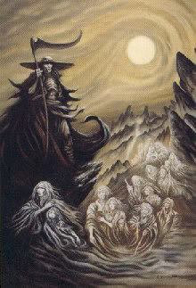
He gathered up the souls to present them to Druid Heaven on the 31st of October. The Sun God shared the holiday and received thanks for the year's harvest.

Slide 4
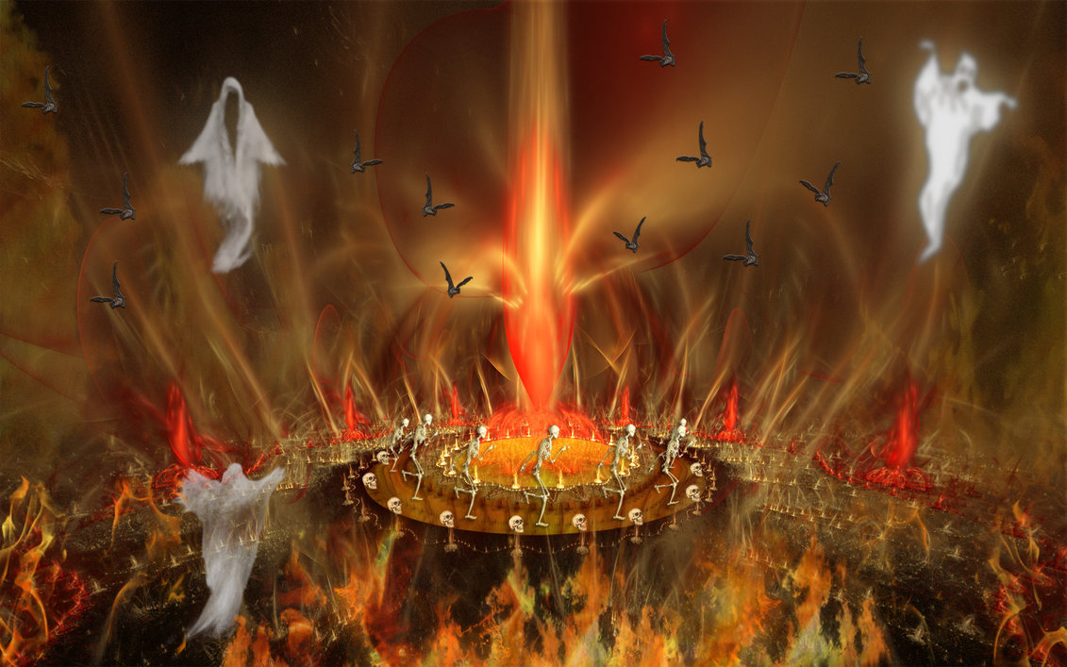
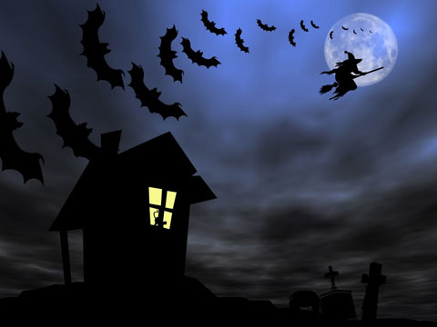
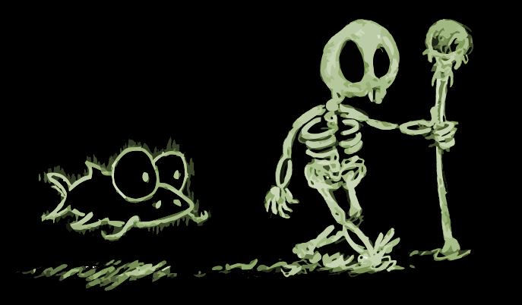
The Druid New Year begins on the 1st of November. Winter comes and the Lord of Dead rules. So there are many ghosts, goblins, witches, skeletons and cats.

Slide 5
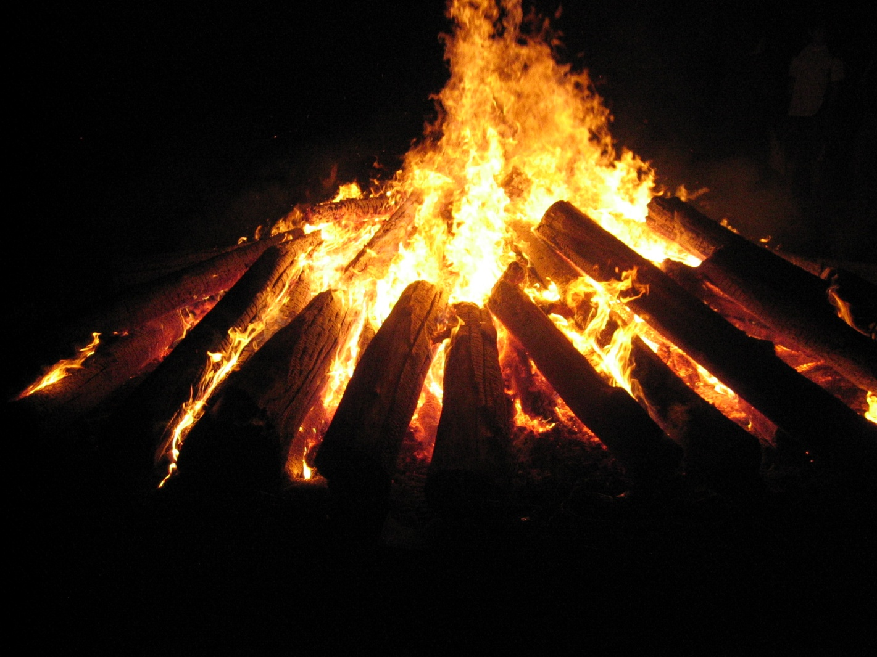
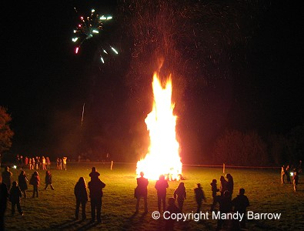
Druids lighted huge bonfires to frighten away evil spirits. And we can see bonfires on Halloween today.

Slide 6
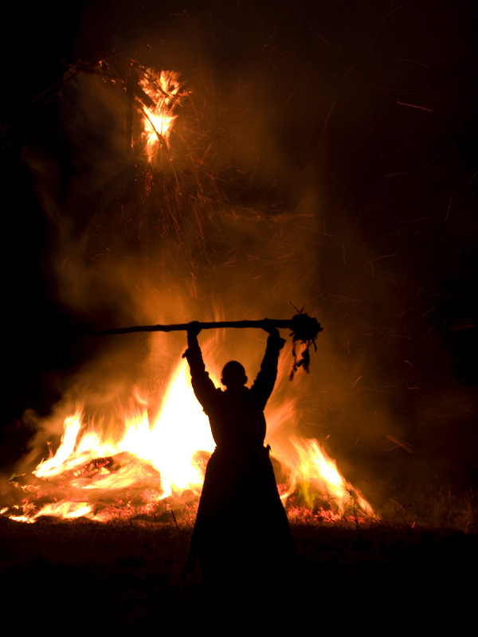
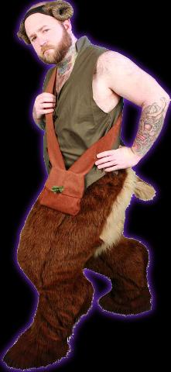
Long ago, many people believed that on a certain autumn night dead spirits came back to earth. And people held a festival that was the start of our Halloween. This festival was held on October 31, the evening before All Saint's Day. People built fires on hilltops to scare off the ghosts. They also scared the ghosts away by wearing costumes made of animal heads and skins.

Slide 7
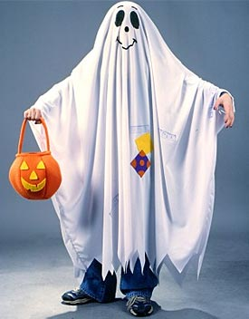
Traces of the festival remain in our Halloween custom. Only today ghosts are children under sheets.

Slide 8
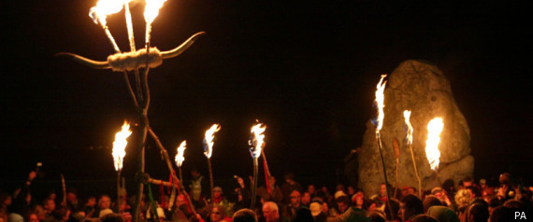
The Halloween colors, too, are orange and black. It was time when orange flames lit up the black night.

Slide 9
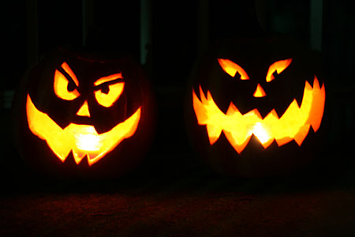
It's not really a religious holiday, it's a holiday for children. Finally, October arrives. It's the Halloween party. The children pick large orange pumpkins, cut the eyes, nose and mouth and put lights inside them to scare their friends.

Slide 10
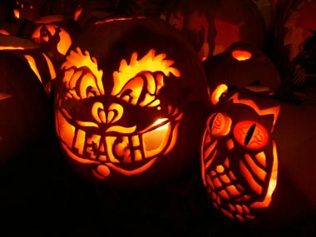
These lights are called "Jack of the lanterns“
A man named Jack, was kept out of Heaven because he was stingy and expelled from Hell for playing tricks on the Devil.

Slide 11
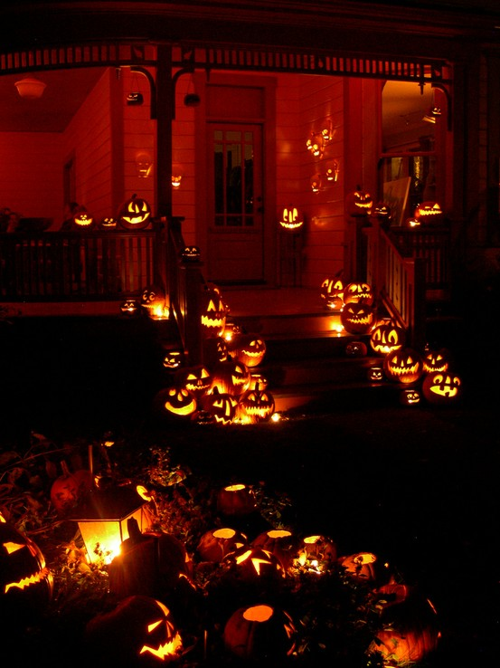
Many people carve happy and funny face. They place the pumpkins in the windows or on the doorsteps.

Slide 12
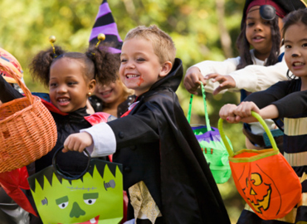
The children also put on strange masks and frightening costumes every Halloween. Some children paint their faces to look like monsters. Then they carry baskets and bags. They go from house to house and knock on the doors.

Slide 13
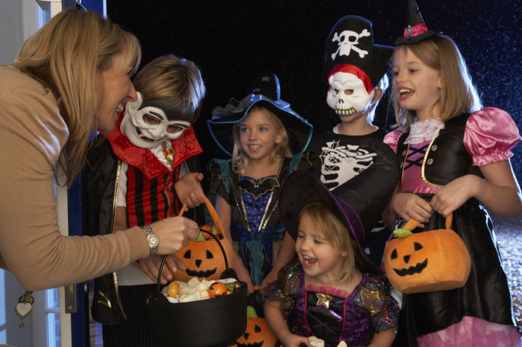
They sing “Trick or treat! Trick or treat!” meaning “Give us a treat or we’ll play a trick on you”. People give the children sweets, cookies and apples.

Slide 14
