Slide 1


“WHAT DO YOU KNOW ABOUT CINEMA?”
THE ENGLISH QUIZ FOR 8-10 CLASSES

Slide 2

1. How much time do you need to pass through 24 cadres of film?
За какое время перед нами проходят двадцать четыре кадра кинопленки?
1 second
2 seconds
3 seconds
4 seconds

Slide 3
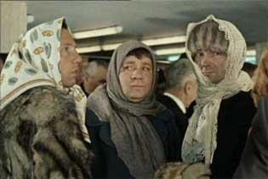
2. What academic degree unexpectedly received a modest Director of the russian kindergarten, also known as “the gentleman of the fortune"?
Какого ученого звания неожиданно для себя удостоился скромный директор детского сада, он же «джентльмен удачи»?
Manager
Professor
Master
Assistant

Slide 4
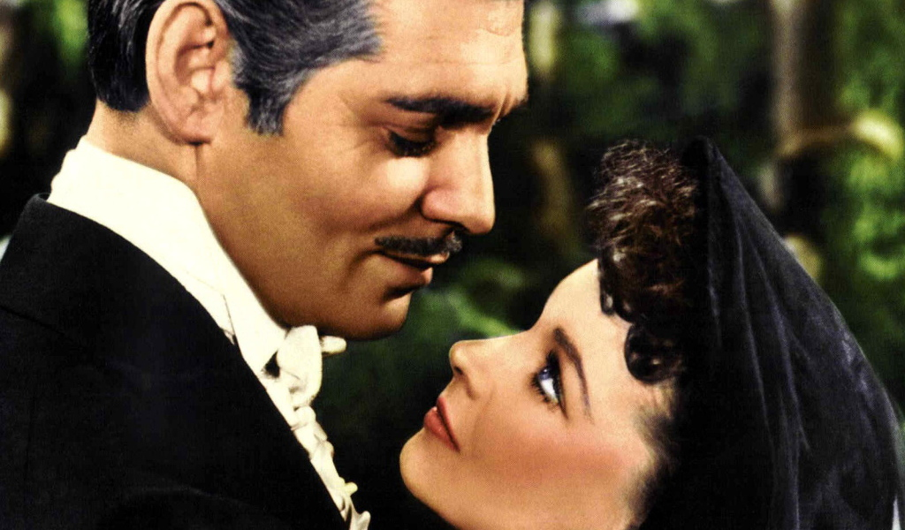
3. Which English actress played the role of a woman who was the symbol of the American character in the movie, filmed in 1939 based on the novel by Margaret Mitchell?
a)Marilyn Monroe
b)Vivien Lee
c)Odry Hepbern
d)Sophy Loren

Slide 5
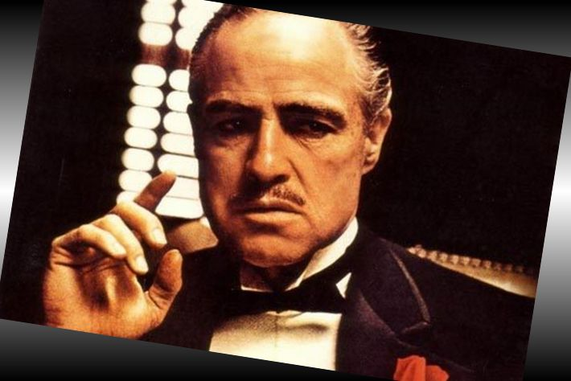
4. Who was the Director of the American film “The Godfather"?
a)Frensis Ford Coppola
b)Stiven Spilberg
c)Quentin Tarantino
d)James Cameron

Slide 6
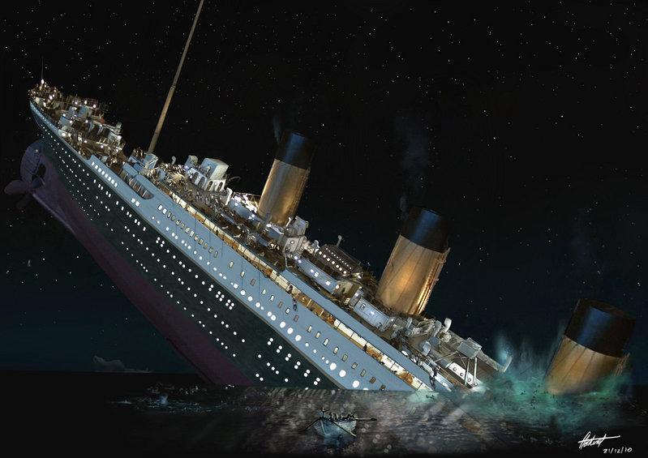
5. What is the name of the Director of the film "Star wars“?
6. How many "Oscar“awards got the film "Titanic"?
2
6
9
11

Slide 7
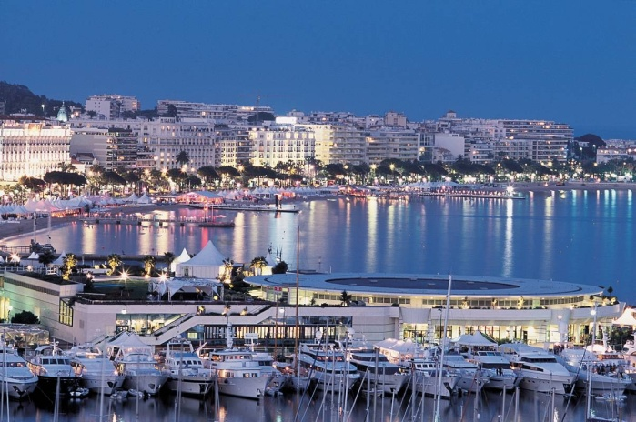
7. Which role is known worldwide acted by Sean Connery ,Pierce Brosnan and Daniel Craig?
What film brought the early success to Christina Orbakajte and also gave her the nickname?
What is the name the name of the film “Pulp fiction“(“Криминальное чтиво”).
Which city of Europe is the place of the most prestigious
film festival?

Slide 8
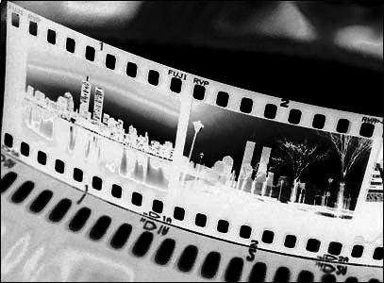
11. What Soviet film first received the "Oscar" as the best foreign film?
a)”The War and the Peace”
b) “Anna Karenina”
c) “The Idiot”
d) “The crime and the punishment”

Slide 9

12. What is the name of the actor who played the main male role in the film "Pretty woman”?
13.What is the name of the actor who played the main role in the movie "Terminator“?
14. Who was the Director of the film “The Fifth Element“?
15. From what country did the first TV soap Opera “ The Slave Izaura“ come to Russia?
a)The USA b) The UK c) Brazil
d) Argentina

Slide 10
“Guess the film with 5 words"
a girl,five,threat,prediction,a concert - “the name”
A head,a legend,a tree,a girl, a horse-rider - “the name”
Emptiness,a city,monkeys,running, rescue - “the name”
suspicion,investigation,tricks,death, a student - “the name”

Slide 11
5.animals,a game,a town,dice, the past- “the name”
6.A sponge,the sea,crabsburger,a star, trousers– “the name”
7. A father ,a mother,a brother,2 sisters, Springfield – “the name”
8.An iceberg,a ship,dances,a portrait, a strike– “the name”
9.Cars ,robots,people,Megatron, friendship- “the name”

Slide 12

“Cinema through the glass”
1) The cat’s soul
2) The animals in white
3) The wooden lady
4) The end
5) Saint-Petersburg believes in smiles
6) Brought by the waves

Slide 13
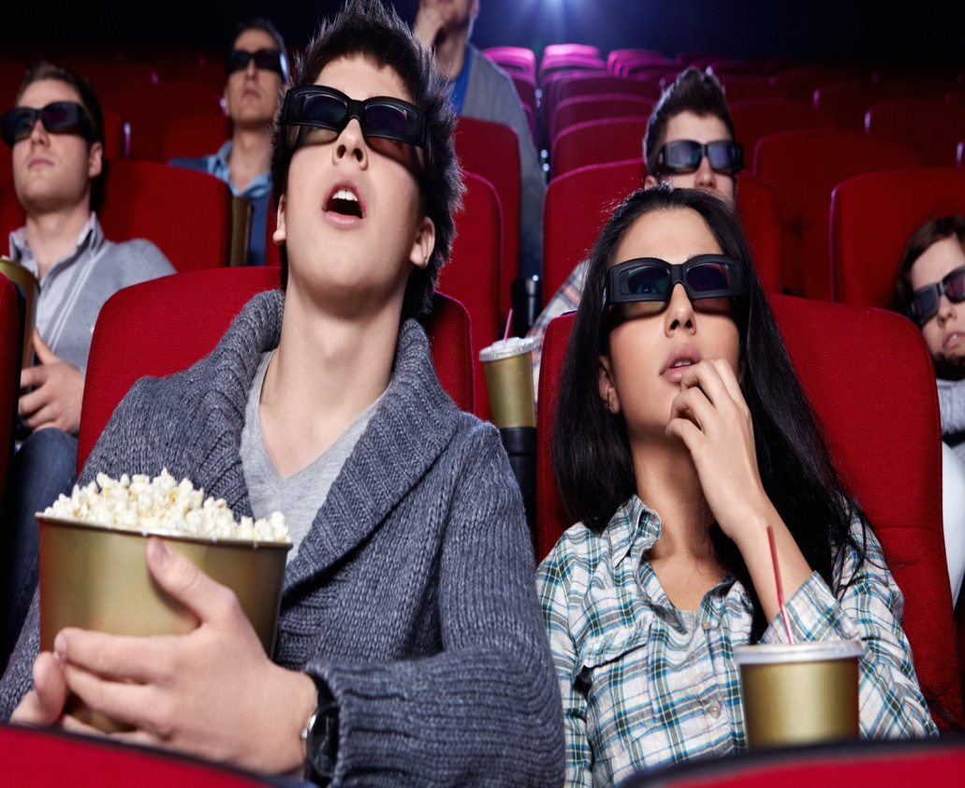
7) A girl- ladybird
8) A dog without a hat
9) Down
10) And the sunsets there are loud
11) The 6 daughter
12) The Moon peaces
13) The Saturnian

Slide 14
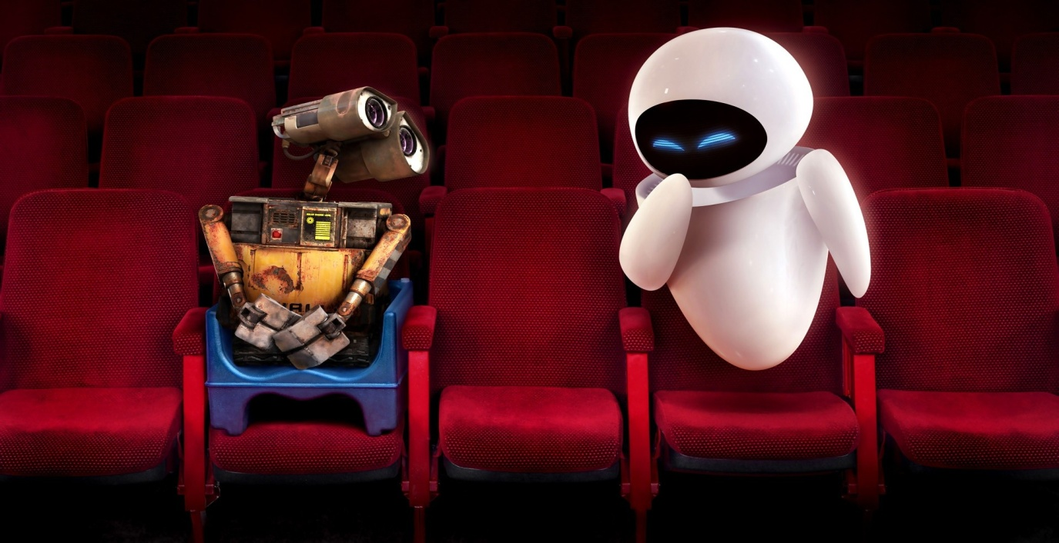
Acting
Show the scene from the film
Guess what film is it

Slide 15
Make the story
A, Shrek, doll, well, crazy, small, go, sleep, the end, good morning,OK

