Slide 1
MASTER CHEF
Учитель английского языка
МОУ СОШ 24
Копейского городского округа Саломатова Наталья Виталиевна

Slide 2
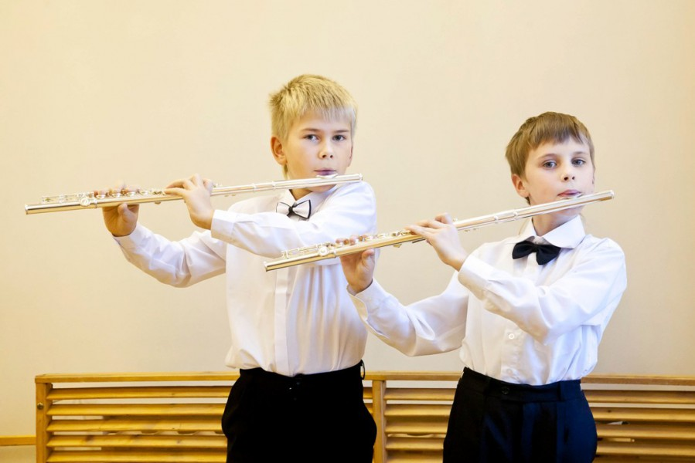
Phonetic exersices
A tutor who tooted a flute
Tried to tutor two tooters to toot.
Said the two to the tutor
“Is it harder to toot
Or to tutor two tooters to toot?”

Slide 3
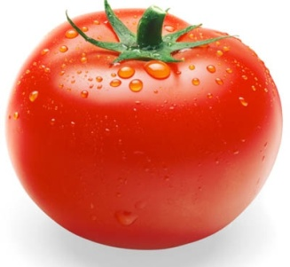
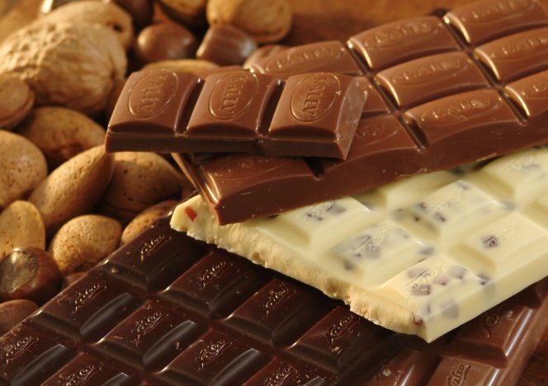
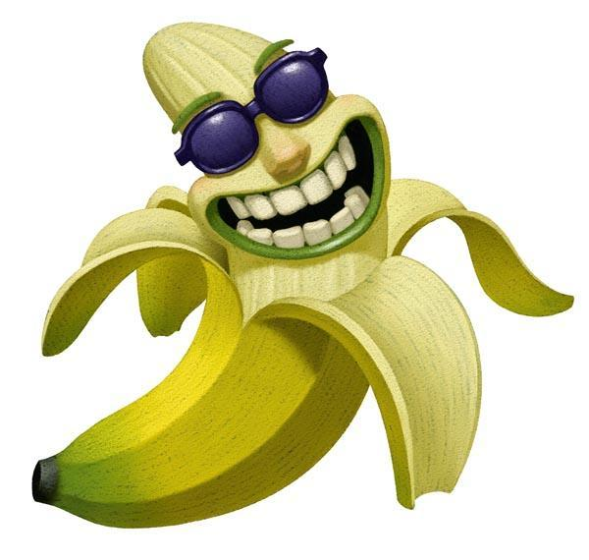
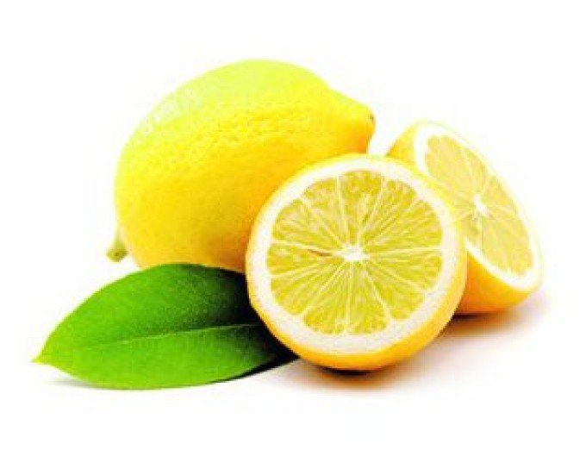
It`s red, it`s a vegetable, we make juice of it.
It`s yummy, it is very sweet and it can be black, white and milk.
It`s a fruit. Monkeys like it. It`s yellow.
It`s also yellow, it’s a fruit, we can`t eat it without sugar.
We put it into the tea.

Slide 4
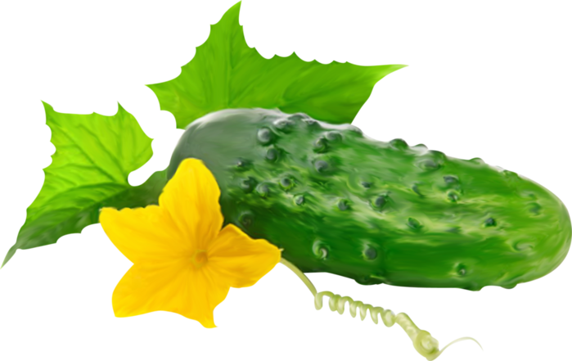
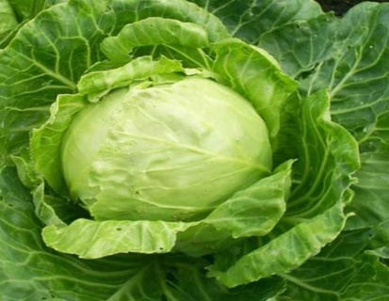
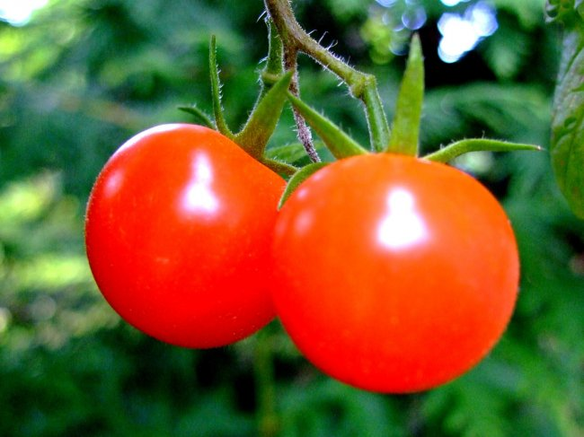
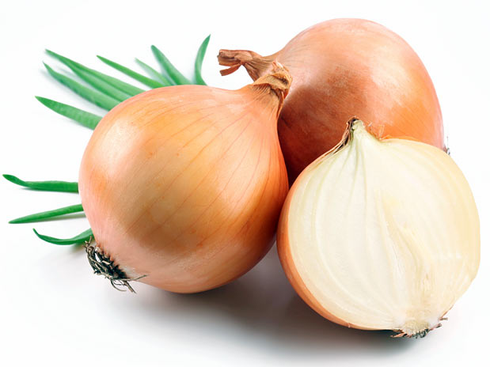
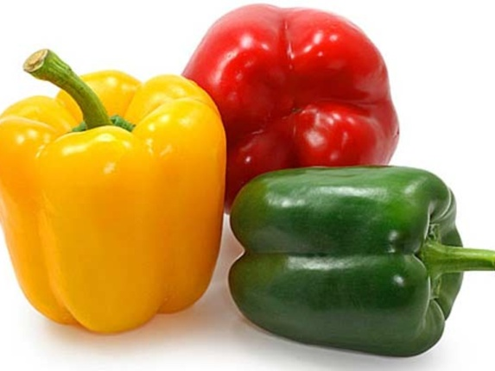
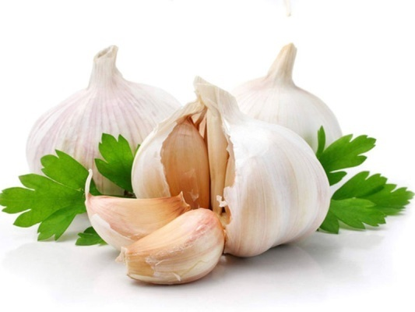
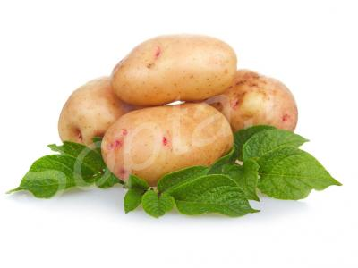
cabbage
cucumbers
tomatoes
I like … but I don’t like …
onions
peppers
garlic
potatoes

Slide 5
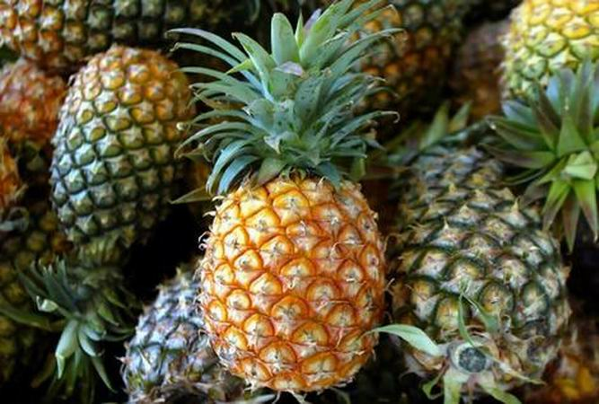
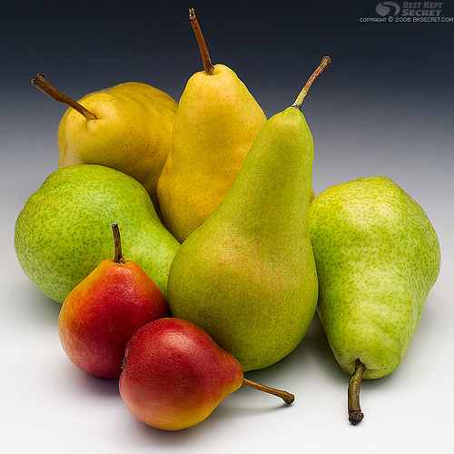
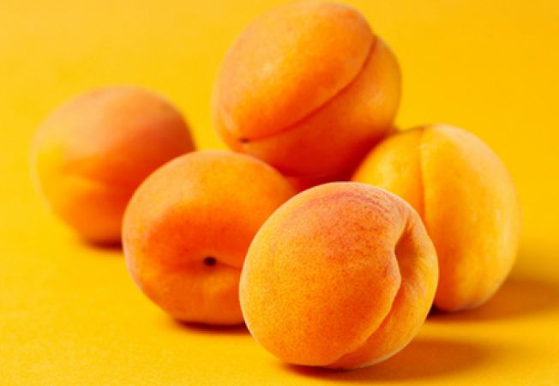
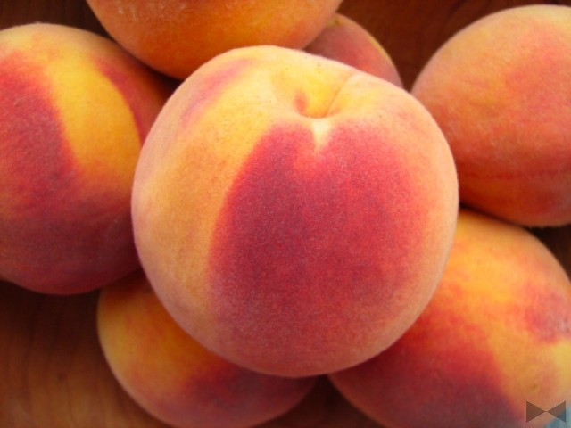
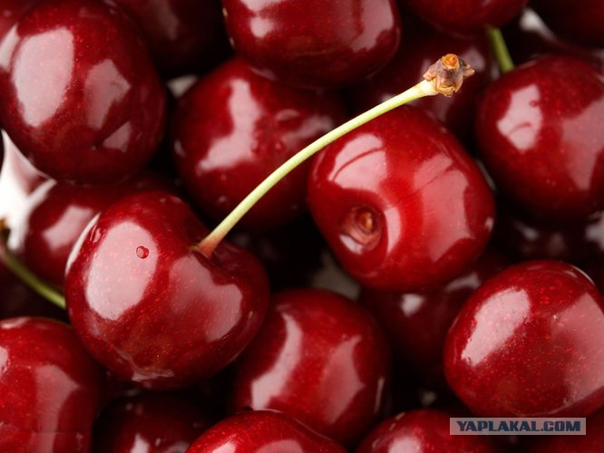
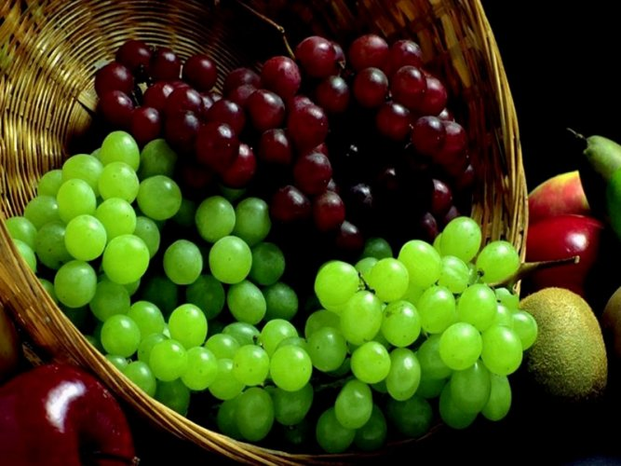
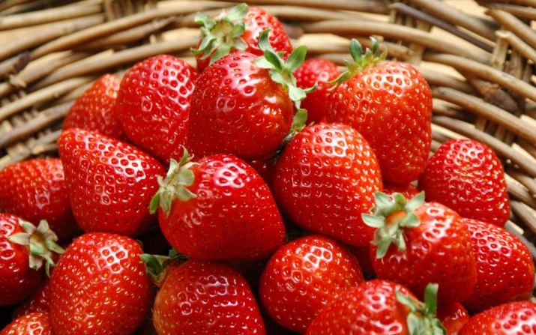
pineapple
apricot
pear
My favourite fruit is…
peach
cherry
grape
strawberry

Slide 6

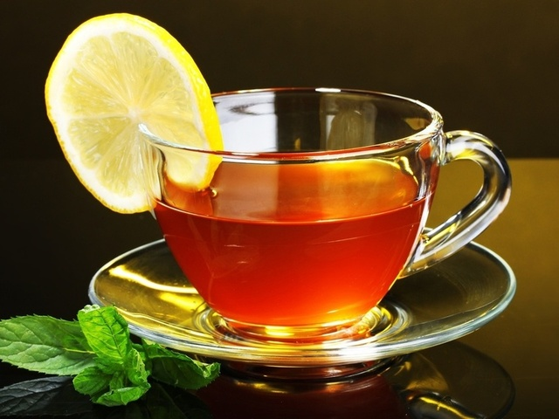
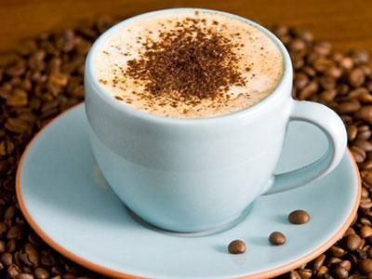
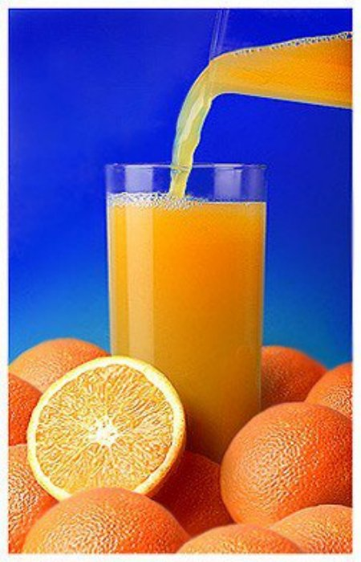
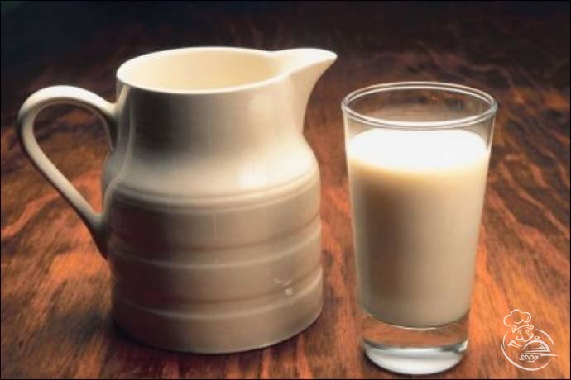
coffee
water
tea
I usually drink…
milk
juice

Slide 7
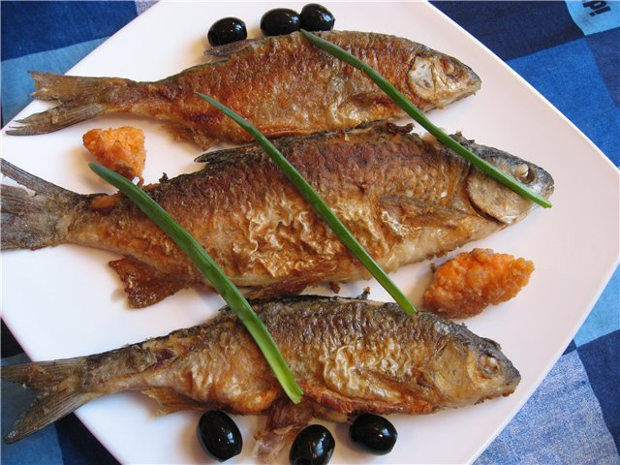
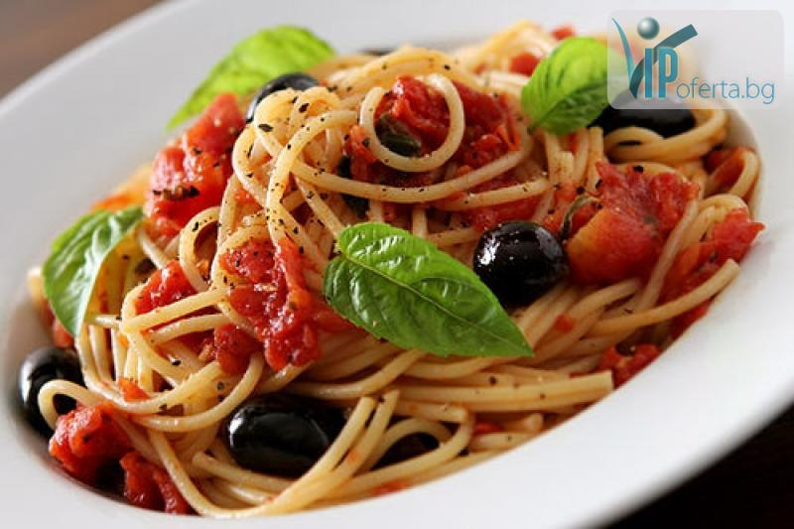
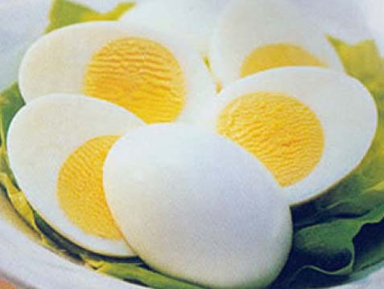
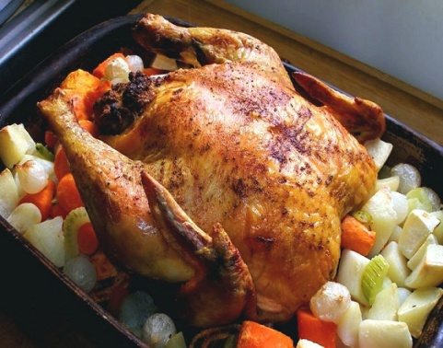
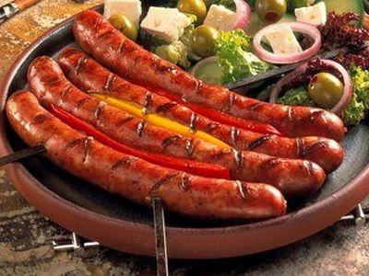
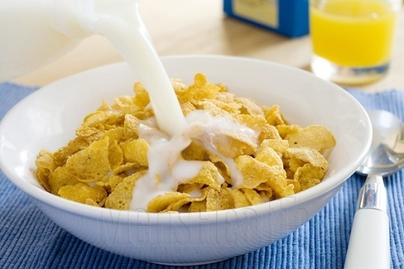
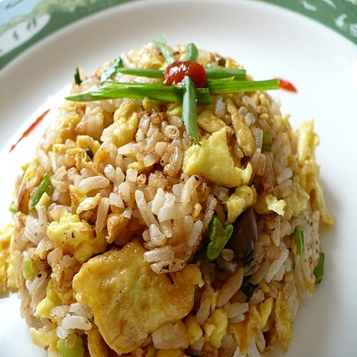
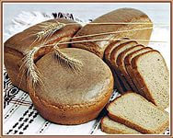
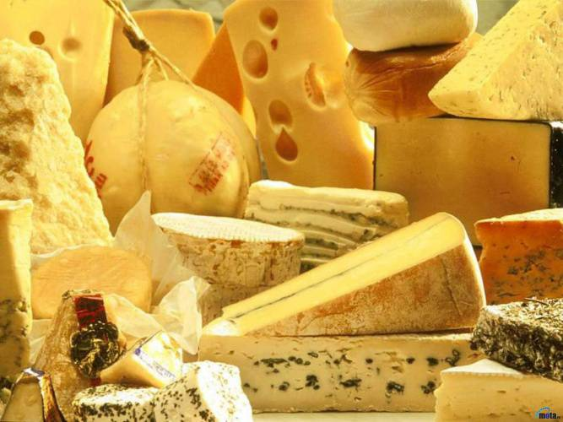
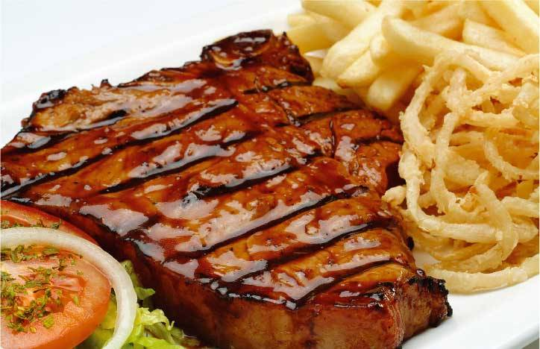
fish
pasta
eggs
chicken
For breakfast / lunch / dinner I eat …
sausages
cereal
rice
bread
cheese
meat

Slide 8
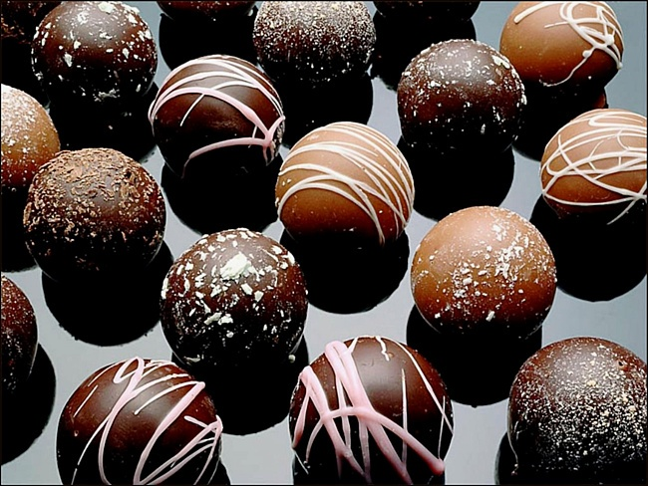
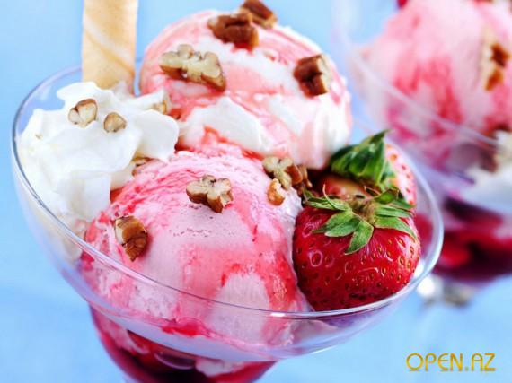
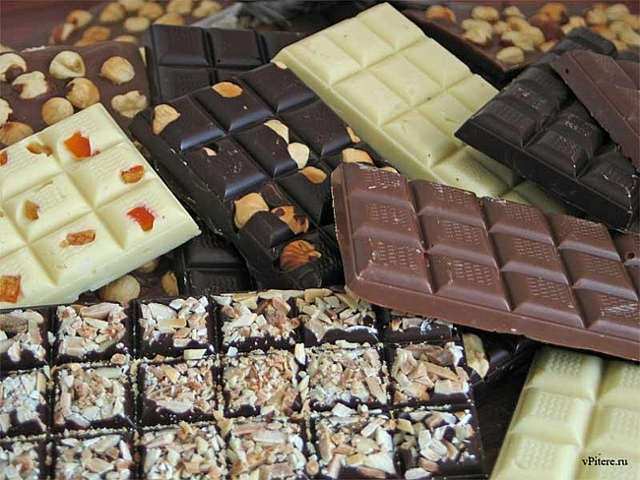
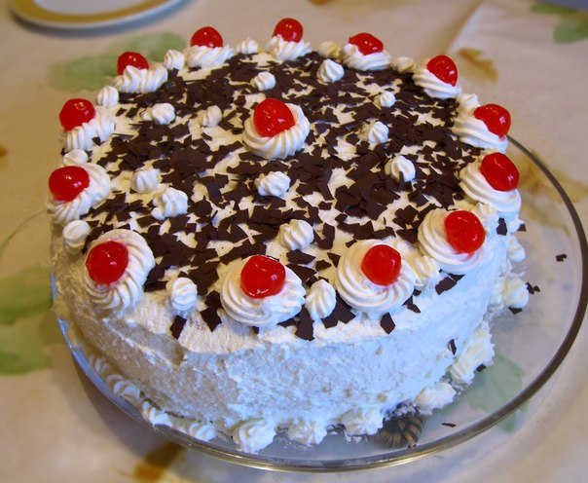
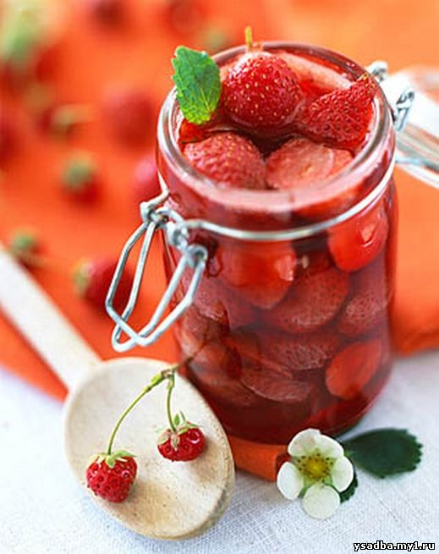
sweets
Ice cream
chocolate
Try this … It’s tasty!
jam
cake

Slide 9
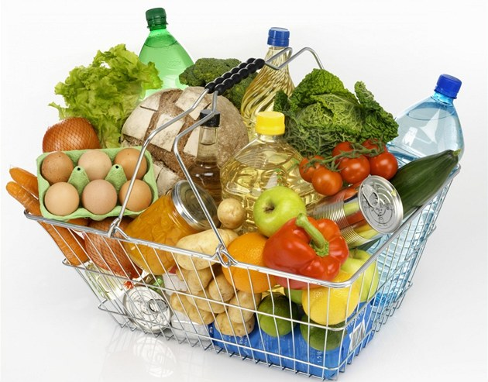
CHECK YOUR MEMORY

Slide 10
CHOOSE THE ODD WORD OUT
1. MILK, CHEESE, YOGHURT,
CEREAL
2. MILK, WATER, COFFEE
BUTTER,
3. BREAD, CAKE, PIE
CHEESE,
4. ORANGE, CARROT, TANGERINE,
CUCUMBER
5. TEA, CREAM, BREAD
FISH,
6. CABBAGE, ONION, PEPPER
TOMATO,

Slide 11
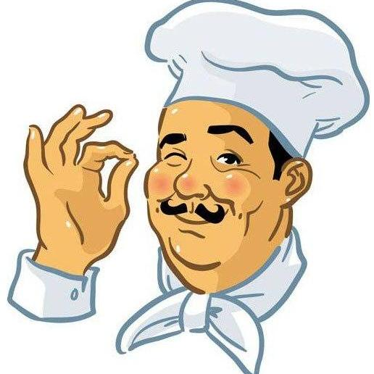
SOLVE THE PUZZLE “FOOD”
J
E
F
R
B
P
C
B
C
C
A M
G G
I S H
I C E
R E A D
A S T A
H E E S E
U T T E R
H I C K E N
A B B A G E

Slide 12
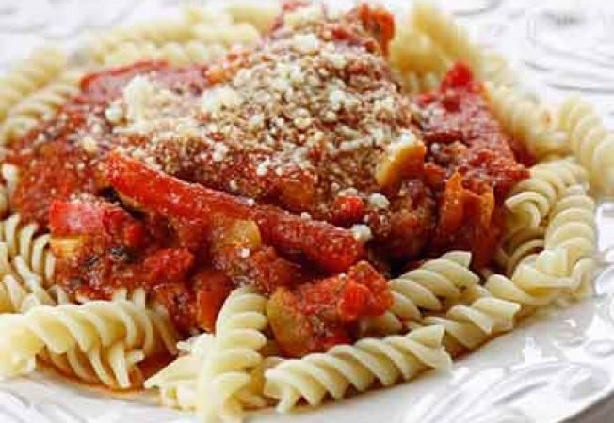
READING
ANN: How about pasta with chicken in tomato sause for dinner tonight?

Slide 13
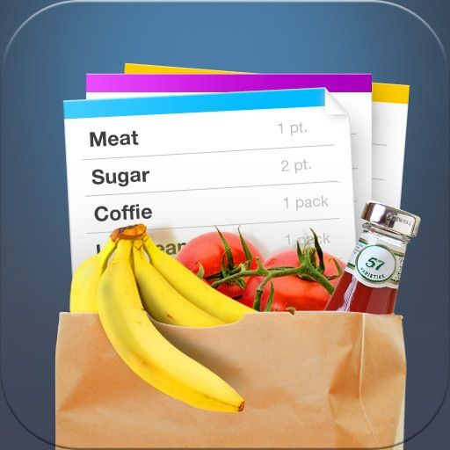
Ann and Bob’s shopping list
1. Garlic
2. Chicken
3. Olive oil
4. Cheese

Slide 14
I learn…
I remember…
I know…

Slide 15



Я все понял
Я кое-что недопонял
Я многое не понял

