Slide 1


Slide 2



It’s fun to learn English!
It’s fun
to learn
English!
It

Slide 3
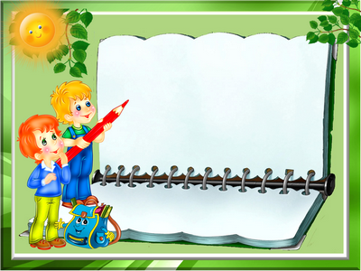
Invisible words
Цель: нарисовать в воздухе загаданное слово. Задача
остальных игроков – угадать слово
Invisible words
Цель: нарисовать в воздухе загаданное слово. Задача остальных игроков – угадать слово

Slide 4
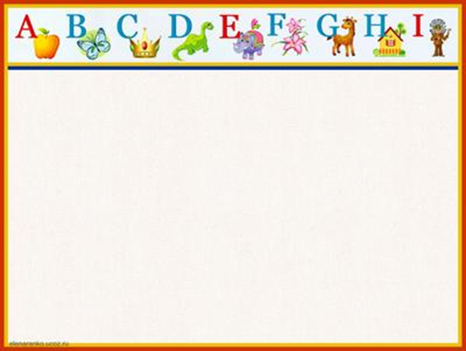
Who knows more?
“Sport”
“Food”
“Clothes”
“Animal”

Slide 5

Captains
competition

Slide 6
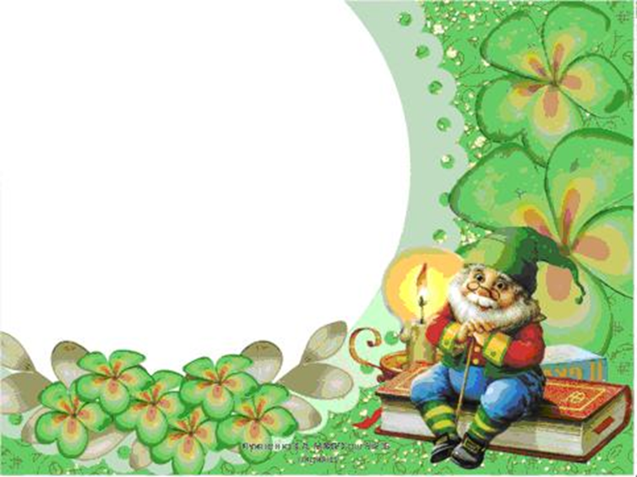
The king would sing, about a ring
that would go ding.
Black bug bit a big black bear.
But where is the big black bear that
the big black bug bit?
The thirty-three thieves thought
that they thrilled the
throne throughout Thursday

Slide 7

Twelve twins twirled twelve twigs.
If a white chalk chalks on
a black blackboard,
Will a black chalk
chalk on a white blackboard?
Betty and Bob brought back
blue balloons
from the big bazaar.

Slide 8

Who speaks
better?

Slide 9

Creative Task

Slide 10

Home
task

Slide 11

Thanks for your
attention!
Good bye!

