Slide 1
Travelling by train
Dyominova Adelina, 9B

Slide 2

Modern life is impossible without travelling. Thousands of people travel every day on business or for pleasure. They can travel by air, by rail, by sea or by road.

Slide 3
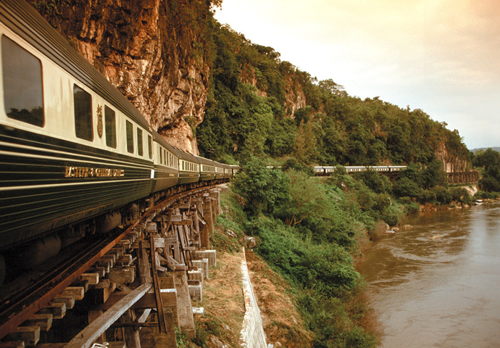
It is very interesting to travel. You can see other countries, continents; you get acquainted with other people, their traditions and customs. I want to tell you about travelling by train.

Slide 4
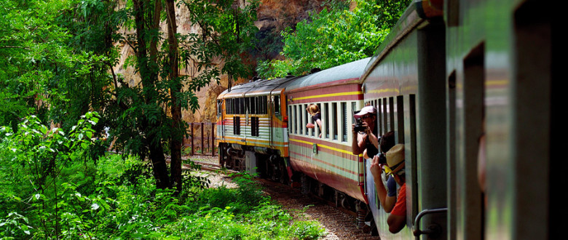
Travelling by train is slower, but it has its advantages. You can see much more interesting places of the country you are travelling through. Modern trains have very comfortable seats. There are also sleeping cars and dining cars which make long journey enjoyable. Speed, comfort and safety are the main advantages of trains.

Slide 5
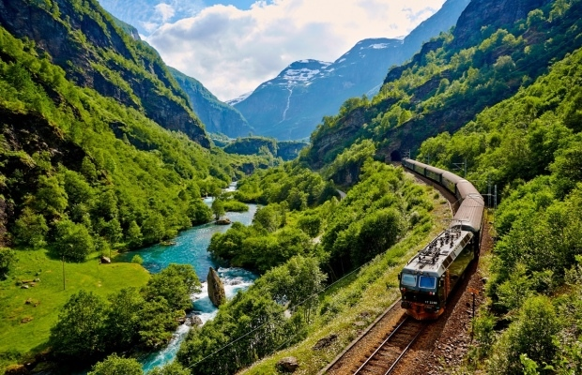
And I want to tell you once again about Advantages and Disadvantages of Railway Transport

Slide 6

Advantages:
The greatest advantage of the railway transport is that it is the most reliable type of transport as it is the least affected by weather conditions such as rain, snow, fog etc. compared to other kinds of transport.
The railway transport is better organized than any other form of transport.
Train is the safest form of transport. The chances of accidents and breakdowns of railways are minimum.

Slide 7
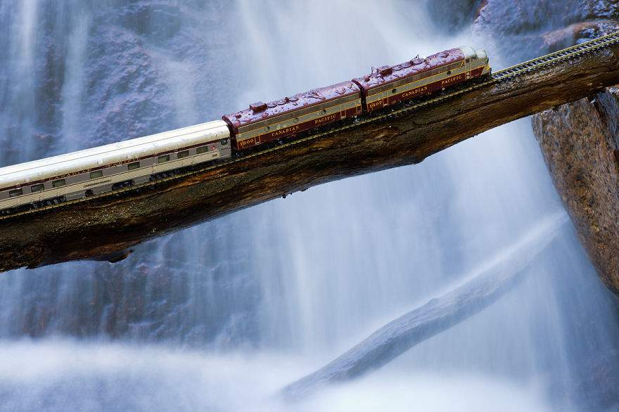
However, travelling by train also has some disadvantages. It is more expensive and the trains are sometimes crowded and delayed. The trains cannot take you from door to door You need a bus or a taxi to take you to the railway station. You have to fit timetable and travel at certain time. You can’t quickly move to exact places. Finally, you don't feel free.
Despite the disadvantages, I still prefer travelling by train to travelling by car. Because I feel more relaxed when I reach my destination.

