Slide 1
Reported Speech
Косвенная речь

Slide 2
Прямая речь – это чьи-либо цитируемые, точные слова. Прямая речь заключается в кавычки
She said: "I can speak two foreign languages“.
Косвенная речь передает точное содержание чьего-либо высказывания, но не точные слова. В косвенной реки кавычки не используются. После глаголов (say, tell) используется или может быть опущено that
She said (that) she could speak two foreign languages

Slide 3
Say или tell
SAY – при отсутствии личного дополнения
Jack said (that) he felt tired
SAY+ to+ дополнение, обозначающее адресата
Jack said to us (that) he felt tired.
TELL + косвенное дополнение (кому)
Jack told us (that) he felt tired

Slide 4
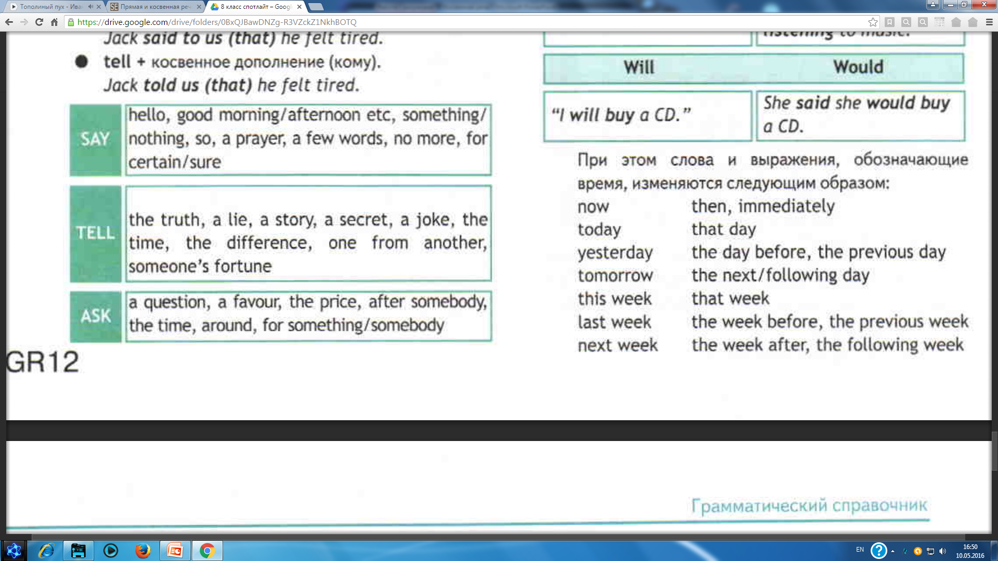
Запомнить!!!!

Slide 5
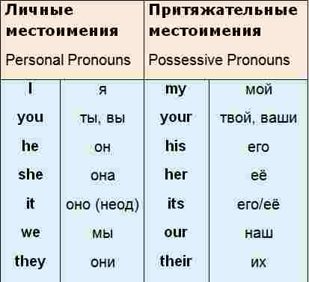
Высказывания в косвенной речи
В косвенной речи личные/притяжательные местоимения изменяются соответсвенно значению предложения.
Peter said, “I’ve lost my watch.”
Peter said (that) he had lost his watch.

Slide 6
Согласование времен в косвенной речи
Согласование времен может вызвать трудности, когда сказуемое главного предложения (непосредственно слова автора) использовано в одной из форм прошедшего времени. Если сказуемое главного предложения выражено глаголом в настоящем времени, то предложение в косвенной речи сохраняет глагольные формы во всех частях предложения:
He says, 'I will come.'
He says that he will come.

Slide 7
Согласование со сказуемым в прошедшем времени
Здесь действует принцип - сказуемое придаточного предложения (того, что стояло в кавычках) будет введено в косвенную речь во времени на ступень ранее, то есть:
Present перейдет в Past
He said, 'I love my wife.‘
He said he loved his wife.
Future перейдет в Past
Mike was told, 'They will arrive tomorrow.‘
Mike was told that they would arrive the next day.
Past перейдет в Past Perfect
“I saw this film in Spanish”, he said.
He said (that) he had seen that film in Spanish

Slide 8
Так же меняются
yesterday – the day before
tomorrow – the next day
here – there
now – then
today – that day
ago – before
this week – that week
next week – the week after
last week - the week after

Slide 9
1. She said, "I am reading."
She said that __________.
2. They said, "We are busy."
They said that __________.
3. He said, "I know a better restaurant."
He said that __________.
4. She said, "I woke up early."
She said that __________.
5. He said, "I will ring her."
He said that __________.
6. They said, "We have just arrived."
They said that __________.
7. He said, "I will clean the car."
He said that __________.
8. She said, "I did not say that."
She said that __________.
9. She said, "I don't know where my shoes are."
She said that __________.
10. He said: "I won't tell anyone."
He said that __________.

Slide 10
Keys:
1. Nick said he would get up at 5 o’clock the next day.
2. I asked him if he was sure about that.
3. The teacher asked children if they were ready for the test.
4. The weather forecast said there would be a tornado in 3 hours.

Slide 11
HOMEWORK

