Slide 1

How to protect endangered species?

Slide 2
New words
Species
Society
Diet
Hay
Linseed
Date
seal

Slide 3
Some/ any/ no
I saw … enter the room
Does … know his name?
There is … water in the glass
Is there … animal at the video?

Slide 4
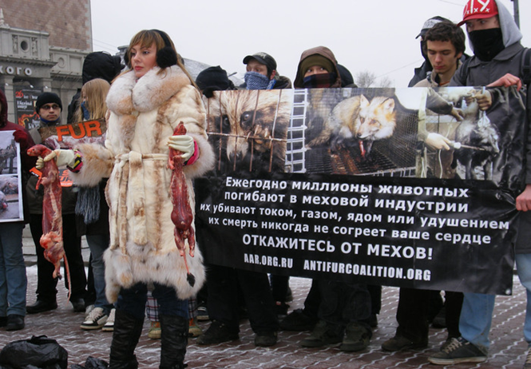
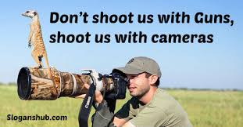
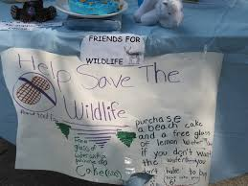
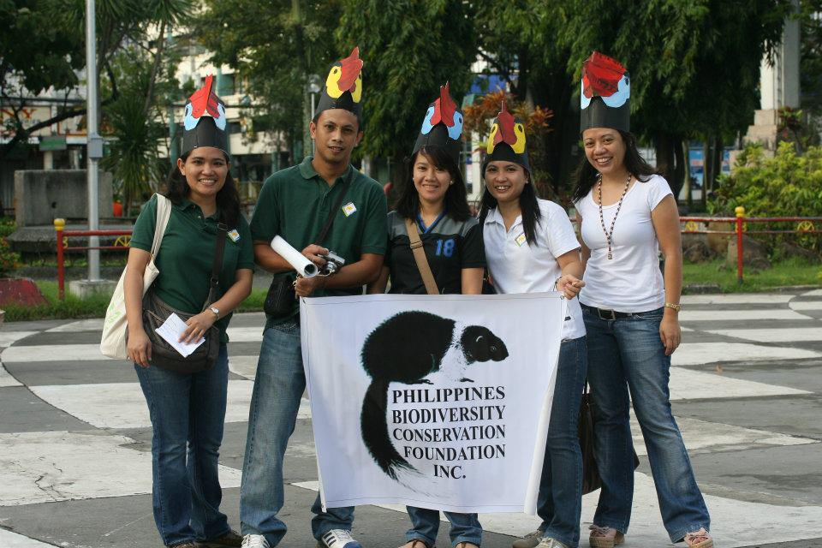
How do these people fighting for protection of endangering animals?

Slide 5
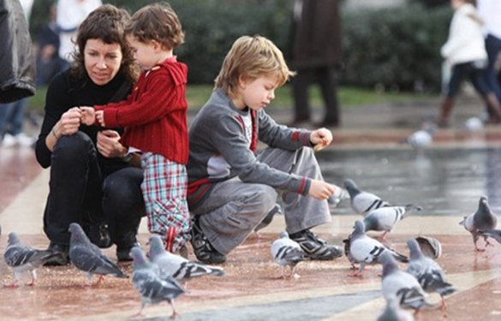
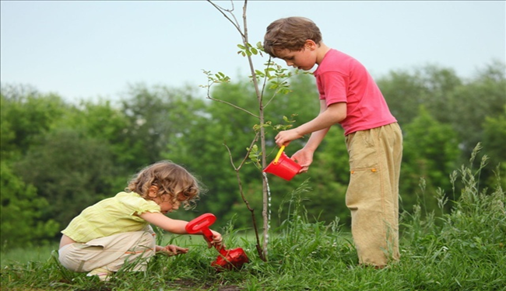
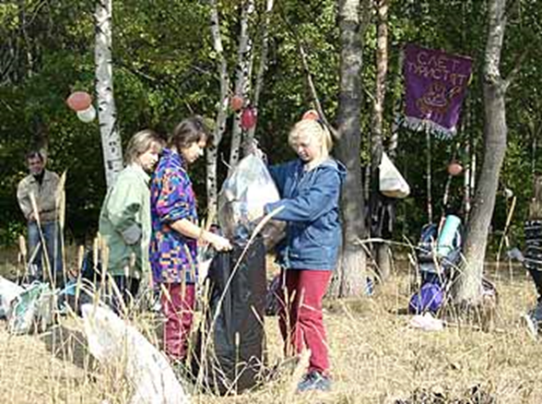
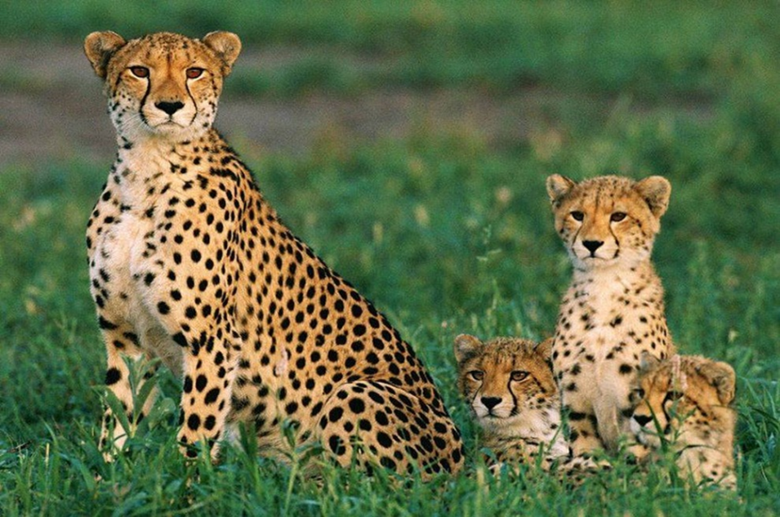
What do people in the pictures do to solve the problem?

Slide 6
And what would you do to save our nature?
Offer your own solutions to the problem.
Discuss with your classmates the ways of protecting wildlife
Put forward arguments that the measures you are going to take will work.

