Slide 1
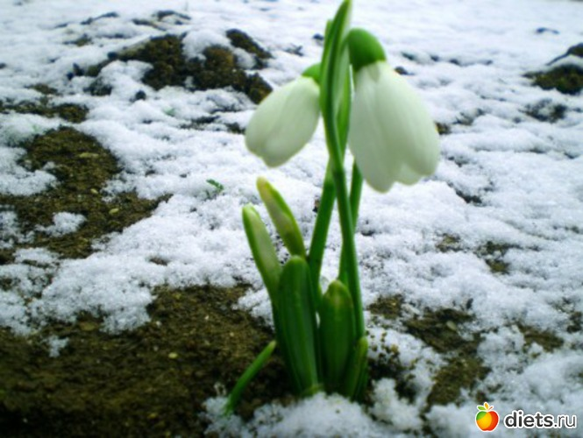
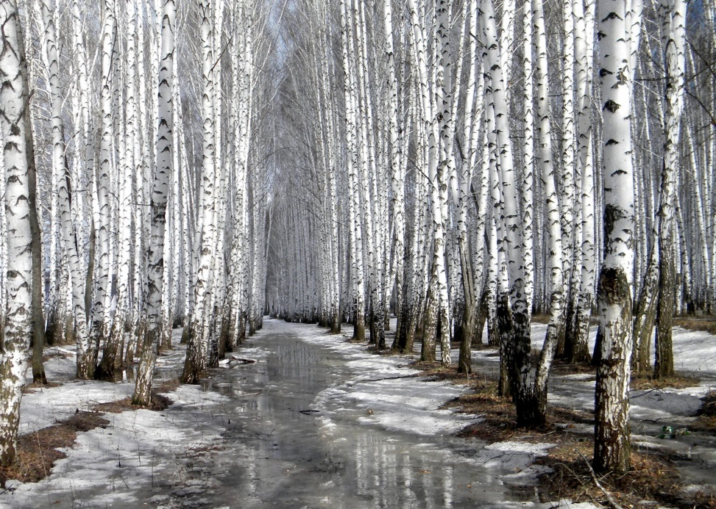
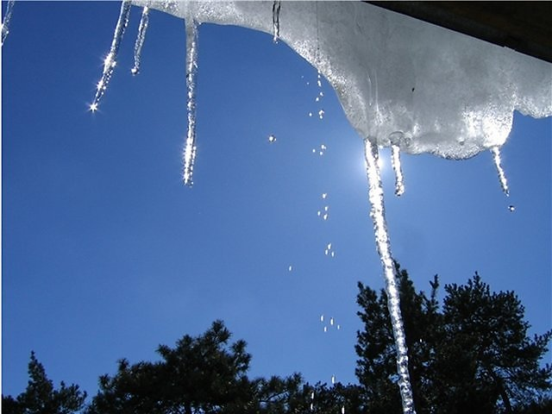
THE 1st OF MARCH

Slide 2
WEAHTER
W- [ w ]
WHERE - WHEN - WINDOW
WHAT - WERE - WAS
WORK
WATCH - WEEKEND

Slide 3
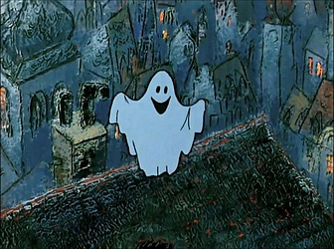
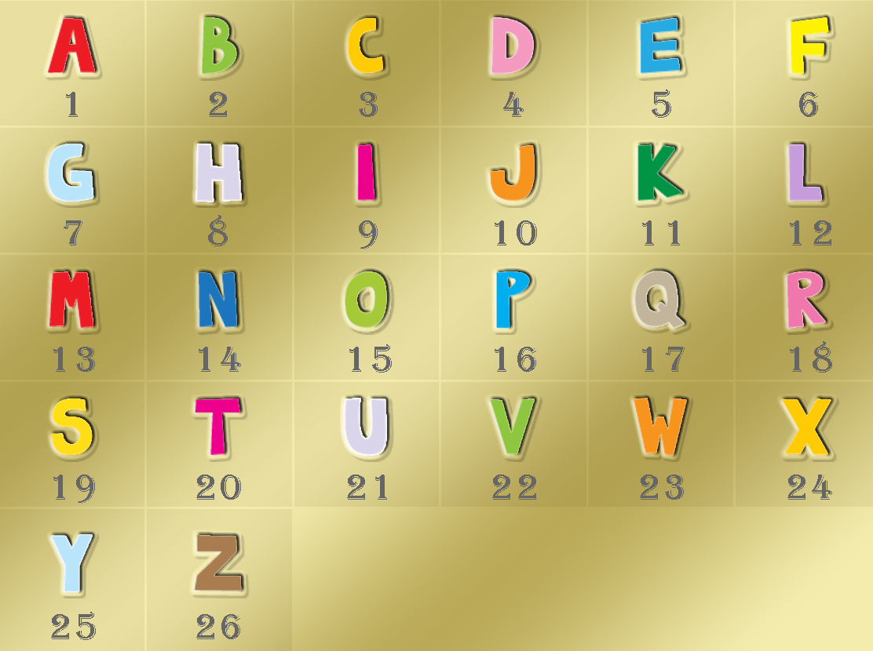
9,14
20,8,5
16,1,19,20
7, 8, 15, 19, 20
20,15, 23, 14, 19

Slide 4
At the lesson we:
Learn new words .
Work with the text.
Form and use Past Simple.

Slide 5
Use the letters to make up the words
beautiful
buafetuli –
edretsed –
uqite –
elacn –
ylgu –
deserted
quiet
clean
ugly

Slide 6
Мatch the opposites
А. Clean, beautiful, busy, crowded
В. Ugly, polluted, deserted, quiet

Slide 7
READ THE TEXT AND FIND
IN IT THE SENTENCES WITH NEW WORDS
EX. 3, P. 66

Slide 8


Slide 9
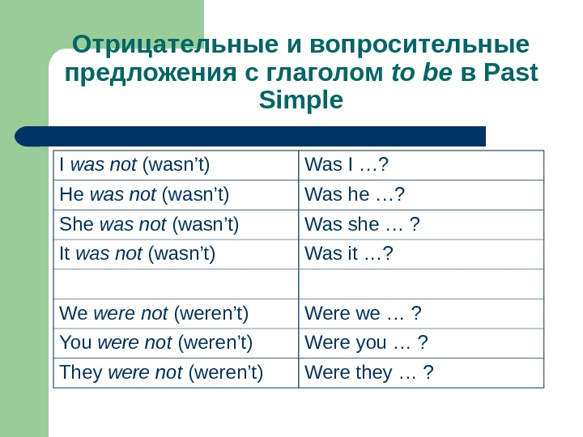

Slide 10


LET’S REST

Slide 11
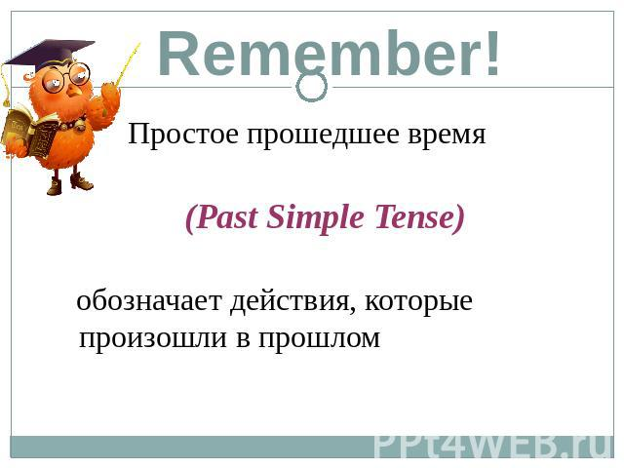
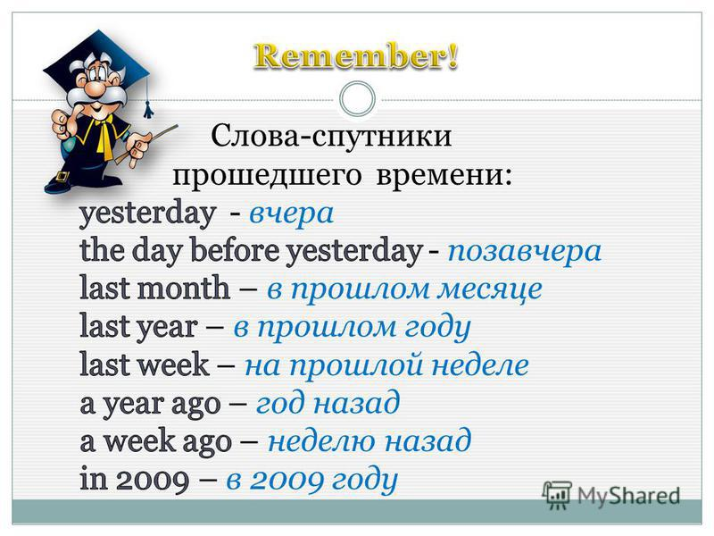

Slide 13
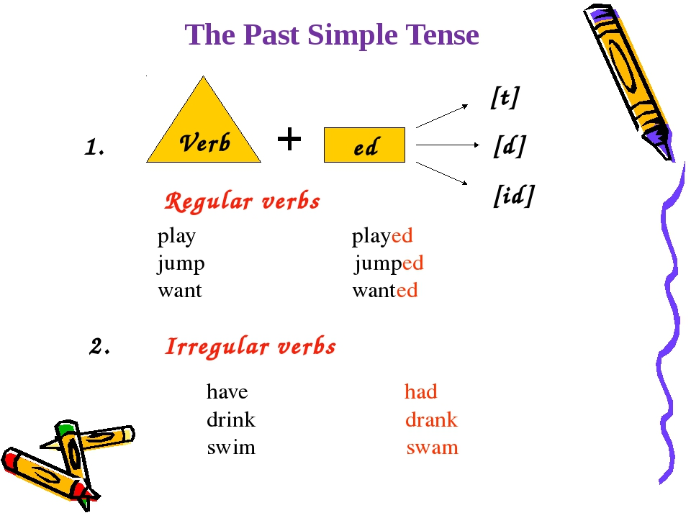

Slide 14
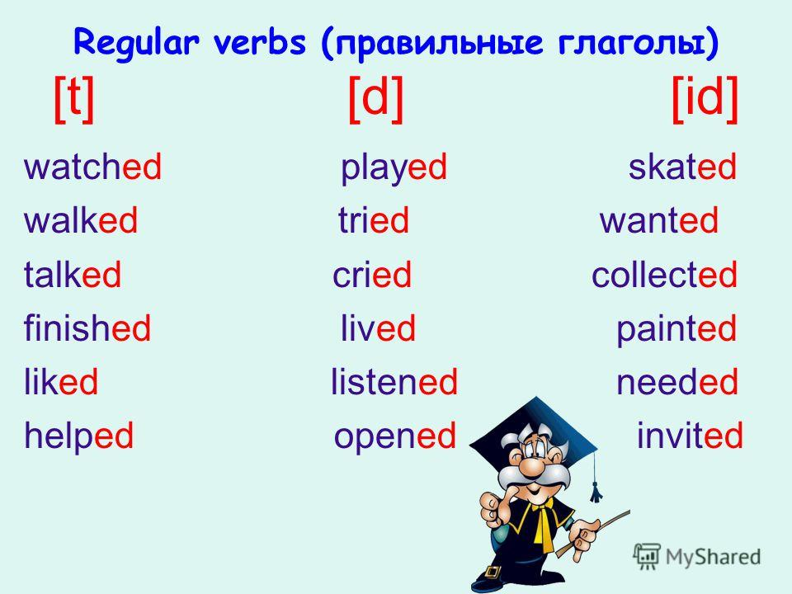

Slide 15
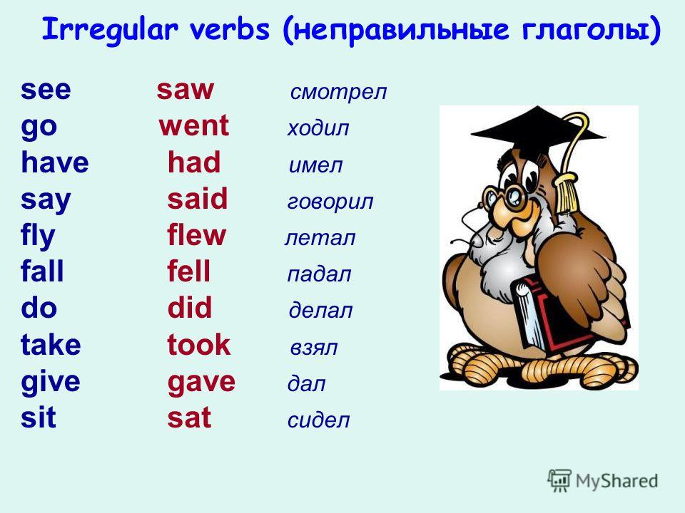

Slide 16


Slide 17
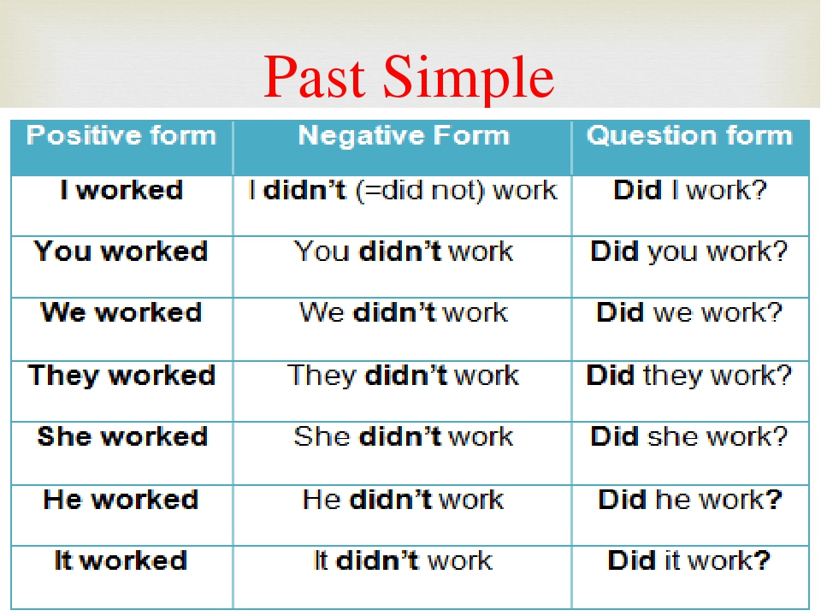

Slide 18
REFLEXION
know how...
NOW I
can…

Slide 19
HOMEWORK:
1. Ex: 4,5, p.69
2. Ex. 4a, 5a p.69( to write the first and the second forms of the verbs).

Slide 20

THANK YOU FOR THE LESSON

Slide 21
Пашенькина Алевтина Анатольевна
МБОУ Ульяновская СШ
Лукояновского района
Нижегородской области
Презентация к уроку английского языка
6 класс
УМК «SPOTLIGHT»
MODULE 7, LESSON 7a
PAST SIMPLE

