Slide 1

The 14th of May.
Saturday.
I went to America
You study
Past simple: irregular verbs
Past simple: affirmative, negative and interrogative sentences.

Slide 2
Good afternoon, my children!
How are you?

Slide 3
Look at the slides “tangerine” to make pleasant mood.

Slide 4

You’ll choose one of split papers. And make split papers which written team’s name. So you’ll divide into three groups.
- past simple;
- regular verbs;
- irregular verbs;

Slide 5

Checking the HT by method of “a plane”.
- What was your HT?

Slide 6

New words:
leave [ li:v ] кету
journey [ dƷә:ni] саяхат
eat [ i:t ] жеу
local [ lәukl] жергілікті
know [ nәu ] білу
survive [ sәvaiv ] өмір сүру
die [ dai ] өлу, қайтыс болу

Slide 7
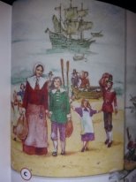
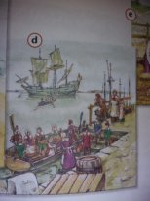
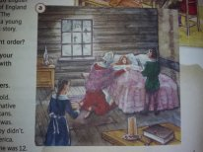
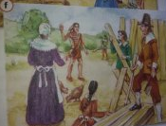
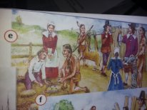
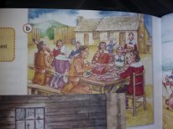
Exercise – 1, p. 126. Listen and follow the text in your book. Then match the paragraphs 1-6 with pictures a – f.

Slide 8

Exercise – 1, p. 126. Match the questions with the answers.
1. When did John leave England? - f
2. Where did he and his family go? - e
3. Was their journey difficult? - c
4. What was the weather like during the winter? - a
5. At first, did they have a lot to eat? - d
6. Did John’s sister survive? - g
7. Who helped them? - b

Slide 9

Past simple: irregular verbs.
Irregular forms – there are no grammatical rules for the formation of the verbs in the past simple. SB, p149.

Slide 10

Exercise – 3, p. 127. Use verbs from the table in Ex-2 and complete the sentences about the story.
John left England when he was 12.
He and his family went to a new country.
In March, Squanto came to John’s new home.
Squanto was a native American but he spoke English.
John was scared when he saw Squanto.
Squanto didn’t know how to find food.
Soon the Pilgrims had more food.
They ate fruit, vegetables, fish and meat.

Slide 11

Irregular verbs: affirmative, negative and interrogative sentences.
Affirmative: They went. They knew.
Negative: They didn’t go. They didn’t know.
After did/didn’t we use the infinitive (They didn’t go, NOT They didn’t went)
Interrogative: Did they go? - Yes, they did / No, they didn’t
Did they know? – Yes, they did / No, they didn’t

Slide 12

Exercise – 5, p. 127. For each verb make a past simple affirmative and negative sentence and a question.

Slide 13

Conclude the lesson with the method of “Last five minutes”.

Slide 14

Your HT will be Exercise – 8, p.127. write your diary for last weekend. (use the list of irregular verbs on page 149)

Slide 15
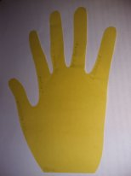
The strategy “Five fingers”
1 – My mood is …(менің көңіл-күйім...)
2 – I learned …(мен үйрендім...)
3 – It’s difficult …(маған қиын болды...)
4 – It’s lucky…(сабақта сәтті болды...)
5 – I helped …(мен көмектестім...)

Slide 16

The lesson is over. Good bye!

