Slide 1
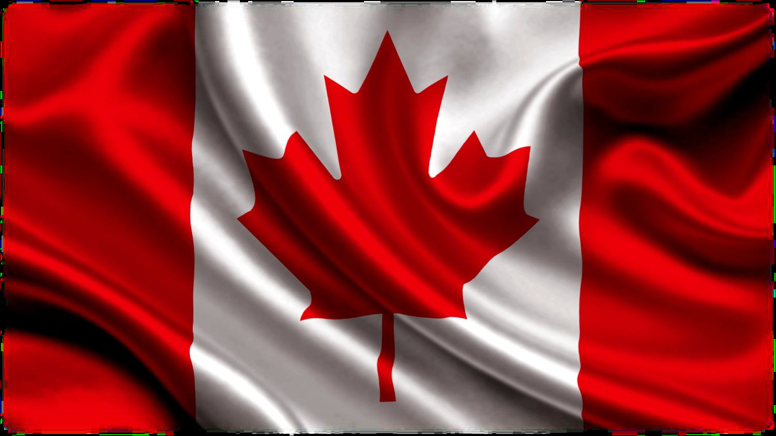
Lesson play of Canada
Teacher: Novoteyeva A.A

Slide 2
Yourself-game
All about Canada | 10 | 20 | 30 | 40 | 50
Big cities | 10 | 20 | 30 | 40 | 50
Political system of Canada | 10 | 20 | 30 | 40 | 50
Educational system of Canada | 10 | 20 | 30 | 40 | 50
Famous people | 10 | 20 | 30 | 40 | 50
Grammar | 10 | 20 | 30 | 40 | 50

Slide 3
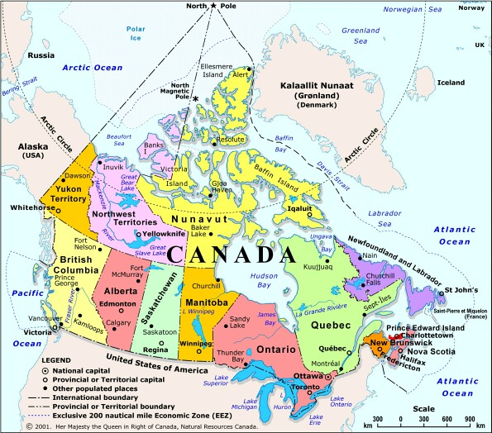
Where is situated Canada?
Canada is situated on the North American continent. As Canada extends from thousands of miles from the Arctic Ocean to the United States and from the Atlantic Ocean to the Pacific Ocean

Slide 4
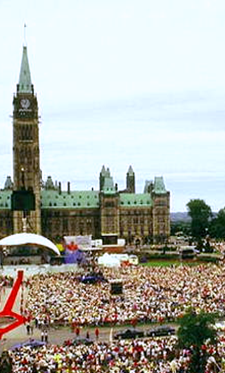
What’s the population of Canada?
The population of Canada is about 33 million people

Slide 5
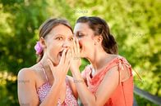
What languages are spoken in Canada?
In Canada are spoken of two languages: English and French

Slide 6
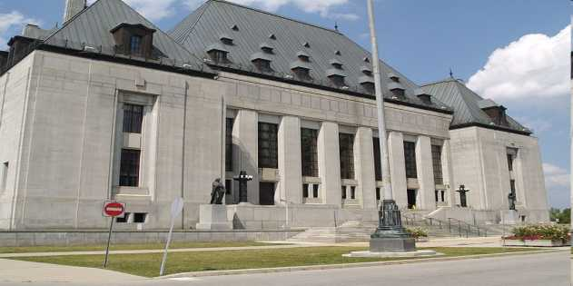
When did Canada become independent?
Canada became independent in 1931 from Britain

Slide 7
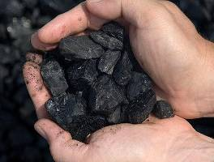
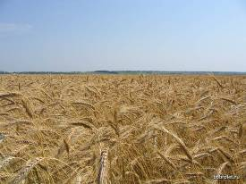
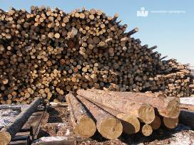
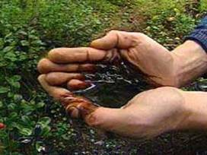
What are its main natural resources?
Canada is reach in the following natural resources: non-ferrous metals, uranium, oil, natural gas, coal

Slide 8
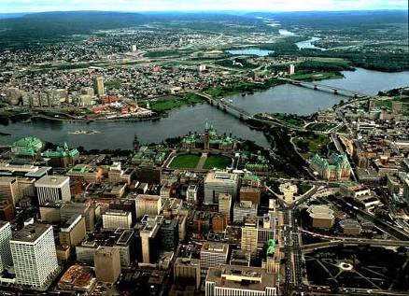
What is the capital of Canada?
Ottawa is the capital of Canada

Slide 9
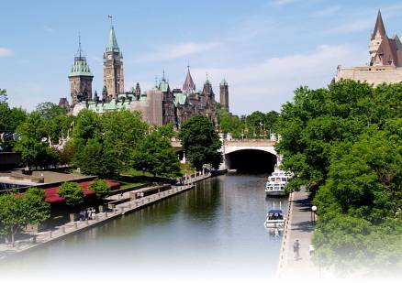
Symbol of this town is Parliament buildings
Ottawa

Slide 10
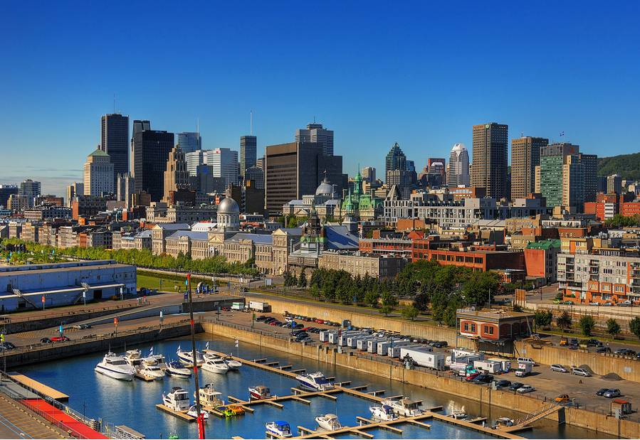
The main cities in Canada
The main cities in Canada are Toronto, Montreal and Vancouver

Slide 11
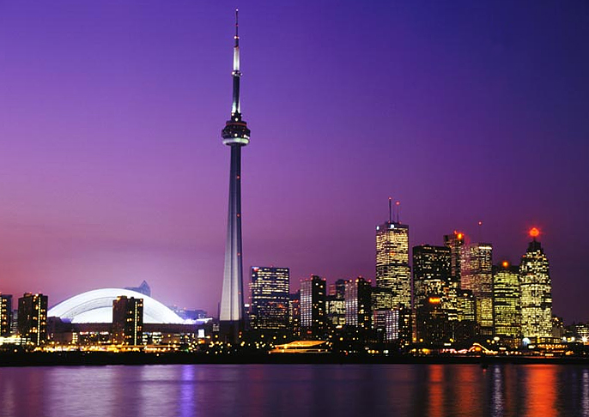
It’s the capital and largest city of province Ontario, and it is located on the north share of Lake Ontario
Toronto

Slide 12
This town situated in province of Quebec – the French part of Canada
Montreal

Slide 13
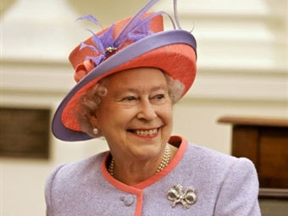
Who is the head of state Canada?
The Queen of England Elizabeth II

Slide 14
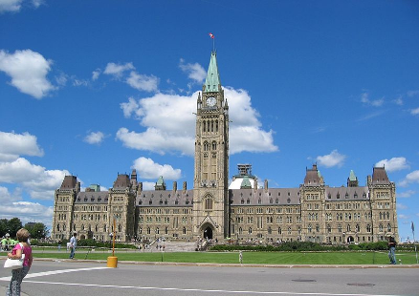
What form of government in Canada?
Canada in the independent parliamentary state

Slide 15
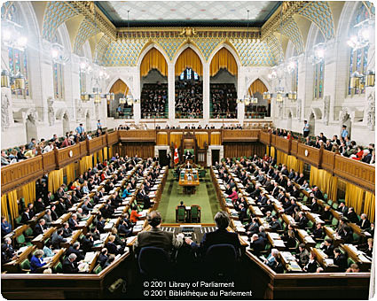
What the Parliament of Canada consists?
Parliament of Canada consists of two houses, the Upper House called the Senate, and the Lower House called the House of Common

Slide 16
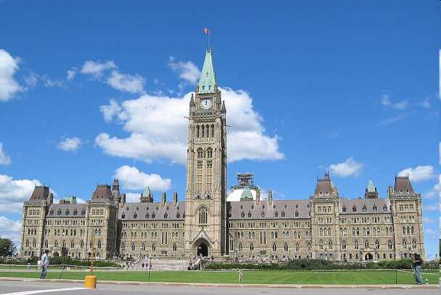
How many branches of power have in Canada? Call its.
In Canada have three branches of power: judicial, legislative and executive

Slide 17
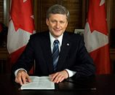
What power of Prime Minister of Canada possesses?
The Prime Minister of Canada has full executive power: to appoint all members of the Cabinet, parliamentary secretaries, senators, judges, of the Supreme court of Canada, the Governor General and other senior federal and provincial officials

Slide 18
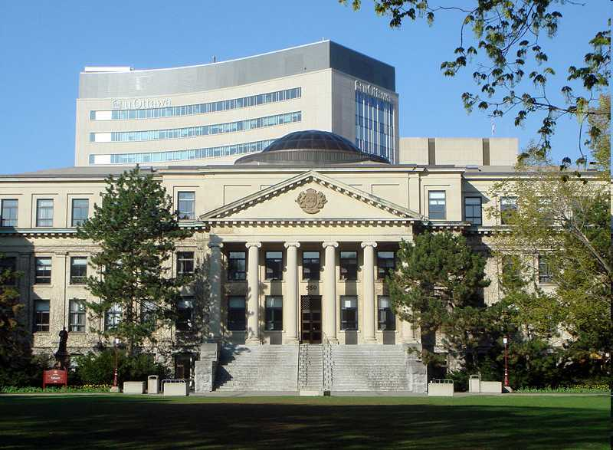
The school system of Canada is similar of school system in the USA?
The school system of Canada is very much like the one in the USA, but there are certain differences

Slide 19
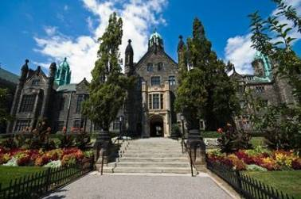
What educational is basic and general in Canada?
Elementary education is basic and general in Canada

Slide 20
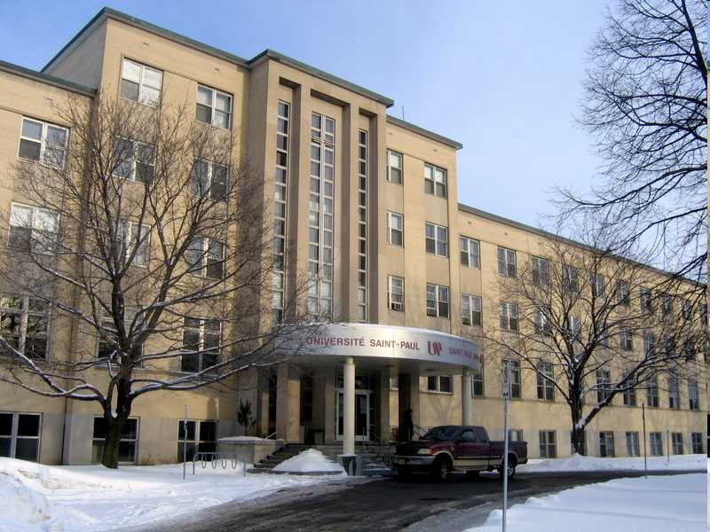
What types of school have in Canada?
In Canada have state and private school

Slide 21
What kinds of colleges and universities have in Canada?
They are religious college, institutes, of technology, institutes of applied arts, colleges of agricultural, technology and other. ..

Slide 22
How many years last average the compulsory education in Canada?
Education in Canada is general and compulsory for children from 6 to 16 years old
10 years

Slide 23
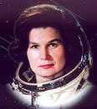
What’s name the first woman astronaut from Canada?
Roberta Bondar was the first woman astronaut from Canada

Slide 24

What is it Franck Gehry?
He is a famous architect from Canada

Slide 25
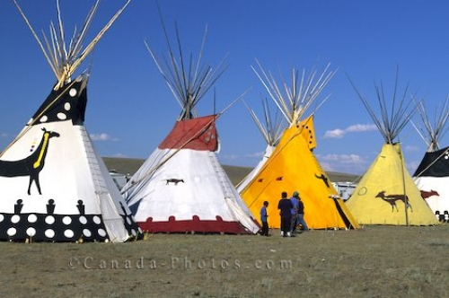
Indigenous people in Canada are …
Eskimos and Indian

Slide 26
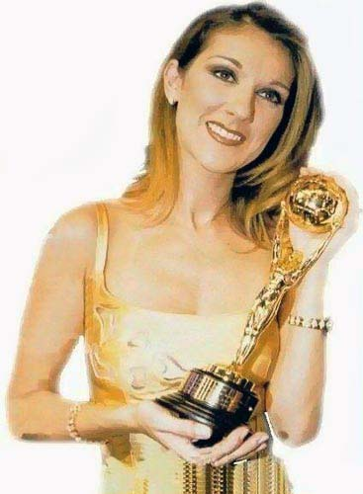
Who was the famous singer who was born in Charlemagne?
Selin Deon

Slide 27
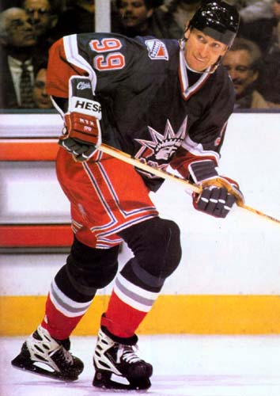
Who was the famous Hockey –player ?
Ivan – Gretzky

Slide 28
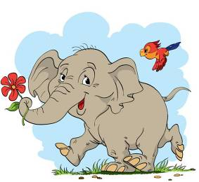
When we use Zero Conditional?
We use Zero Conditional for something that always happens or is always true, including scientific facts. In both cloth we use Present Simple

Slide 29
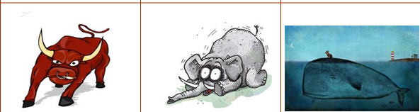
What is it degree comparison of adjective?
Это степени сравнения качественных имен прилагательных

Slide 30
Translate: Торонто самый красивый город для туристов
Toronto is the most beautiful town for tourists

Slide 31
Translate: Это знаменитый город
This is a famous town

Slide 32
Translate: Канада больше чем Казахстан
Canada is bigger than Kazakhstan

Slide 33
Thank you for your attention!

