Slide 1
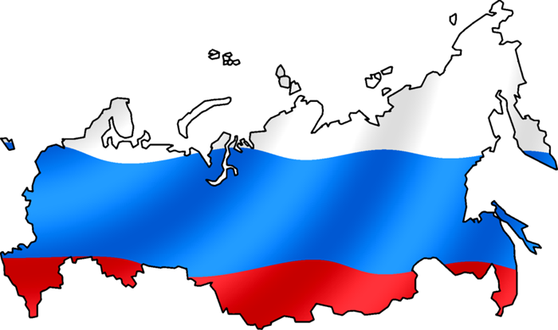
What do you know about Russia?

Slide 2
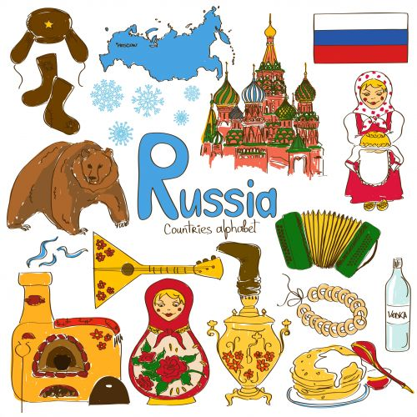

Slide 3
Quiz
1.What are Russian pancakes called?
kotleti
bulochki
bliny
2. This singer is often called the "Primadonna" of Russia. Who is she?
Zhana Friske
Layma Vaykule
Alla Pugachova

Slide 4
3. These are famous Russian dolls. There is one big doll with an opening in her middle. Inside the big doll is a smaller doll and inside that doll there's an even smaller doll. Sometimes, there can be over 20 dolls, all inside each other. What are these dolls called?
shatai boltai
kukli
matrioshki
4. What is the building where the Russian President lives called?
Isakovskiy Sobor
Kreml (Kremlin)
Beliy Dom

Slide 5
5. What feat is Valentina Tereshkova associated with?
She was a famous Soviet spy during the Cold War
She was the first woman to go to space
She was the first Russian actress to enter Hollywood
6. What are the colors of the Russian flag?
Green, Gold and Yellow
Red, White and Gold
White, Blue and Red
7. When was the Moscow Olympics held?
1985
1973
1980

Slide 6
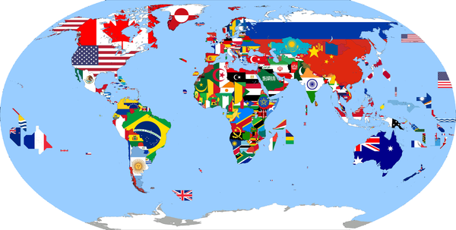
Look at the map of these countries. Australia and the USA are big countries. They are bigger than Britain. But Russia is bigger than Australia and the USA. It is a very big country. The weather can be different in different parts of Russia. In April it is cold and there is a lot of snow in Siberia, but it is warm on the Black Sea coast.
Listen and read. Ex 1,p.42

Slide 7
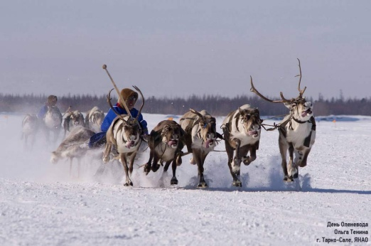
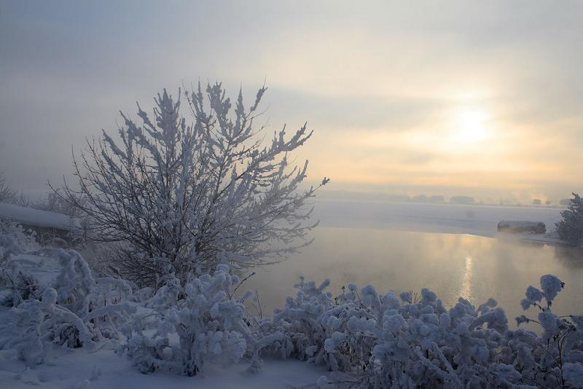
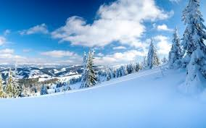
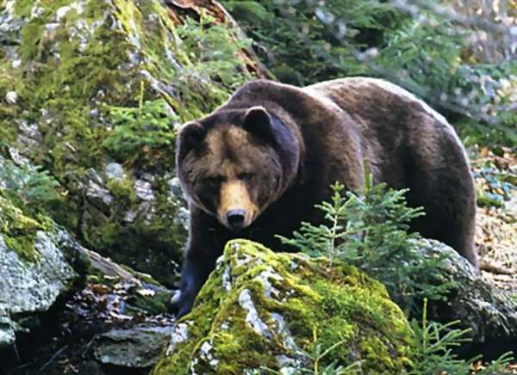
These are pictures of Siberia taiga in winter. You can’t see brown bears in taiga now. They sleep in their holes under the snow in winter. But there are lots of bears in the forest in the other seasons. Some trees in the taiga are 40 metres tall.

Slide 8
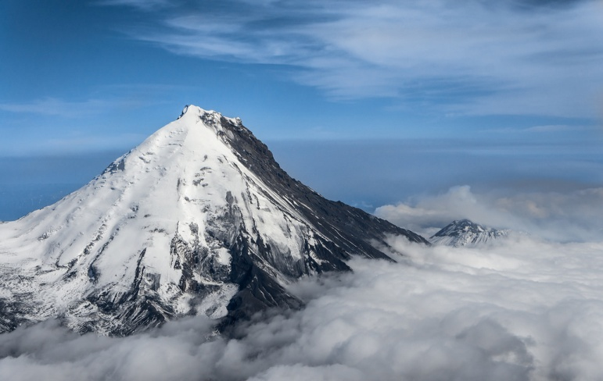
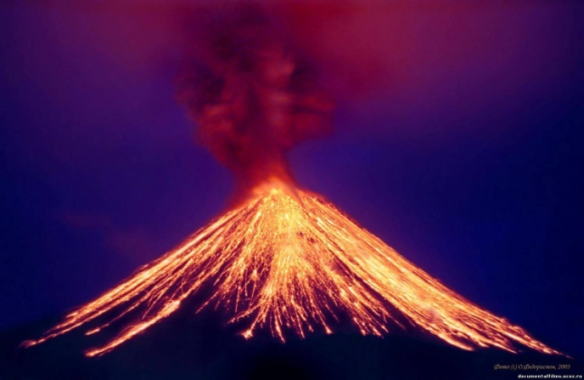
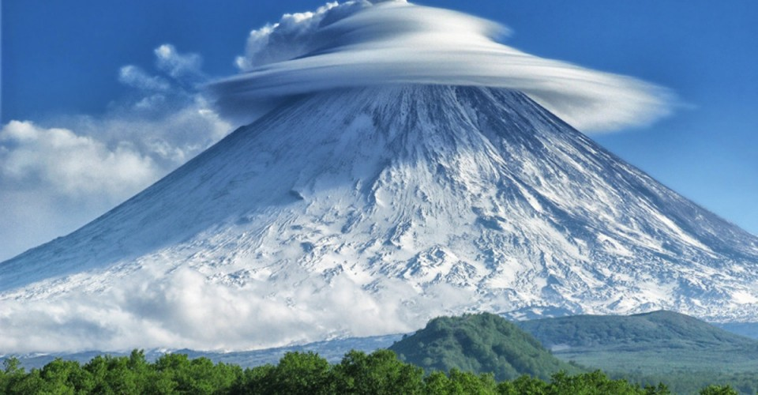
These are pictures of Kamchatka. It’s spring time. Kamchatka is famous for its active volcanoes. There are 29 active volcanoes there. You can see lakes with hot water not far from volcanoes.

Slide 9
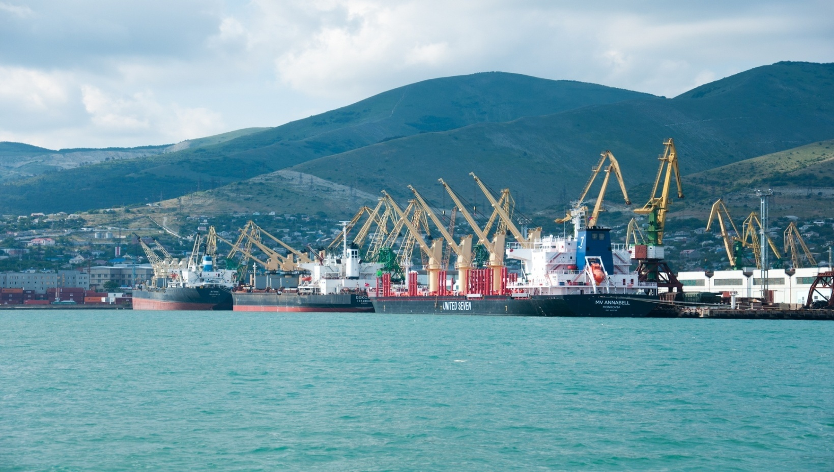
THE Black Sea
These are pictures of the Black Sea coast in summer. The Black Sea is in the south of Russia. It is famous for its beaches, holiday camps and big ports. It’s hot and sunny in summer and it’s warm in the other seasons of the year there.

Slide 10
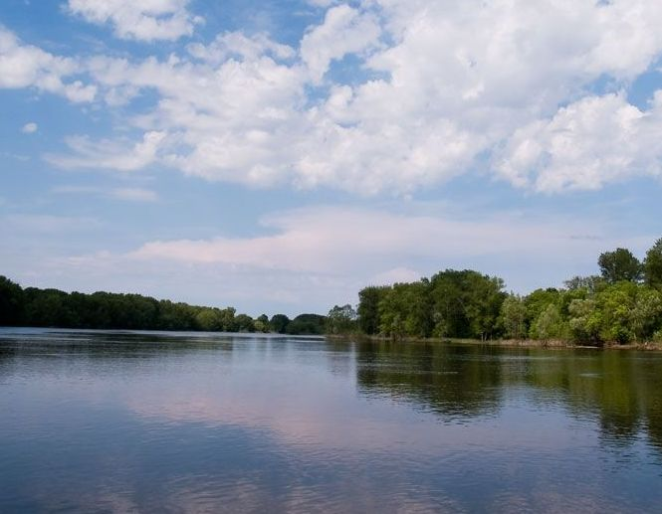
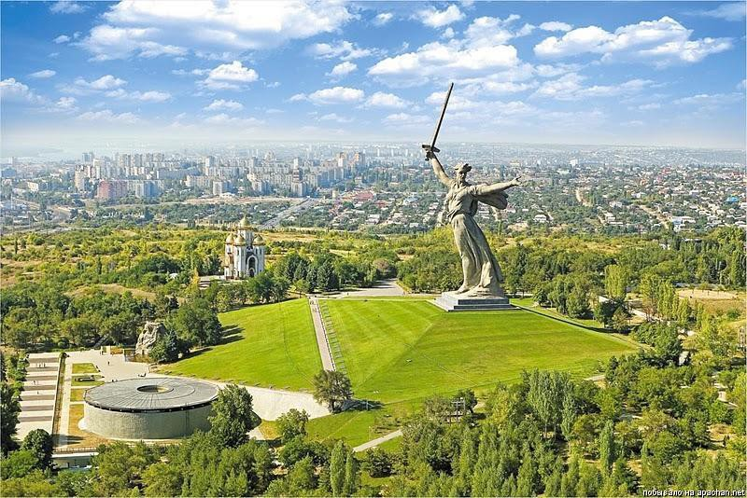
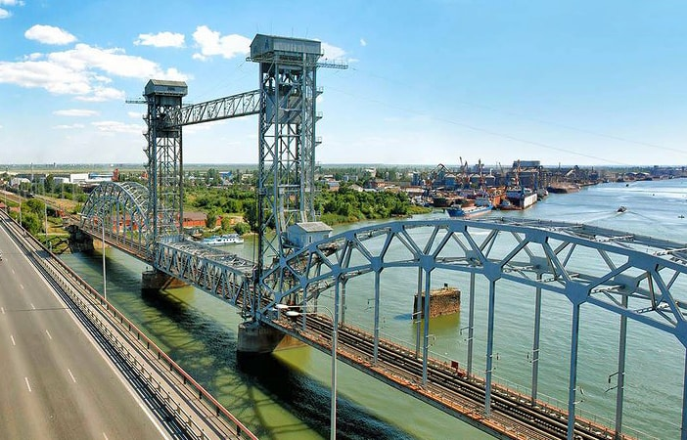
Volga
These are pictures of the Volga river in autumn. The Volga is very long. It is famous all over the world. You can see a lot of big ships on the river. There are 11 big cities by the side of the river.

Slide 11
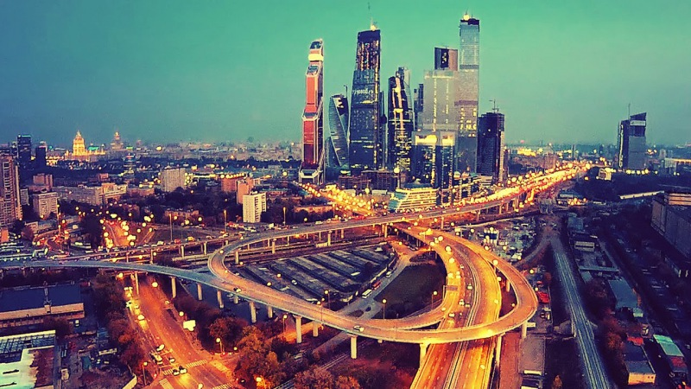
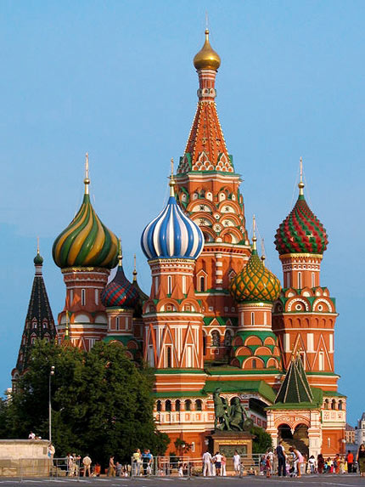
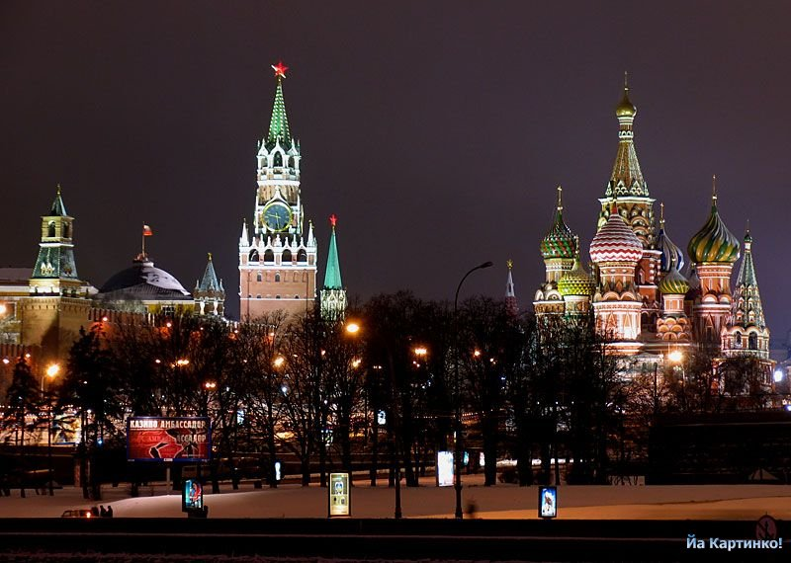
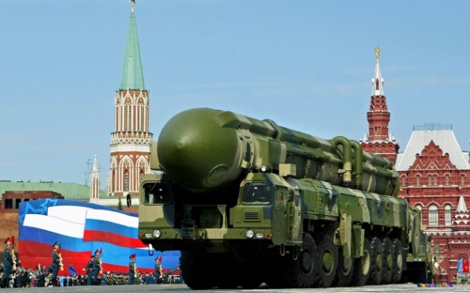
Moscow is a capital of Russia

Slide 12
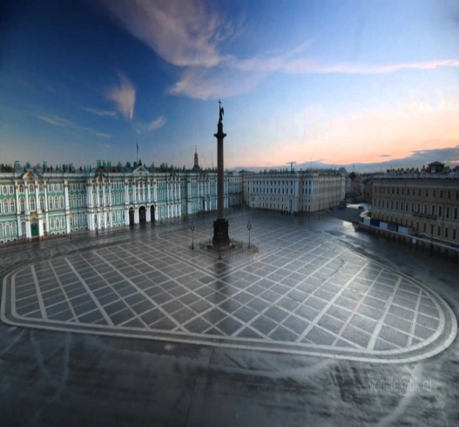
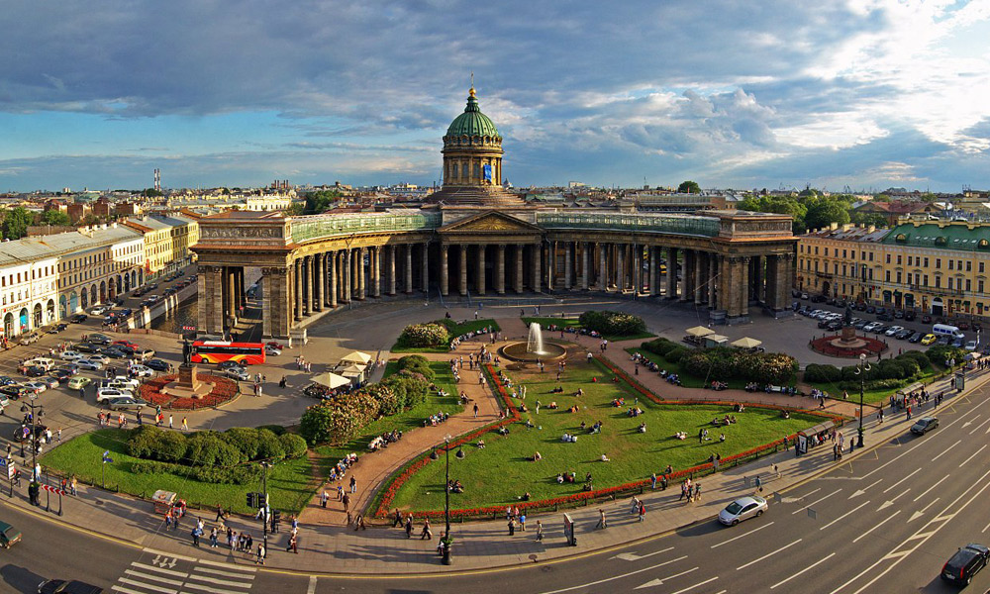
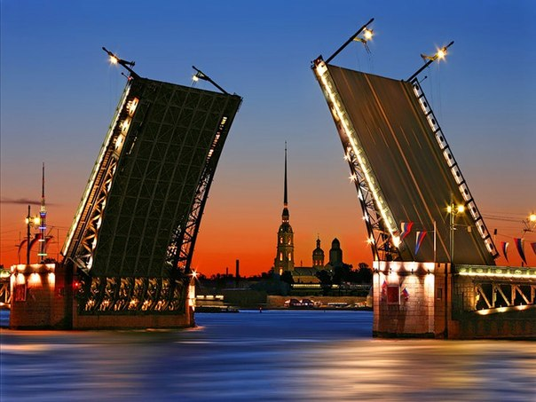
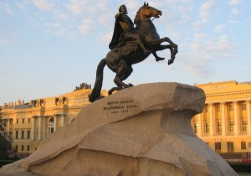
St. Petersburg

Slide 13
Where do you want to go? Why?
I want to go …. because…

