Slide 1
The country and the city

Slide 2
Phonetic exercise
[α:] car, farm, garden, dark, farmer
[аυ] brown, how, cow, town, now
[л] jump, up, London, funny, country
[ı] big, live, hill, windy, bridge, city

Slide 3
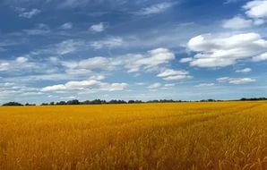
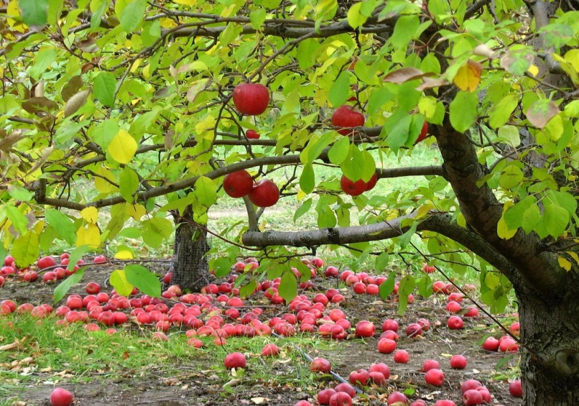
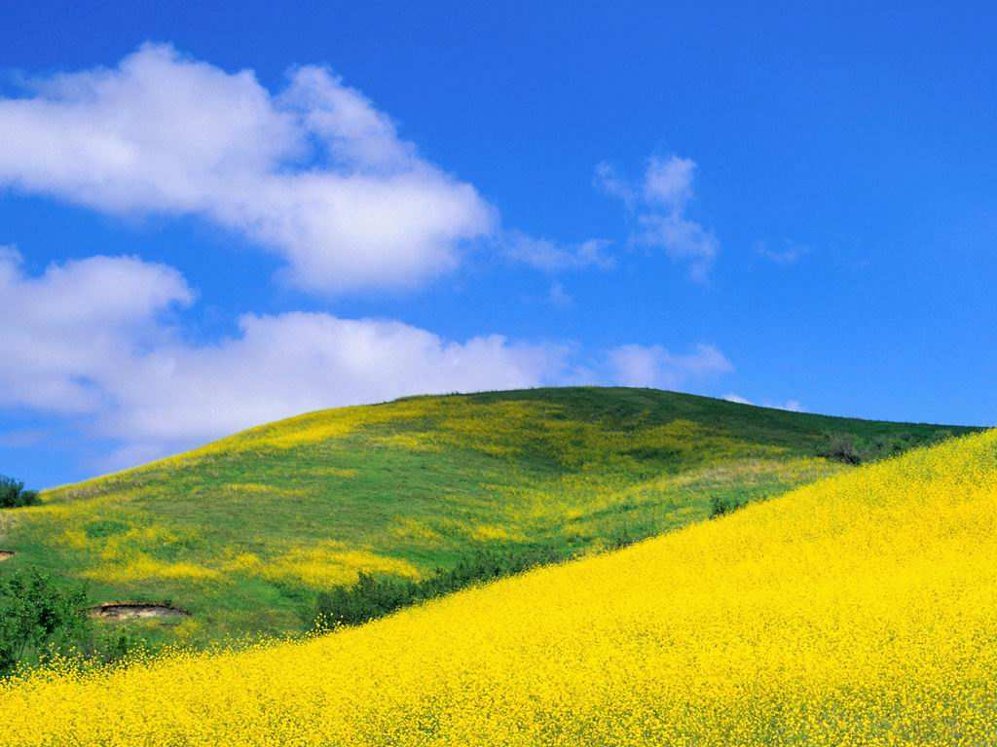
Do you know these words?
field
apple-tree
hill

Slide 4
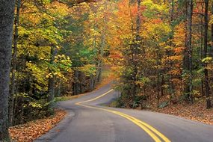
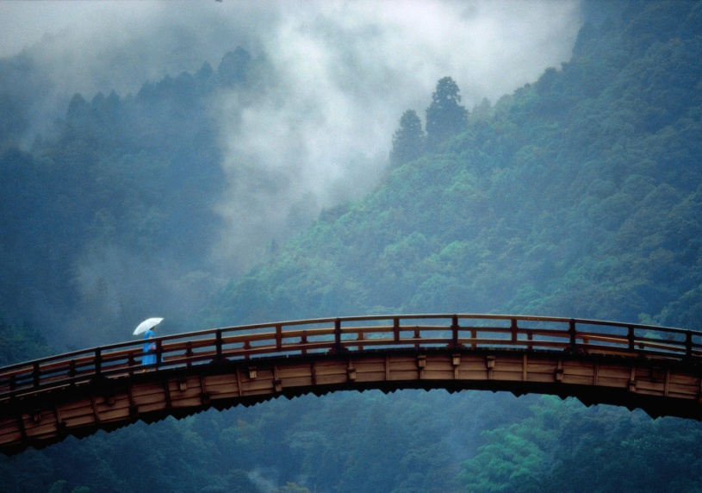
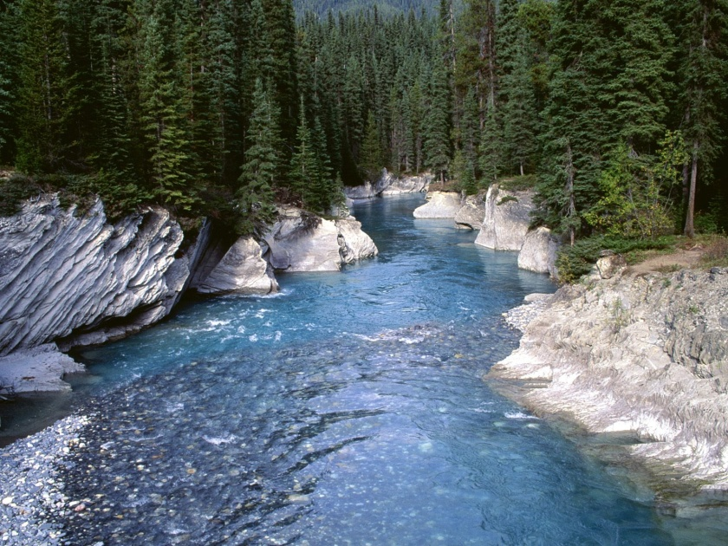
Do you know these words?
road
bridge
river

Slide 5
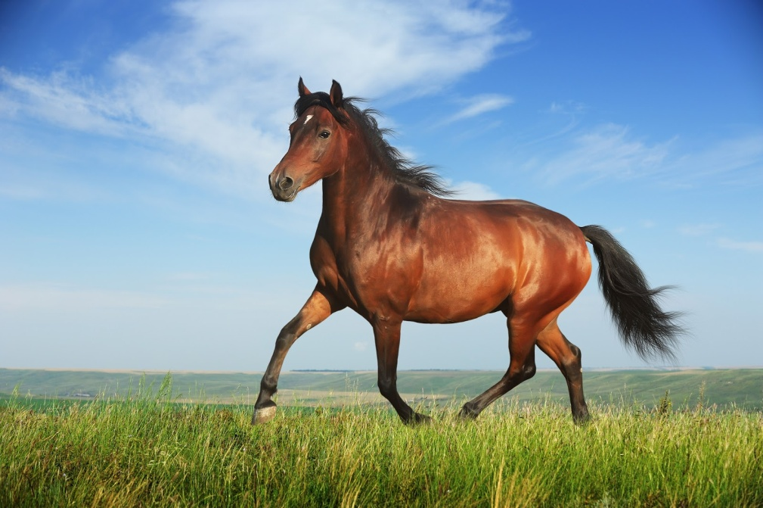
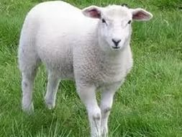
Do you know these words?
horse
sheep

Slide 6
What the topic of our lesson?
The country and the city

Slide 7
Play the game
What the weather like today?

Slide 8
Evaluation
Well done
Good
Not bad

Slide 9
Act out
Hello
Hello. Can I help you?
What is the weather like in …. ?
It’s ….. but ….. and ….. .
What a pity! Bye-bye!
Bye-bye.

Slide 10
Let’s have a rest
Clap, clap, clap your hands,
Clap your hands together
Stamp, stamp, stamp your feet,
Stamp your feet together.
Touch, touch, touch your ears
Touch your ears together
Touch, touch, touch your cheeks
Touch your cheeks together
Shake, shake, shake your hands
Shake your hands together
Smile, smile at your friends
Let us smile together

Slide 11
Degrees of comparison
Степени сравнения прилагательных
положительная сравнительная превосходная
Positive Comparative Superlative
- er the … est
large larger the largest
большой больше самый большой

Slide 12
В односложных прилагательных с кратким гласным звуком удваивается согласная
положительная сравнительная превосходная
big bigger (the) biggest
hot hotter (the) hottest

Slide 13
Буква y на конце прилагательных выпадает:
положительная сравнительная превосходная
happy happier (the) happiest

Slide 14
Буква e на конце прилагательных выпадает:
положительная сравнительная превосходная
nice nicer (the) nicest

Slide 15
В сравнительной степени часто употребляется союз than - чем.
smaller
taller than
shorter

Slide 16
Ex. 19, p 40 listen, read and learn
Kind – kinder – (the) kindest
Small – smaller - (the) smallest
Short – shorter - (the) shortest
Tall - taller - (the) tallest
Clean – cleaner - (the) cleanest

