Slide 1

Муниципальное образовательное учреждение
Дополнительного образования
«Центр внешкольной работы «Юность» г.Комсомольск-на-Амуре
2016г.
«Riddles about nature»
Автор: Анисимова Вера Константиновна,
Педагог дополнительного образования

Slide 2

A blue sheet which covers
The whole world.
What is it?
The sky

Slide 3
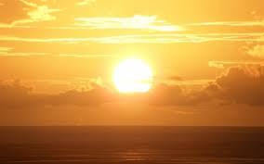
I am big,
I am in the sky
I give light.
What am I?
The Sun

Slide 4
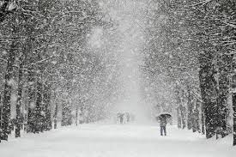
In the spring becomes old,
In the summer dies,
In the winter comes alive.
The snow

Slide 5
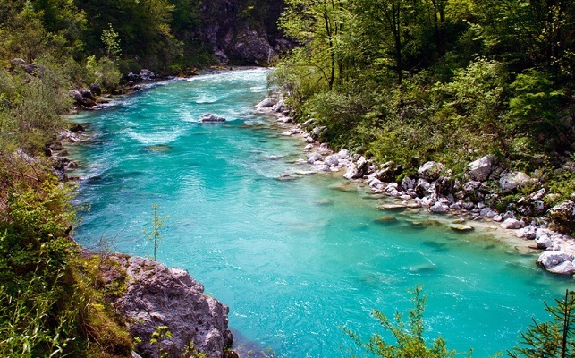
It runs and runs,
But it never run away.
It flows.
Who knows
What I am taking about?
The river

Slide 6

It has no wings, but flies,
It pours tears, but has no eyes.
A cloud

Slide 7
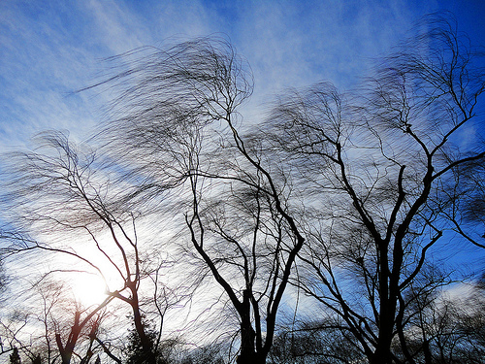
What is with no hands
And with no feet,
With no a head or body,
But may open the door?
The wind

Slide 8

What is it that makes a noise
In the fields and in the garden,
But cannot get into the house?
Rain

Slide 9
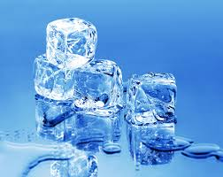
It is white, it is cold.
You can skate on it.
What is it?
Ice

Slide 10

What flies when it was born,
Lies when it is alive,
And running, when it dies?
A snowflake

Slide 11

Who changes the clothes four times within one year?
The ground

Slide 12

I am purple, yellow, red, and green
The King cannot reach me and neither can the Queen.
I show my colors after the rain
And only when the sun comes out again.
Rainbow

Slide 13
Список использованных ресурсов:
1). Филипченко М.П. «Загадки на английском языке для начальной школы»,- Ростов-на-Дону, «Феникс», 2014г.
http://bgfons.com/upload/sky_texture1969.jpg
http://getbg.net/upload/full/www.GetBg.net_Nature___Sea_The_sun_over_the_sea_037361_.jpg
http://www.vseznaika.org/wp-content/uploads/2015/11/pic-00187.jpg
http://udivitelno.com/images/9/biryuzovaya-reka-socha.jpg
http://samlib.ru/img/m/margarita_o/poslushajoblako/bankoboev.ru_oblako_na_nebe.jpg
http://xn----8sbiecm6bhdx8i.xn--p1ai/sites/default/files/images/okruzhayushhij_mir/veter.jpg
http://inshe.tv/wp-content/uploads/2015/10/dojd.jpg
http://ogemorroe.com/wp-content/uploads/2014/06/led.jpg

Slide 14
http://www.jr1.ru/i/orig/15385-1600x1200.jpg
www.uspectech.ru/wp-content/uploads/2015/08/плодородка.jpg
http://wp.miray.com.ua/site/miray/files/wallpapers/wallpaper-1676.jpg

