Slide 1

Урок – соревнование
“Let’s go to school”

Slide 2
There are two teams
“gentlemen” and “ladies”

Slide 3
What do you study?
Maths, Russian, Chemistry, Music, Spanish, Literature, History, Dancing, English, Natural History, Handicraft, Astronomy, Art, IT, PE,
Physics, Geometry

Slide 4
Конкурс «АНТОНИМЫ»

Slide 5
Let’ check up your answers.
speak – listen
ask questions – answer questions
sit – stand
do homework – do class work
translate from English into Russian -
translate from Russian into English
start – finish
go - stop

Slide 6

Конкурс "Собери портфель"

Slide 7

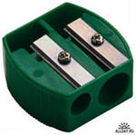



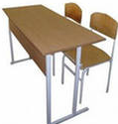
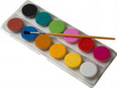

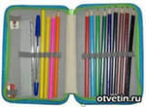
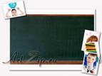

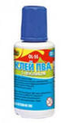
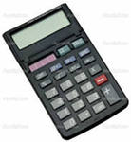

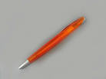

Slide 8
Let’ check up your answers. bag, ruler, pencil, paints, sharpener, textbook, workbook, calculator, pen, pencil-box, glue

Slide 9
Let’ check up your answers.
Pen, chalk, blackboard – write
Pencil – draw
Paints – paint
Eraser – clean
Sharpener – sharp
Textbook – read
Workbook, copybook – do homework
Calculator – count
Ruler – make lines
Glue – fix
Pencil-box – keep pens

Slide 10
“BOYS” “GIRLS”
I can … I will …

Slide 11
Break
Must - clap your hand
Mustn’t - jump at place

Slide 12
Конкурс
“Best reading"
1 Hello, we are English pupils Kelly and Bill.
2 We go to school in London.
3 We can read and write in English.
4 We can learn poems by heart.
5 We count in the Math lesson.
6 We can translate from Russian into English.
7 We like to go to school.

Slide 13
Конкурс
“Do you understand me?"
Қысқаша әңгіме оқылады. Оқушылар не түсінді оны қағаз бетіне сурет түрінде түсіреді
Jane is an English girl. She lives in the country. Jane has three pets. She likes them very much. They are cats. Their names are Sooty, Smoky and Tiger. One is white, one is black and one is black and white. The name of the white cat is not Sooty is not black and white, and Tiger is not black and white.

Slide 14
Рефлексия
"Жетістік" баспалдағы
Сабақ соңында қатысушылар баспалдақтың қай тұсында тұрғанын белгілейді, түсініктеме береді.
мен барлығын түсінгеніме сенімдімін.
мен барлығын түсінгеніме жартылай сенімдімін.
мен қайталауды қажет етемін.
мен ештеңе түсінбедім.

