Slide 1
Our place in space
Muravjova Varvara, Class 4A

Slide 2
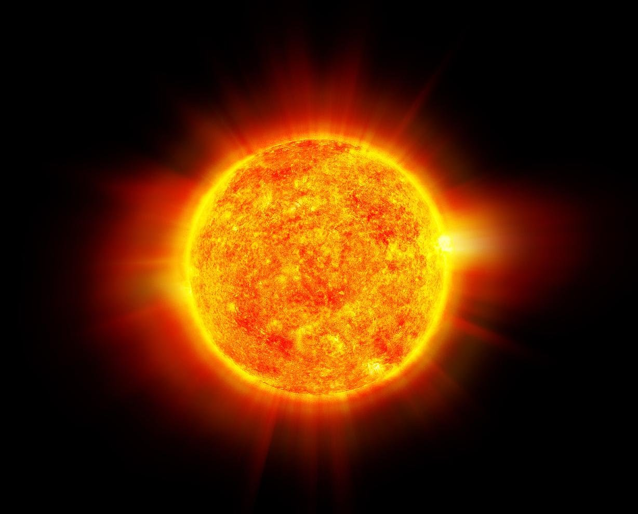
Earth gets light, heat and energy
from the Sun.

Slide 3
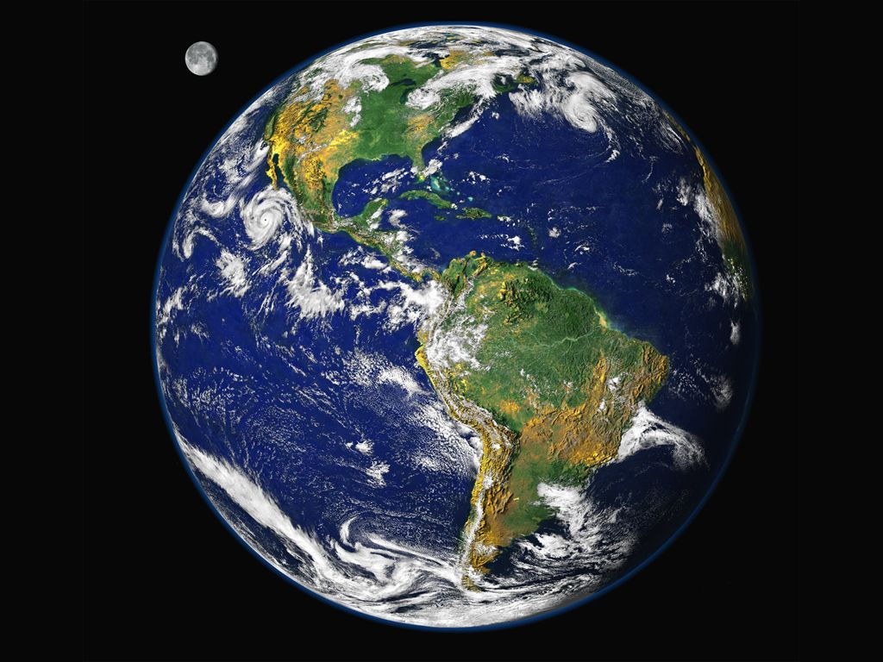
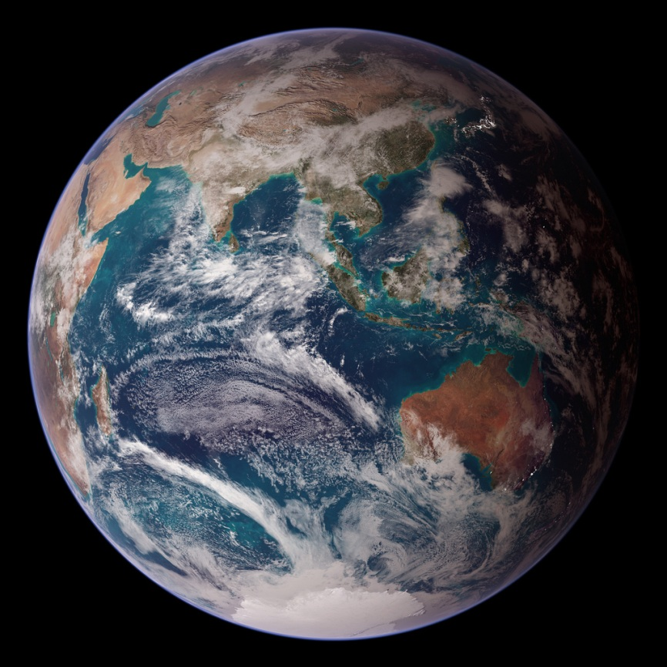
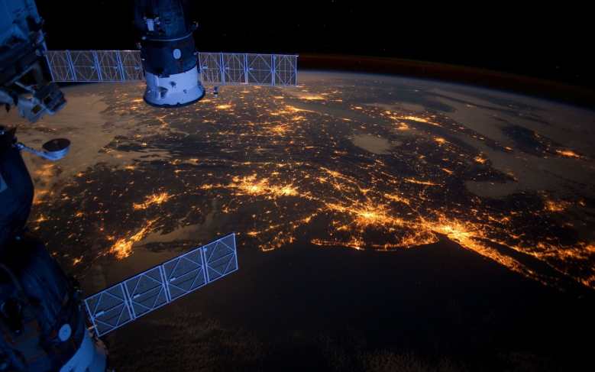
Scientists take photos of Earth from space.

Slide 4
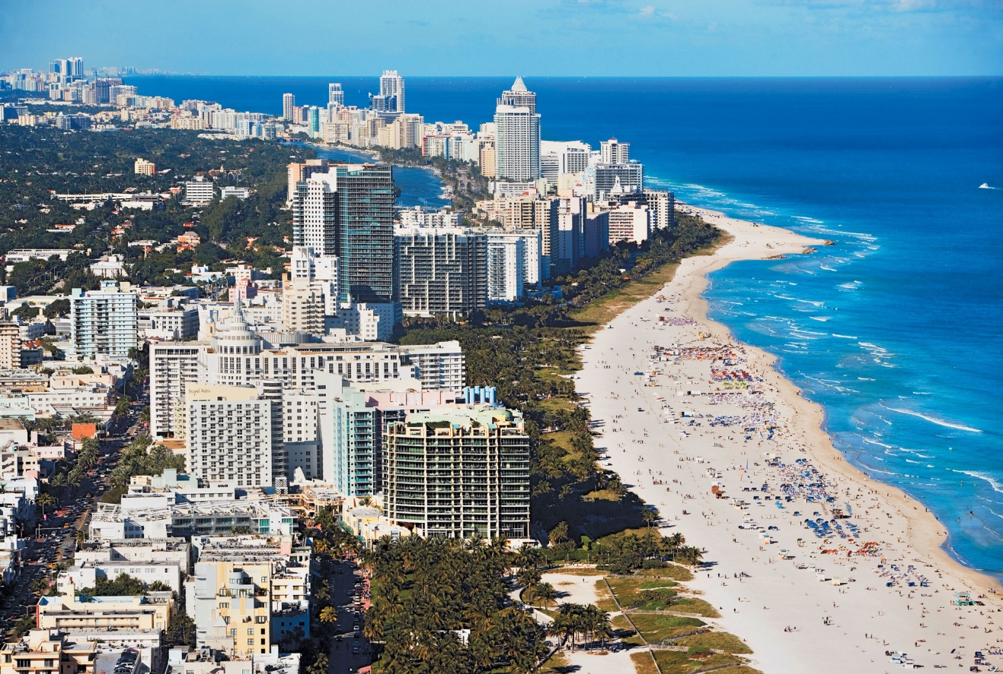
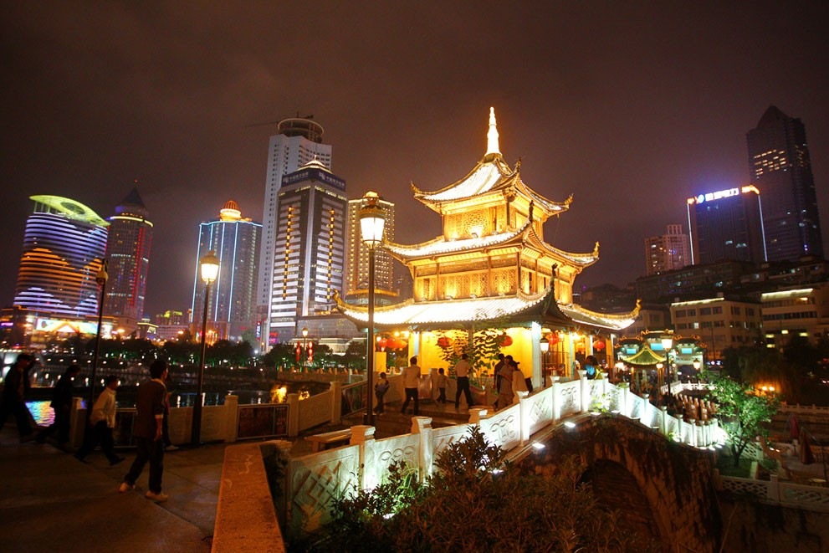

Slide 5
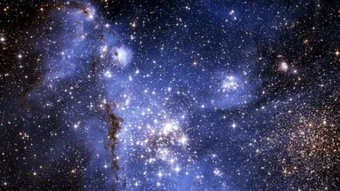
Stars are hot balls

Slide 6
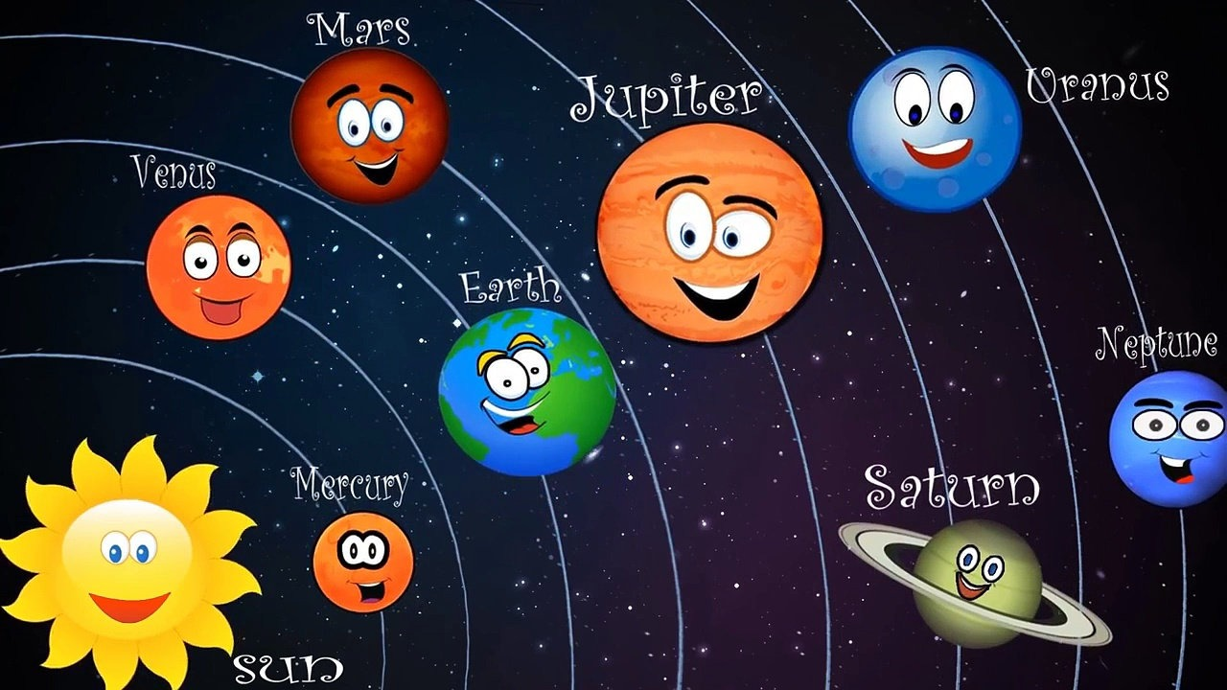
The Sun is the center of our solar system. All its planets revolve around it.

Slide 7
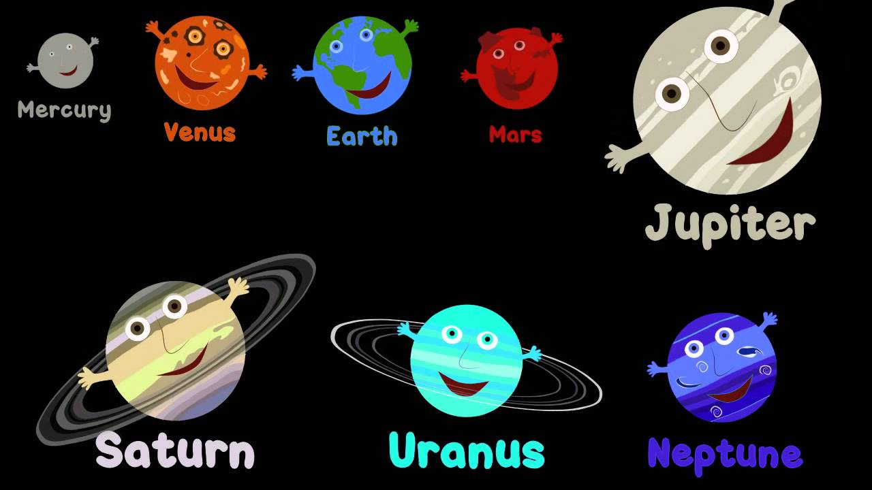
Our Neighbors

Slide 8
Thank you for your attention!!!

