Slide 1
«The Paralympic games»

Slide 2
Phonetic Exercise.
ing
Skating, cycling, swimming, sailing, boxing, skiing, fishing, windsurfing.

Slide 3
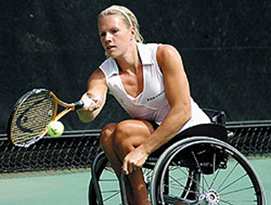
COMPLETE THESE COLLOCATION LIST WITH EITHER DO/GO/PLAY
go
A) ___ cycling (fishing)
B) ___ athletics (judo)
C) ____ basketball (golf)
Play is often used with sports that are team games, or where we play with another person. Go is often used for things done outside and which we can do alone. These sports often end in –ing.
do
play

Slide 4
COMPLETE THE FOLLOWING SENTENCE BEGINNINGS WITH THESE COLLOCATIONS TO MAKE SENTENCES ABOUT YOURSELF.
I often…
I sometimes…
I don’t…
I’d like to…

Slide 5
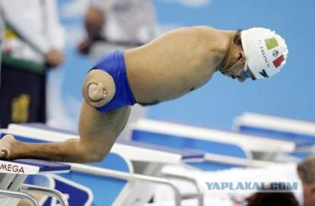
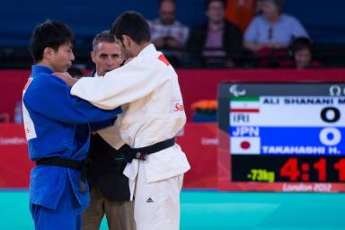
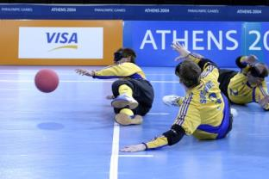
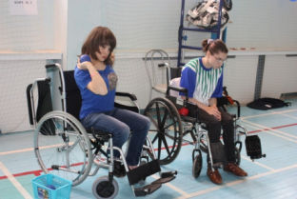
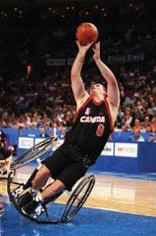
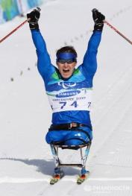
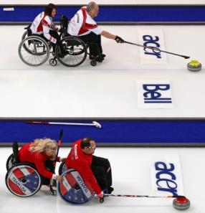
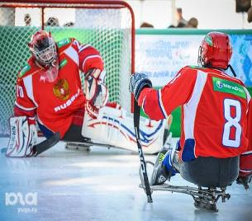
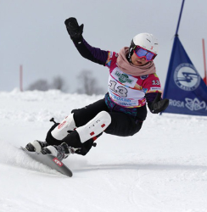
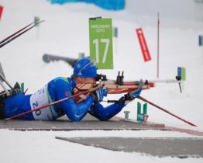
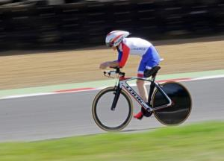
swimming
goalball
boccia
judo
skiing
Paralympic games
basketball
curling
hockey
snowboarding
biathlon
cycling
Who are these games for?

Slide 6
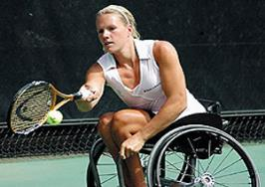
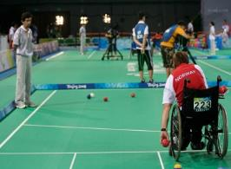
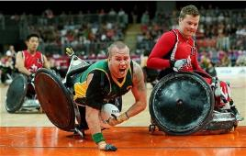
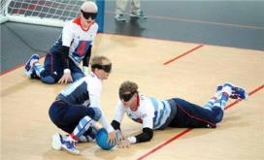
Read the stories about three of the sports and match them to the picture.
Tennis
1.Men and women athletes with a physical disability can participate in it. It is combination of rules and skills required in basketball and rugby.
Boccia
2. It is a sport for people who are wheelchair users. It is played in indoor halls. The players throw the coloured balls as closer as possible to a white ball.
Wheelchair rugby
3. It is a team sports in which only blind athletes can participate. It is played on a volleyball ground with a ball which has a bell inside.
Goalball

Slide 7
What do you think about the Paralympic Games? Is it necessary for disabled athletes to participate in them? Why? Why not?
I think the Paralympics are necessary.
They give an opportunity to...
Sport develops...
Sport helps...
It teaches...
I don’t think the Paralympics are necessary.
On the one hand...
On the other hand sport needs...

Slide 8
Nothing succeeds like success.
Good bye.

