Slide 1
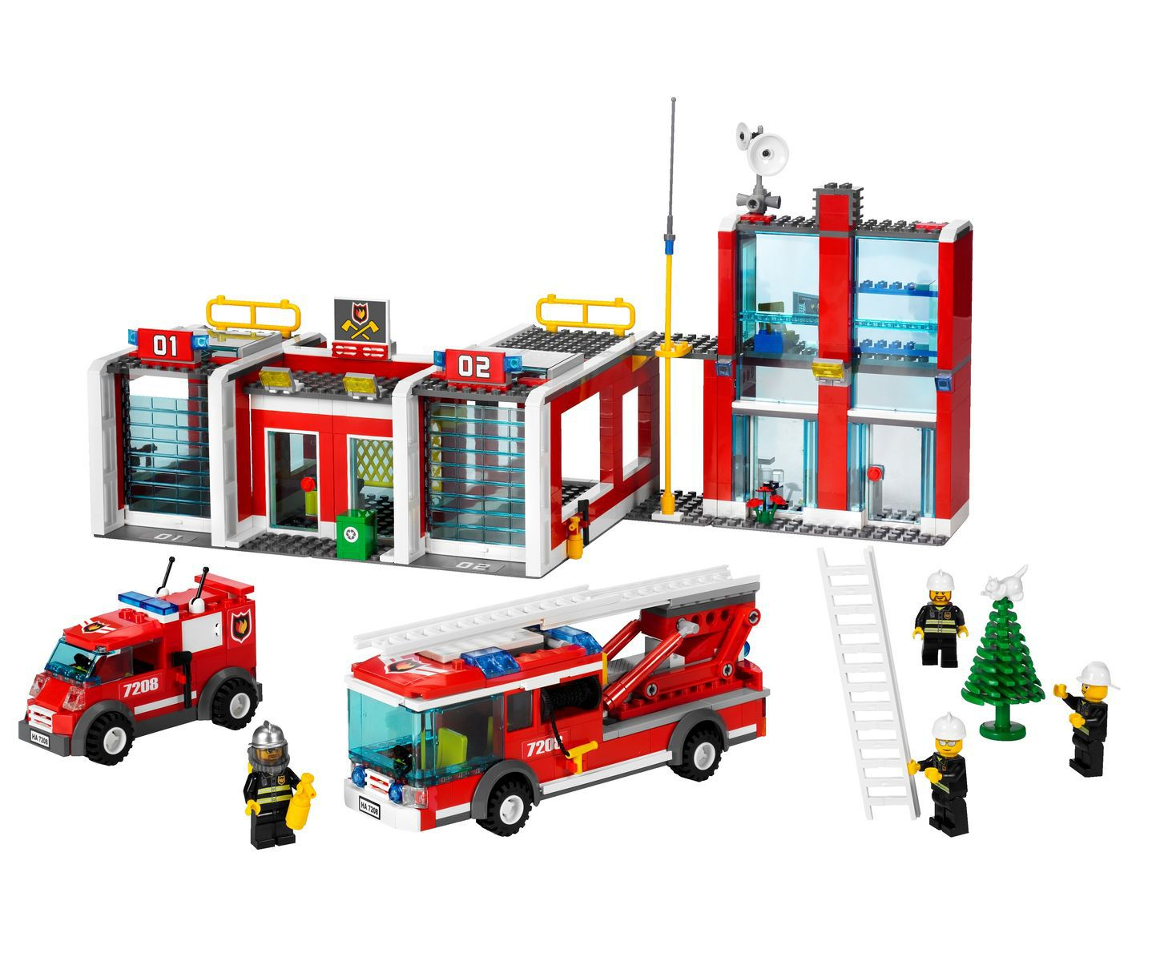
AT THE TOY SHOP

Slide 2

THEY ARE MOTHER, BROTHER, FATHER
brother
mother
father

Slide 3
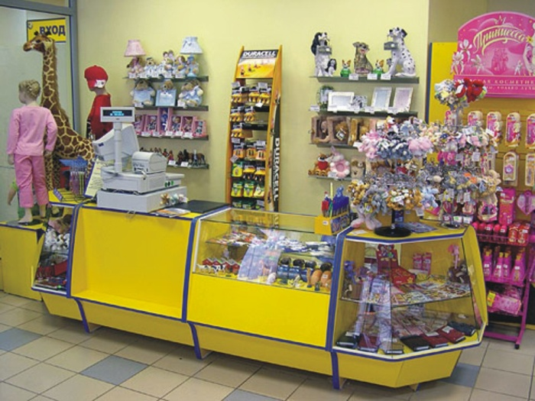
AT THE TOY SHOP

Slide 4
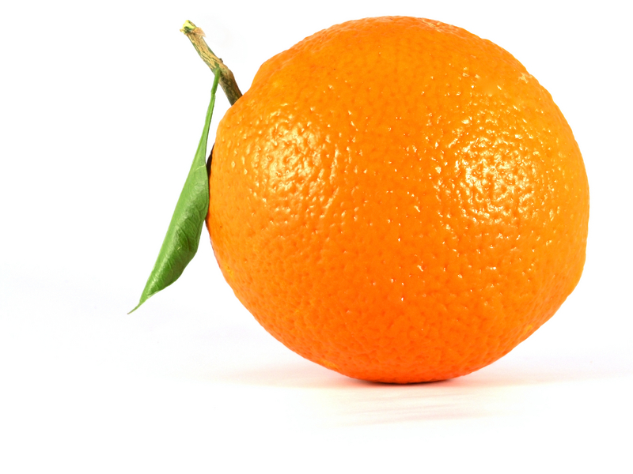

Slide 5
THIS ORANGE

Slide 6
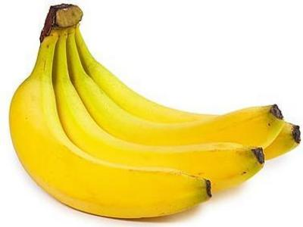

Slide 7
THOSE BANANAS

Slide 8
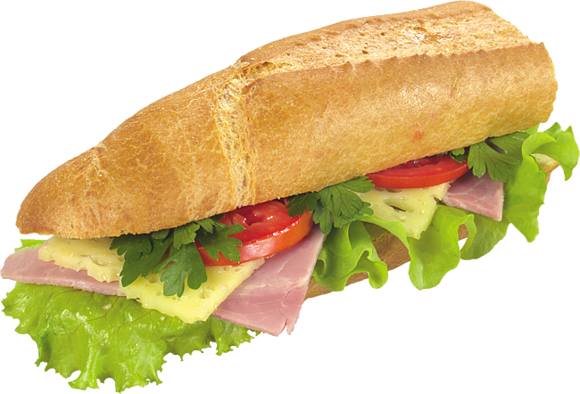

Slide 9
THIS SANDWICH

Slide 10
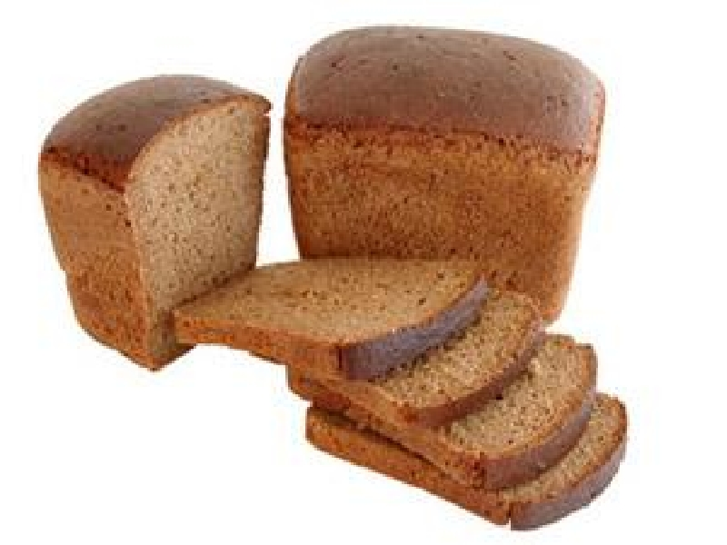

Slide 11
THAT BREAD

Slide 12
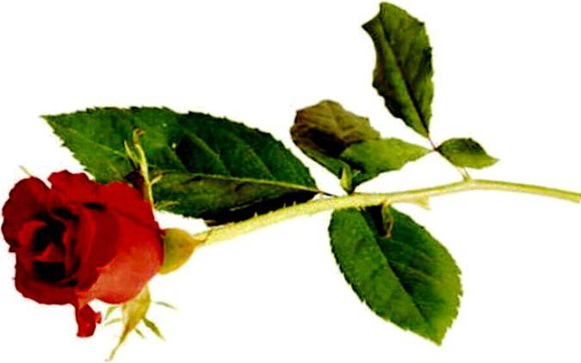

Slide 13
THIS ROSE

Slide 14
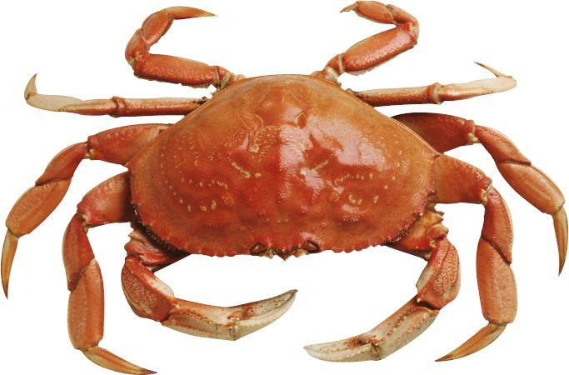

Slide 15
THAT CRAB

Slide 16
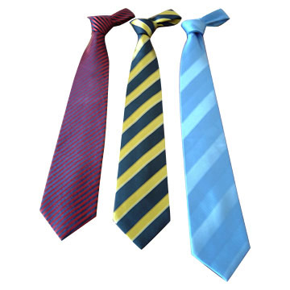

Slide 17
THOSE TIES

Slide 18
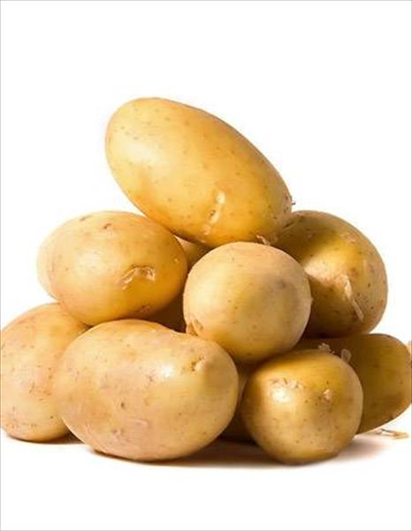

Slide 19
THESE POTATOES

Slide 20
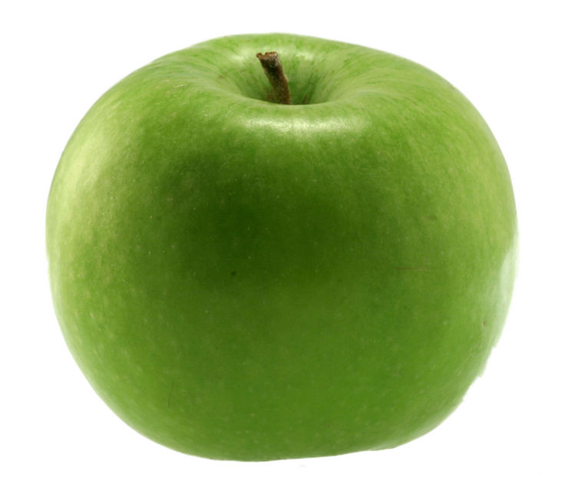
A GREEN APPLE

Slide 21
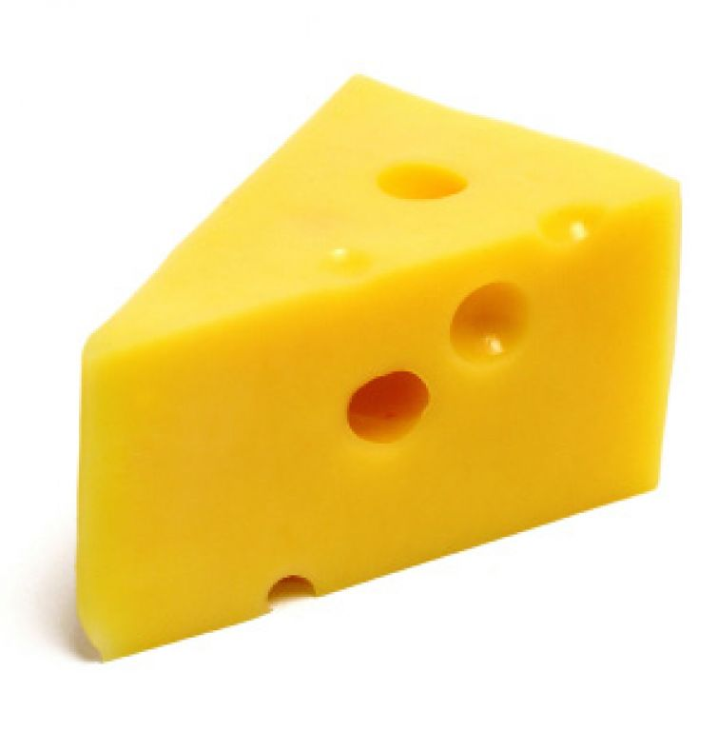
YELLOW CHEESE

Slide 22
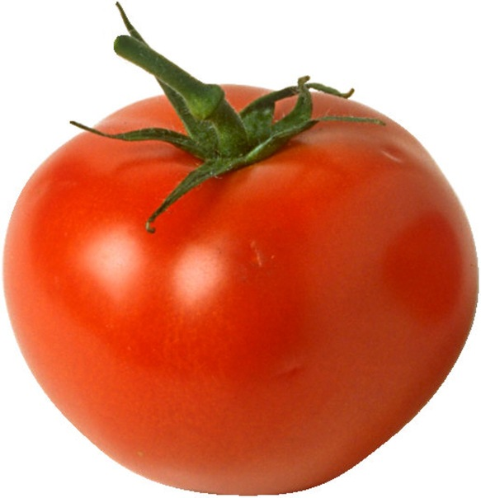
A RED TOMATO

Slide 23
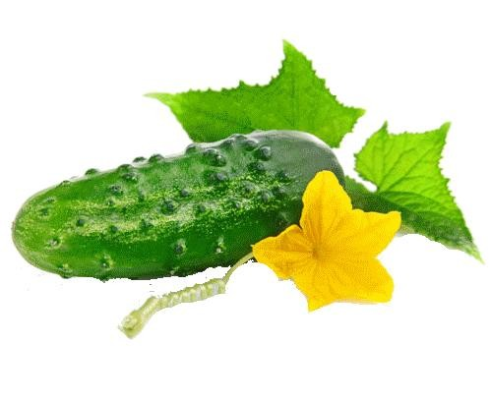
A GREEN CUCUMBER

Slide 24
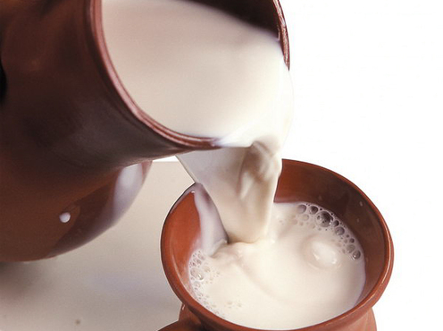
WHITE MILK

Slide 25
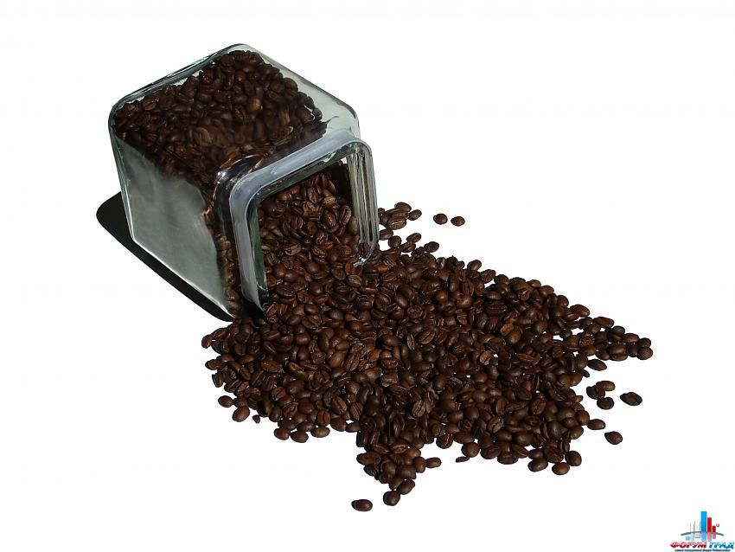
BROWN COFFEE

Slide 26

IT`S … .
WHAT COLOUR IS THE … ?

