Slide 1
МАОУ СОШ №37
Проект на тему : «Американская и Английская еда . Что общего и в чем различие?»
Учеников 5 «Б» класса :
- Лязгин Максим
- Куропатская Елизавета
- Белобородова Анастасия
- Зарипов Александр
- Петрачёв Данил
Научный руководитель – учитель английского языка Гостюшкина Светлана Евгеньевна.

Slide 2
Traditional English food
Traditional English food has been greatly influenced by other national cuisines n recent years.Despite this fact , if you travel to English , you can still be served up traditional English dishes in a restaurant or at a hotel.
A typical English breakfast is usualy quite big and substantial. It inludes pork sausages, bacon and eggs , tomatoes, baked beans, mushrooms and a toast. Some people enjoy porridge ,fruit and yogurt in the morning, followed by a toast and jam, or orange marmalade. A traditional breakfast

Slide 3


Slide 4
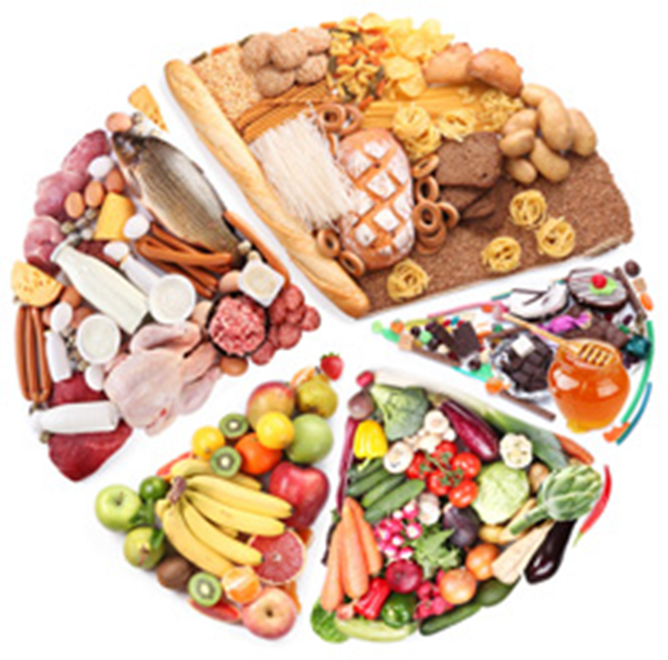
Drink is tea, which British people prefer having with cold milk. Another popular morning drink is orange juice.

Slide 5

For many Englishmen lunch is a fast meal. In big cities there are a lot of sandwiches bars where office clerks can choose all sorts of sandwiches with meat, fish, chicken, ham, prawns, eggs, cheese, vegetables and lettuce. English pubs also serve good food for lunch, hot and cold. Quite a lot of workers go to famous «fish and crisps shops>> and buy their favourite deep fried cod or haddock with French fries.

Slide 6
A lot of Englishmen drink their 5 oclock tea. It’s a traditional light meal after work. People enjoy their favourite teas with cookies, cakes, freshly baked sweet buns, scones and other pastries.
British people eat their evening meal at about 7 oclock , when all members of the family are at home together. As a rule, a typical dinner is meat and vegetables. It can be roast chicken or lamb with potatoes, or steamed vegetables with meat gravy. For desert, English wives cook various puddings and serve them with ice-cream or jam.
On Sundays British families like to sit together at the table enjoying roast beef, lamb or chicken, served with Yorkshire pudding and dressed with English mustard, apple sauce or mint sauce
English food is simple but very delicious. Today it continues to marge in national cuisines from all over the world

Slide 7
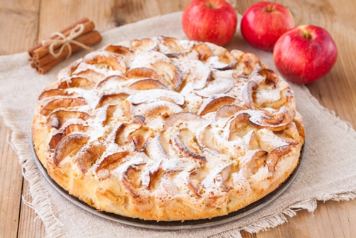

Slide 8
Fast food-unhealthy food
The term “fast food” was first mentioned by a publishing company Merriam-Webster from the United States of America in the middle of the last century . It was given to hot meals served in small outlets or stands, located in the crowded urban areas. They did not have any shelter from rain or tables with some seats around them, because sandwiches and crispy potatoes were not supposed to eat at the place. They were packed as “take-away” to eat “on the go” or in a car. Such restaurant as McDonalds, Pizza Hut, Celentano, KFC Fast are known as the best fast food places, where people can have a meal and enjoy their staying there. Tasty food, affordable prices, cozy seating places, nice music, stylish decorations and additional conveniences make those restaurants very popular. There is an opinion that fast food is unhealthy and must be forbidden. Children and teenagers love hamburgers and french fries so much that they become addicted to them and ready to eat them all day and night! This is a rapidly digestible kind of food and in a short period after the meal, people feel hungry again. As a result, they consume more calories than it is prescribed as the day norm. In combination with low physical activities, such an unhealthy diet leads to overweight and obesity. In my opinion, fast food is an extremely unhealthy diet. It causes some extra weight and health problems. That is why it is a big risk to eat such dishes every day. Firstly, ingredients that were processed, cooked and stored in a refrigerator have much lower concentration of useful substances (vitamins and minerals) than in fresh food. Moreover, nutritional supplements can damage a stomach. Synthetic preservation agents can lead to nephrolithiasis, intestinal and blood pressure disorders, and allergic reactions. Such a common preservative as E 211 destroys the liver, disrupts the nervous system, and in combination with vitamin C causes cancer. Secondly, bread, meat and fat are a hazardous combination. The indigestion system works hard to comsume proteins, carbohydrates and fats at the same time. All that is accompanied by such symptoms as heaviness in the stomach and intensive intestinal gases. Thirdly, inappropriate storage conditions or violation of sanitary norms may also lead to poisoning with headache and nausea. In some cases, it may result in the necessity of medical treatment. Clients are not capable to control such issues as breakage of the refrigerator, contact of the food with insects and inappropriate hygiene of the personnel. To sum up, it is undisputable that fast food must be excluded from the everyday diet.

Slide 9
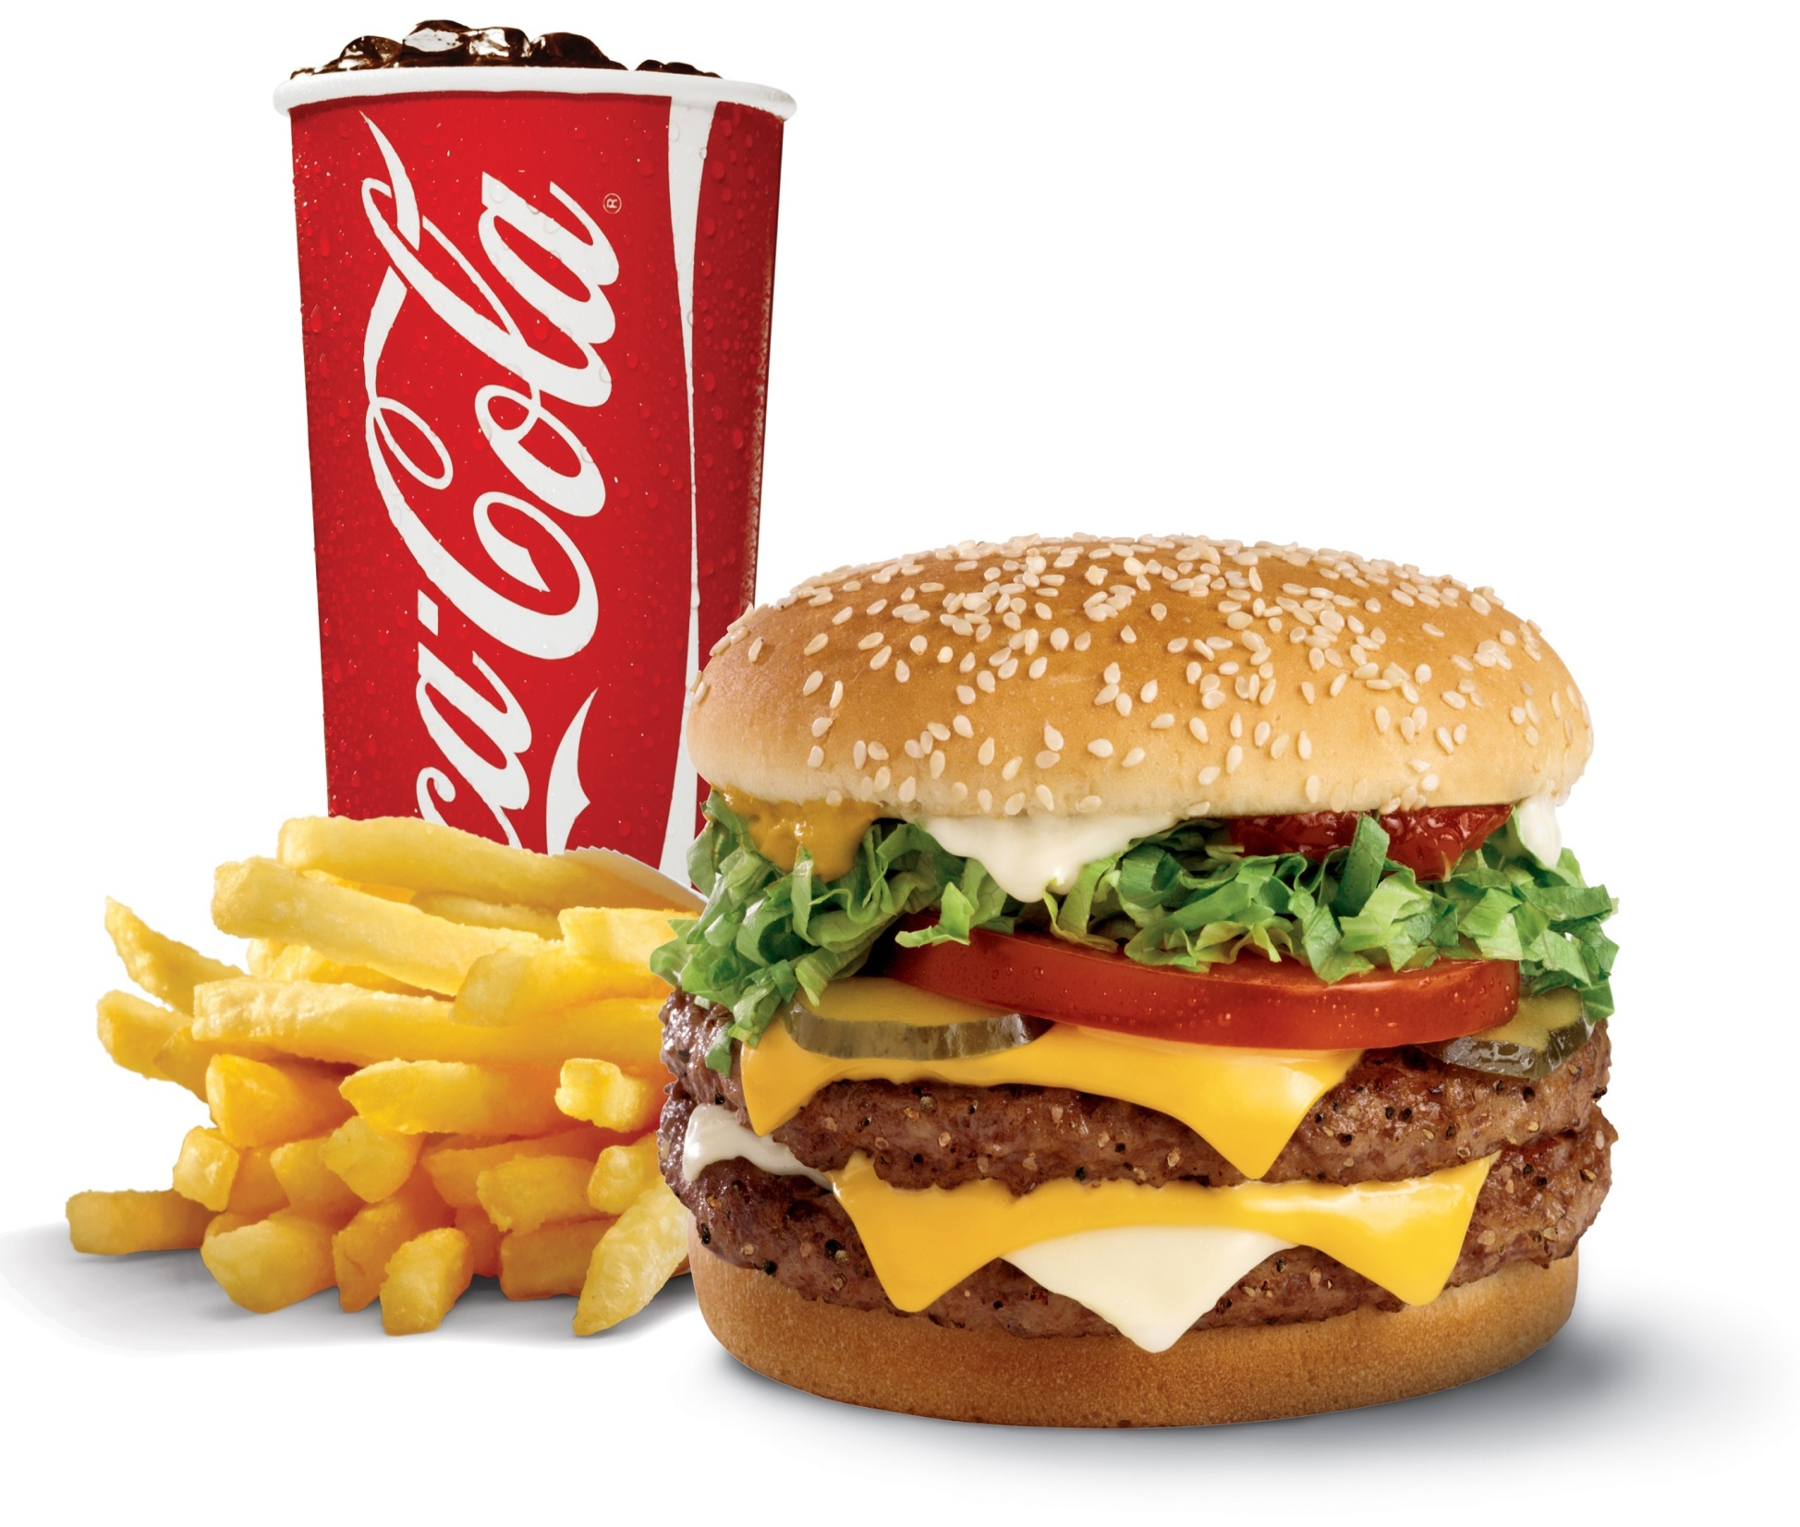

Slide 11
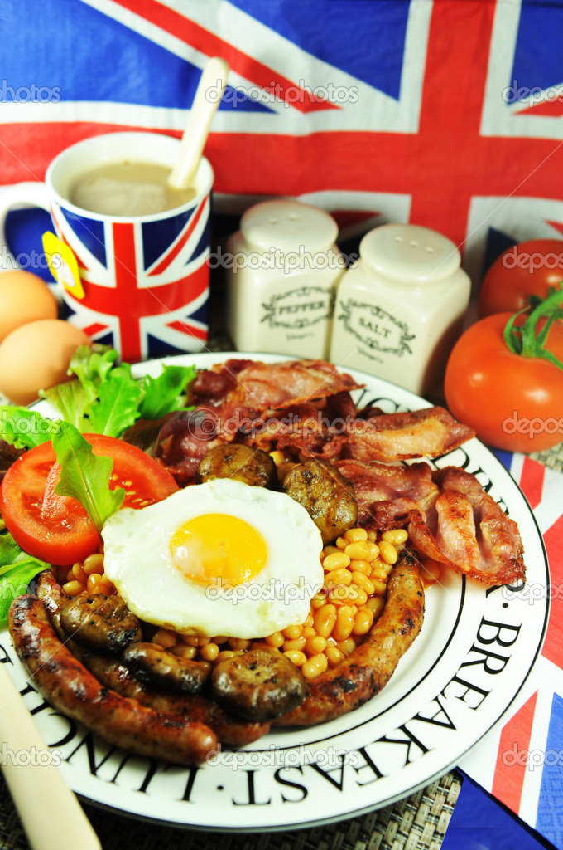
English and American food
Traditionally English people have three meals a day: breakfast, lunch and dinner

Slide 12
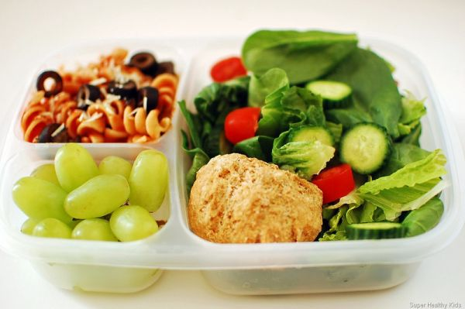
breakfast
Britain’s most popular breakfast consists of cereal, toast with marmalade, juice and yogurt with a cup of tea or coffee

Slide 13
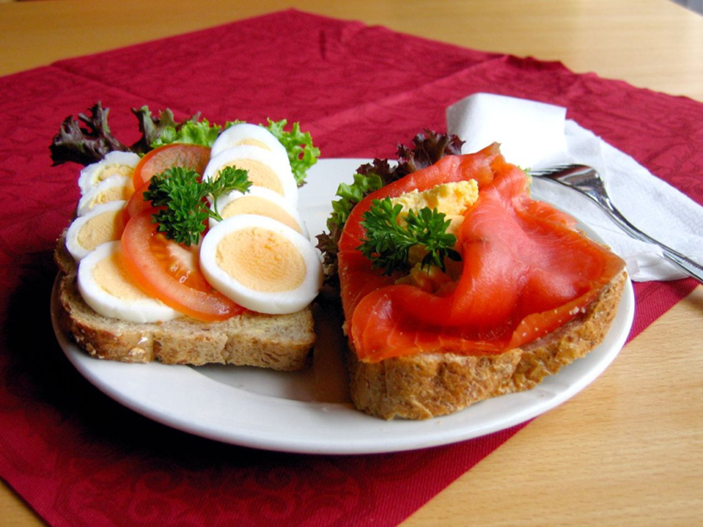
lunch
Lunch is a light meal

Slide 14
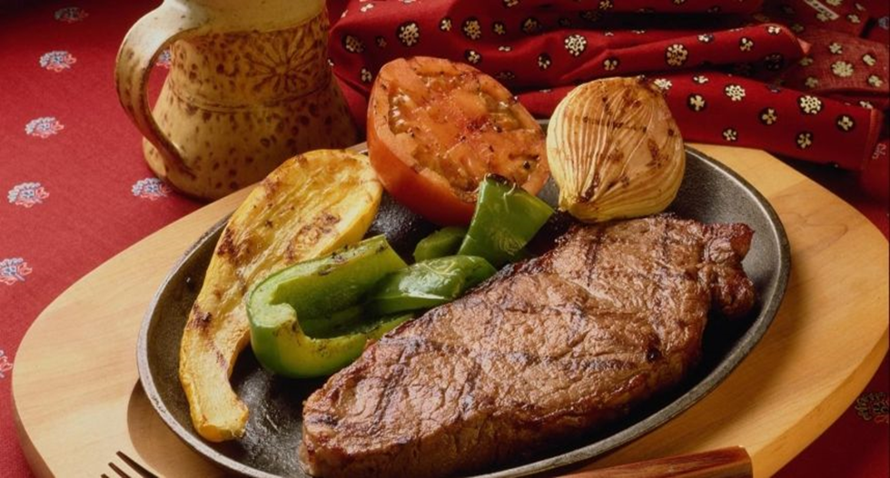
dinner
The main meal is dinner, which is usually between 6 and 7 p.m.
A typical evening meal is a meat dish with vegetables and desert

Slide 15
Some dishes
British people like chicken, fish, cheese, Yorkshire pudding, ginger cookies.
Americans eat a lot.
May be the US is most famous for “fast foods”
They like hot dog, hamburger, apple pie, corn dogs, grits, Fritos, Red velvet cake, Coca-Cola
Most Americans now have a light breakfast, instead of traditional eggs, bacon, toast, orange juice and coffee.

Slide 16
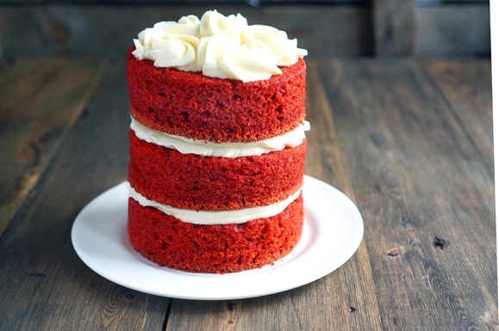

Slide 17
USEFUL FOOD
SPINACH AND OTHER GREEN VEGETABLES
Vegetables-useful food that "head to toe" packed all the important and necessary nutrient for the body. For example, only a single serving of spinach provides the body with a daily dose of vitamin A and vitamin c. half it also contains folate-vitamin that protects against heart disease, stroke and colon cancer. Broccoli is high in fiber and more packed with vitamins and minerals than any other food. If you're furious hater ' green ' then simply hide them. Make vegetable puree and add it to any sauce. The smaller nashinkuete, the less taste, and so it is easier for the body to absorb nutrients.

Slide 18
BUNTING
Oatmeal is another useful food that you can eat for breakfast to arm yourself with the necessary energy for the whole coming day or two hours before a workout to give themselves the necessary strength for the exercise. For convenience you should buy oat flakes, but unsweetened and nepripravlennye. For enhancing the taste of milk and use all sorts of berries. Oatmeal contains soluble fiber, meaning that it attracts fluids and remains in the stomach longer than insoluble fiber (such as vegetables). Soluble fiber reduce cholesterol in the blood by interacting with the digestive acid (which is made from cholesterol) and removing it from the body. When this happens, the liver must withdraw cholesterol from the blood, to reduce the levels of digestive acids, and cholesterol.

Slide 20
WHOLE-GRAIN BREAD
People always craves carbs, because the body needs them. The main thing to consume those who were less processed-carbohydrates, in which the fibers remain intact. Grains, like wheat, corn, oats, barley, rye is seeded cereals and is divided into three parts-germ, bran and endosperm. Endosperm surrounds the germ and nutritionally adequate, is hopeless. It contains starch, a little protein and certain vitamins. Sprout is a small part of the grain. While it is small, it has a great nutritional power. Rostock contains proteins, oils and vitamins B-thiamin, riboflavin, niacin and pyridoxine. It also contains vitamin e and minerals-magnesium, zinc, potassium and iron. Bran is the third part of the grain and the part where all the fiber. This cover around grain which contains b vitamins, zinc, calcium, potassium, magnesium and other minerals.

Slide 21
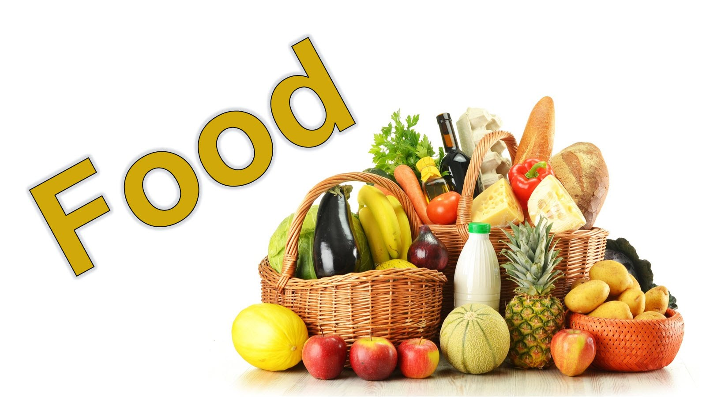
ALMONDS AND OTHER NUTS
nuts-our saviors and healthy food! They contain monounsaturated fats, which purify arteries and help you feel full. All nuts contain a lot of protein and monounsaturated fats. But almonds-King of nuts. Eating two handfuls a day this useful food (approximately 50 grams of almonds), you can suppress your appetite, especially if you send them into your stomach along with the quarter litre of water!

Slide 22
American Cuisine
American food is definitely multinational, just like its population. People from other countries when arriving to the USA brought with them their national recipes. So, now all American food is partly Italian, partly Greek, partly Jewish, partly Chinese, partly French, etc. Very often traditional American food is associated with fast food, including hamburgers , French fries, hot dogs, pizzas and some other quick and easy-made dishes Another American traditional involves salad bars. Many restaurants offer them to their visitors. The main rule of salad is to pay one price

Slide 23
and eat as much as you want. Such national celebrations as Thanksgiving and Christmas I many families are followed by roast turkey or stuffed duck. Another traditional American food is doughnuts. However, they were brought to the USA by Dutch immigrants in the 19th century. One can find all sorts of doughnuts in American cafes. During the day Americans eat lots of ready-to-cook food. Breakfasts are usually light, with just a plateful of cereal and a cup of fresh-brewed coffee. For lunch some families eat fresh salads, sandwiches or tinned soups, which require simply heating. Dinner is the most nutritious meal. Traditionally families cook pasta or roast beef with rice, serve fresh salads, drink a glass of water, juice or wine and sometimes have a dessert with tea. Some families order a take-away food, such as pizza, sushi, Chinese food, etc.

Slide 24
