Slide 1

English cinema
Starygin Ivan , Kirichok Dmitriy , Harunghin Maksim ,Izvin Artem.

Slide 2
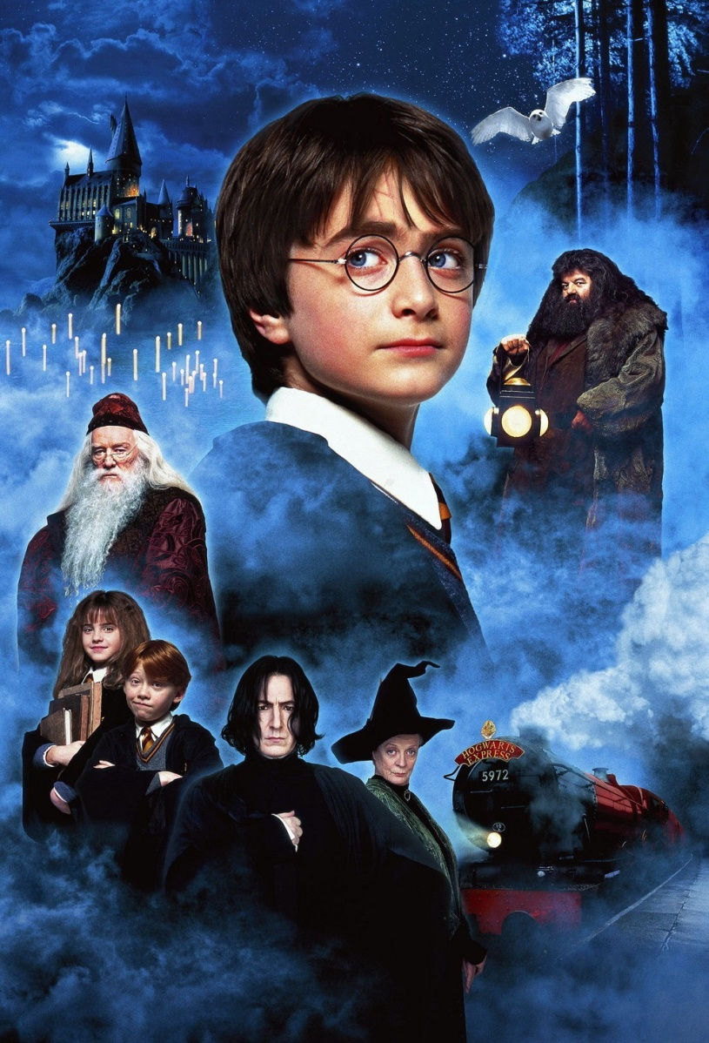
1. The actors of Great Britain and their roles
1. Daniel Radcliffe
2. Tomas Felton
3. Rupert Grint
4. Emma Watson

Slide 3
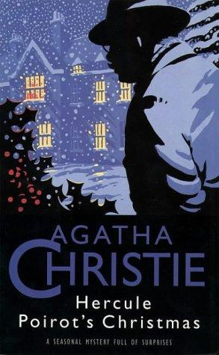


2. The first films of Great Britain

Slide 4
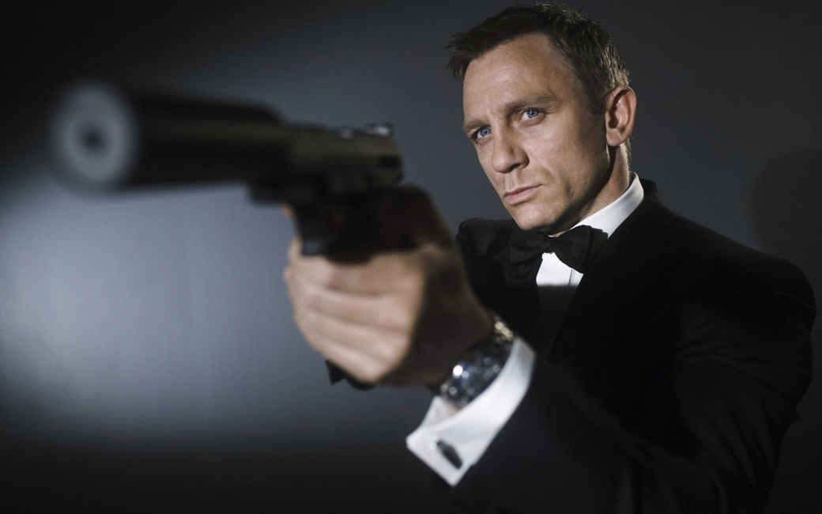
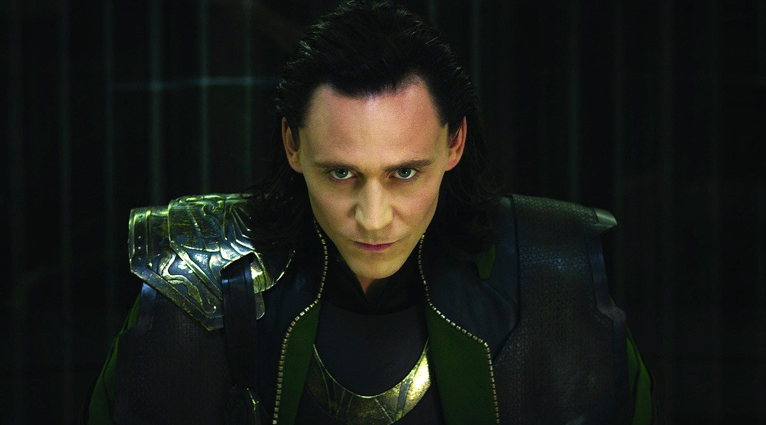
Actors of Great Britain
Tom Hiddleston (Avengers)
Daniel Craig (Agent 007)

Slide 5
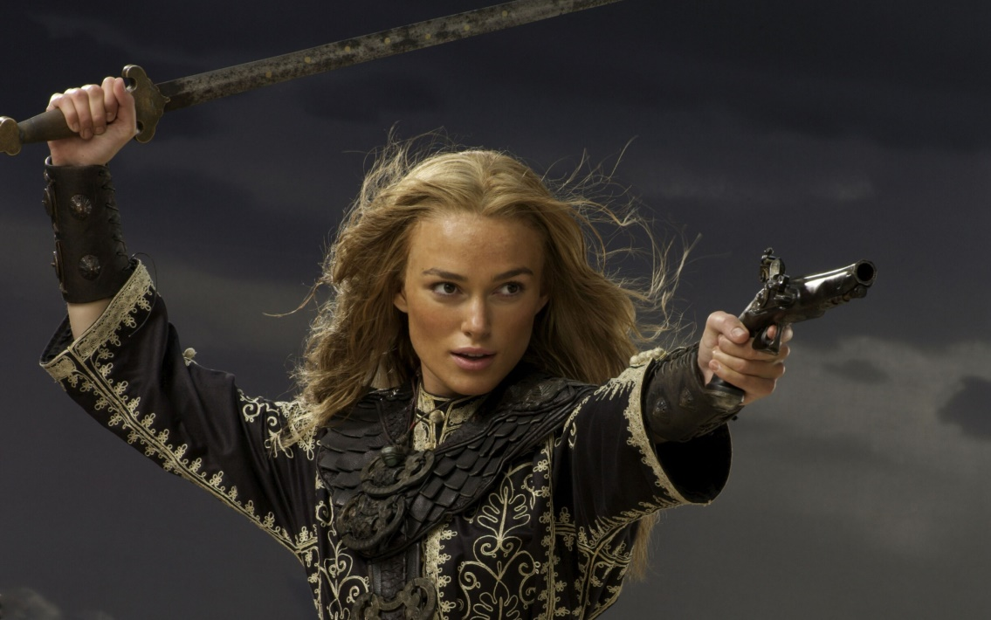
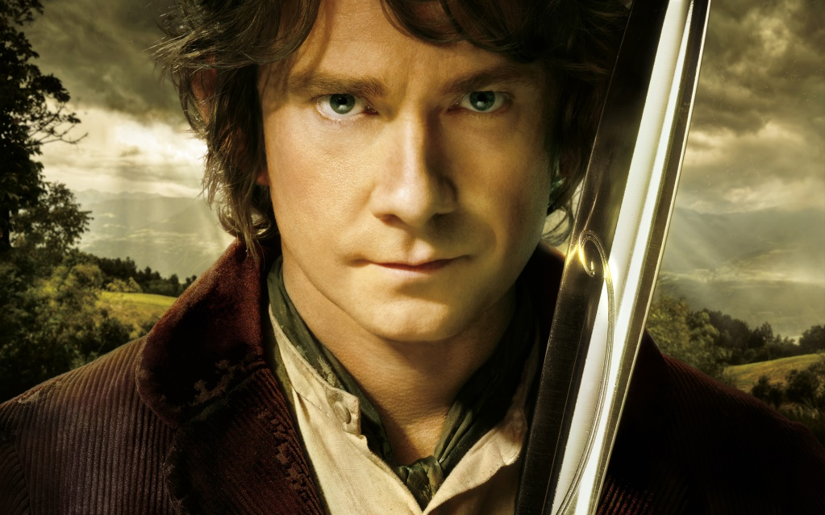
Actors of Great Britain
Martin Freeman(Hobbit)
Keira Knightley( Pirates of the Caribbean)

Slide 6
Very known the cinema actor Britain and theirs roles
Part 2

Slide 7

How would Hollywood be without British talent? Without English restraint and at the same time recklessness?
Perhaps, since the time of the great Shakespeare, the school of theater in Great Britain has been put on a higher professional level than anywhere else. At a time when American actors are becoming stars by chance (the producer noticed at the bank / restaurant / on the street and offered work)

Slide 8
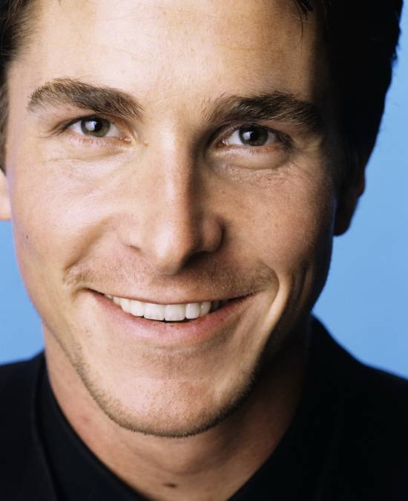
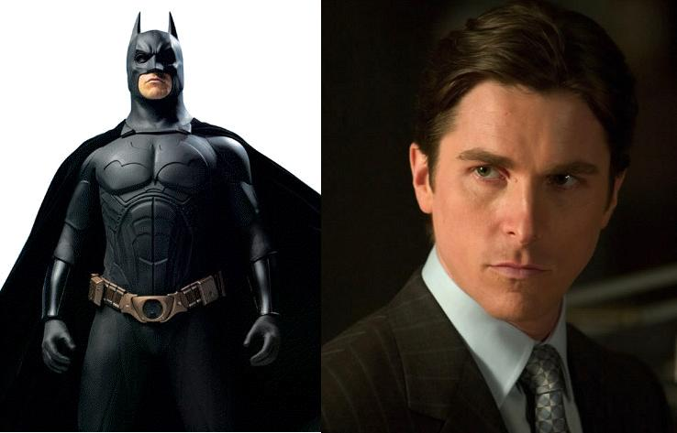
Christian Bale
Chris was born in Wales on January 30, 1974. Already at the age of 13, the boy attracted attention in Spielberg's "Empire of the Sun" (1987). In 2000, Bale played a serial maniac in the movie "American Psycho". In the Batman trilogy, Nolan Bale was honored to play in all three films of the Dark Knight Batman himself. The role of Dickie Eklund in the movie "The Fighter" brought Christian Oscar, Golden Globe and the award from the Screen Actors Guild for the role of the second plan

Slide 9
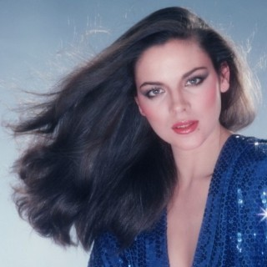
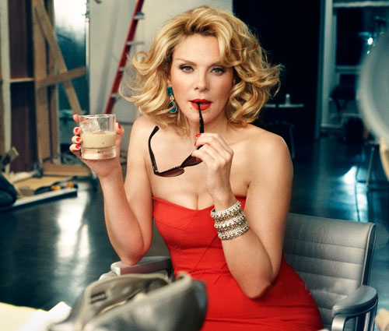
Kim Cattrall
She became famous thanks to the movie "Police Academy" of the 80s.

Slide 10
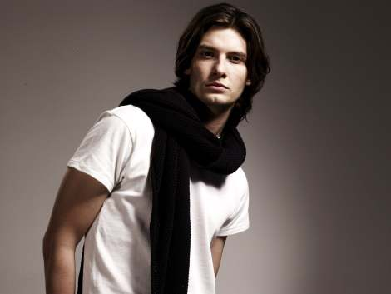
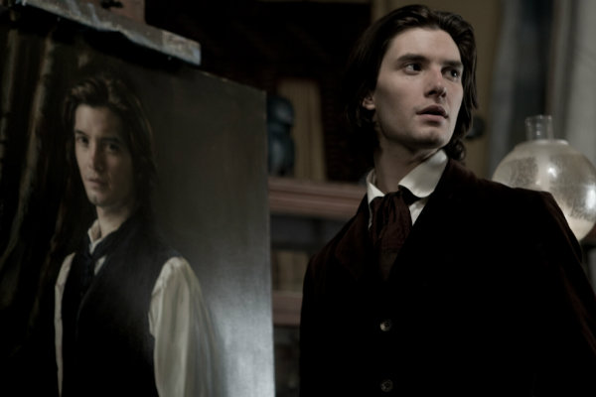
Ben Barnes
Ben was born in London on August 20, 1981. He became famous after performing his role as Prince Caspian in the film "The Chronicles of Narnia."

Slide 11
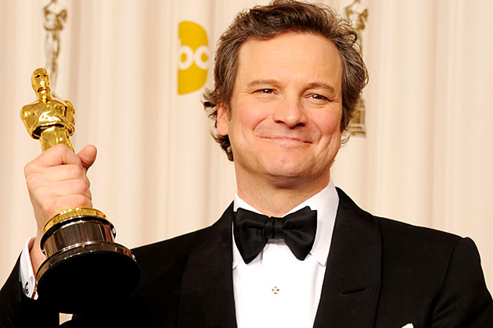
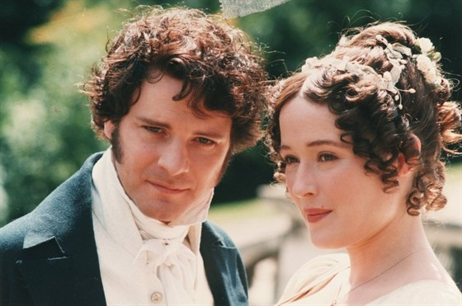
Colin Firth
A sample of a man full of dignity, a true gentleman. His roles in such films as "The English Patient", "Shakespeare in Love," "The Diary of Bridget Jones," "What the Girl Wants", "Mama Mia!", "Portrait of Dorian Gray", brought Colin an unprecedented worldwide fame. And the role of King George VI in the movie "King says" has resulted in such awards as BAFTA, the Screen Actors Guild Award and, of course, Oscar! Man of dreams!

Slide 12
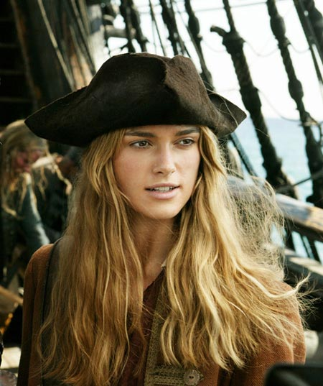
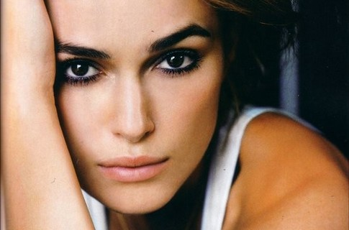
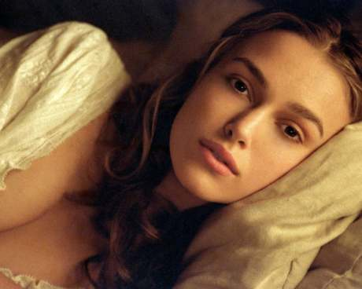
Keira Knightley
March 26, 1985 in London was born "princess of pirates." Almost all her works have become world famous: She starred in the films "Play as Beckham", "Pride and Prejudice", "King Arthur", "Pirates of the Caribbean", "Real Love.

Slide 13

New!!!
The British kinomatografist will release continuation of the cult and most cash documentary about the wild nature ''Planet Earth 2"

Slide 14

On official YouTube BBC channel the trailer of the most expensive documentary which shootings lasted for 10 years has been published. The picture will become continuation of the epic serial film released in 2006 and which has beaten all mysimy world box office of 109 million dollars.

Slide 15

Premiere 2018!
To the word the record sum of 16 million pounds sterling, or 19.5 million dollars has been spent for shootings. In the movie it was told about unique and a little noticeable corners of Earth. This time it will be a question of fauna of our planet. The premiere of the film is planned for 2018.

Slide 16
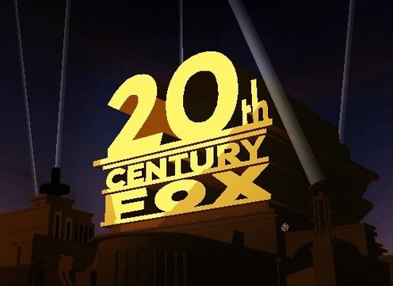
20th Century Fox Film Corporation
One of six largest American film studios which is subsidiary 21st Century Fox. Is engaged also in production of television movies.
The company is founded on May 31, 1935 [1] as a result of merge of two studios: Fox Film Corporation founded in 1915 by William Fox, and Twentieth Century Pictures, founded in 1933 by Daryll F. Zanuk, Joseph Schenk, Raymond Griffith

Slide 17

Intermedia Films
The company was founded in 1995 as Intermedia Film Equities in London. Two years later, Intermedia began operations in Los Angeles, as did Pacifica Film Distribution, which would later merge with Intermedia.
Its first success of note was Sliding Doors, starring Gwyneth Paltrow, opened the Sundance Film Festival.
In 2000, parent company IM Internationalmedia AG held an initial public offering of its stock on the New Market. That year, it won a Golden Globe for the film Nurse Betty. In 2001, the company acquired the library of Lawrence Gordon's studio, Largo Entertainment, with Warner Home Video acting as distributor, and also produced films such as K-PAX and The Wedding Planner.

