Slide 1
Education in
Great Britain
Выполнили:ученицы 6«В» класса
МАОУ СОШ №37
Полякова Рената и Пилипенко Яна

Slide 2
Цели и задачи
Цель:узнать больше об образовании в Великобритании
Задачи:найти достаточно информации об образовании,о школах в Великобритании

Slide 3
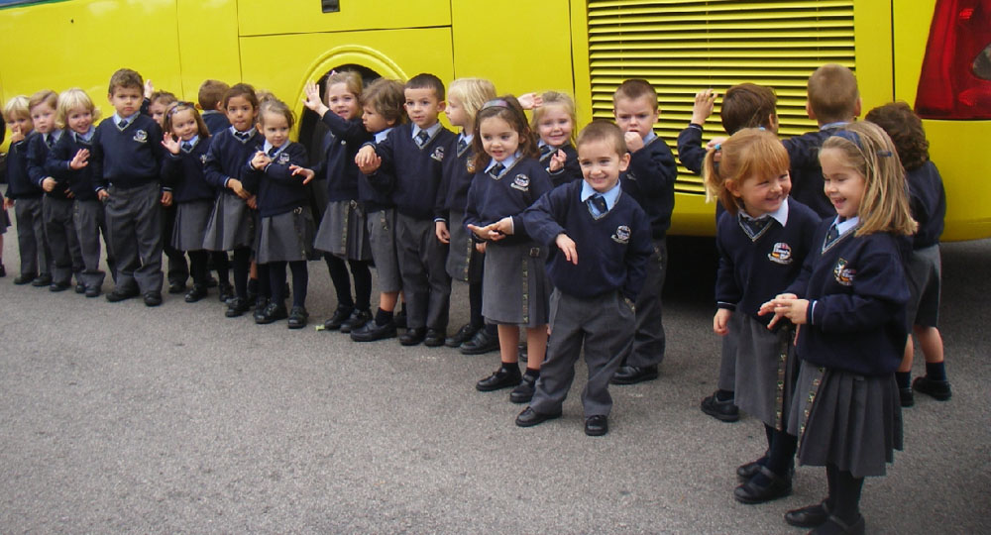
Primary school

Slide 4
Reception class
The child starts going to school in England very much early - from 4 years. The first year at school is called reception class and actually is preparatory before the first class (Year 1). At some public schools there are also kindergartens (nurseries) where accept children since three years

Slide 5
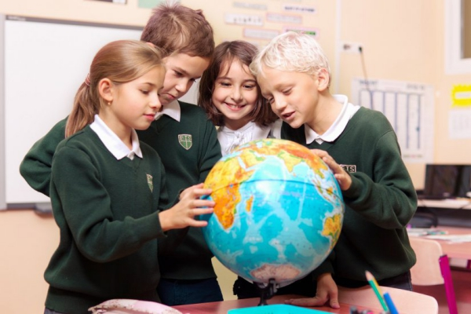

Slide 6
Your child can pass reception class and go to school one year later, since five years. But to wait up to 6-7 years as in Russia you have no right if you don't want to have problems with social services
But you shouldn't be afraid to send the child to school so early - in fact, the institute of elementary school in England performs functions of kindergarten: during the day children play much, walk in the open air, draw, sing and participate in other creative processes. Marks in the first classes aren't given here, lessons on the house aren't set. Often it is possible to learn "progress" of the child only having talked to the school teacher

Slide 7
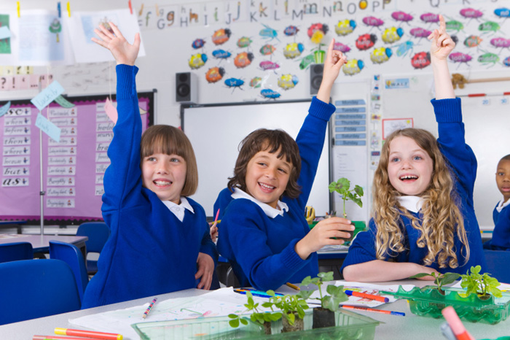

Slide 8
Primary schools in Great Britain: private and public schools
Primary schools in Great Britain happen state and private. At private schools the cost of training can reach several tens of thousands pounds a year. It isn't simpler to arrange the child in prestigious private school at all, and at times even more difficult, than in good state. Often in them get in a queue right after the birth of the kid to be in time by the time of approach of school age. Some future parents are in all seriousness dissatisfied that schools don't allow to get in a queue while mother is still pregnant: therefore in the first day of appearance of the kid on light the happy father instead of celebrating this joyful event, rushes to get run in a queue on the waiting list of desired school.
If the budget of a family doesn't allow suit the child in good private school, then parents should make the choice among free public schools.

Slide 9
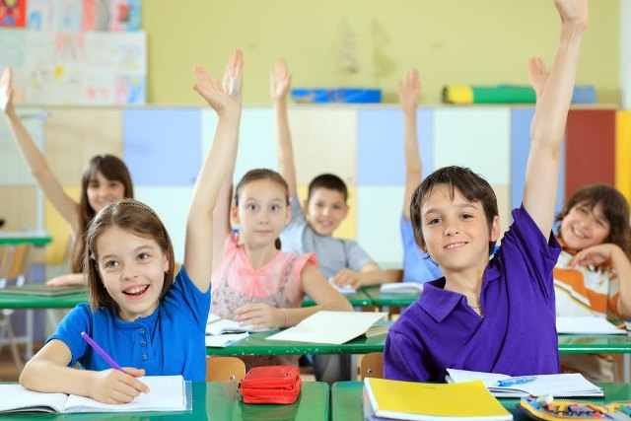

Slide 10
Creativity instead of cramming
Primary education in Great Britain seriously differs from traditional Russian. Everything is aimed at development of creative and research abilities of the child. Children integrate in commands and together execute projects. As a result children not just learn paragraphs from textbooks, and understand an entity of the phenomena and laws. For example, they independently output Pythagoras's table. Besides, such approach to training simplifies adaptation: children permanently communicate with peers, so, find friends quicker and are permanently enhanced in language.

Slide 11
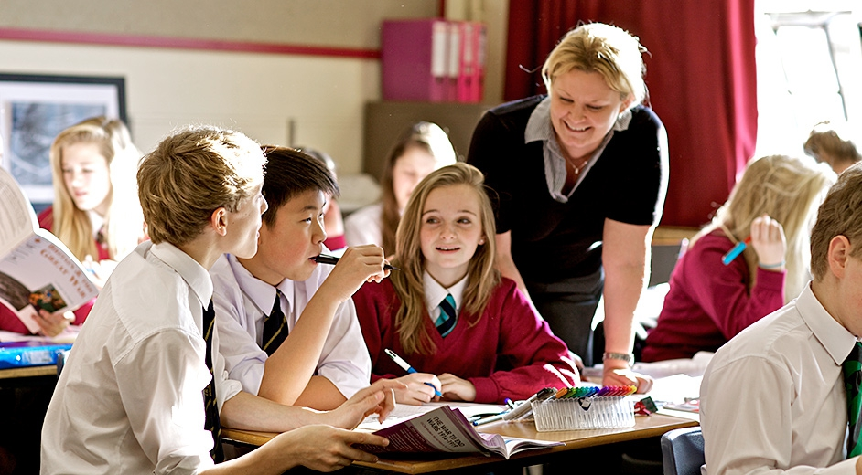
Secondary school

Slide 12
Средняя школа
In England children get secondary school education in state and in private educational institutions (public schools/state schools). At public schools training for residents of Great Britain and for foreigners overlooking a residence free. The Russian pupils are admitted to private schools, most often – to boards. The percent of foreigners in private boards makes 2-15%. Boards differ from day institutions in the fact that provide housing to the pupils. Children live in school residences for academic year, coming back home only for vacation. Some schools offer accommodation in the English families that also has the advantages – here children can like completely the English culture and a way of life in England.

Slide 13
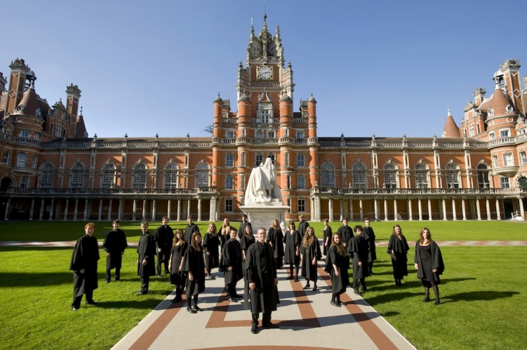

Slide 14
Средняя школа
School year at the British schools consists of three trimesters – autumn, spring and summer. Between semester so-called "long" vacation, and in the middle of each semester – "short", by duration up to one week is spent

Slide 15
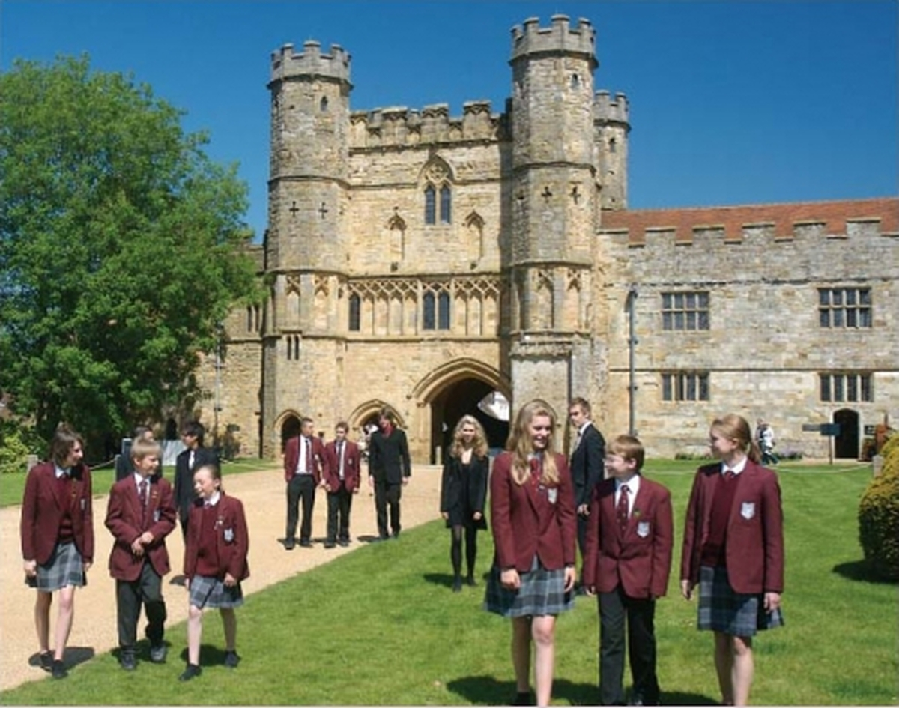

Slide 16
Средняя школа
So, at high schools of England children study several obligatory objects which are approved by an education system, and in addition choose several elective courses. Mandatory subject include mathematics, history, English, informatics, biology, the second foreign language and other disciplines. As additional most often select economy, accounts department, business - administration. For the last two years (from 14 to 16 years) children have training for final examinations (usually till 6-10 objects) for obtaining the certificate.

Slide 17
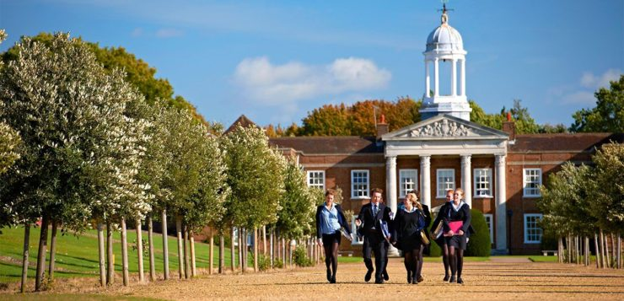

Slide 18
Средняя школа
Secondary education in England isn't limited only to intellectual loading. Children do one or several sports (it can be cricket, swimming, rowing, riding, soccer, basketball), visit lessons of the fine arts, dances, acting skills. Thus all-round development of children and disclosure of their potential is reached.

Slide 19
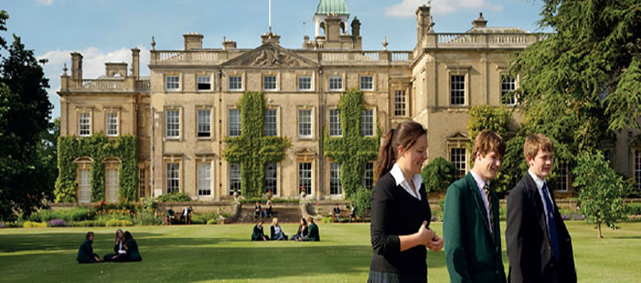

Slide 20
Средняя школа
To be admitted to the English high school, the foreign pupil needs to confirm sufficient level of proficiency in English in the corresponding certificate. It is possible to pass the program of preparation for examination in language on English courses in one of numerous language camps of England. On these courses it is possible not only to improve knowledge of language, but also to have the academic training that will help to adapt quicker at high school. Training takes place in the English camp with full immersion on language Wednesday therefore it is many times more effective than foreign language courses in not English-speaking country.

Slide 21
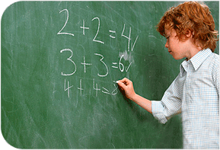

Slide 22
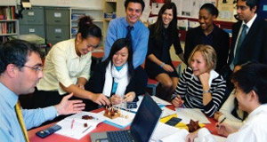
High school

Slide 23
High school in Great Britain - preparation for university (16-18 years)
In 16 years compulsory secondary education comes to an end. After that those who want to go further to the UNIVERSITY continue training in high school in England according to the A-level
A-level (advanced level)
At A-level schools of England represents biennial preuniversity preparation in 3-4 objects which the student chooses from the wide list (20-30 objects). A set of objects can differ a little depending on school. At a step of advanced level there are no obligatory objects - the student selects all objects to himself individually.
In 18 years children take final examinations, in all objects chosen by them, and on the basis of results of these examinations, go to the university. Probny about the A-level program.

Slide 24
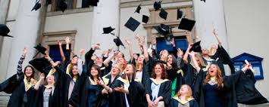

Slide 25



