Slide 1
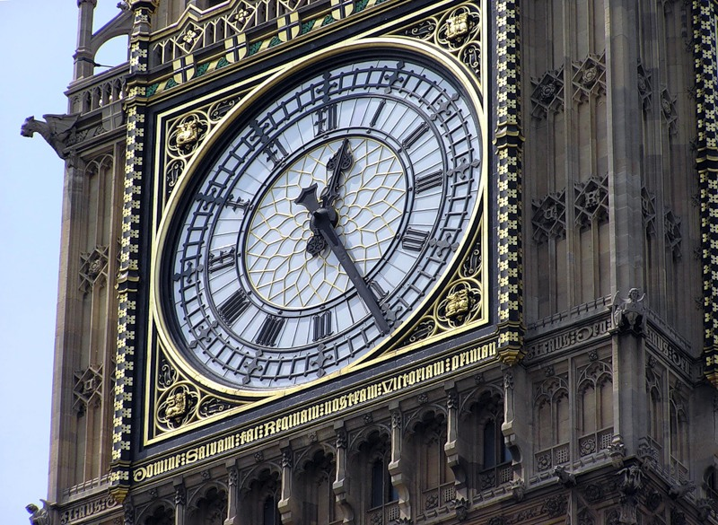
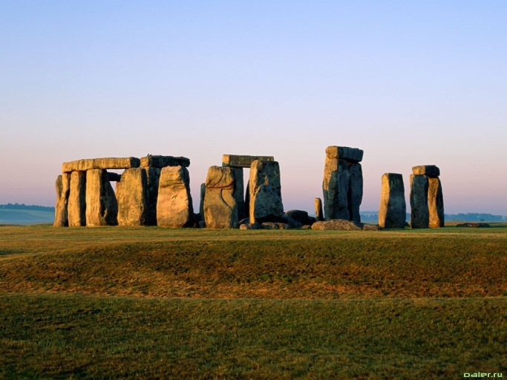
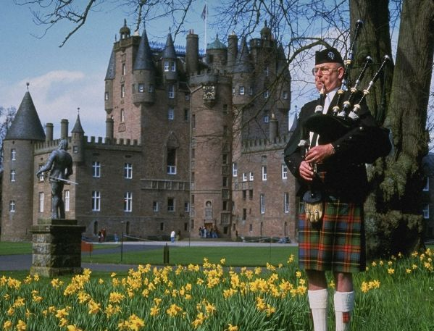
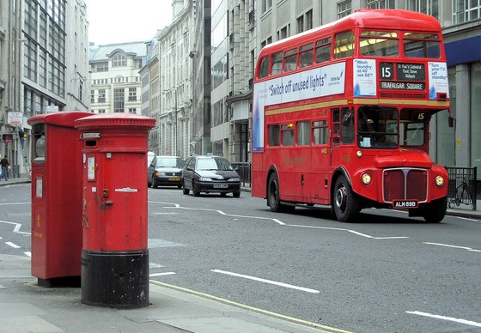
Quiz
Do You Know Great Britain Well?

Slide 2
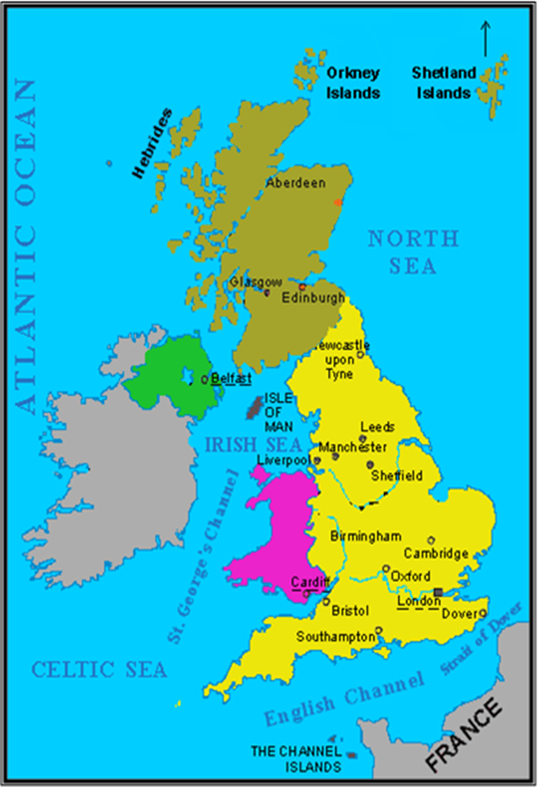
This wonderful country has many different names: Great Britain, the UK, England or just Britain.
What is
the official name
of the country?

Slide 3
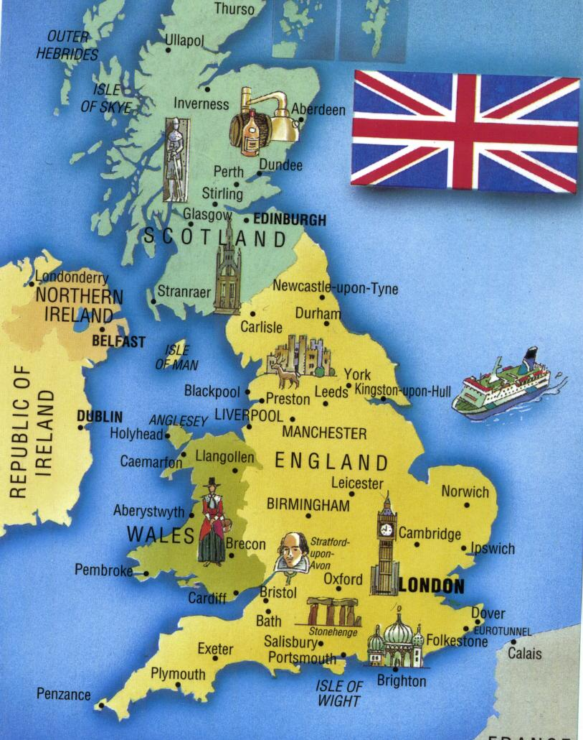
The United Kingdom of Great Britain and Northern Ireland (the UK)

Slide 4
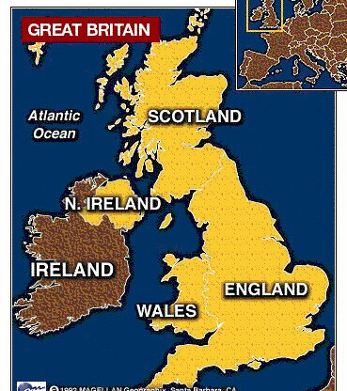
Name four parts of the UK
England
Scotland
Wales
Northern Ireland

Slide 5
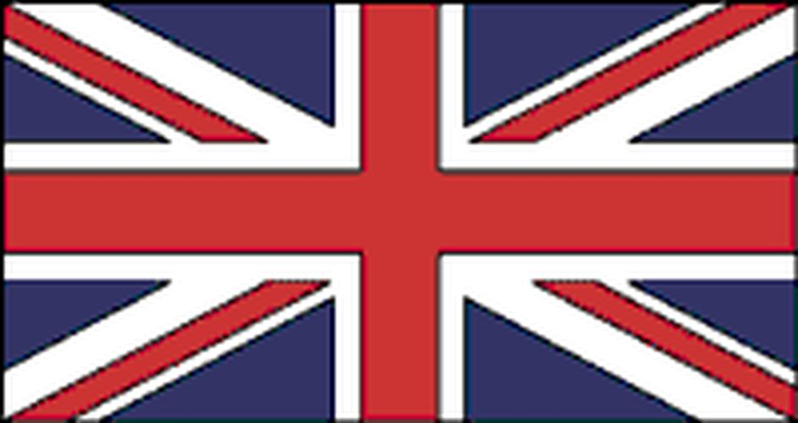
What are the main colours of the Union Flag?

Slide 6
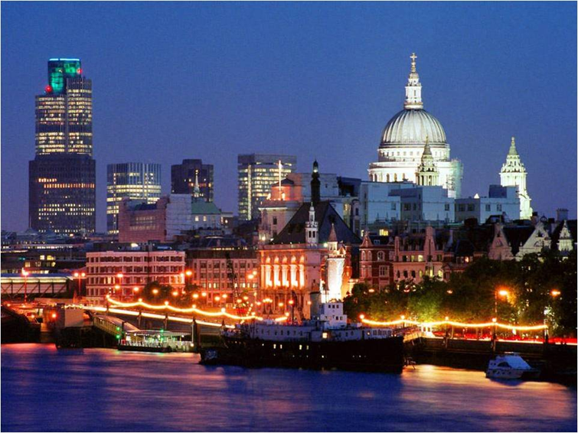
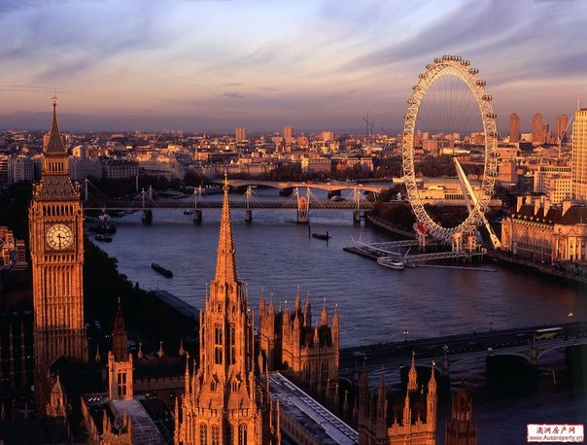
What is the capital of England?
LONDON is the capital of England.

Slide 7
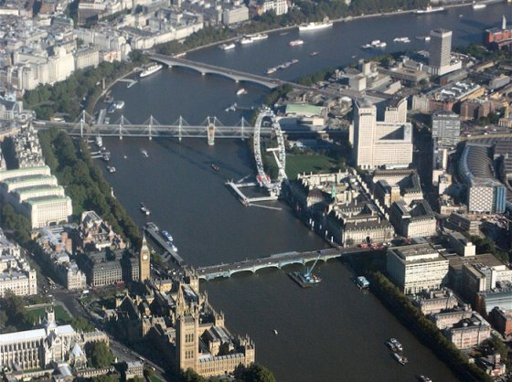
What river is London situated on?

Slide 8
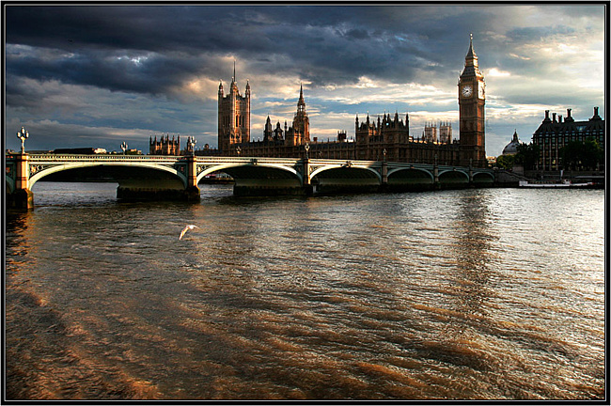
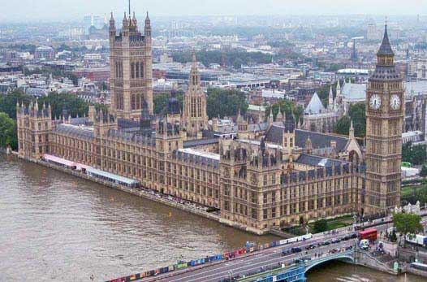
London, the capital of Britain, is situated on the river Thames…

Slide 9
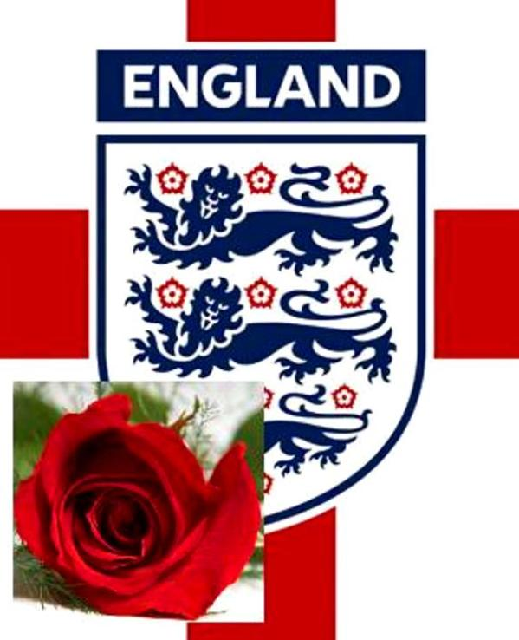
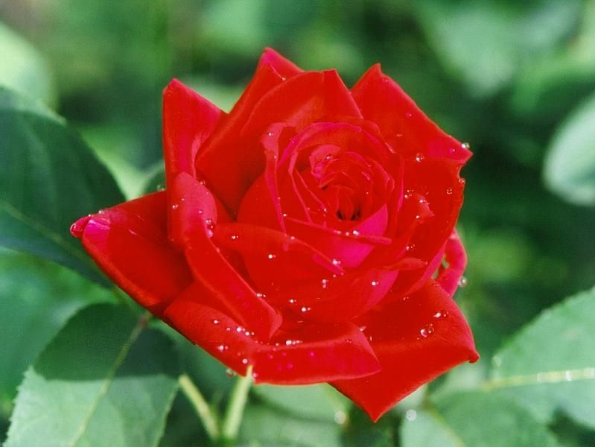
What is the symbol of England?

Slide 10
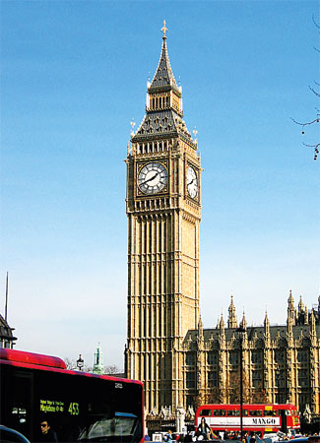
What is the name of the famous clock in London?

Slide 11
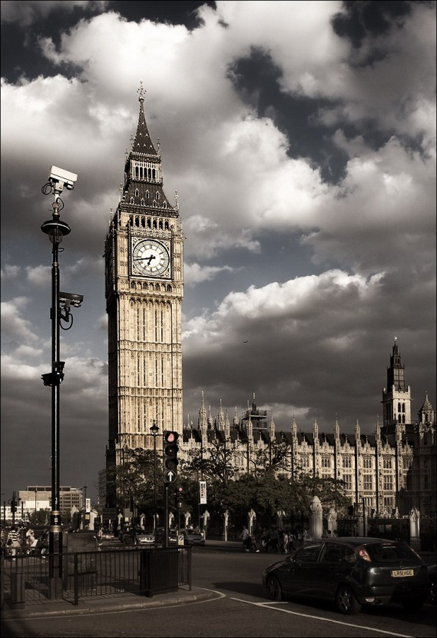
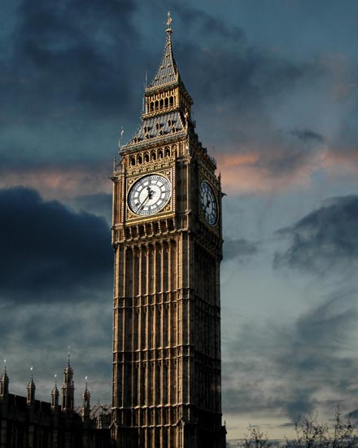
Big Ben

Slide 12
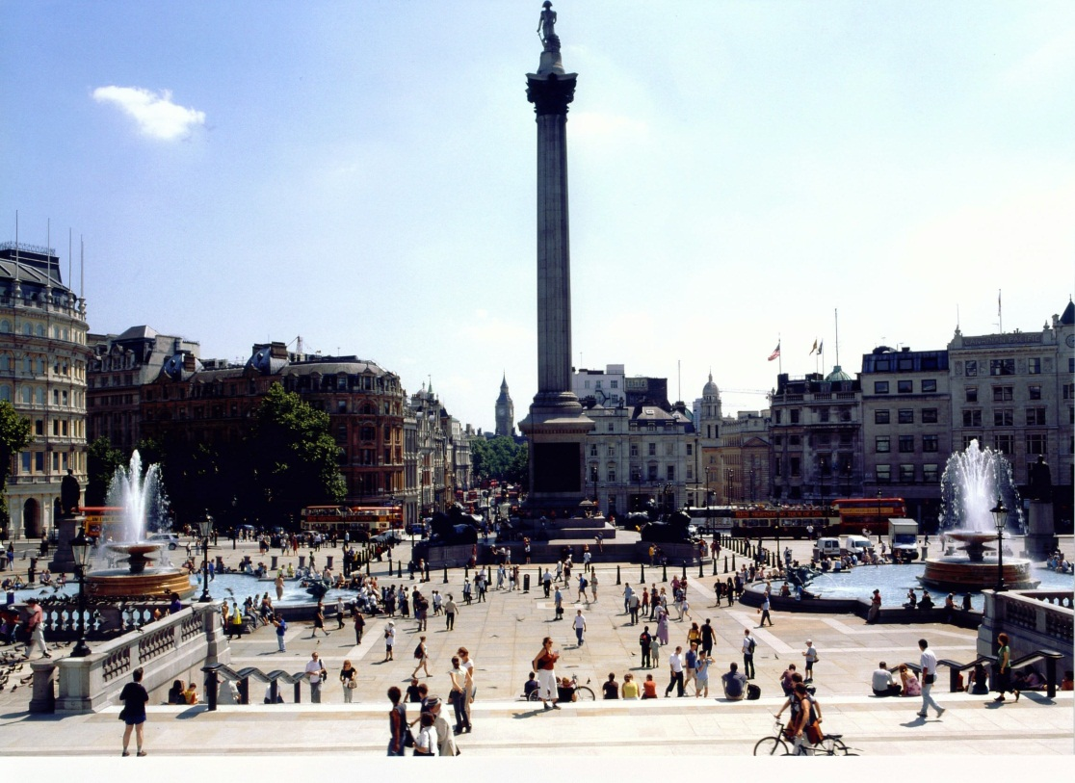
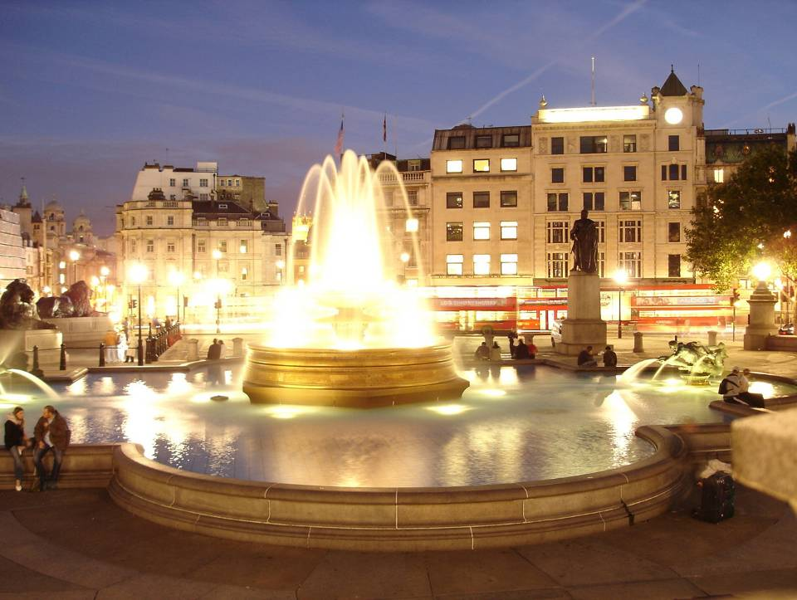
What is the main square in London?
Trafalgar square!

Slide 13
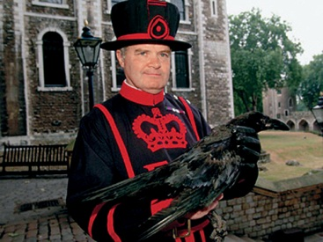
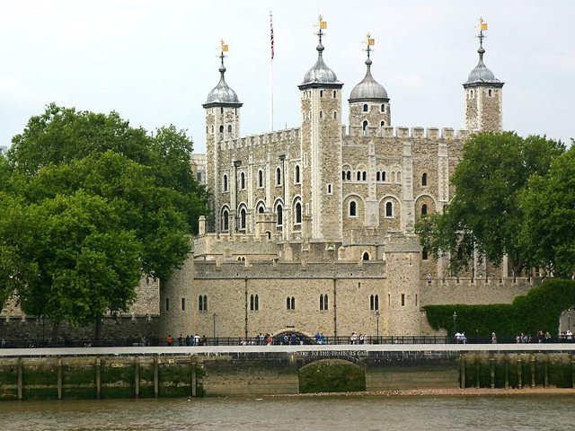
Where can you see ravens in London?
In the Tower

Slide 14
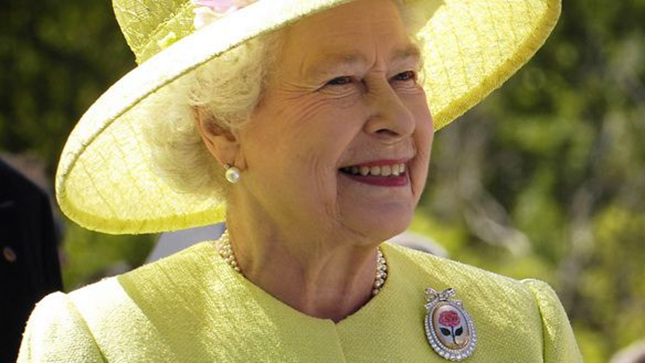
Who is the Head of State in Great Britain?
The Queen Elizabeth

Slide 15
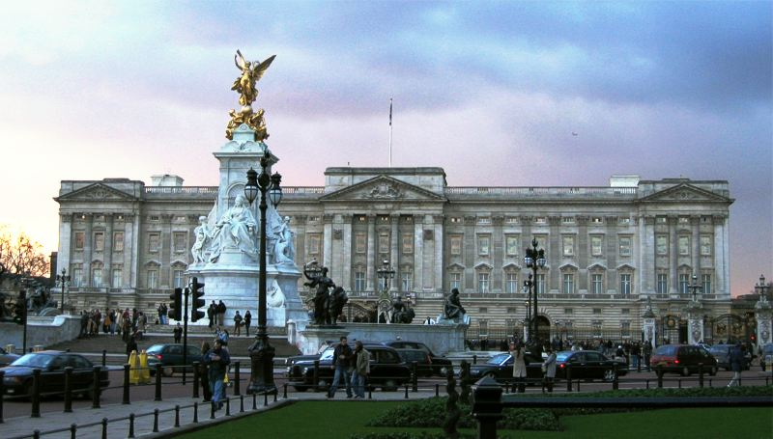
Where does the Queen live?
Buckingham Palace is the official residence and the London home of the Queen!

Slide 16
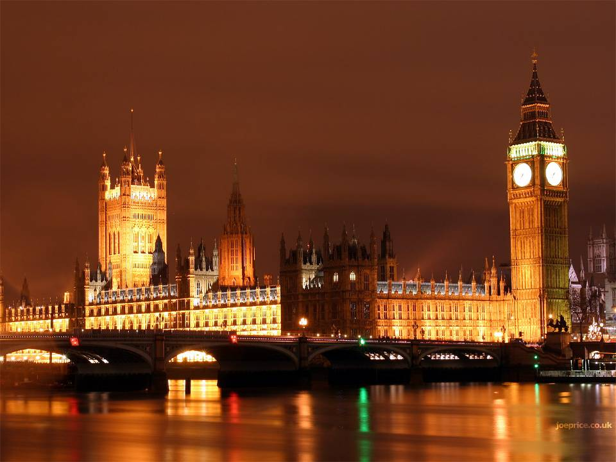
Name the place where the Parliament works.
The Houses of Parliament are the place where Parliament works!

Slide 17
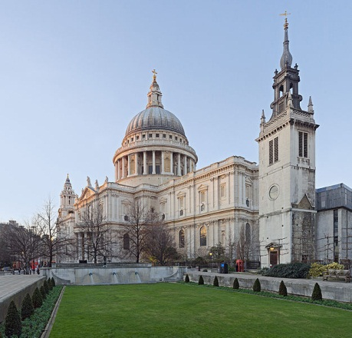
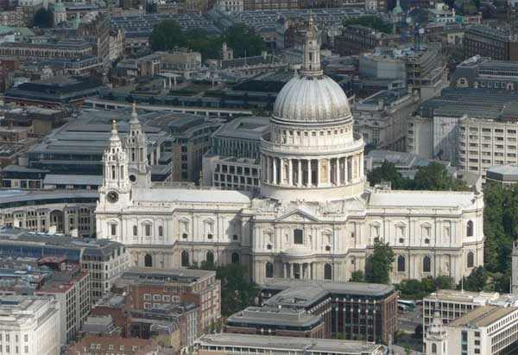
What is St. Paul’s Cathedral? a) Church b) Tower c) Bridge

Slide 18
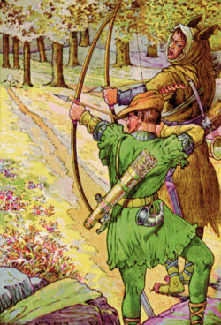
Who lived in Sherwood Forest?
Robin Hood did.

Slide 19
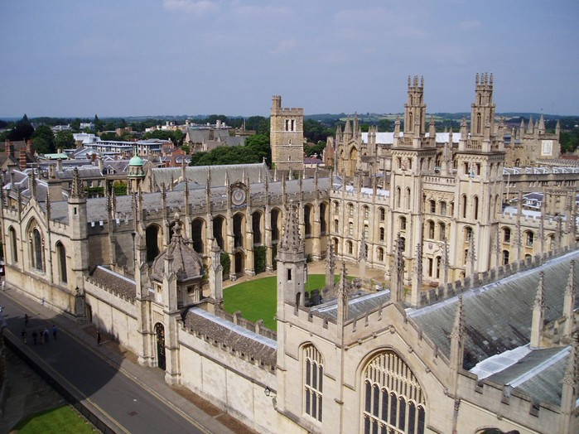
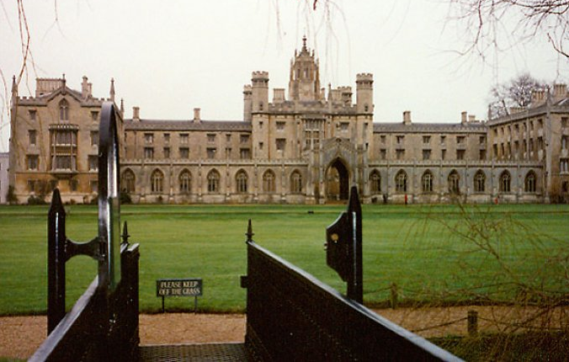
What are the largest and the oldest universities in Britain?
Oxford university
cAMBRIDGE university

Slide 20
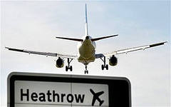
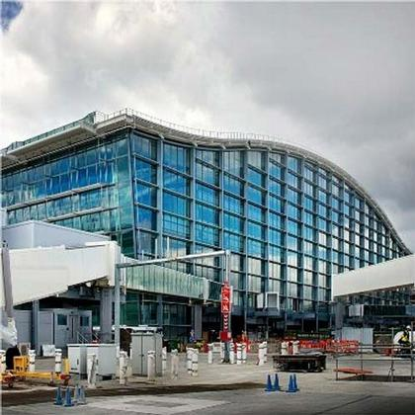
What is the famous airport in London?
Heathrow Airport

Slide 21
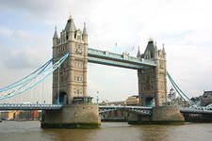
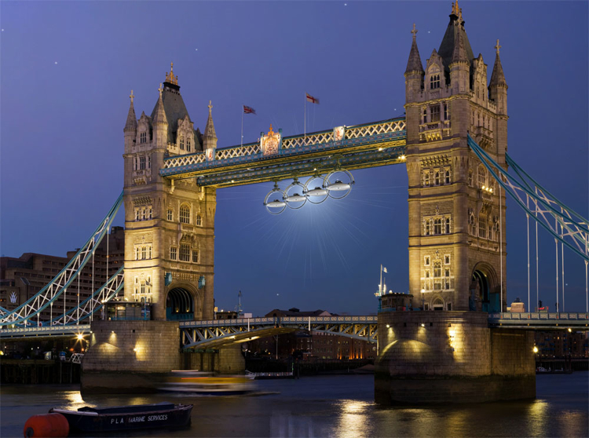
What is the most famous bridge of London?
The Tower Bridge

Slide 22
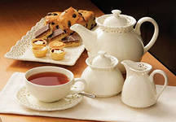
What is the favourite hot drink in Britain?

Slide 23
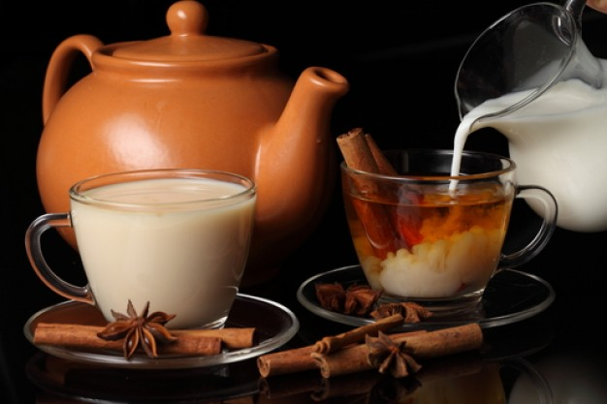
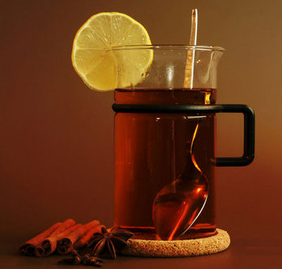
What is the difference between English and Russian tea?

Slide 24
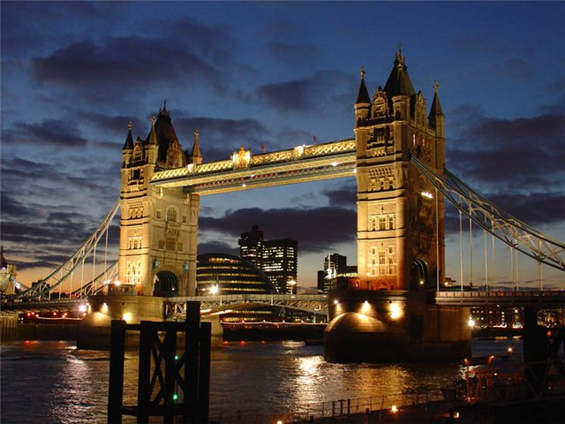
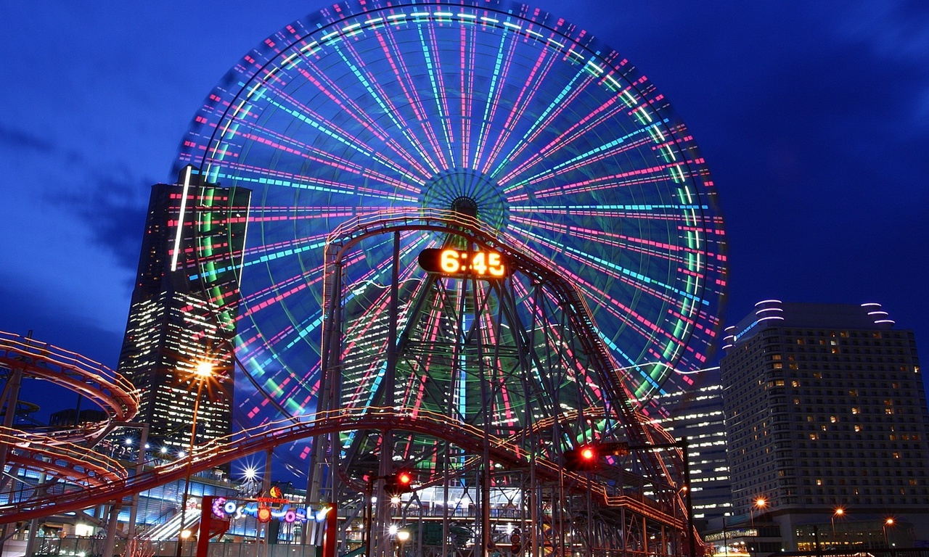

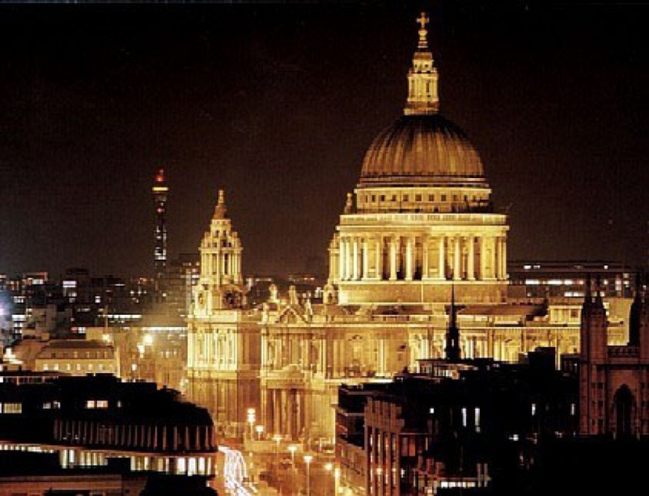
Well done!!!
Goodbye!!!

