Slide 1
English-speaking countries
Выполнена учителем английского языка Васильевой Р.Д,
МБОУ «СОШ № 6»

Slide 2


Plan of the lesson:
Homework (dictation-# 4)
Revision : countries, their capitals and nationalities(# 5-8)
English-speaking countries:
  Continents and capitals (# 9-10)
  Countries and languages (# 11-13)
(# 16)
Speaking (dialogue- cards) (# 14-15)
Grammar Revision (plurals, have got/has got) (# 17-22)
(# 23)

Slide 3
Write the numbers. (dictation)
25
19
96
16
10
12
11
70
15
47
17
13
twenty‐five
nineteen
ninety‐six
sixteen
ten
twelve
eleven
seventy
fifteen
forty‐seven
seventeen
thirteen

Slide 4
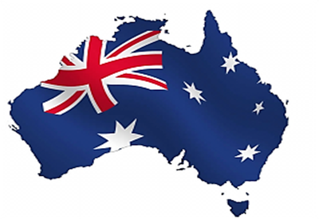


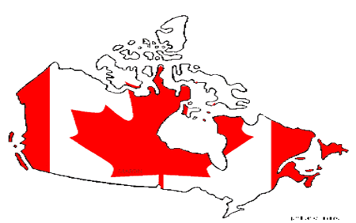
Name the countries and their capitals
Spain
Turkey
Madrid
Canada
Ottawa
Ankara
Canberra
Australia

Slide 5
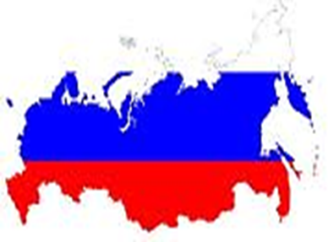


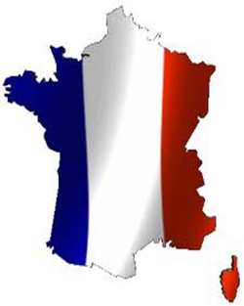
Name the countries and their capitals
The UK
Moscow
France
London
Tokyo
Russia
Paris
Japan

Slide 6


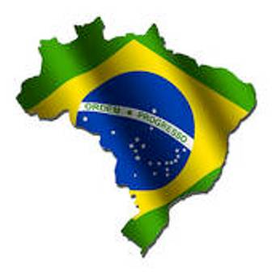

Name the countries and their capitals
The USA
Brazil
Rome
Berlin
Italy
Germany
Brazilia
Washington

Slide 7


Name the countries and their capitals
Greece
Australia
Portugal
Canberra
Lisbon
Athens

Slide 8

Continents
Asia [eiZq]
North America
South America
Australia
Europe
Africa
W
E
S

Slide 9

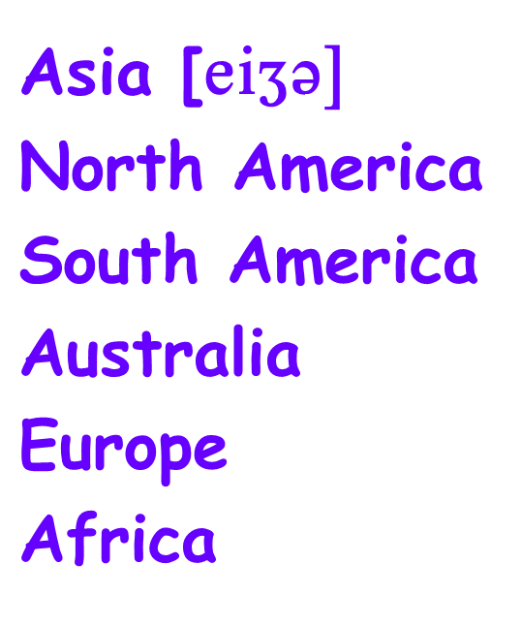

Look at the map. What countries can you see? Say as in a model:
  London is in Europe.
  London is the capital of the UK
  Ottawa
  Madrid
  Ankara
  Moscow
  Canberra
  Wellington
  Tokyo
  Paris
  Rome
  Washington
  Lisbon
  Athens

Slide 10
Choose countries where people speak English
The USA
The UK
Germany
China
Australia
Turkey
Spain
Greece
Portugal
People speak English in…
People don’t speak English in…

Slide 11

Countries and languages
The USA
The UK
Germany
China
Australia
Turkey
Spain
Greece
Portugal
English
English
German
Chinese
English
Turkish
Spanish
Greek
Portugese

Slide 12

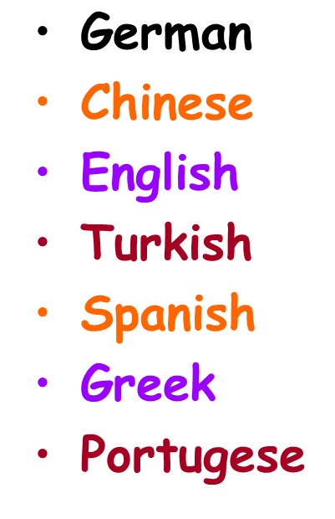

Choose countries and say what language people speak
People speak English in…
People speak …………… in…
The USA
The UK
Germany
China
Australia
Turkey
Spain
Greece
Portugal

Slide 13
Countries and nationalities
The USA
The UK
Germany
China
Australia
Turkey
Spain
Greece
Portugal
American
British
German
Chinese
Australian
Turkish
Spanish
Greek
Portugese

Slide 14

-Where’s Lin from?
-She is from New Zealand.
-What’s the capital of New Zealand?
-Wellington.
-What nationality is she?
-She is a New Zealander.
-What languages can she speak?
-She can speak English.

Slide 15
This – that,
These – those.
Touch your tummy,
Touch your nose.
This – that,
These – those.
Touch your shoulders,
Touch your toes.

Slide 16

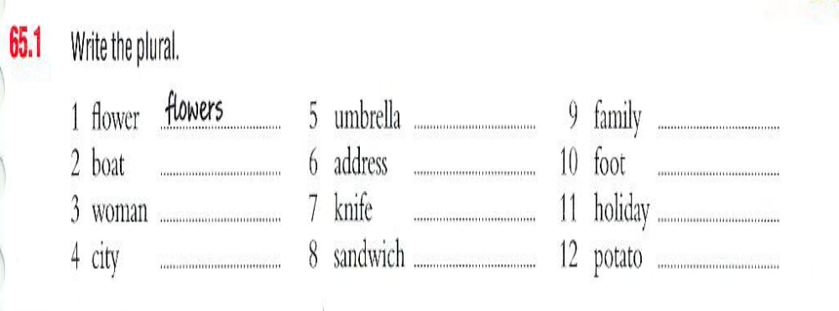
Grammar Revision

Slide 17
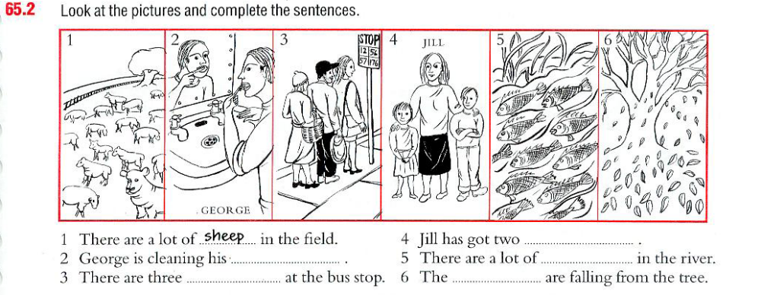
Grammar Revision

Slide 18

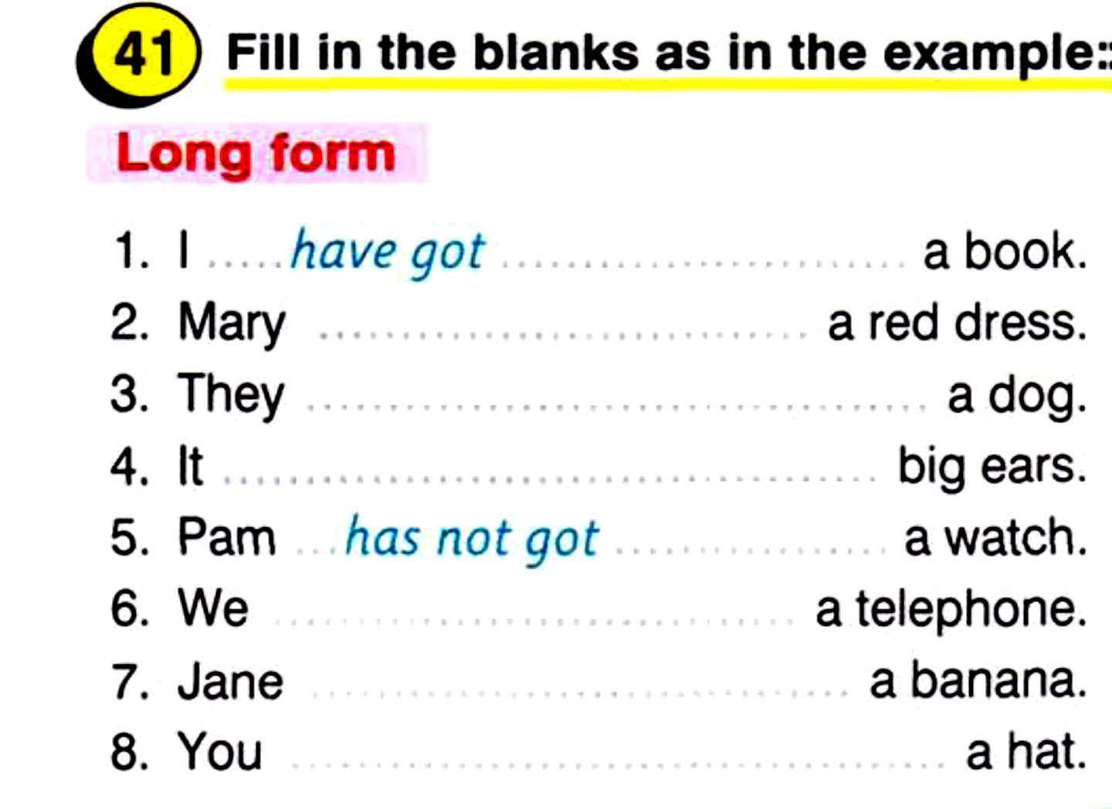

Slide 19
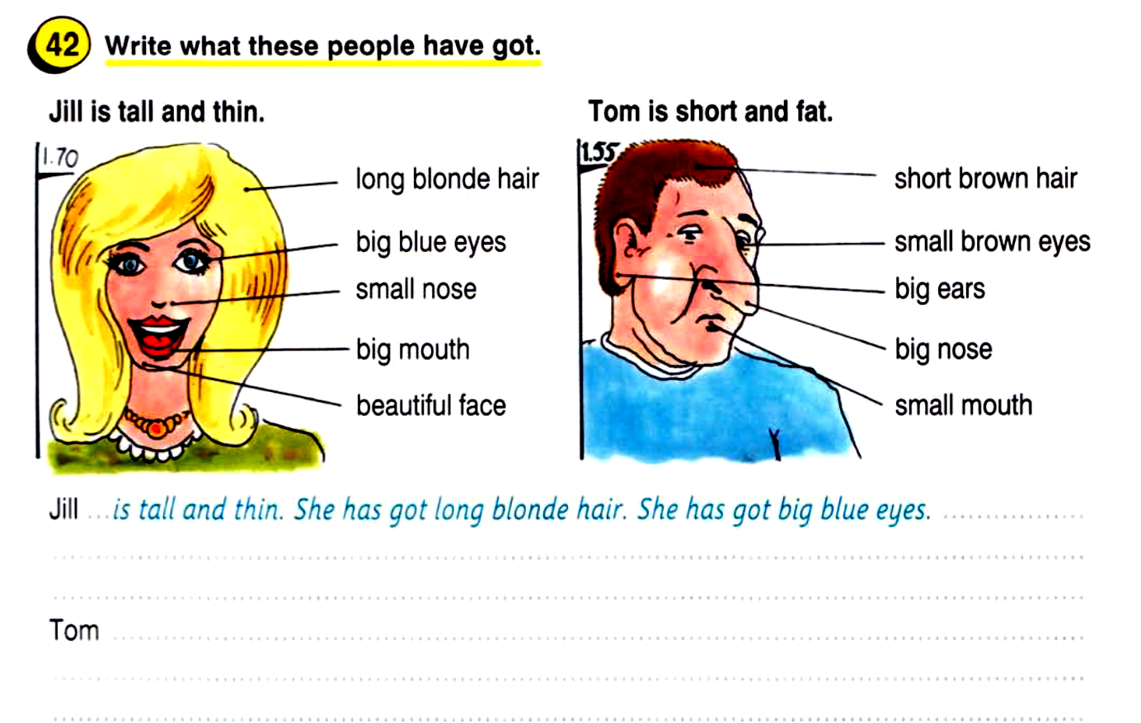

Slide 20
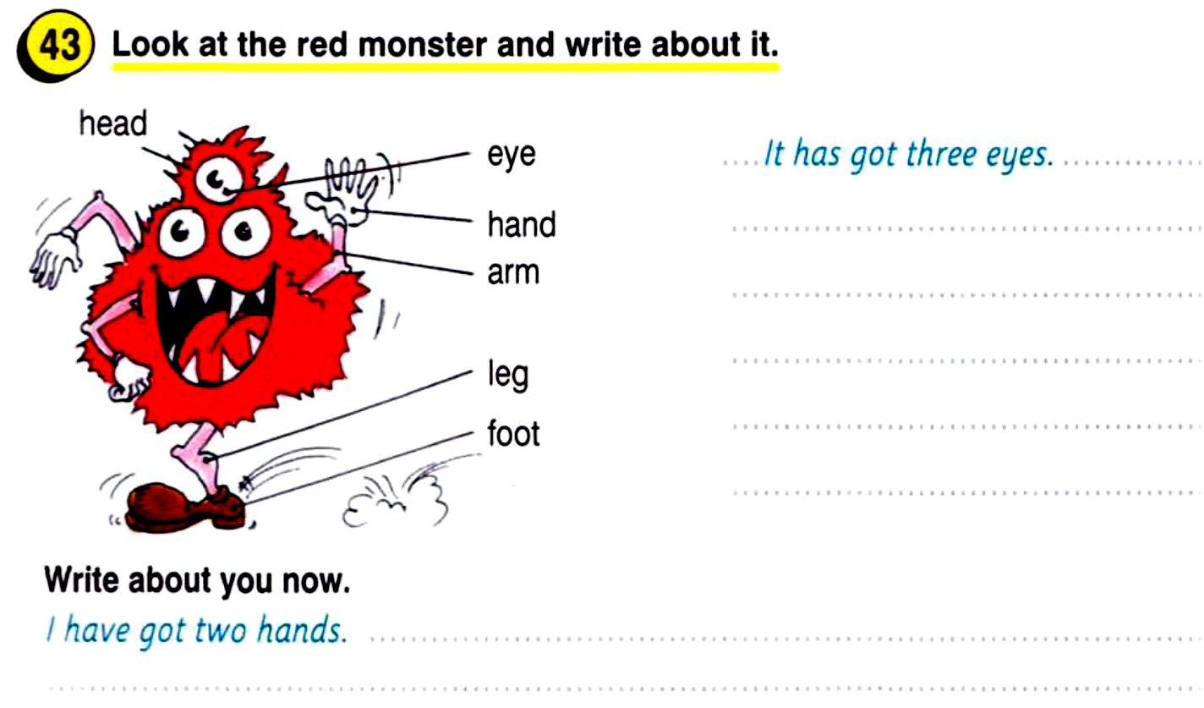

Slide 21

Р с 26 у 2

