Slide 1
Roses are …
Violets are…
Sugar is …
And so are …
(you, blue, red, sweet)

Slide 2
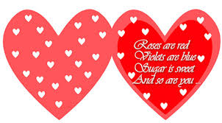

Slide 3
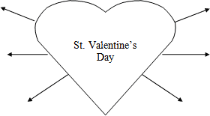
КАКИЕ У ВАС АССОЦИАЦИИ С ДНЕМ СВЯТОГО ВАЛЕНТИНА?

Slide 4

Знаете ли вы?
1.A person whom someone loves.
2.A special card sent on St. Valentine’s Day, usually anonymous (анонимное).
3.Valentine’s Day is celebrated during (в течении) this month.
4.This colour is a symbol of love.
5.A very strong feeling of liking someone.
6.Something that is given as a gift on Valentine’s Day like a box of chocolate, flowers.
7.The most romantic present which we can smell that is given to girls on St.Valentine’s Day.
8.Something that is written on valentine cards and addressed to a boy or a girl.

Slide 5

Составьте слова
1) epsnret
2) aetnVlnie
3) eruyFbar
4) vole
5) iferdn
6) siks
7) dre

