Slide 1
The Floral symbols
By Severina L.G.

Slide 2
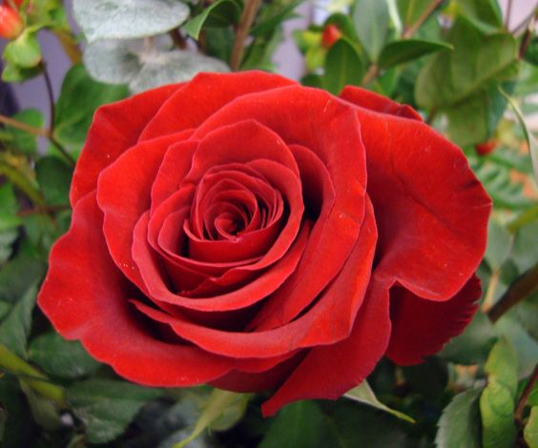
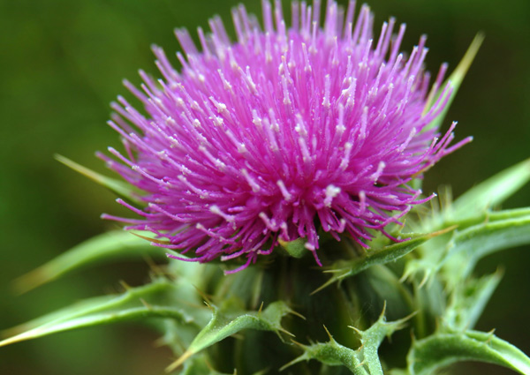
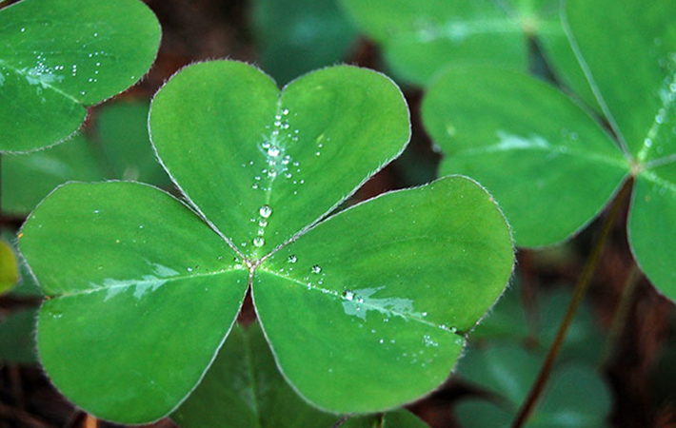
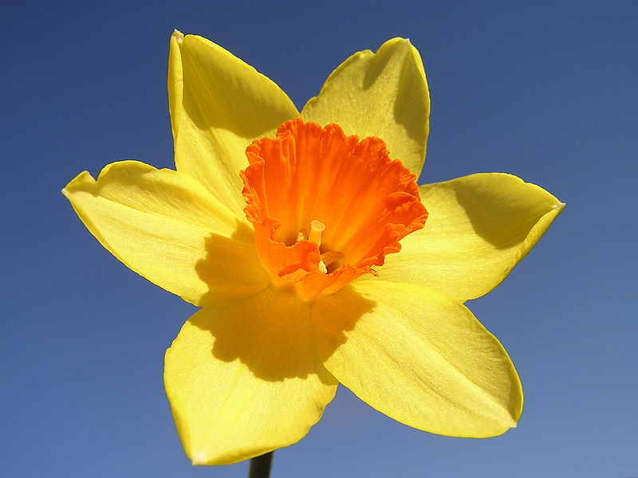
THE FLORAL SYMBOLS

Slide 3
Match the words from the first and the second column
national | cities
floral | colours
historic | country
traditional | symbols
largest | elements
multinational | names
culture | saint
official | conflicts

Slide 4
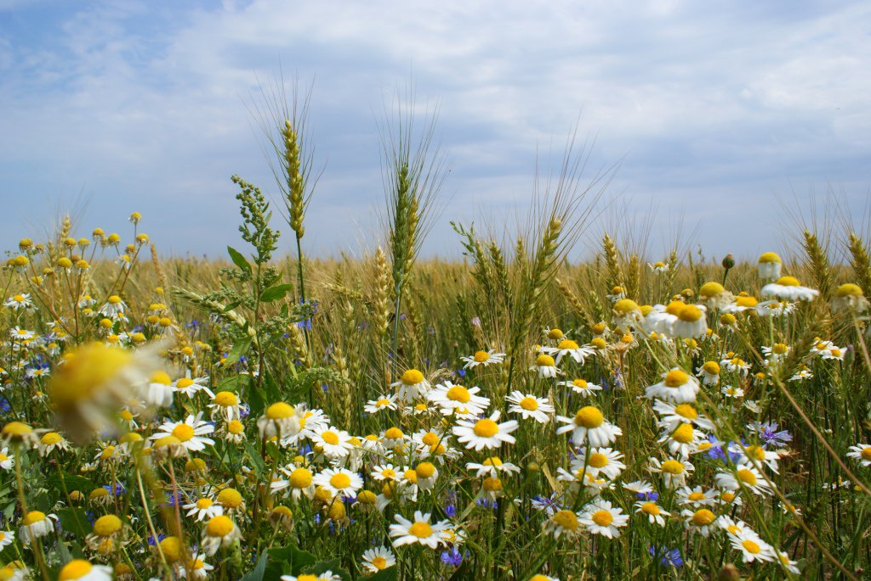

Draw the floral symbol of our town/district/country

Slide 5
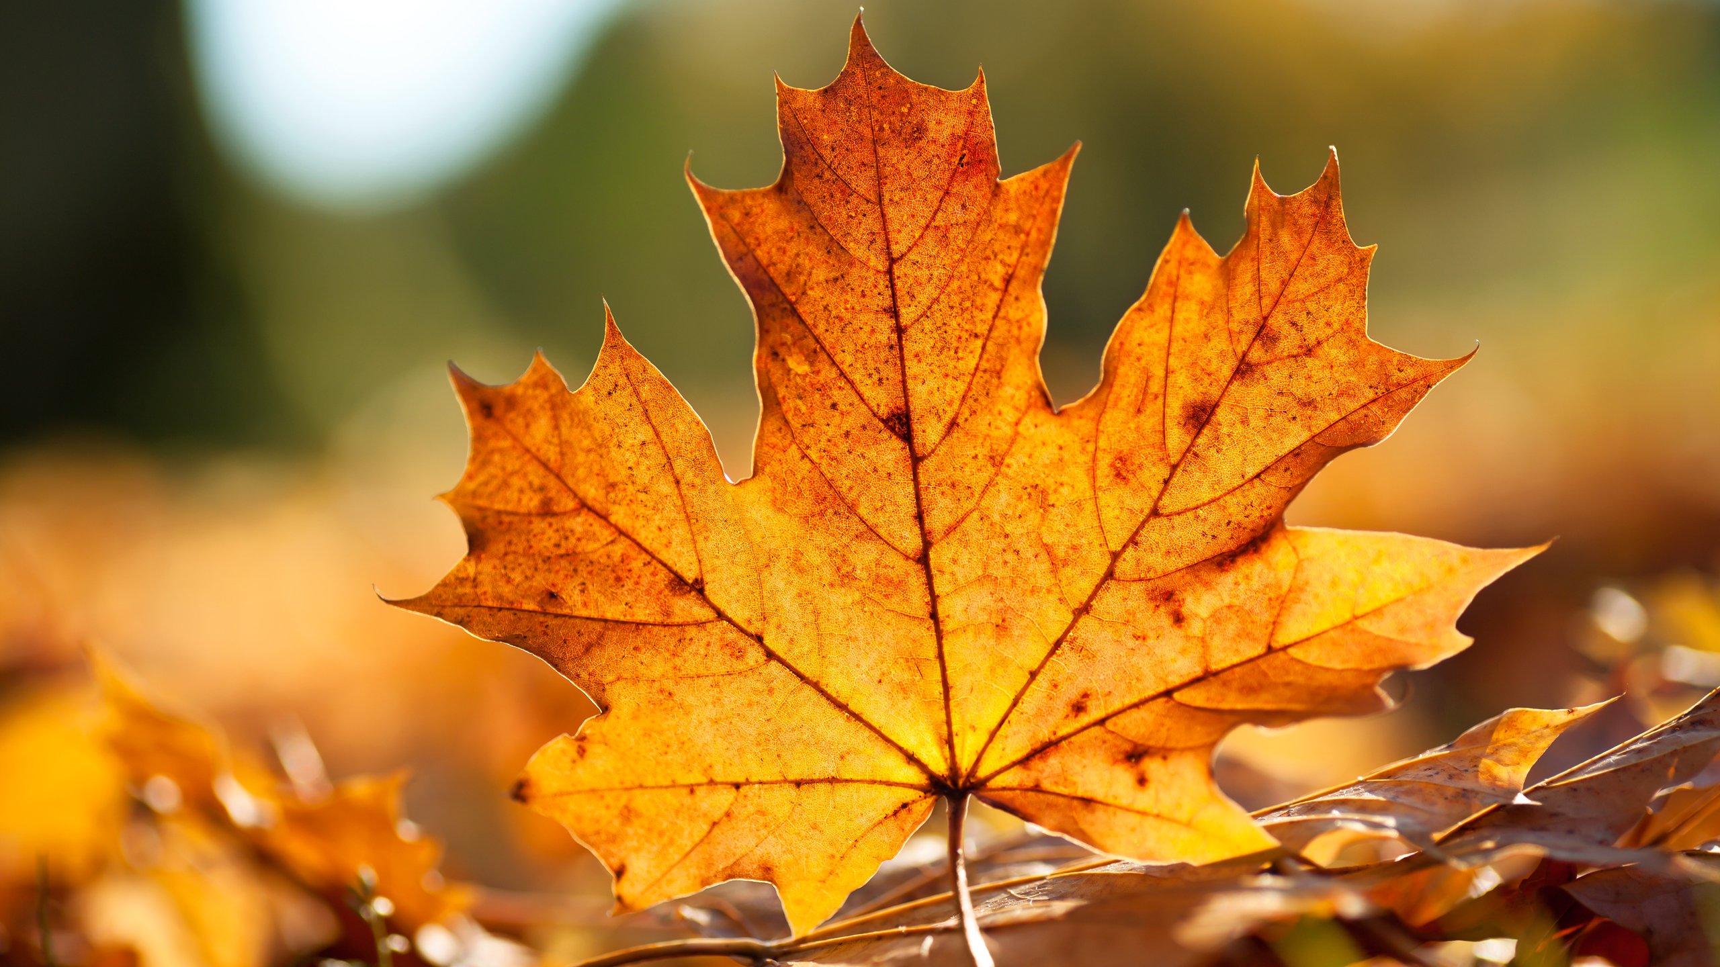
In which country is a maple the national symbol?

Slide 6
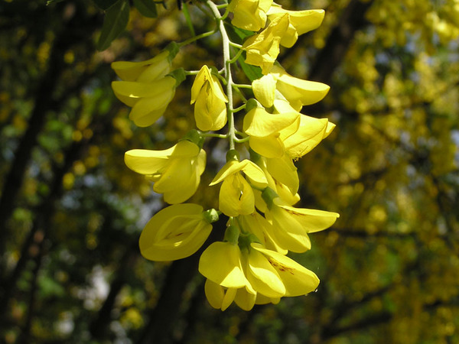
In which country is a golden wattle the national symbol?

Slide 7
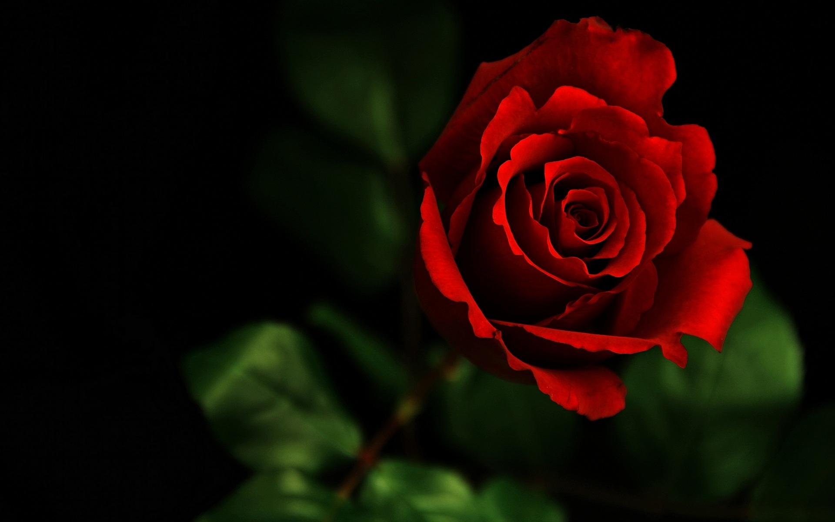
In which country is a red rose the national symbol?

Slide 8
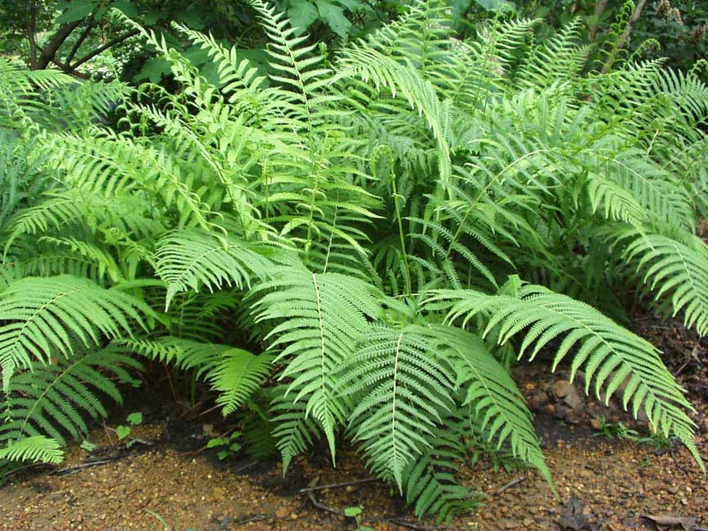
In which country is a fern the national symbol?

Slide 9
Home task
Write an essay about the floral symbol of any other country

