Slide 1



We learn English

Slide 2



We learn English
RIDDLES
10
20
30
40
50
WHERE?
10
20
30
40
50
What time is it?
10
20
30
40
50
FOOD
10
20
30
40
50
Animals
10
20
30
40
50

Slide 3



RIDDLES
10
What has teeth but cannot eat?
It’s a hairbrush.

Slide 4
RIDDLES
20
Which letter is a hot drink?
T - tea

Slide 5
RIDDLES
30
What goes around the world but stays in a corner?
It’s a stamp.

Slide 6
RIDDLES
40
Without hands it can paint,
Without teeth it can bite.
It’s frost.

Slide 7
RIDDLES
50
What is black when it is clean and white when it is dirty?
It’s a blackboard.

Slide 8

WHERE?
10
Where do you cook dinner?
I cook dinner in the kitchen.

Slide 9
WHERE?
20
Where do you buy bread?
I buy bread at the baker’s.

Slide 10
WHERE?
30
Where do you buy stamps?
We buy stamps at the post office.

Slide 11
WHERE?
40
Where can you
take books?
I can take books at the library.

Slide 12
WHERE?
50
Where can you buy some aspirin?
We can buy some aspirin at the chemist’s.

Slide 13


What time is it?
10
It’s six o’clock.

Slide 14

What time is it?
20
It’s twenty five past one.

Slide 15

What time is it?
30
It’s five to twelve.

Slide 16

What time is it?
40
It’s ten past nine.

Slide 17

What time is it?
50
It’s half past seven.

Slide 18

FOOD
10
It’s butter.

Slide 19
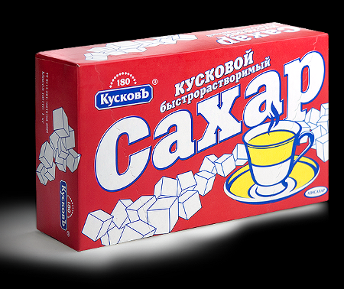
FOOD
20
It’s sugar.

Slide 20
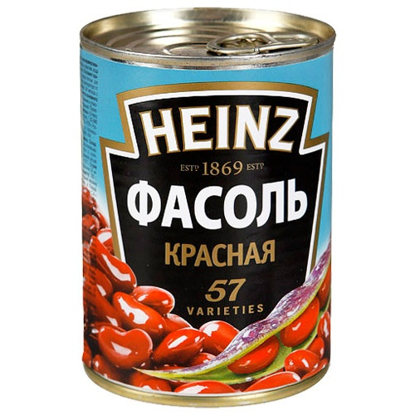
FOOD
30
It’s a tin of beans.

Slide 21

FOOD
40
It’s a packet of biscuits.

Slide 22
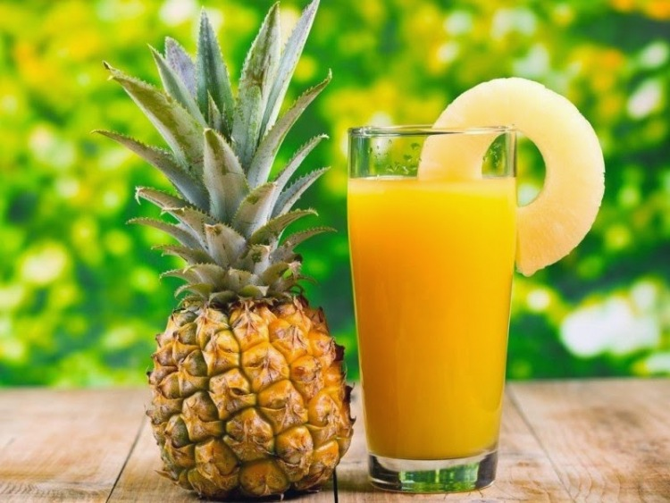
FOOD
50
It’s a glass of pineapple juice.

Slide 23

Animals
10
It’s a monkey.

Slide 24
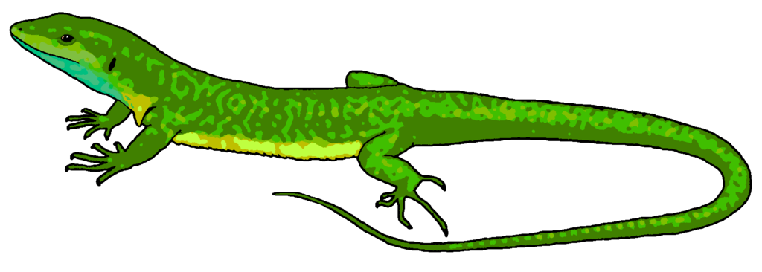
Animals
20
It’s a lizard.

Slide 25

Animals
30
Введите вопрос
It’s a whale.

Slide 26

Animals
40
It’s a hippo.

Slide 27

Animals
50
It’s a seal.

Slide 28
ИНТЕРНЕТ - РЕСУРСЫ
Идея кнопки «домик»
Знак вопроса
Мудрая сова
Разделитель

Slide 29

Сайт: http://elenaranko.ucoz.ru/

