Slide 1
My Sweet Home
There is no place like home

Slide 2
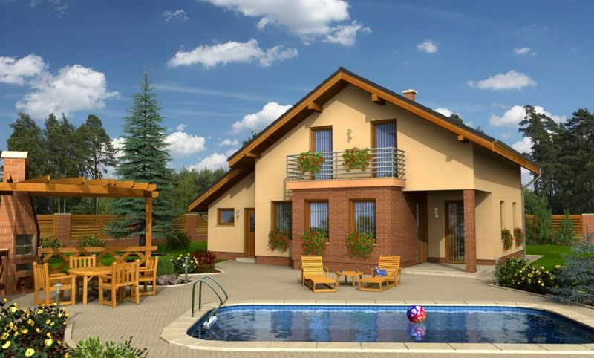
The house of my dream

Slide 3
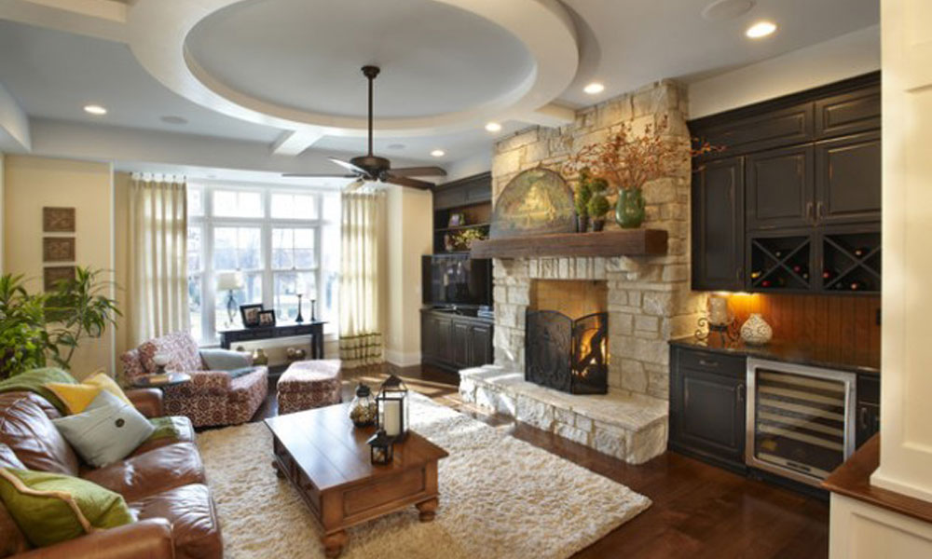
My living room doesn`t have much furniture. But it`s very light.

Slide 4
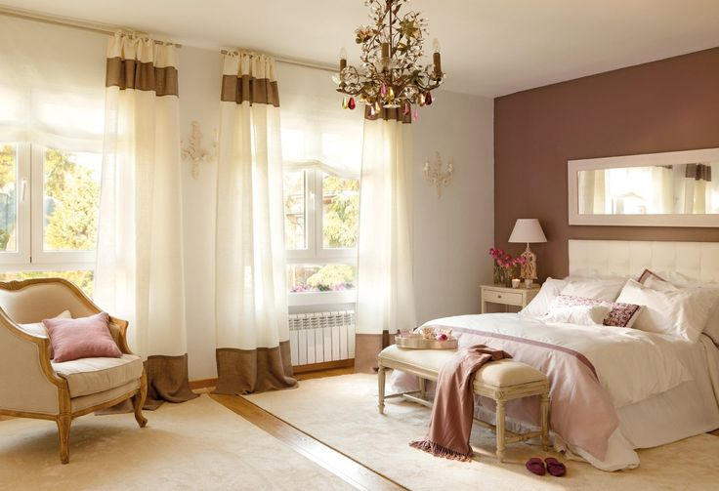
There are three bedrooms in my house, they are on the first floor.

Slide 5
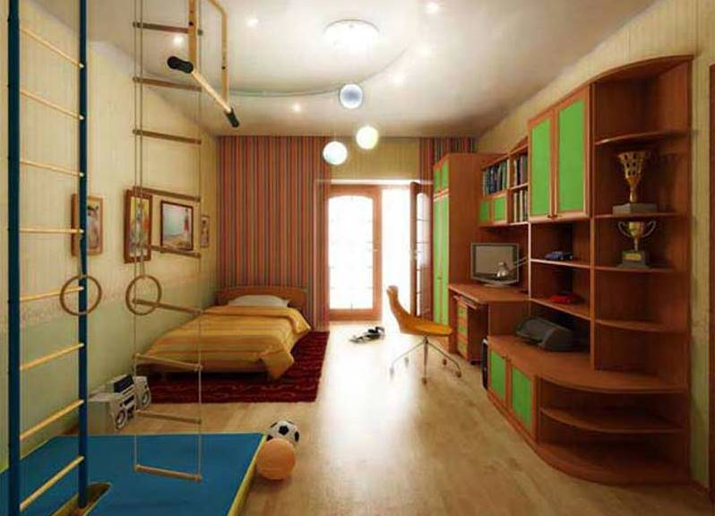
Children`s room is an important place in the house, the place where children sleep and do their homework.

Slide 6
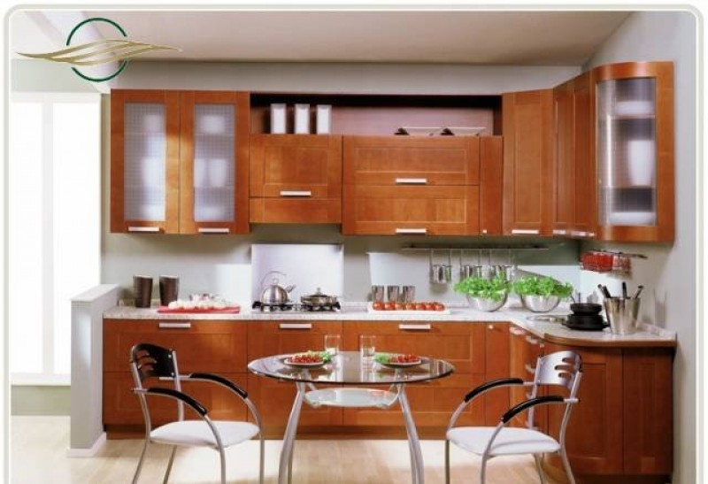
The place to have meals is the kitchen. It`s on the first floor.

Slide 7
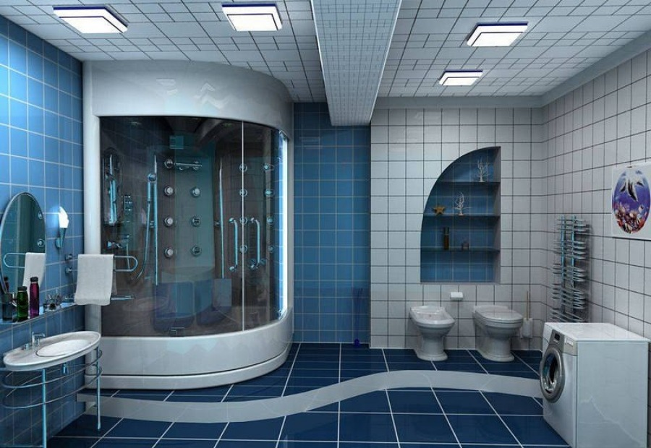
If you want to wash, there are three bathrooms on the first floor of the house.

Slide 8
East or West home is best
Come and see me some day.
You are always welcome!

Slide 9
Thank you for your attention

