Slide 1

An English proverb:
Every man is an architect of his fortune.
architect [ˈɑ:kɪtekt]
fortune [ˈfɔ:tʃən]

Slide 2

What’s the theme of our lesson?
Jobs

Slide 3

Today at the lesson we will:
revise the words for the topic «Jobs»;
discuss important qualities for a successful career;
tell about different kinds of jobs.
The aim of the lesson is:
to speak about future career.

Slide 4
Concept Wheel
Name the synonyms to the word
Jobs

Slide 5
What professions do you know?
professions

Slide 6



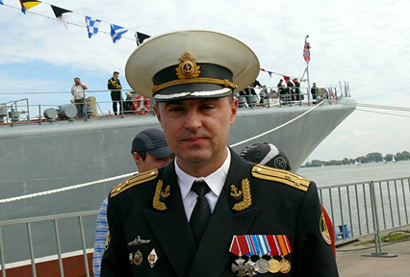
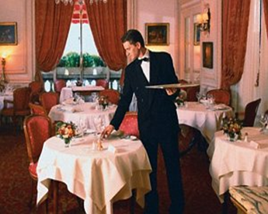
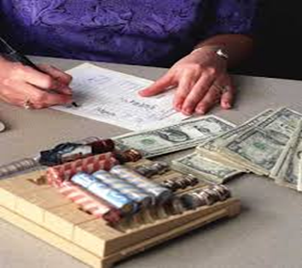
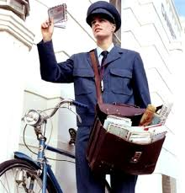
Choose a profession and tell about it.
What are their jobs?
Where do these people work?
What do they usually do at work?

Slide 7
teacher\ cashier\ professor\ nurse\ officer\ secretary\ postman\ accountant\ postal worker
2 extra
1) Someone who gets cash or pays out money in a shop is a\an ____________.
2) A\an_______ is qualified and licensed to give people medical treatment.
3)A\an________ is an employee who does clerical and administrative work in an office for a person or organization.
4)A\an__________ is someone who can count well and keeps the money records of a business.
5) Someone with an important job in a military organization is a\an _________.
6) A\an______ is a teacher of the highest academic rank in a college or university.
7) A\an_________ takes and brings letters and parcels as a job.

Slide 8
6) A teacher of the highest academic rank in a college or university.
4) Someone who can count well and keeps the money records of a business.
2) A\an_______is qualified and licensed to give people medical treatment.
1) Someone who gets cash or pays out money in a shop.
7) A\an_____ takes and brings letters and parcels as a job.
3)A\an________is an employee who does clerical and administrative work in an office for a person or organization.
5) Someone with an important job in a military organization
 |  |  |  | 5 | 6
1 |  | 3 | 4 |  |  | 7
 | 2
O
F
F
I
C
E
R
P
R
O
F
E
S
S
O
R
C
A
S
H
I
E
R
S
E
C
R
E
T
A
R
Y
A
C
C
O
U
N
T
A
N
T
P
O
S
T
M
A
N
N
U
R
S
E
S | U | C | C | E | S | S
Criteria: 0mistake – «5»
1 mistake – «4»
2-3mistakes – «3»
4-7mistakes- «2»

Slide 9

What qualities are required for the following professions.
Qualities for job:
friendly
brave
organised [ˈɔːɡ(ə)naɪzd]
fit
healthy
strong
сaring [ˈkɛə(r)ɪŋ]
patient
skilful
intelligent
careful
hardworking
likeable
efficient [ɪˈfɪʃənt]
calm [kɑ:m]
honest
responsible
practical
….……
A: What is your job?
B: I’m a\an______.
A: If you want to be a nice_____ , you should be_________ .
………..

Slide 10

There are a lot of factors influence your mind to choose a future career…
Interests & Hobbies
Prestige of a profession
Parents’ advice
Friends’ opinion
Teachers’ advice

Slide 11


Have you chosen your future profession?
What do you want to be?
In my opinion, I want to be….
As for me, I’d like to be….
To tell you the truth,….
Unfortunately, I haven’t decided yet.

Slide 12
Questionnaire
1)Name:____________________
2)Qualities: I am __________________
3) Hobbies\Interests: I’m good at___________
4) Where do you want to study?:
I want to study at college/University/ Military Academy
5)Where do you want to work?:
I want to work inside\outside\in an office\in the army\________
6) When do you want to work?:
I’d like to work full-time\part-time\ overtime\ in the mornings\___
7) How would you like to work?:
I’d like to work with my hands\other people\a company\______
8) Salary:__________
I would recommend ______to be ….

Slide 13

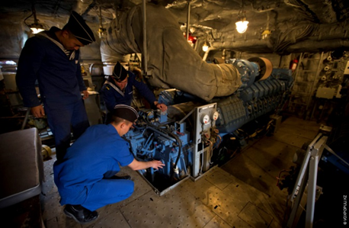
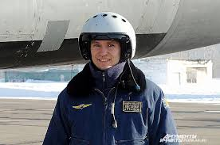


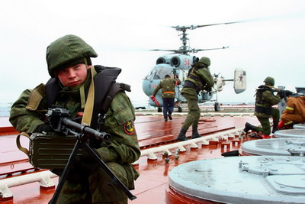
You are a school career adviser.
Recommend cadets what job to choose. Explain your choice.

Slide 14
Speaking
Say what job you would recommend cadets to choose. Use the following phrases:
He is …
patient
responsible
he is good at
… studies ...
study at Military Academy
He likes/wants to..
work part-time / full-time
work overtime
He is ready to…
work with hands\ other people
wear a uniform
I would recommend …
salary
well paid

Slide 15

«Steps to success»
4th step
Become a qualified specialist
3rd step
Enter the University
2nd step
Pass exams
1st step
Study hard everyday

Slide 16

You are going to give a talk about your career plans. 1.5----2 minutes
exam
Criteria:
10-12 sentences - «5»
8-10 «4»
6-7 «3»
0-5 2»
Remember to say
what job you want to do in future;
what reasons of your choice, and why;
whether your family approve of your career choice or not.
You have to talk continuously.

Slide 17
Write a cinquain
a naval officer
1 noun
2 adjectives
3 verbs
1 word combination

Slide 18
H\W
You have received a letter from your English-speaking pen friend, Ben.
…Yesterday I did a test to see which job is the most appropriate for me. According to the results I should become a doctor. But it would be absolutely impossible because I am afraid of blood…
…What future career would you like to have, why? Do your parents agree with your choice? In what way will English be useful for your career?
Write him a letter and answer his 3 questions.
Write 100–120 words.
Remember the rules of letter writing.

Slide 19
Now I know …
Now I can…
Do you know the words «Jobs» now?
I…
Can you describe the profession now?
What was interesting at the lesson?
What was difficult?

