Slide 1
Презентация для кружка «Юный лингвист»
7 класс
Учителя английского языка
Мартынюк Л.В.

Slide 2
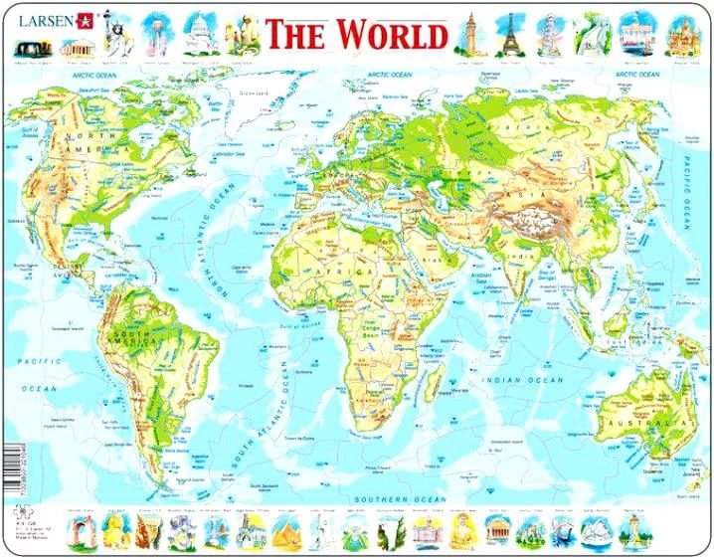
English Speaking Countries

Slide 3
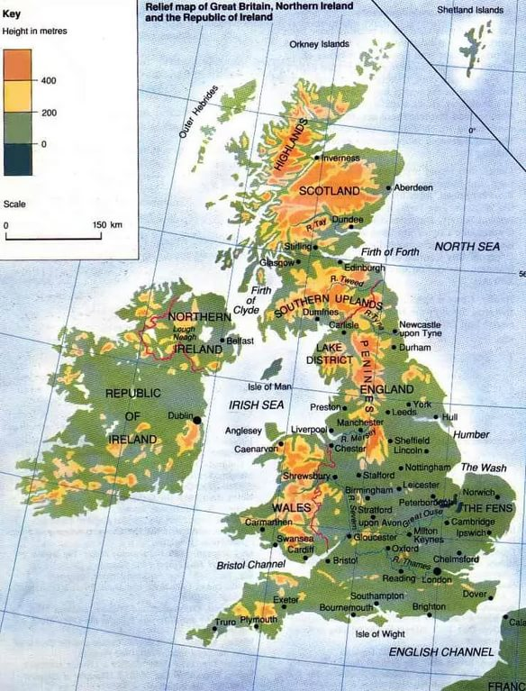

The United Kingdom of Great Britain and Northern Ireland is situated on the British Isles. The British Isles consist of two large islands, Great Britain and Ireland, and above five thousand small islands. Their total area is over 315 000 square kilometers. The United Kingdom is made up of four countries: England, Scotland, Wales and Northern Ireland. Their capitals are London, Edinburgh, Cardiff and Belfast respectively.

Slide 4
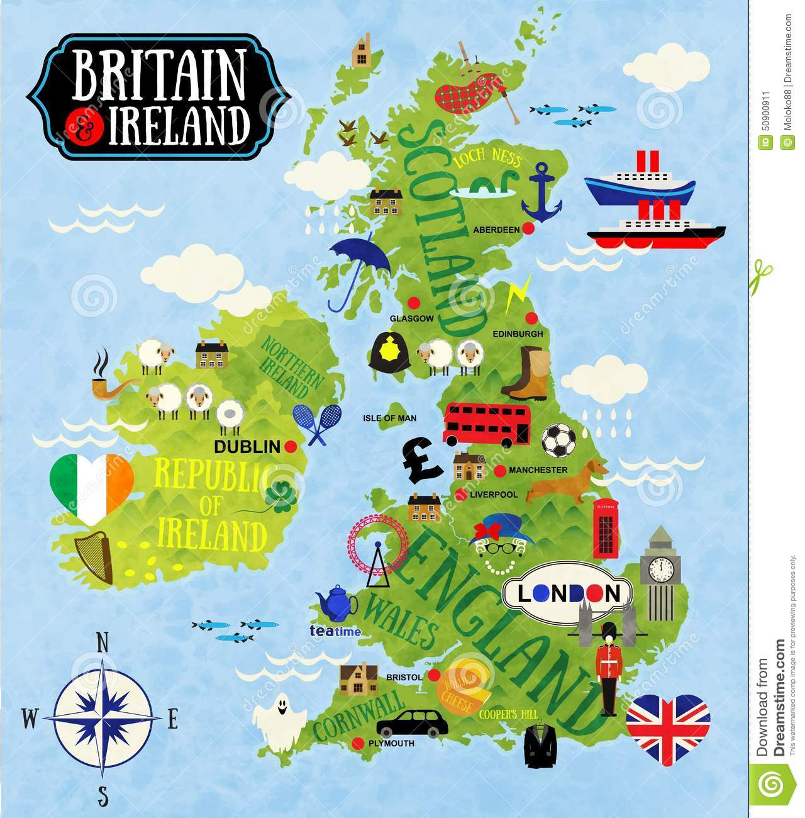

Parts of GB and their capitals

Slide 5

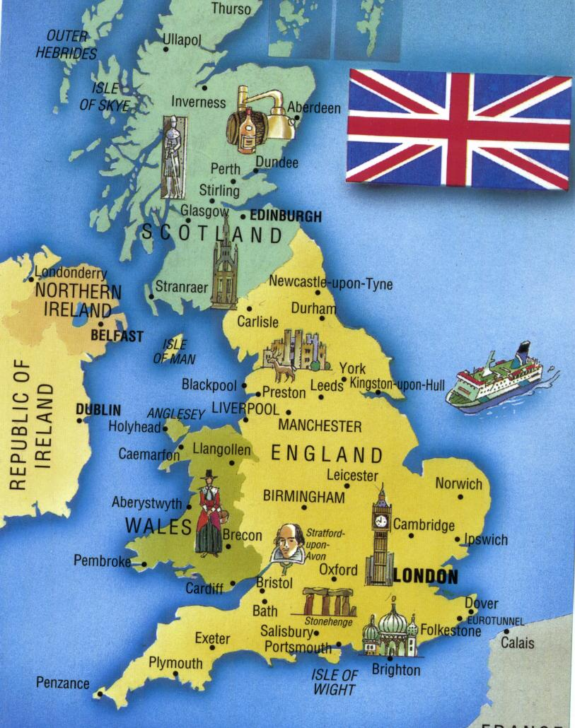
The UK is one of the world’s smallest countries. The population of the country is over 87 million and about 80% of it is urban. The UK is highly developed industrial country.

Slide 6
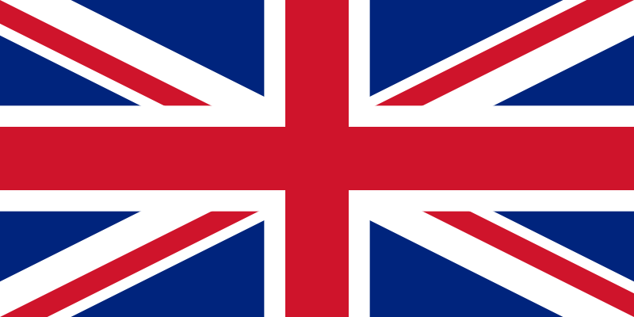
The flag of Great Britain
Union Jack

Slide 7
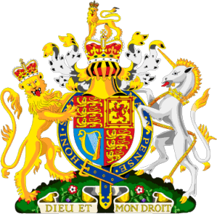
The coat of arms
The lion and the horse are the symbols of the power .

Slide 8
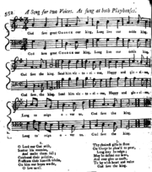

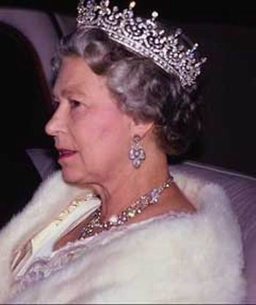

The hymn of Great Britain
God save the Queen
Боже, храни Королеву!
God save our gracious Queen
Long live our noble Queen,
God save the Queen!
Send her victorious,
Happy and glorious,
Long to reign over us:
God save the Queen!
O Lord, our God, arise,
Strike down her enemies,
And make them fall:
Confound their politics,
Frustrate their knavish tricks,
On Thee our hopes we fix:
God save us all!
Боже, храни нашу великодушную Королеву,
Да здравствует наша благородная Королева,
Боже, храни Королеву:
Сделай её победоносной,
удачливой и прославленной,
Пусть она правит над нами:
Боже, храни Королеву.
Господь, ты наш Бог, воскресни,
Поссорь её врагов,
И заставь их проиграть.
Запутай их действия,
Сорви их подлые планы,
На тебя мы возлагаем наши надежды,
Боже, храни нас всех.

Slide 9

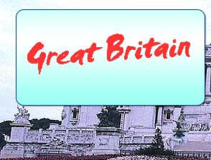
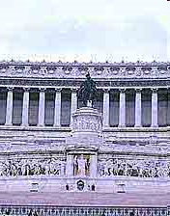

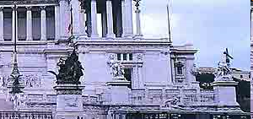
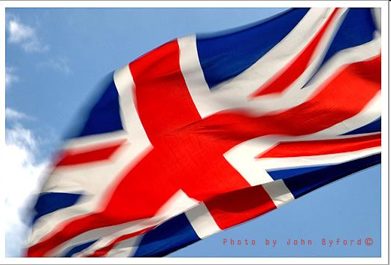
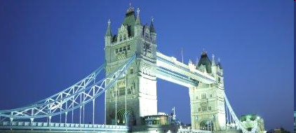
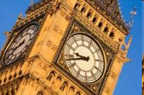
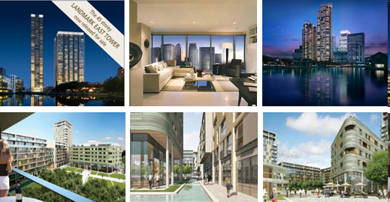
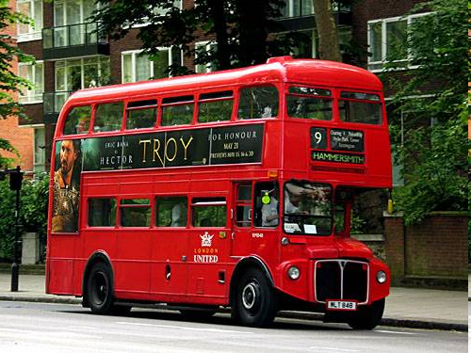

Slide 10

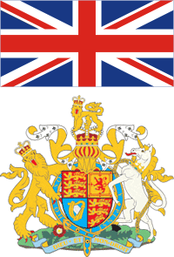
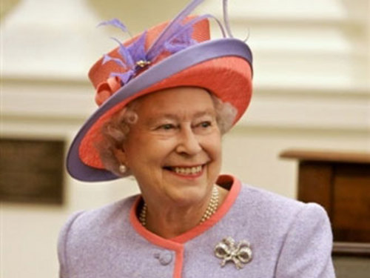
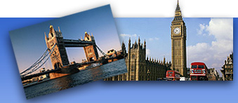
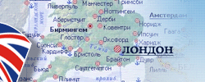
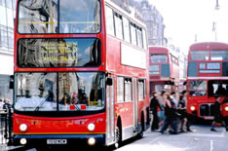
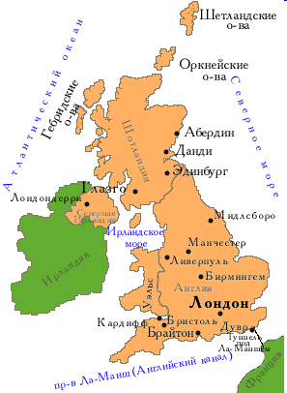
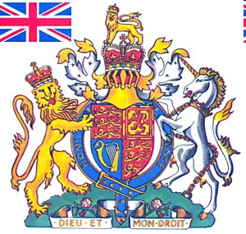





Slide 11

Thank you for your attention!

