Slide 1
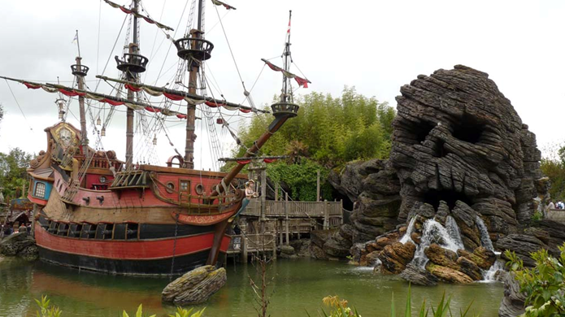
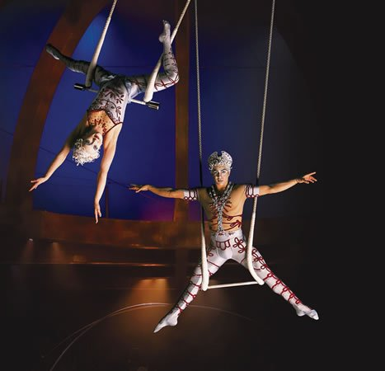
fly in a pirate ship
see trapeze artists

Slide 2

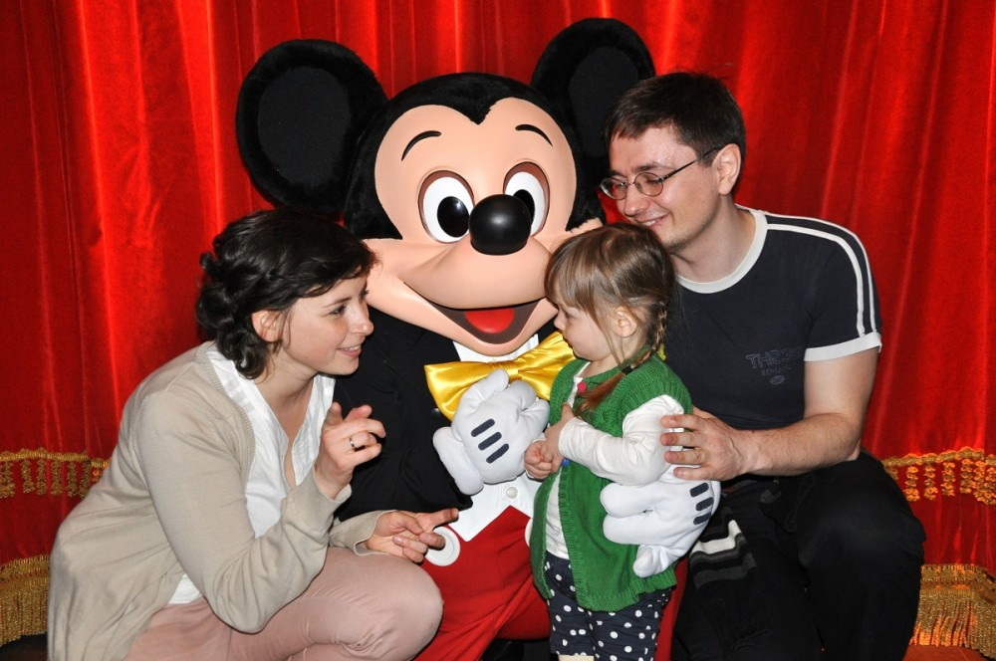
[gəʊst]
meet a ghost
shake hands with cartoon characters

Slide 3
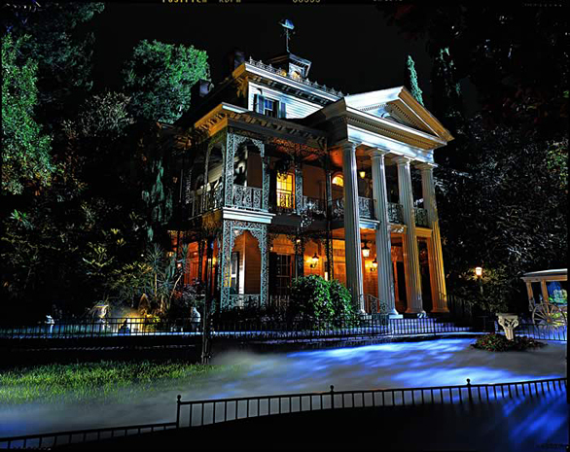
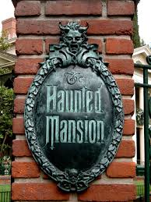
explore a haunted mansion
[ˈhɔːntɪd]
[mænʃn]

Slide 4
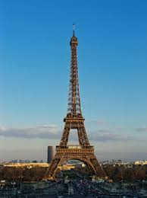
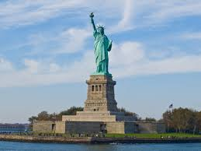
see famous landmarks

Slide 5
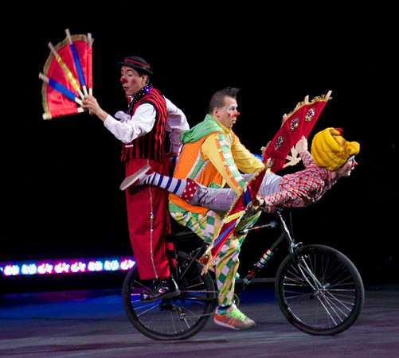
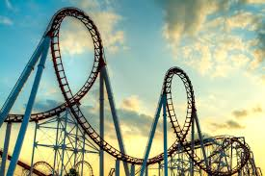
see clowns performing tricks
[ˈrəʊlərkəʊstər]
ride on a rollercoaster

Slide 6
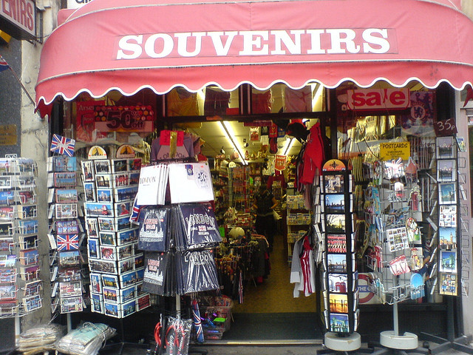
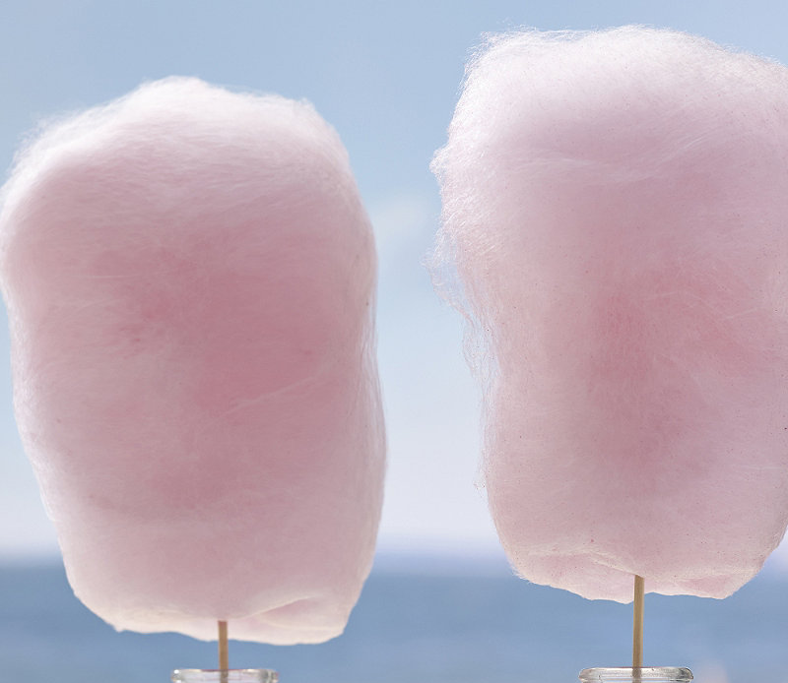
[ˈsuːvənɪə]
go souvenir shopping
eat candy floss

Slide 7
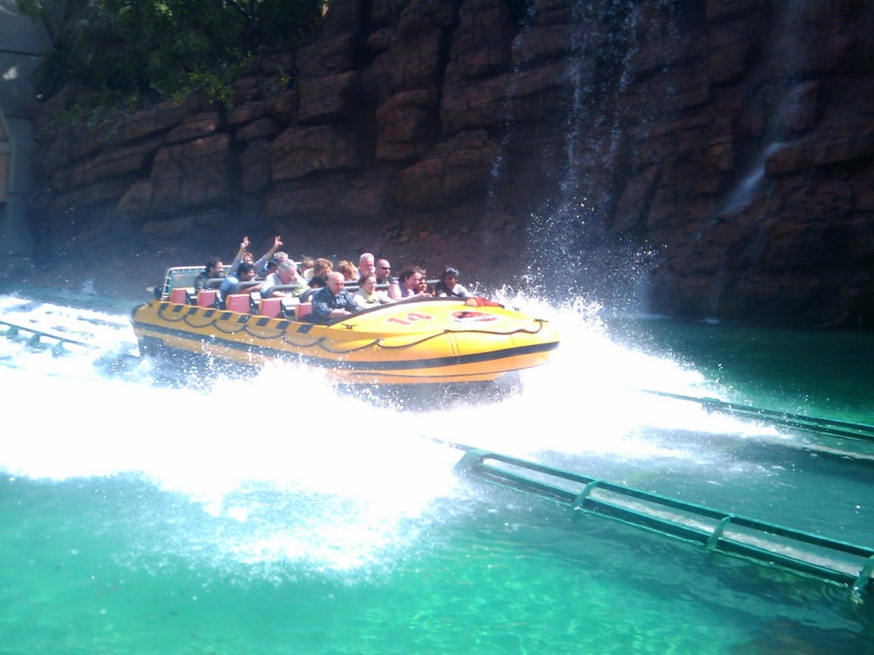
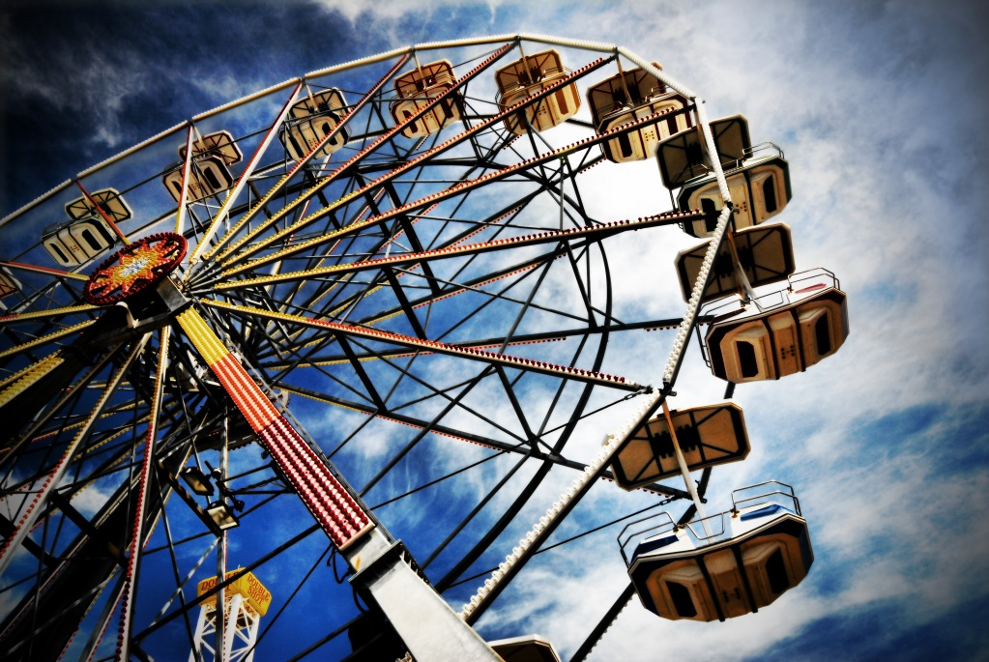
go on a water ride
ride on the big wheel

Slide 8
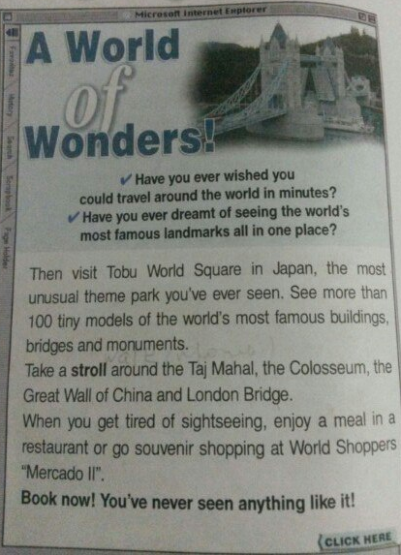
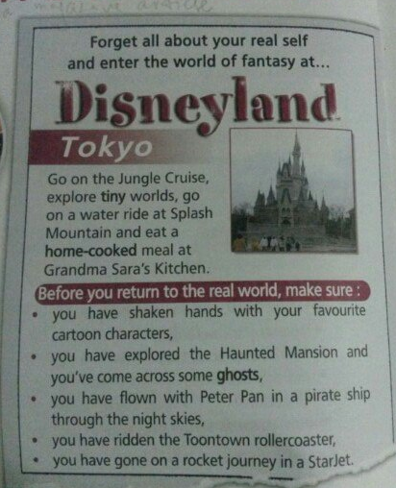

Slide 9
He has travelled around the USA. (He knows the USA)
They have come home. ( They are at home now)
HAVE/HAS + V³

Slide 10
Example:
you/ever/be/to Moscow?
Have you ever been to Moscow?
you/ever/be/abroad?
your parents/ever/go/on a rollercoaster ride?
your family/ ever/travel/by boat?
your best friend/ever/fly/in a helicopter?
you/ever/see/a ghost?

