Slide 1

Бюджетное профессиональное образовательное учреждение Омской области «Омский колледж отраслевых технологий строительства и транспорта»
Развитие стилей архитектуры в Англии
Выполнила: студентка 935 группы Пьянкова Д. А.
Руководитель: Бондаренко В.В.

Slide 2
The development of styles of architecture in England
The Romanesque style
Gothic style
Baroque
Classicism
Modernism
Modern architecture

Slide 3
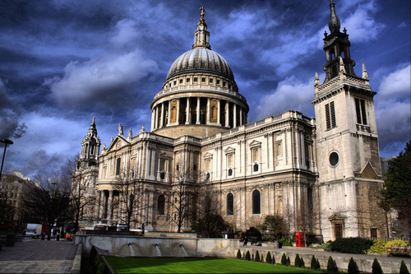
The main facade of the Cathedral is in Baroque style and decorated with bunk portico with double columns and a pediment.
St. Paul's Cathedral, erected in 1675-1710. according to the project Christopher Wren (1632-1723), is unusual in the history of architecture with a combination of medieval Cathedral with a classic dome.

Slide 4
The Romanesque style
The Romanesque style in England is emerging a little later than mainland Europe. The plans of the facades are elongated, having a different arrangement of the transept. On the facade the interior decor is widely used, reaching its roots from the wooden architecture, using wood carving.
In General the Romanesque cathedrals of England, with clearly identified typological community plans give the impression of a wide variety of forms and freedom of architectural and compositional solutions. This impression is reinforced by the picturesque location of temples.

Slide 5
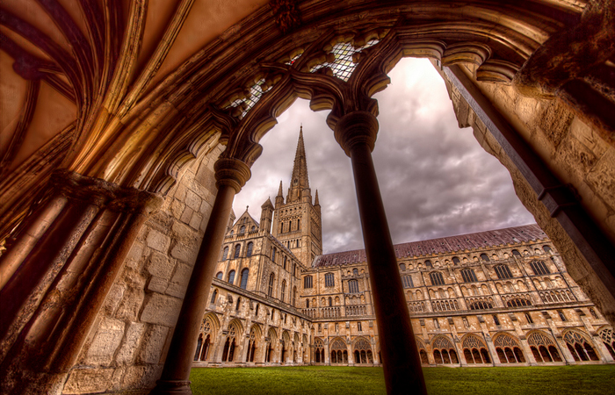
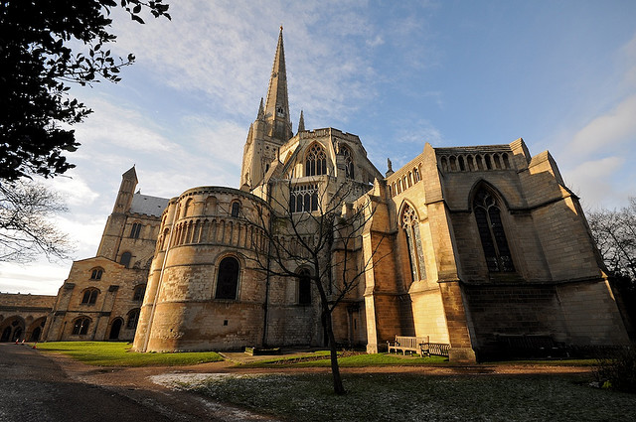
Norwich Cathedral
Interior view of the Romanesque Church of England does not produce the impression of weight and massiveness. So, at the Cathedral in Norwich this feeling is largely overcome due to the wide openings of the arches of the lower tier, empor and Windows, revealing the walls of the middle nave.

Slide 6
Gothic style
With the third quarter of the 12th century in England, a period of Gothic art. The growing economic recovery has led to the fact that since the 14th century, England already had an important place in the global market.
The company, which accounts for the development of Gothic art, it became a turning point for English culture. That was the time of the formation of the English language.

Slide 7
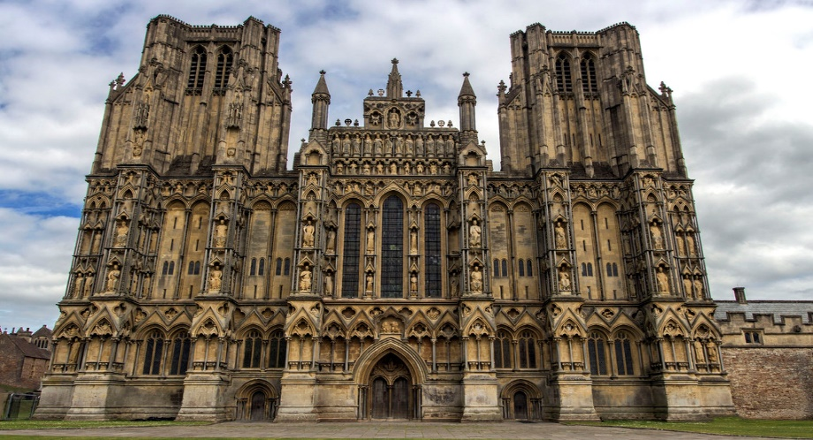
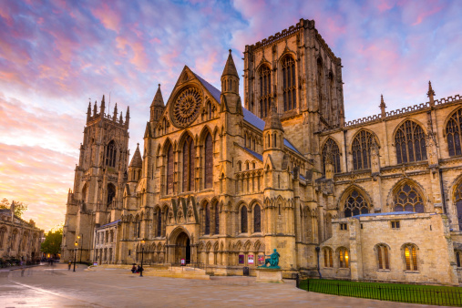
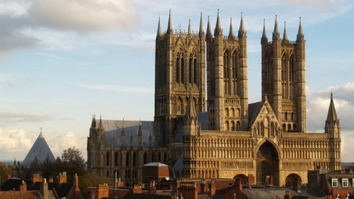
In England , the style lasted until the end of the XV century, largely appeared the influence of the local architectural school. In English Gothic release:
Early English; the style is up to 1270 years Wells Cathedral
"Decorated style" to 1370 years
York Minster
"Perpendicular style" of the XV-XVI century
The Cathedral Church of the Blessed Virgin Mary of Lincoln

Slide 8
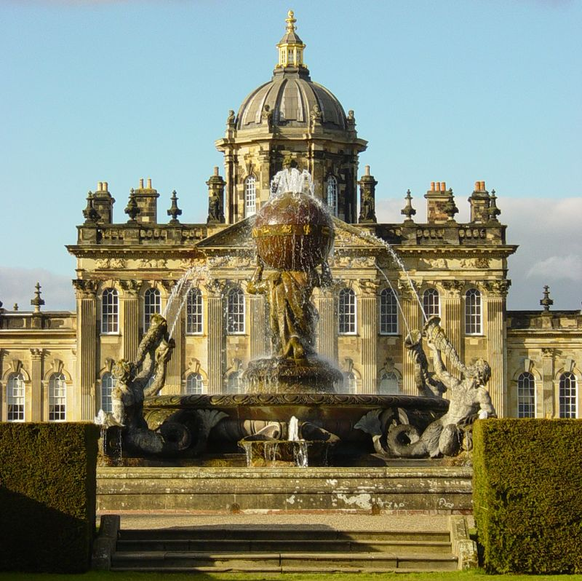
Baroque
Baroque in England were limited and short period of existence. A minor was and "clergy" of artists who have supported the style of European Baroque, including:
John Vanbru, architect
Nicholas Hexmoor, architect and assistant John Vanbru
Baroque style stick to the foreign artists invited to London. But most of them are portrait painters, and not the architects:
Anthony van Dyck, Godfrey Neller

Slide 9
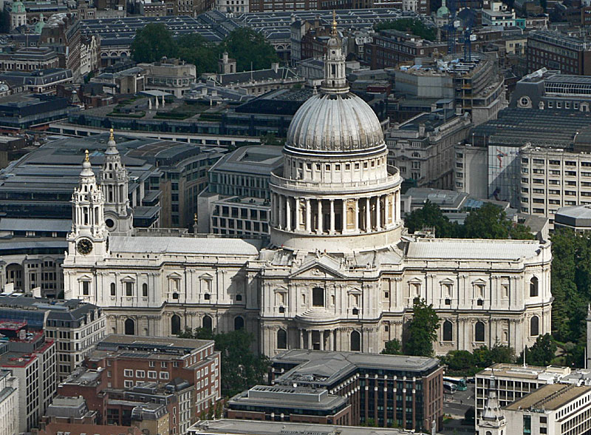
Classicism
The St. Paul's Cathedral in London
Classicism in England. Classicism is literally swept England, becoming a Royal architectural style. A whole galaxy of talented architects of England of the time studied and continued ideas of Palladio, Inigo Jones, Christopher Wren., the Earl of Burlington, William Kent.
The English architect Inigo Jones, an admirer of the works of Andrea Palladio, in the 17th century suffered the architectural legacy of Palladio to England. It is believed that Jones was one of the architects that marked the beginning of English school of architecture.

Slide 10
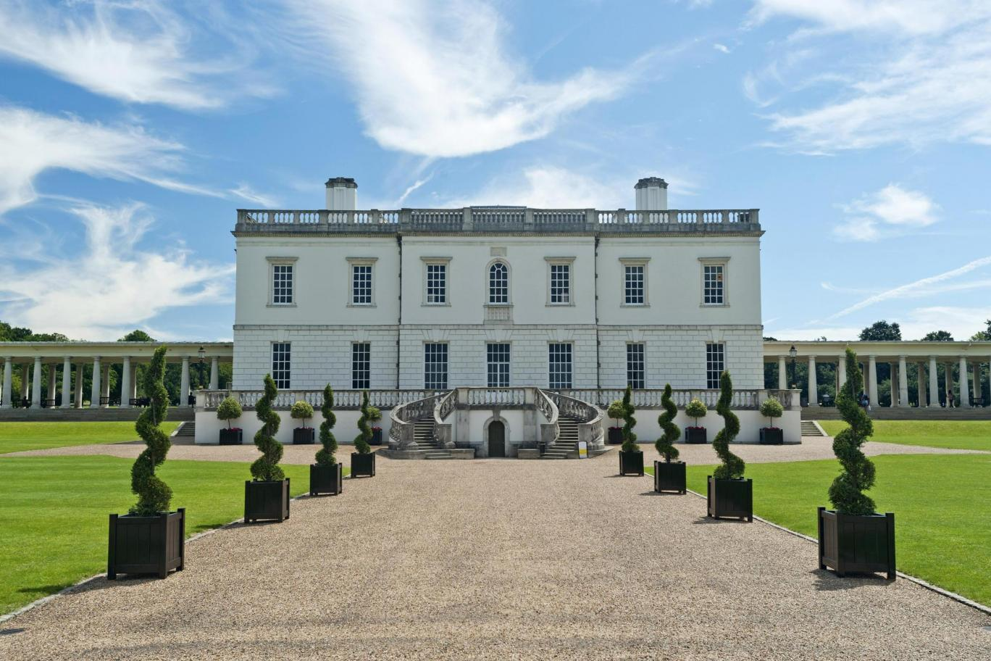
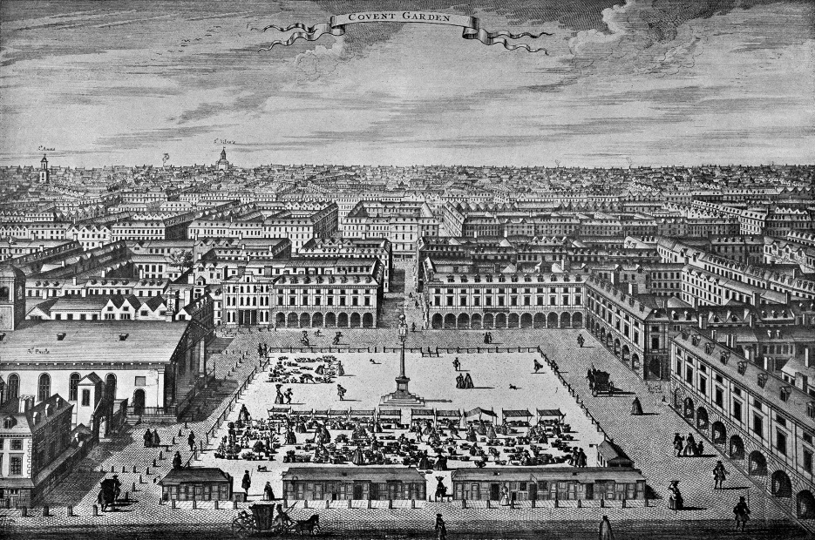
The first architectural monuments of classicism was built in the 17th century in England by the architect I. Jones (Inigo Jones. English architect, designer and artist. 1573—1652.): Queens house in Greenwich (Queen's House Queen's House. 1635), the ensemble of the square of Covent garden in London (1630.) These buildings have an understated design, underlined by the lack of decor.
The ensemble of the square of Covent garden in London
Queen’s House

Slide 11
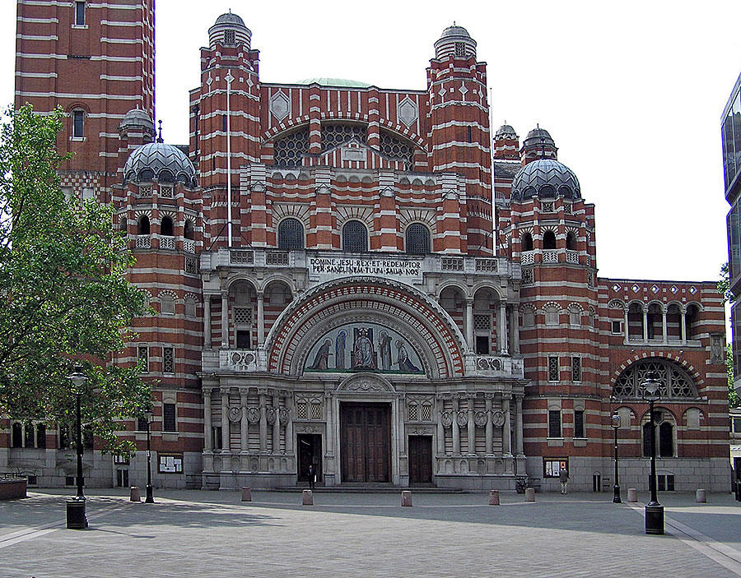
Modernism
Art Nouveau in architecture of the 20th century was not as common in England as in other European countries. More precisely, there are very few examples of the development of this style. Although the English and Scots made a huge contribution to the formation of the interiors and their details.
The main content of the period of Modernity was the pursuit of the synthesis of the various sources, methods, styles, forms and techniques.
Westminster Cathedral

Slide 12
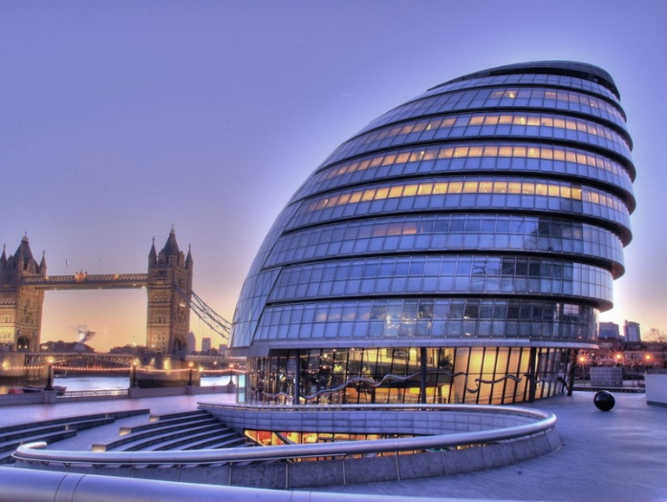
Modern architecture
City hall

Slide 13
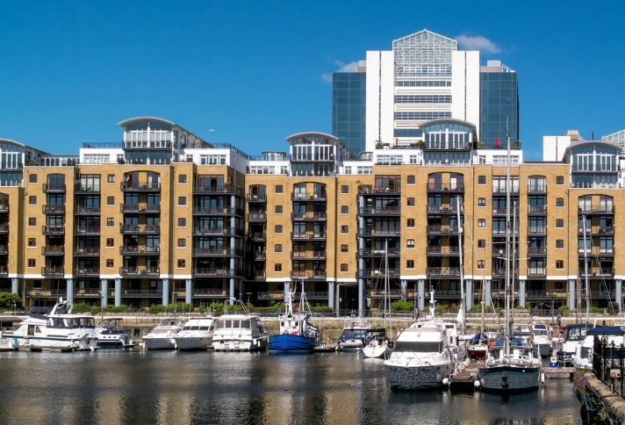
Actively eliminating outdated industrial enterprise, erected a modern, most civil buildings.
A striking example was the reconstruction located in the heart of London docks.

Slide 14
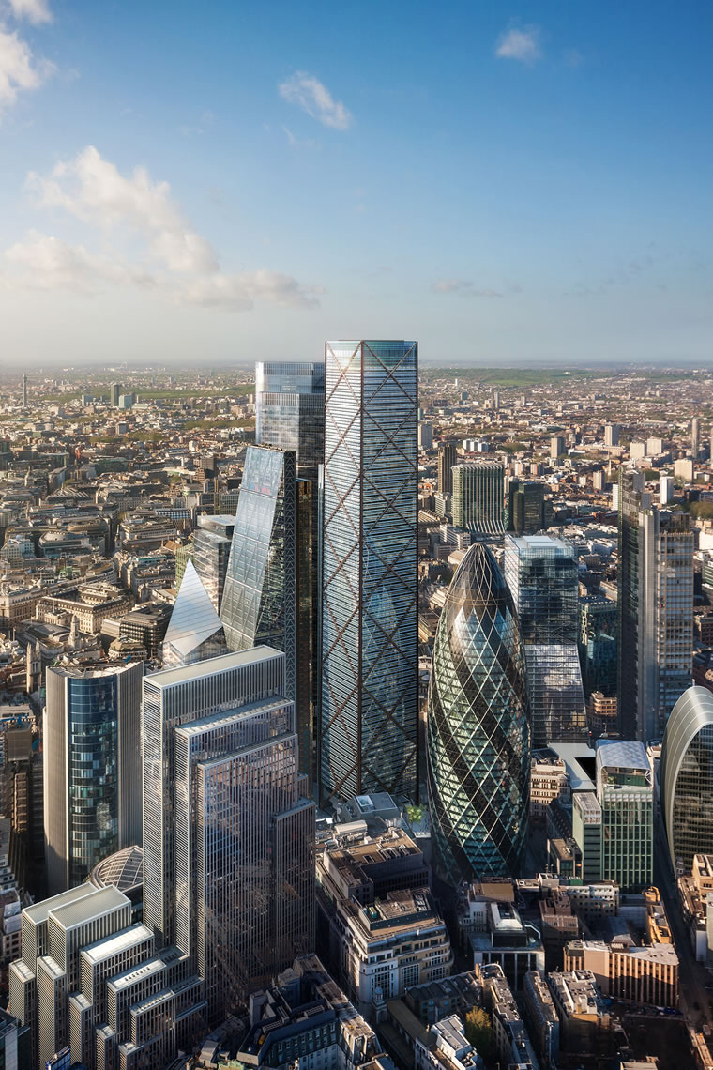
At the end of XX main task was the creation of multifunctional buildings – "architecture of big cities." Large cool atriums of the buildings of hotels and offices, and then multi-purpose building turned into skyscrapers. The construction of high rise buildings was caused by the increase in comfort business centers of appreciation of value of land under construction.

Slide 15
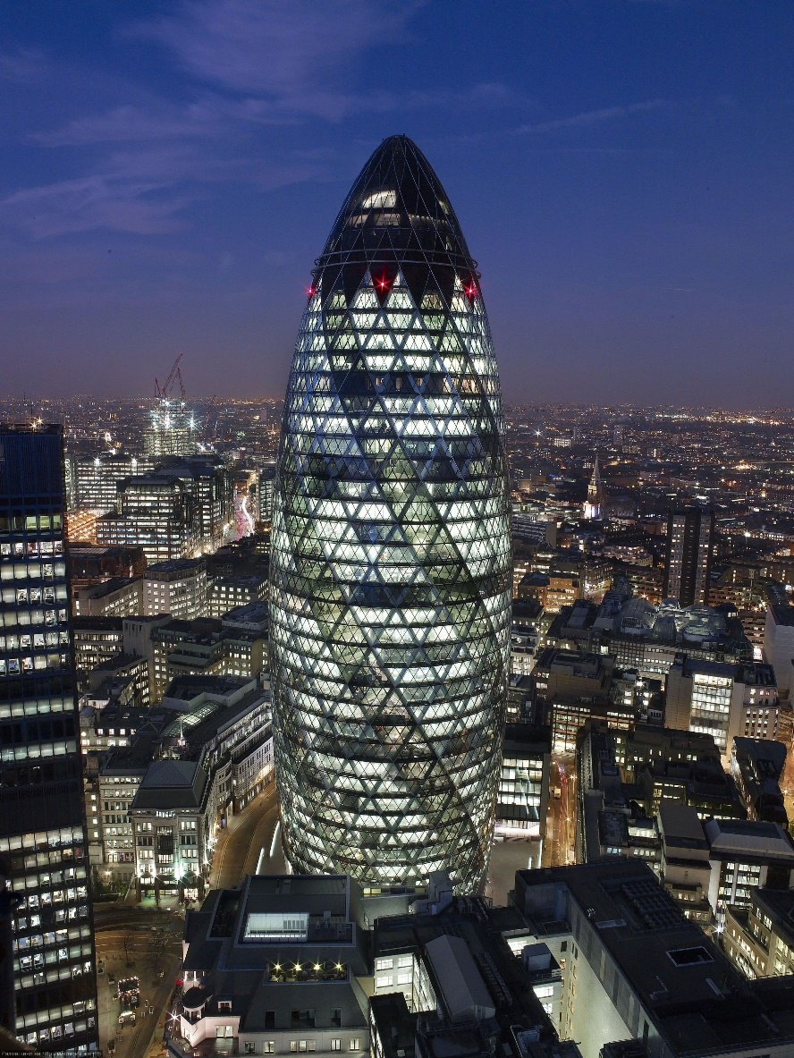
The headquarters of the Swiss company Swiss Re and one of the major works of Norman foster The construction lasted 2 years – from 2001 to 2003, But the official opening was held in April 2004 Immediately after the "birth" of the skyscraper has received several awards from Emporis Skyscraper Award for best skyscraper of the 2003 and 2004 annual award of the George. Stirling. Ironic but Londoners dubbed it cucumber or gherkin — the characteristic shape and greenish glass.
"The Gherkin, 30"

Slide 16
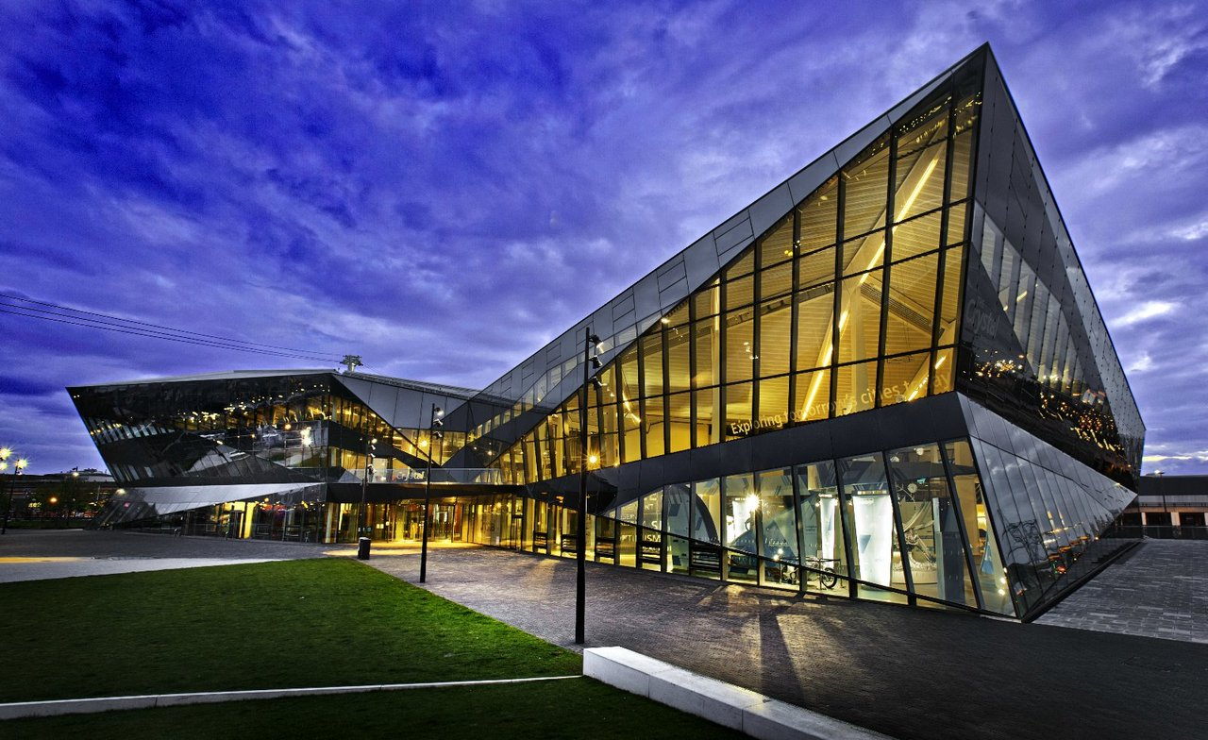
The end of the twentieth century is marked by the use of new constructional and facing materials of "high technology": the invention of aluminum alloys, polymers, new modifications of translucent materials. Intensive development of modern forms of bearing and enclosing structures. All this allowed to satisfy the requirements put forward social development is a cost effective, mobile, diverse, lightweight wide-span load-bearing structures. These achievements have generated a totally new means of expression, which contributed to the addition of new architectural forms and imagery.

