Slide 1
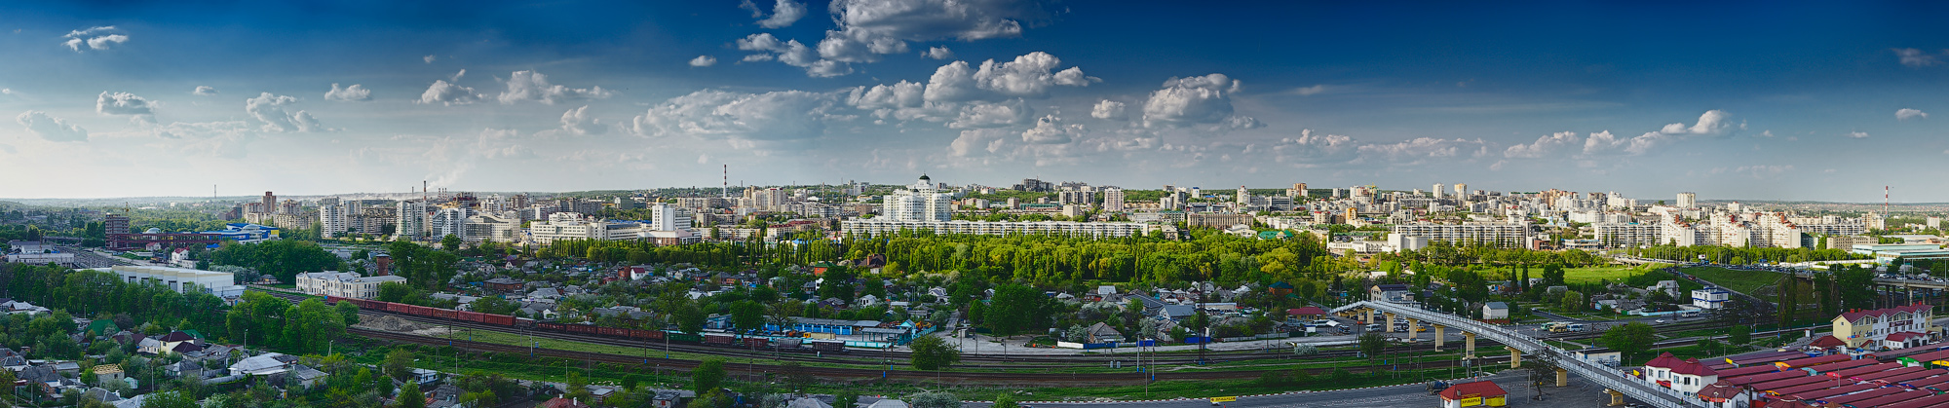
The famous people of the Belgorod Region

Slide 2
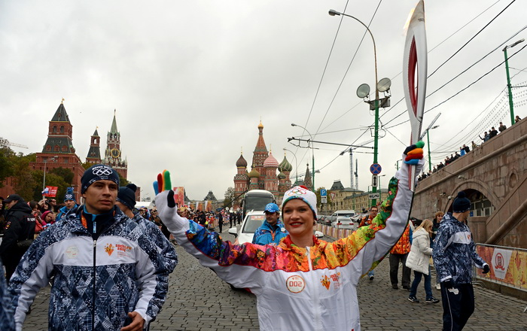
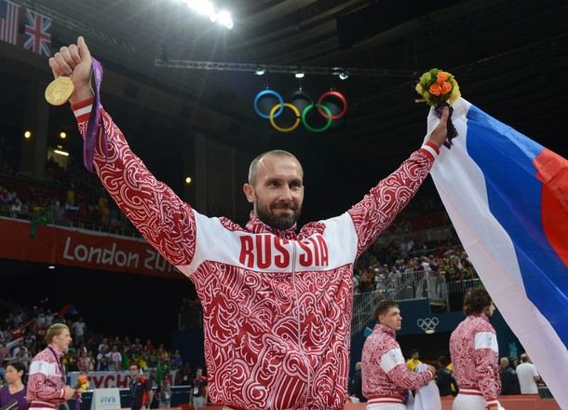
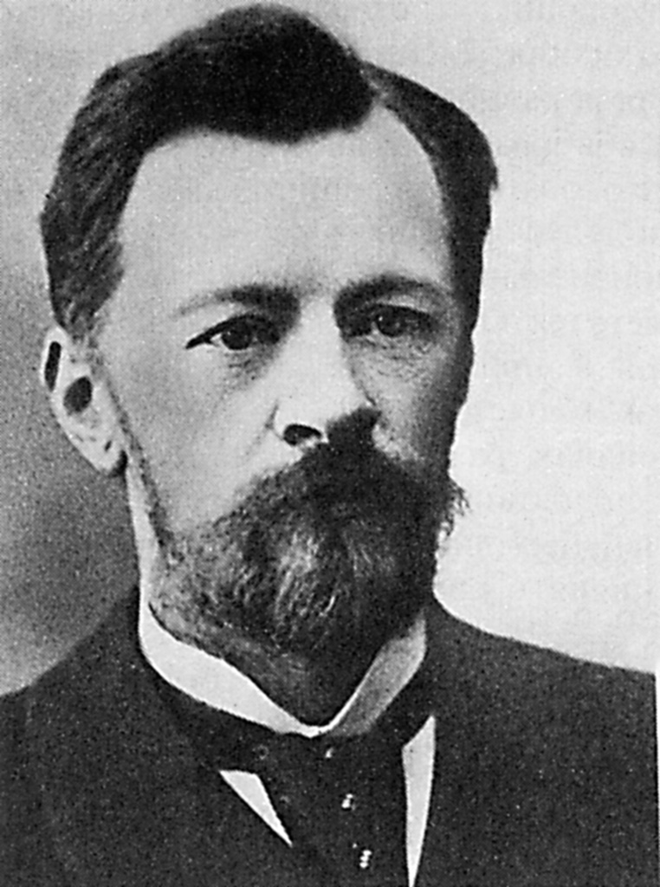
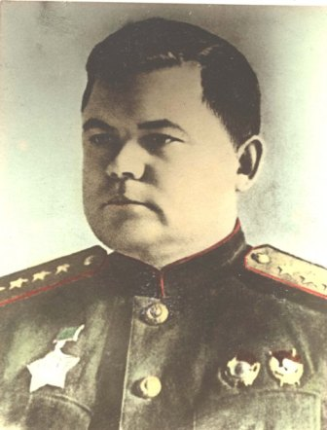
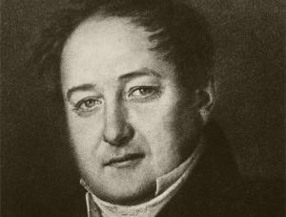
In the Belgorod Region there are a lot of famous people who are widely known in Russia.

Slide 3
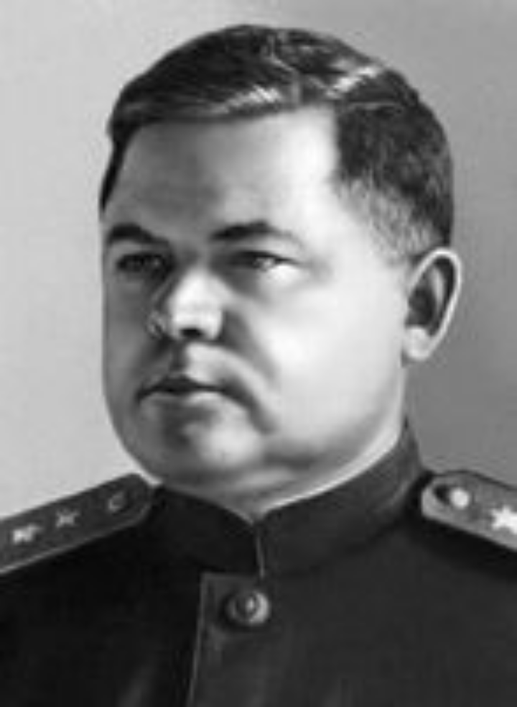
Nikolay Fyodorovich Vatutin
(1901-1944)
a general (генерал), a military leader during the Great Patriotic War (1941- 1945), born in the village of Chepukhino.

Slide 4
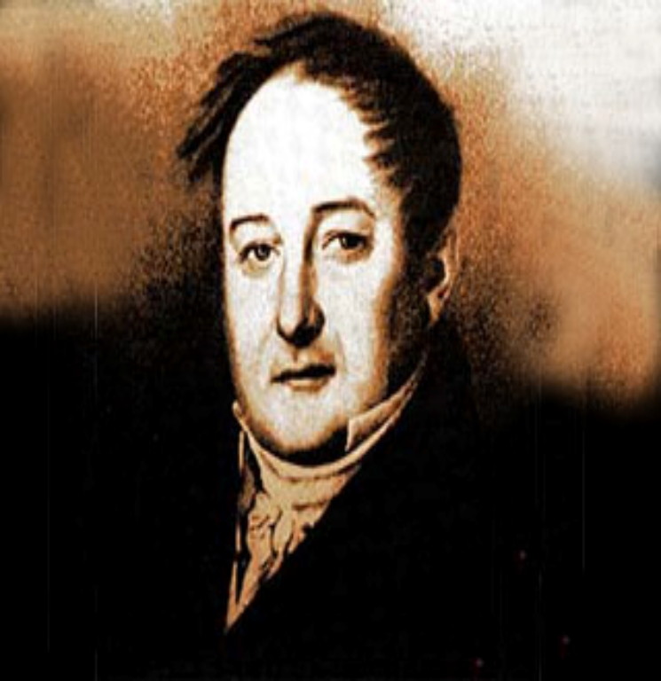
Mikhail Semyonovich Shchepkin (1788-1863)
a Russian actor, “the pride of national art”, 58 years of his life were devoted to the stage, born in the village of Krasnoye.

Slide 5
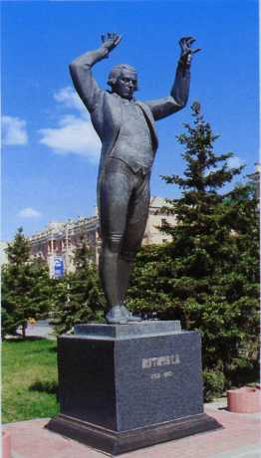
Stepan Anikievich Degtyarev
(1766-1813)
a conductor and a composer (дирижёр и композитор), the leader of the private musical theatre of Count (граф) Sheremetev; wrote the first Russian oratorios, 60 concertos, born in the Borisovka District.

Slide 6
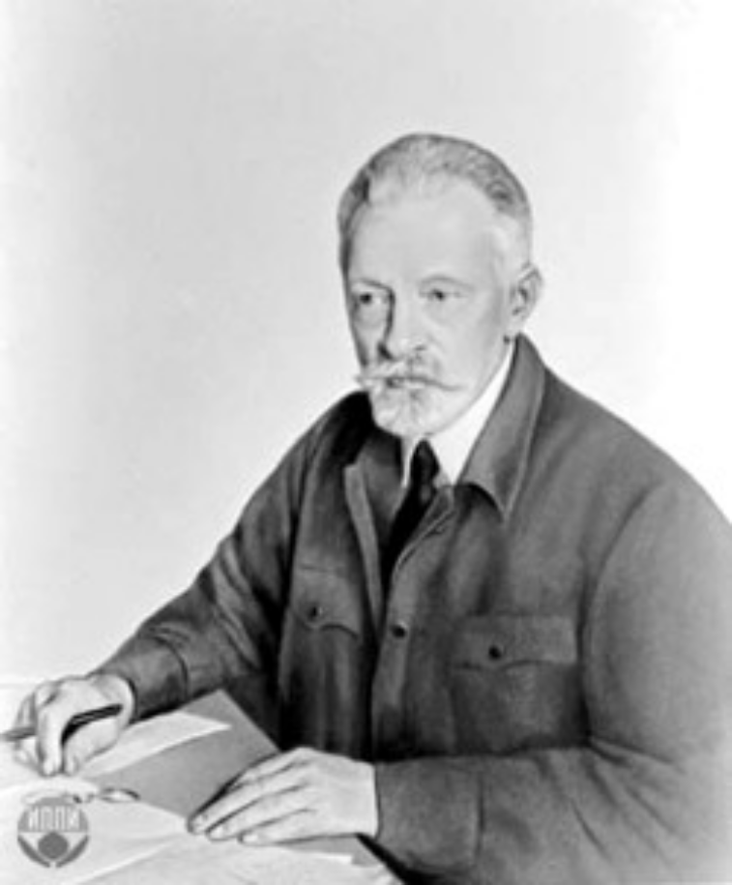
Vladimir Grigorjevich Shukhov
(1853-1939)
a professor, a genius of engineering design and construction projects; (гений инженерного проектирования и строительства) his main creation is the tower in Shabolovka Street in Moscow; built 500 bridges , born in the town of Graivoron

Slide 7
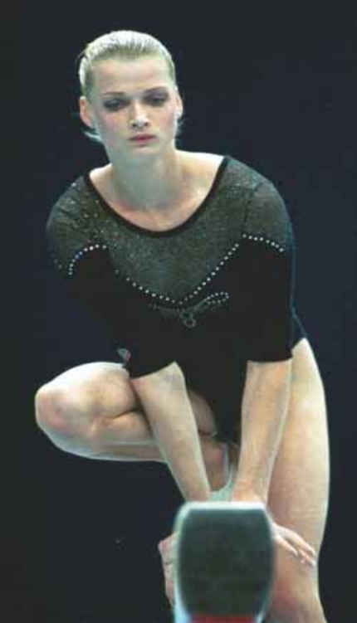
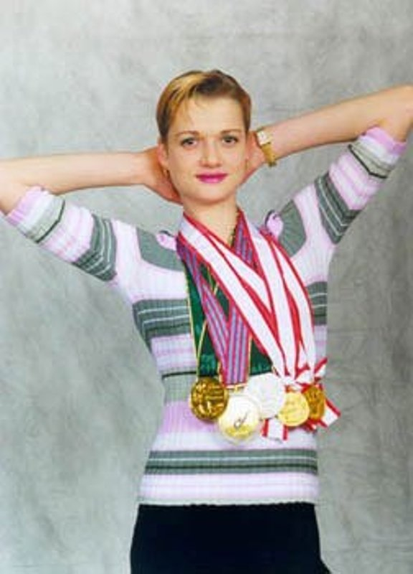
Svetlana Khorkina
a gymnast, a two-times Olympic champion, a many times champion of the world, Europe and Russia in gymnastics, born in Belgorod.

Slide 8
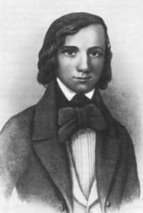
Nikolai Vladimirovich Stankevich
(1813-1840)
a philosopher, a poet and a community leader, born in Biryuch.

Slide 9
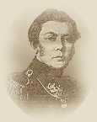
Vladimir Fedoseevich Raevsky
(1795-1872)
a Decembrist, a progressive thinker and writer, a hero of the Napoleonic War of 1812 and a friend of Alexander Pushkin, born in Stary Oskol.

Slide 10
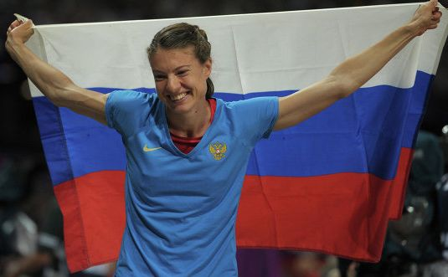
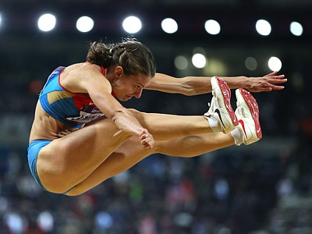
Yelena Sokolova
a Russian long jumper. She finished fifth at the 2007 European Indoor Championships, and won the silver medal at the 2007 Summer Universiade. In 2009 she won the silver medal. In August 2012, she won the silver medal at the 2012 Summer Olympics with a personal best jump of 7.07 metres. She’s born 23 July 1986 in Belgorod.

Slide 11
