Slide 1



















Slide 2


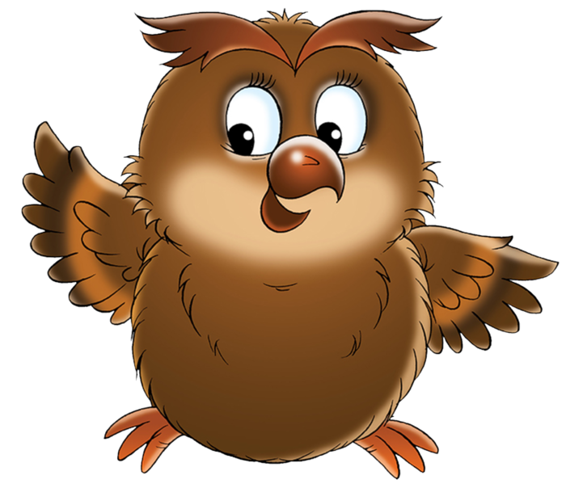


It is a parrot.
It is an owl.
It is a fish.

Slide 3




Slide 4


Slide 5


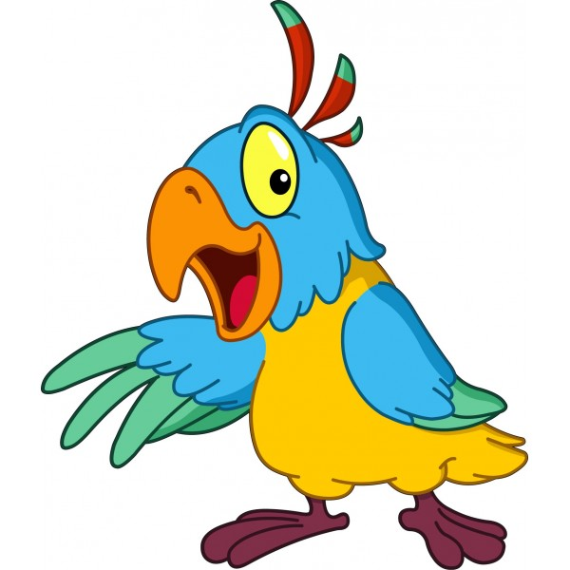
It is an owl.
It is an ant.
It is a parrot.

Slide 8



It is a rabbit.
It is a hamster.
It is a cat.

Slide 11

It is a fish.
It is a tortoise.
It is a crocodile.

Slide 14

It is a rabbit.
It is an ant.
It is a hamster.

Slide 17

It is a fox.
It is a bear.
It is a dog.

Slide 20

It is a cat.
It is a fox.
It is a lion.

Slide 23

It is a frog.
It is a fish.
It is a tortoise.

Slide 26

It is a cow.
It is a zebra.
It is a horse.

Slide 29

It is a hamster.
It is a rabbit.
It is a parrot.

Slide 32
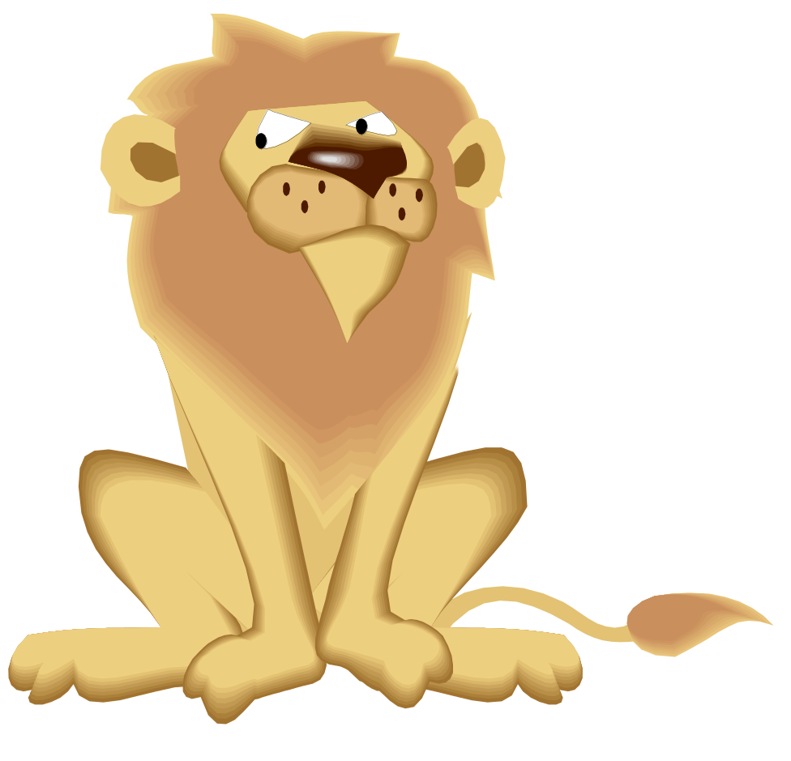
It is a lion.
It is an elephant.
It is a tiger.

Slide 35

It is a horse.
It is a hamster.
It is a pig.

Slide 38
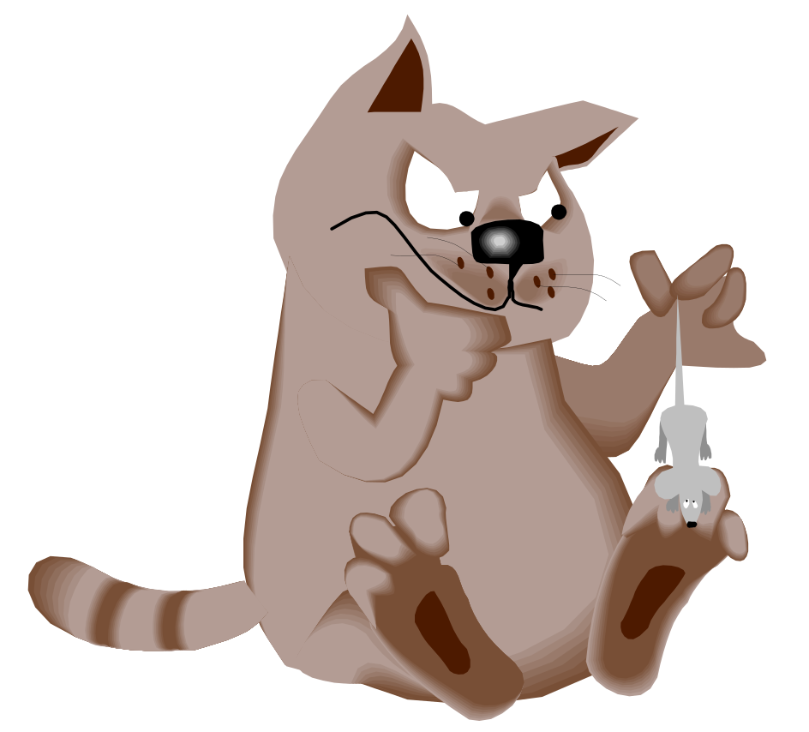
It is a cat.
It is a dog.
It is a rabbit.

Slide 41

It is a lion.
It is a bear.
It is a fox.

Slide 44
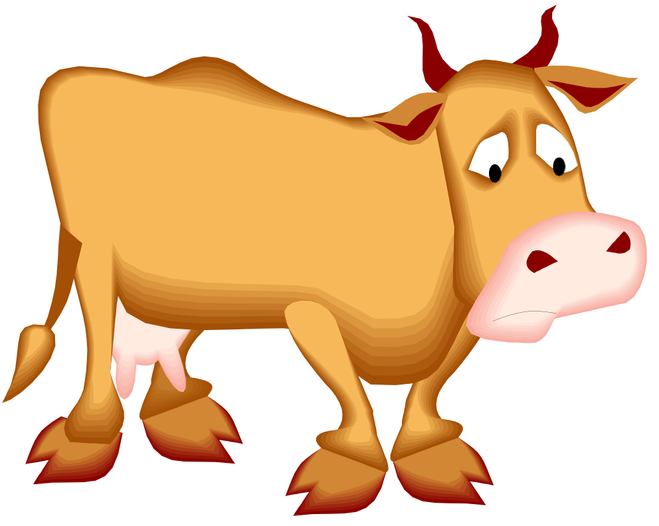
It is a goat.
It is an elephant.
It is a cow.

Slide 47
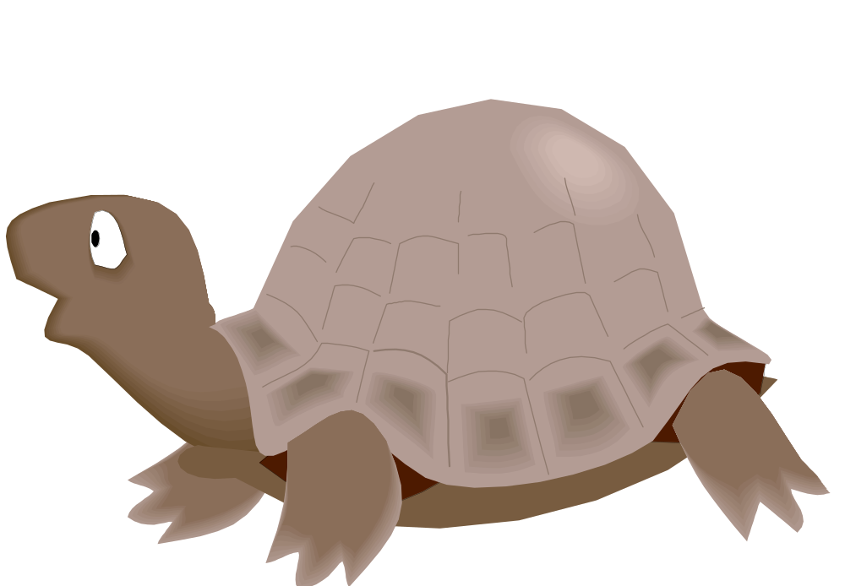
It is a tortoise.
It is a fish.
It is a frog.

Slide 50

It is a frog.
It is a tortoise.
It is a crocodile.

Slide 53

It is a lion.
It is a tiger.
It is a fox.

Slide 56

It is a horse.
It is an elephant.
It is a cow.

Slide 59

http://www.xn--80aauegbcjrdg4a.xn--p1ai/uploads/1/0/5/8/10580347/9960600_orig.jpg
http://www.clipartsfree.de/images/joomgallery/details/bauernhof_cartoon-bilder_4/hamster_clipart_bild_cartoon_kostenlos_20150104_1026400692.png
http://galerey-room.ru/images/0_5145f_23db1b83_orig.png
http://www.clipartlord.com/wp-content/uploads/2012/11/happy-fish.png
http://www.playcast.ru/uploads/2015/01/04/11432029.png
http://zooclub.ru/attach/fotogal/clip/cats/52.jpg
http://zooclub.ru/attach/fotogal/clip/amfib/32.jpg
http://zooclub.ru/attach/fotogal/clip/dogs/68.jpg
http://zooclub.ru/attach/fotogal/clip/mouse/110.jpg
http://zooclub.ru/attach/fotogal/clip/wdogs/37a.jpg
http://www.search-best-cartoon.com/cartoon-lion/cartoon-lion-02.jpg
http://www.3d-hdwallpaper.com/bulk_images/funny-horse-images-cartoon-dowload.jpg
http://wondersofdisney2.yolasite.com/resources/aladdin/rajahsmile.png
http://zooclub.ru/attach/fotogal/clip/cow/37.jpg
http://cliparts.co/cliparts/kT8/kdy/kT8kdyRxc.gif
http://zooclub.ru/attach/fotogal/clip/rept/67.jpg
http://zooclub.ru/attach/fotogal/clip/elep/26.jpg
http://img1.liveinternet.ru/images/attach/c/2/69/176/69176919_1294913719_15.png
http://funforkids.ru/pictures/turtle/turtle16.gif

Slide 60

http://images.clipartpanda.com/smiley-face-thumbs-up-cartoon-yTkeza64c.png
http://images.clipartpanda.com/sarcasm-clipart-clipart-wondering-smiley-emoticon-512x512-7a0c.png
https://orientacionandujar.files.wordpress.com/2012/09/marco-para-decorar-animales.png
Шаблон презентации «Линии» скачан с сайта http://pedsovet.su/ (Режим доступа: http://pedsovet.su/load/418-1-0-27097)
http://prazdnichnyymir.ru/prazdnichnyi-dizain-blogov/alfavity/6003/zhirafy-alfavity-latinica/
http://ed101.bu.edu/StudentDoc/current/ED101sp13/jloconn/jloconn/uploads/1/7/1/5/17158974/713715990.png
http://www.pubzi.com/f/lg-double-arrow-button.png
http://www.physics.ncsu.edu/ntg/leegroup/Links.png
https://openclipart.org/image/2400px/svg_to_png/16950/jean-victor-balin-add.png

