Slide 1
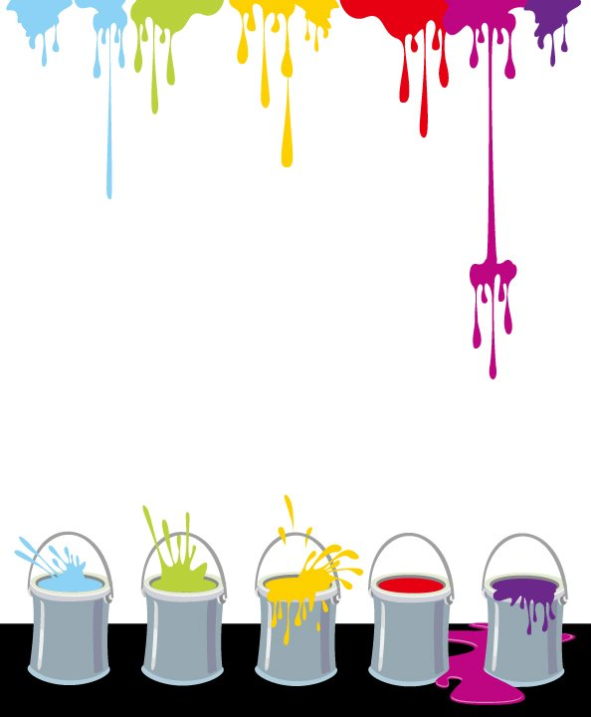








Slide 2





black
brown
purple

Slide 3

blue
green
purple

Slide 4

orange
red
pink

Slide 5

pink
brown
red

Slide 6

orange
brown
black

Slide 7

grey
green
white

Slide 8

blue
green
yellow

Slide 9

yellow
brown
green

Slide 10

blue
red
purple

Slide 11

grey
white
yellow

Slide 12


orange
red
green

Slide 13


http://img9.3lian.com/c1/vec2013/9/56.jpg
http://nfepta.org/wp-content/uploads/2014/05/websiteslinks-icon.png
http://pm-zone.org/wp-content/uploads/2015/06/1310437626_1.jpg
http://soltechenergies.net/wp-content/plugins/featured-content-gallery/push-pin-clip-art-free-8011.png
https://drslash.com/wp-content/uploads/2014/07/Plex-Home-Theater.png
http://icon-park.com/imagefiles/book2_icon_black.png
http://icon-park.com/imagefiles/book2_icon_pink.png
http://icon-park.com/imagefiles/book2_icon_blue.png
http://icon-park.com/imagefiles/book2_icon_red.png
http://icon-park.com/imagefiles/book2_icon_light_gray.png
http://icon-park.com/imagefiles/book2_icon_bworn.png
http://icon-park.com/imagefiles/book2_icon_purple.png
http://icon-park.com/imagefiles/book2_icon_yellow.png
http://icon-park.com/imagefiles/book2_icon_white.png
http://icon-park.com/imagefiles/book2_icon_light_orange.png
http://icon-park.com/imagefiles/book2_icon_dark_green.png
http://www.clker.com/cliparts/0/7/6/d/12065593531730575284mystica_Arrow_set_%28Happy%29_Left-Right_2.svg.hi.png
http://images.clipartpanda.com/clipart-house-8514-blue-house-clip-art.png
http://www.internet-inspiration.com/wp-content/uploads/2012/07/red-41503_640.png
(рисунок был использован в качестве шаблона для создания остальных цветов в программе MS PowerPoint, раздел «Работа с рисунками»)

