Slide 1
AMAZING WORLD OF INSECTS
(make comics)
Автор: учитель английского языка
МАОУ «СО(РК)Ш №2»
г.Магадана
Башкатова Яна Сергеевна

Slide 2
The topic is – INSECTS
The aim is – to make a comic on the topic,
- to repeat infrmation about different types of insects,
- to practice speaking skills about insects (dialogs)
The problem is – are they true friends or harmful ones?

Slide 3
INSECTS MAY BE
FLYING (they can fly)
GROUND (they live on the ground and can crawl )

Slide 4
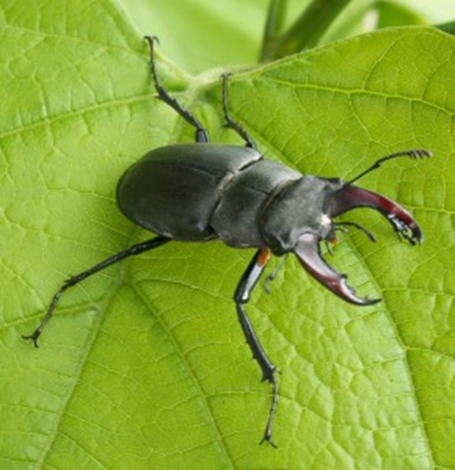
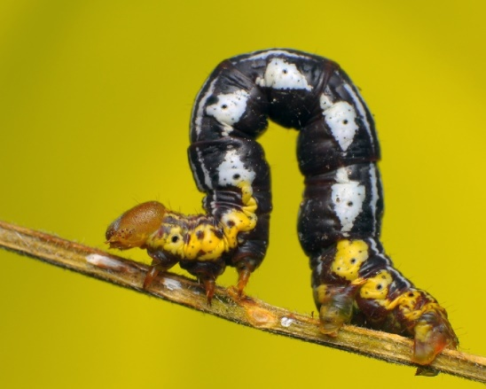
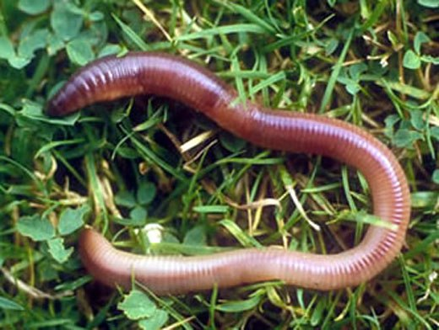
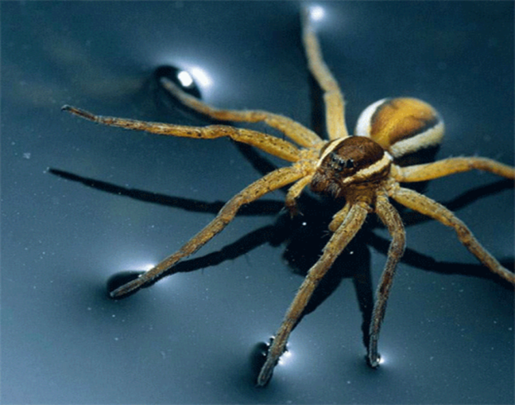
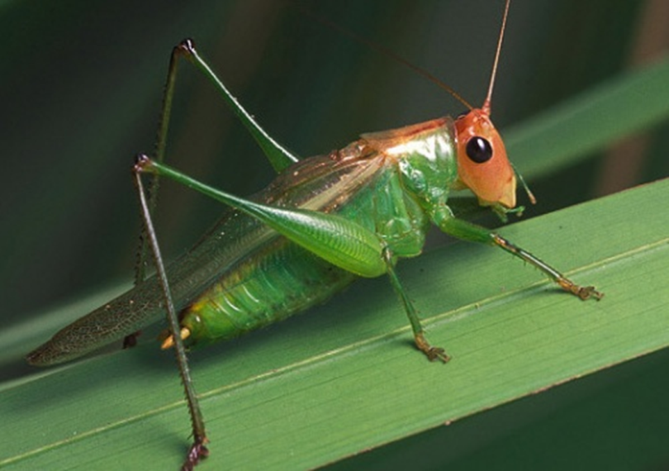
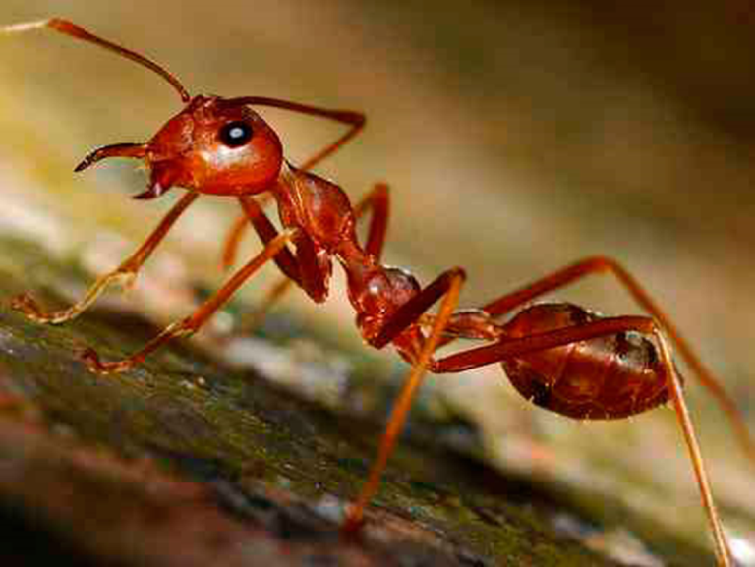
GROUND INSECTS
beetle
caterpillar
worm
grasshopper
ant
spider

Slide 5
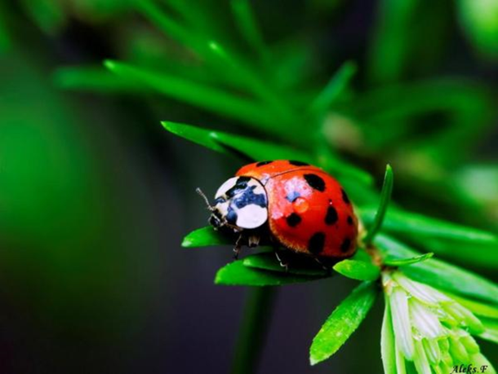
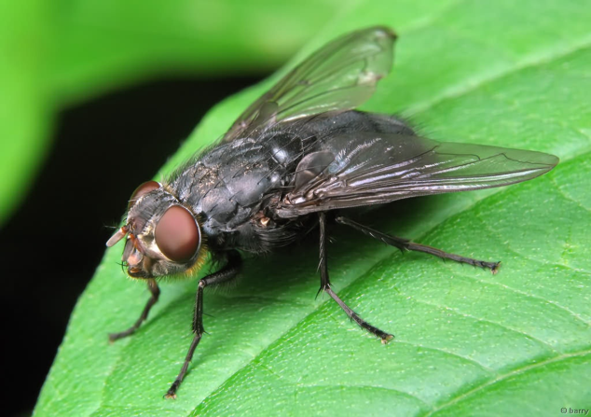
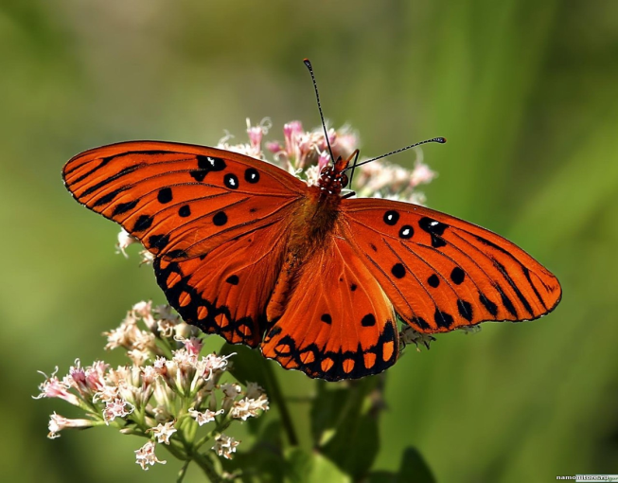
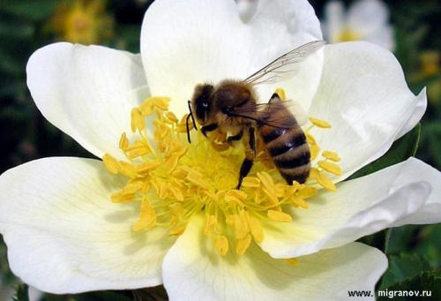
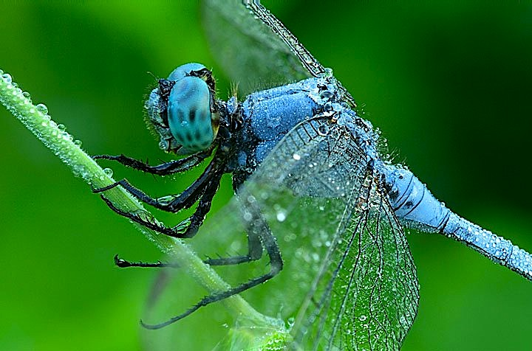
FLYING INSECTS
butterfly
ladybird
fly
bee
dragonfly

Slide 6
