Slide 1

Module 5 b
At the zoo

Slide 2
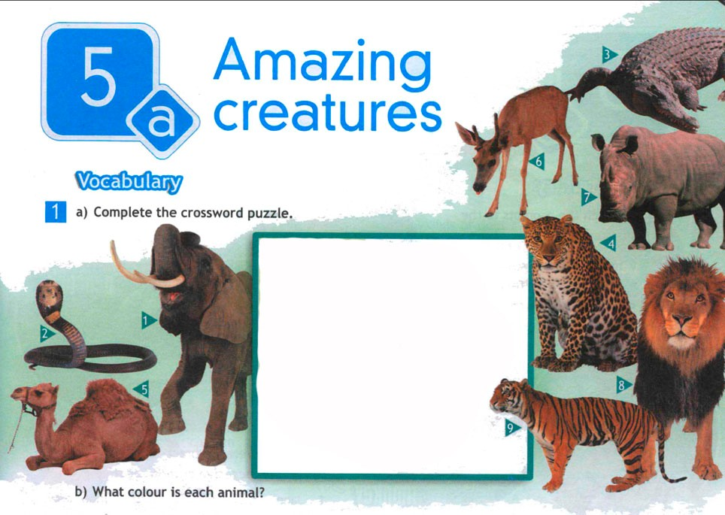
3
6
7
1
2
3
4
e
c
c
4
l
e
o
p
a
r
d
5
e
b
o
c
1
p
r
c
a
2
h
a
o
m
a
6
d
e
e
r
7
r
h
i
n
o
8
i
l
5
t
l
l
8
9
t
i
g
e
r
o
9
n

Slide 3
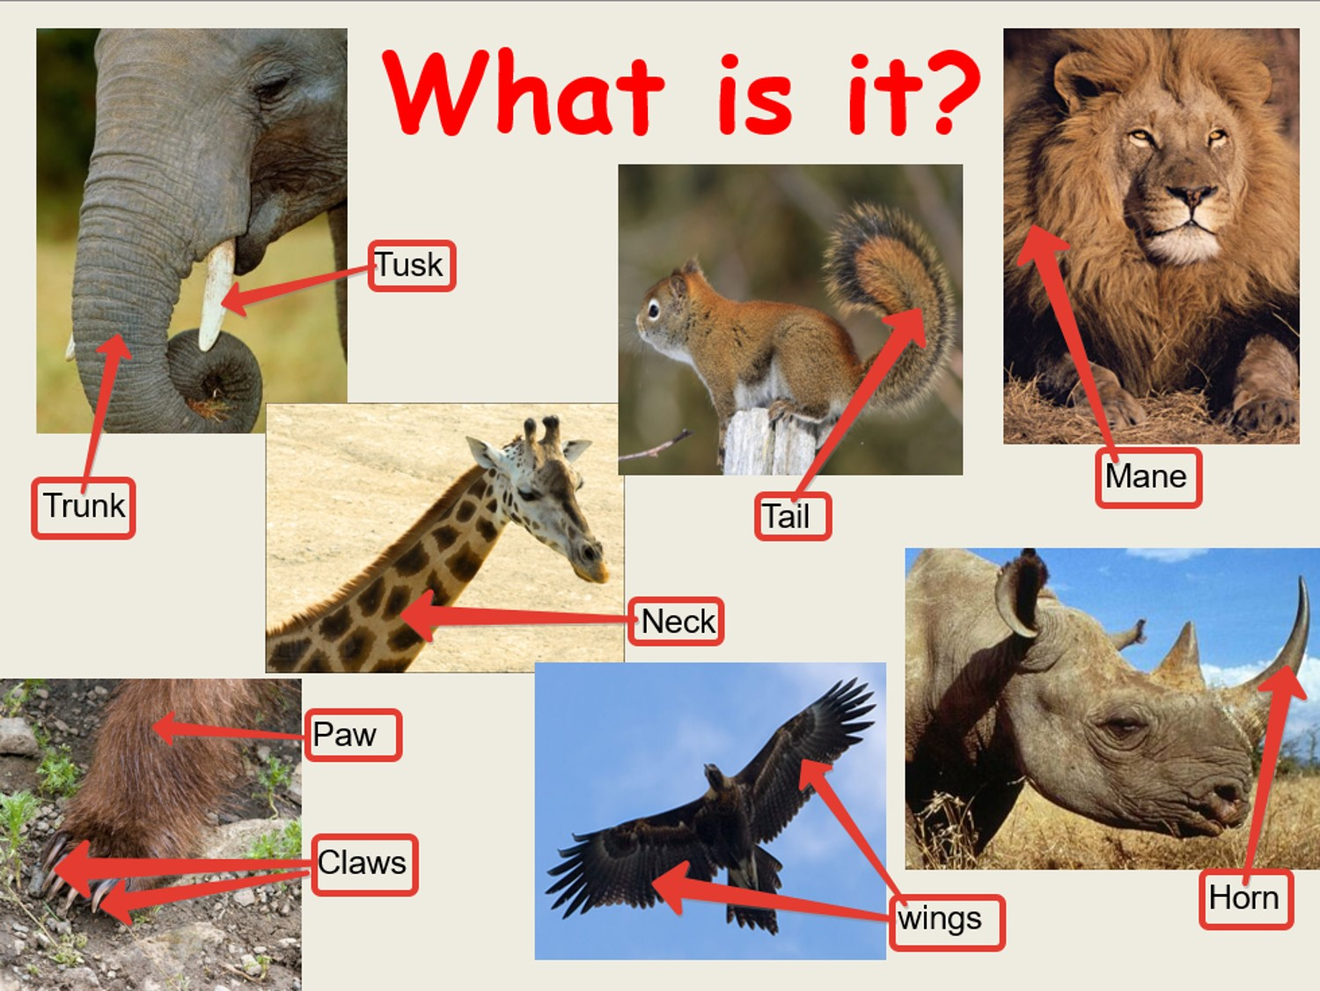

Slide 4
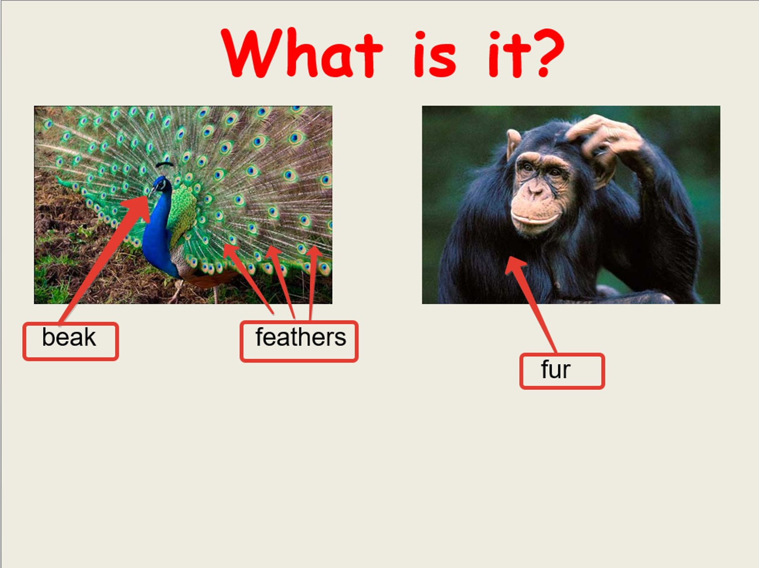

Slide 5
long
short
thin
thick
big
small

Slide 6
Describe any of the animals !
The elephant has got …
The lion has got …
The giraffe has got …
The peacock has got…

Slide 7
Ask questions !
Has it got … ?
Can it… ?
Is it …. ?

Slide 8
Now I know the parts of the body of the animal.
I can act out the dialogue about the animals
at the zoo.
I can read the dialogue about the zoo.
I can describe the animal.

