Slide 1
What kind of human states are compared in this poem?

Slide 2
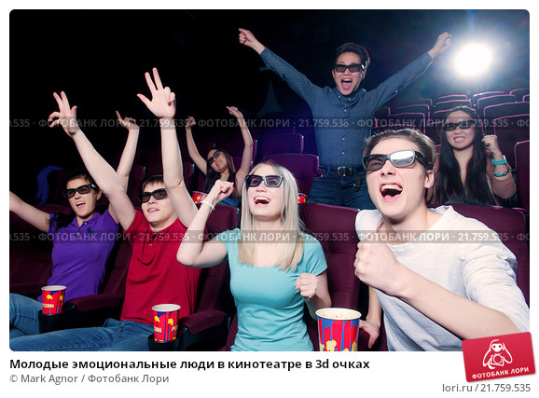

What do young people have and do not have the elderly ones?

Slide 3
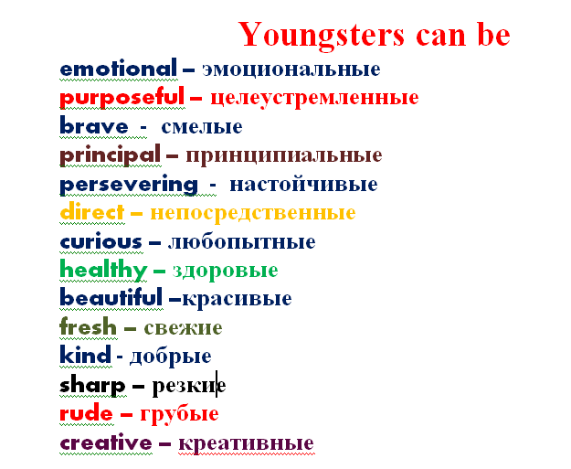

Slide 4
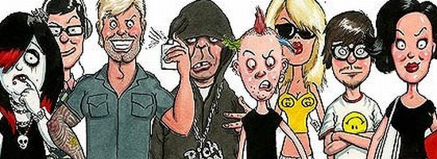
Subcultures
AND
YOUNGSTERS’ individuality

Slide 5
Our tasks:
revise the material
on Subcultures
doing different kinds of work

Slide 6
The main point of our lesson is to answer to the question
WHAT IS THE AIM OF BEING REPRESENTSTIVES OF ANY SUBCULTURES?

Slide 7

Cambridge Advanced Learner's Dictionary & Thesaurus
Subculture - the way of life , customs, and ideas of a particular group of people within a society that are different from the rest of than society.

Slide 8
Cultural groupings
Rockers
Hippies
Bikers
Hackers
Skinheads
Punks
Goths
Ravers
Contents

Slide 9
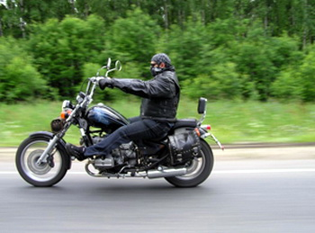
Bikers
Leather jacket
Army boots
Cow – boy hat
Motorized vehicle
Contents

Slide 10
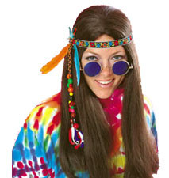
Hippie
Strange behavior
Liberal attitude and lifestyle
Unusual appearance
Contents

Slide 11

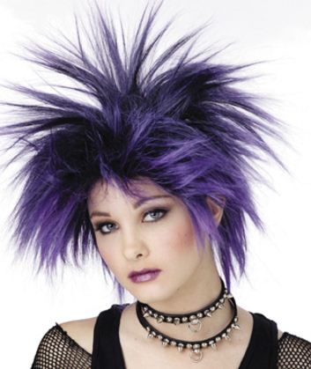
Hackers
Punks
Computer genius
Brightly colored hair
Contents

Slide 12
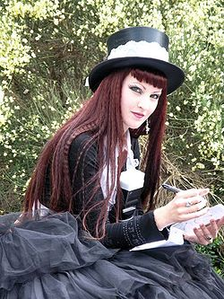
Goth
The Goth subculture has associated tastes in music, and fashion. They like black clothes.

Slide 13
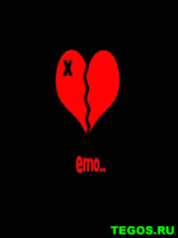

Emo
Emo occurs from the English word "emotion" and it is translated as emotional. It is characterized by strong emotions of the vocalist and chaotic music.

Slide 14
Text analysis (Subculture)
What is the title of the text?
What subcultures are mentioned in this text?
How are stereotypes imposed on young people?
Whom are young people try to imitate in their life style?
What beliefs have different subcultures?
What subcultures are mentioned in this text and how does the author characterize them?
What does the author think about representatives of subcultures?

Slide 15
Find the answer to the questions.
In which text can you find the description of the: 1. goth? 2. mod? 3. skinhead? 4. raver? 5. hacker? 6. biker? | A He is a wizard of the computer community, he knows how his computer works. He can do things with it that seem “magical”. | B He is one of a gang of white boys characterized by closely cropped hair, heavy boots, and braces and a nationalist and racist agenda.
 | C He is a person who leads a wild or uninhibited social life, especially attending “Rave” parties. | D Elements of the lifestyle include music, clothes (often tailor-made), dancing and motor scooters.
 | E He is characterized by black clothes and deathly white make-up. | F He is a member of a motorcycle gang.

Slide 16
Keys
1. - e
2. - d
3. - b
4. – c
5. - a
6. - f

Slide 17

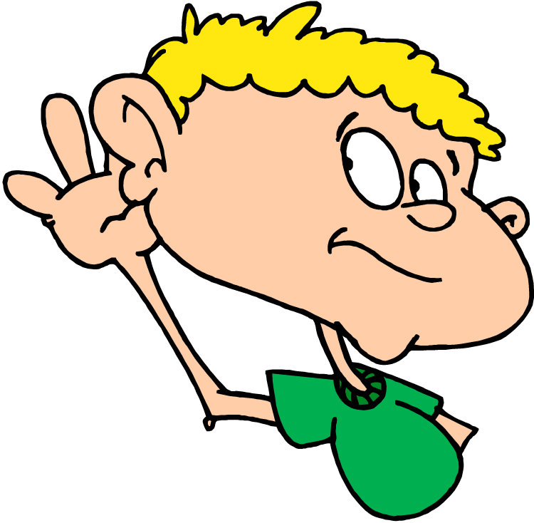


Notes:
Testing

Slide 18

match the attitudes (1-5) with the statements (A-F).
Which speaker says that …
A. the teens want to change the world?
B. when you are a teen, you what to know who you are?
C. some people know where they are going, but most teens don’t have any idea?
D. It seems to the teens that the parents are always against?
E. a subculture is a way of life, a real life?
F. all subcultures are awful?

Slide 19
Keys
SP 1 – D
SP 2 – E
SP3 – B
SP4 – A
SP5 – C
F - EXTRA

Slide 20
Use the words from the right column in the correct form.
I have never supposed that there are so many music styles and so many 1) _____ around us. I have only known something about 2) ____, they are the people who like to wear the 3) ____ clothes and lots of silver jewellery. It seems to me, that I begin to 4) ____ why this subculture is so 5) _____ among teenagers and young people. They start to analyze their 6) ___ and become 7) _______ with it. | culture gothical dark misunderstand popularity live satisfy

Slide 21
I have never supposed that there are so many music styles and so many 1) subcultures around us. I have only known something about 2) goths , they are the people who like to wear the 3) black clothes and lots of silver jewellery. It seems to me, that I begin to 4) understand why this subculture is so 5) popular among teenagers and young people. They start to analyze their 6) life and become 7) satisfied with it.

Slide 22
Choose the right characteristics of a subculture.
1. a way of life.
2. a way for teenagers to express their individuality.
3. the total of the inherited (унаследованный) ideas, beliefs, values and knowledge.
4. any group within a larger complex culture which has interests that vary from those of the mainstream culture.
5. the total range of activities and ideas of a group of people with shared traditions, which are transmitted and reinforced by the members of the group.
6. a group with distinct styles, behaviors and interests.

Slide 23
WHAT IS THE AIM OF BEING REPRESENTSTIVES OF ANY SUBCULTURES?
WHAT DO YOU THINK ABOUT THEM?

Slide 24

Hometask
write about your
own attitude to any subculture

Slide 25
What are your impressions?
OK!
So – so.
Not bad.

