Slide 1
Past Simple.
Questions and negative sentences.

Slide 2
Речевая зарядка
Use the verbs in Past Simple.
1. She helps her mum on Sunday.
She helped her mum last Sunday.
2. We do our homework every day.
We did our homework yesterday.
He had dinner five minutes ago.
3. He has dinner at home.
I gave him a ball last Monday.
4. I give him a ball every Monday.
She saw Ann at school yesterday.
5. She sees Ann at school.
6. They like sweets.
They liked this cake.
7. He lives in Moscow.
He lived in London last year.
8. They go to the cinema on Sunday.
They went to the cinema last Sunday.
9. They play chess.
They played chess last week.
10. I clean my room every day.
I cleaned my room yesterday.

Slide 3
Find the sentences with the verb to be in Past Simple.
I am at school.
They were in London last year.
He is at home.
She isn’t in the forest.
Ann and Mary weren’t at the zoo last week.
Are you in the park?
They went home a minute ago.

Slide 4



Complete the sentences.
1. He … in the country last year.
2. Ann and Ben … at the zoo yesterday.
3. … you at home last night?
4. Kate … not in the desert last year.
5. My mum … in the hall a minute ago.
6. Jack … very lazy last year.
7. … Kate and Jack in London two years ago?
was
was
Were

Slide 5
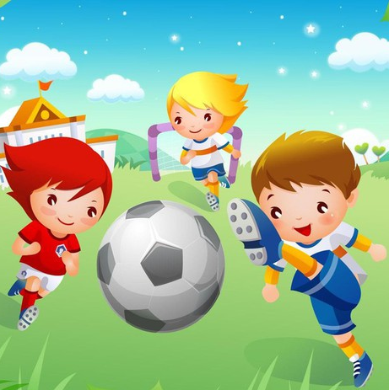
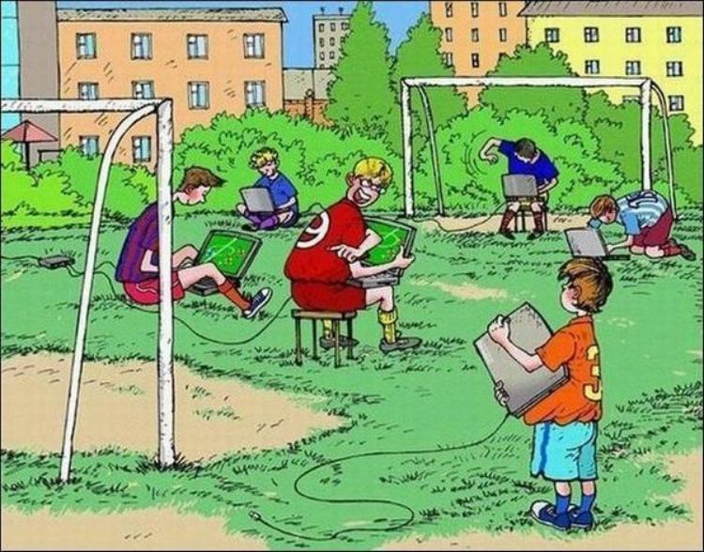
Read and Compare.
They played football last summer.
They didn’t play football last summer.

Slide 6
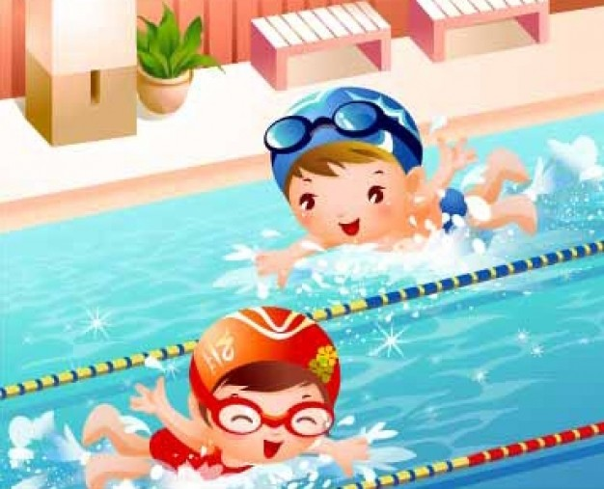
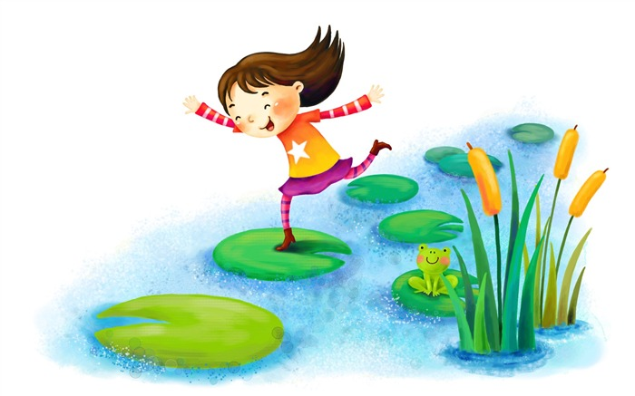
Read and Compare.
They swam yesterday.
She didn’t swim yesterday.

Slide 7
Read and Compare.
I
He
She
It
We
You
They
V
didn’t

Slide 8
Make the sentences negative.
didn’t like
I liked to play football two years ago.
They went to the park yesterday.
Ann had dinner a minute ago.
They listened to music last night.
Ann cried yesterday.
didn’t go
didn’t have
didn’t listen
didn’t cry

Slide 9
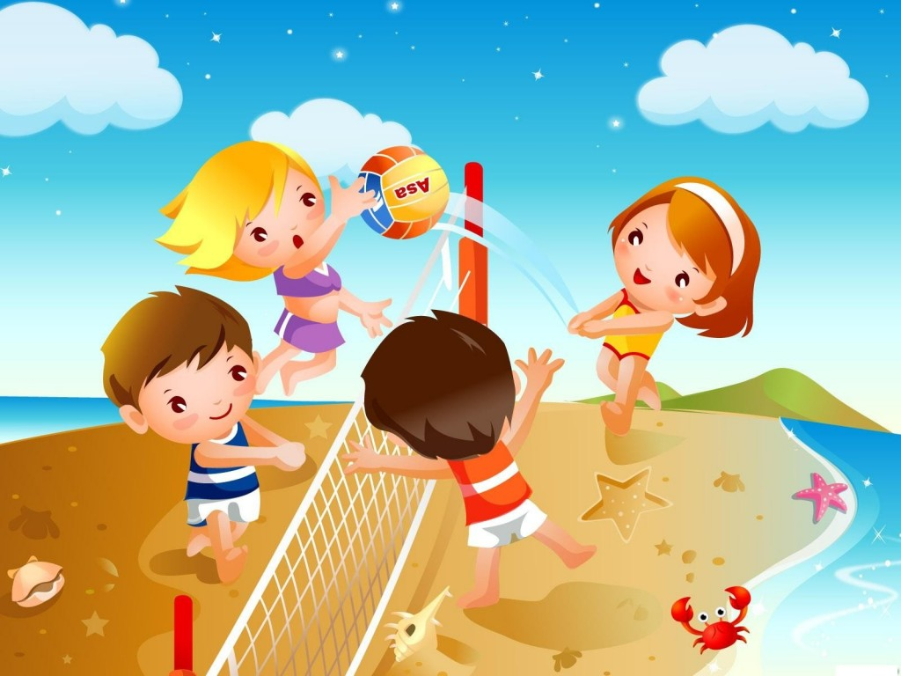
Did they play volleyball? Yes, they did.

Slide 10
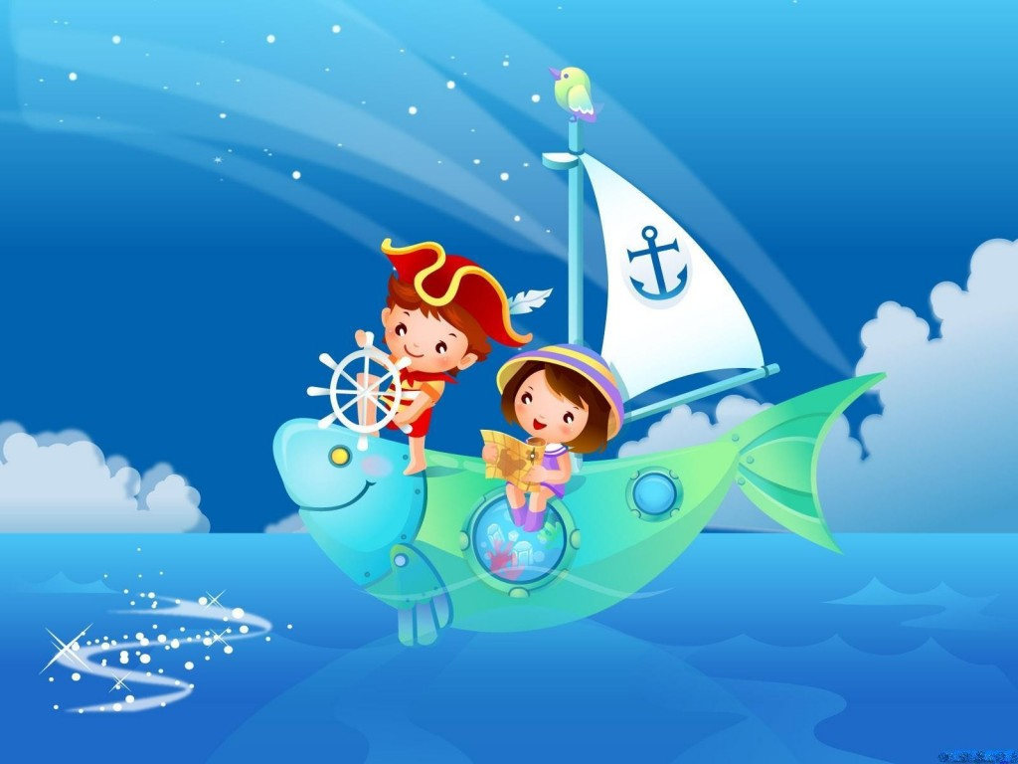
Did they swim yesterday? No, they didn’t

Slide 11
Read and Compare.
I
He
She
It
We
You
They
V
Did

Slide 12
Make the sentences interrogative.
I liked to play football two years ago.
They went to the park yesterday.
Ann had dinner a minute ago.
They listened to music last night.
Ann cried yesterday.
Did you like
Did they go
Did Ann have
Did they listen
Did Ann cry

Slide 13
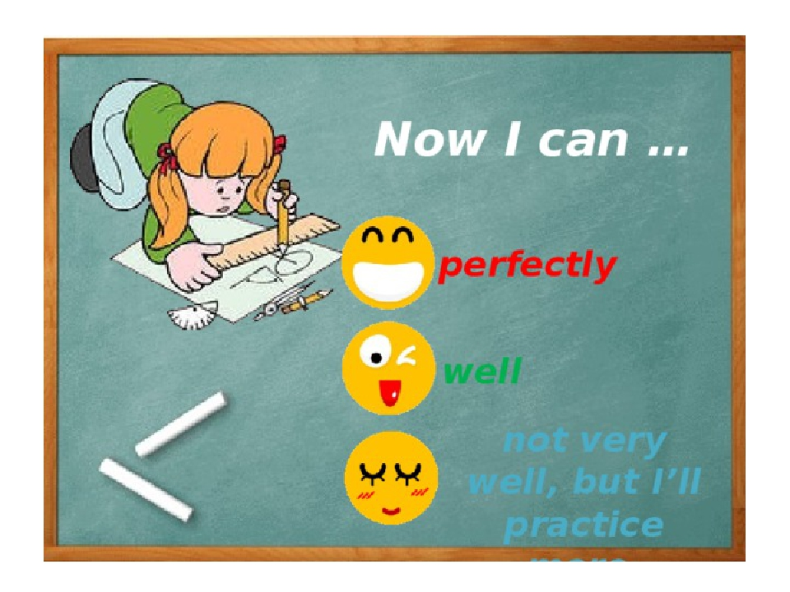
Complete the sentences.

Slide 14

Thank you for your attention.

