Slide 1
There are flamingoes on the island
( Остров Нетландия)

Slide 2
[æ] , [b] , [g] , [ʤ] , [ʃ], [ei] , [m] , [l] , [k] ,[r]

Slide 3
[d] , [p] , [r] , [ð]
[t] , [h] , [au] ,
[e] , [u:] , [n]

Slide 4
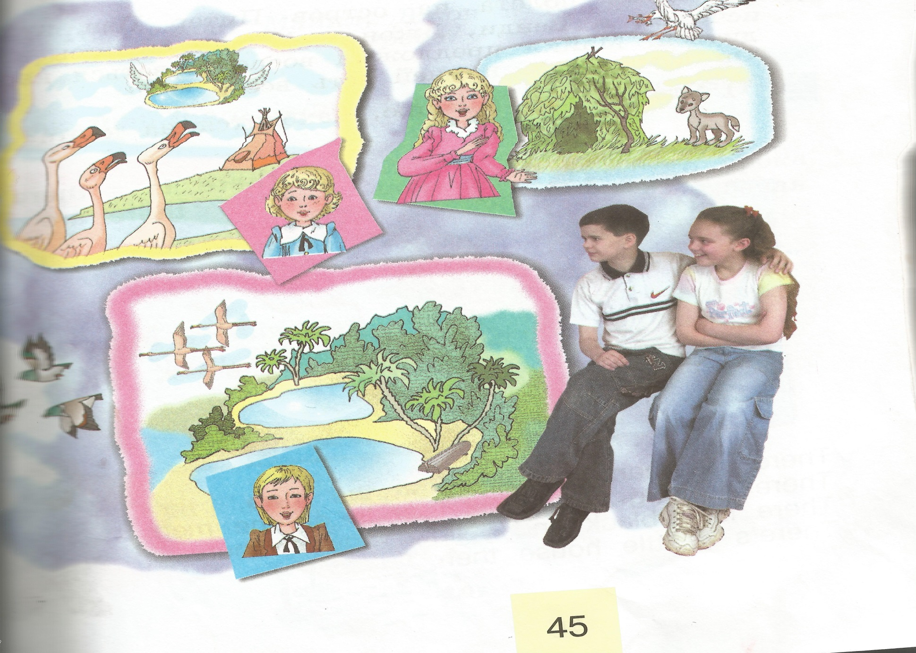

Slide 5
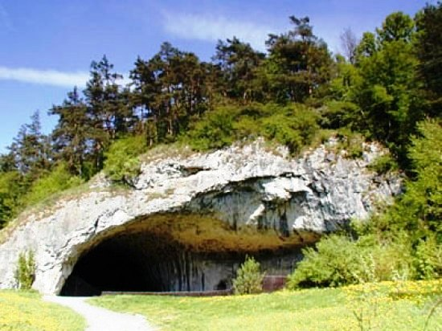
.

Slide 6
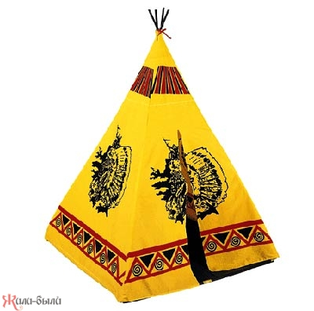
.

Slide 7
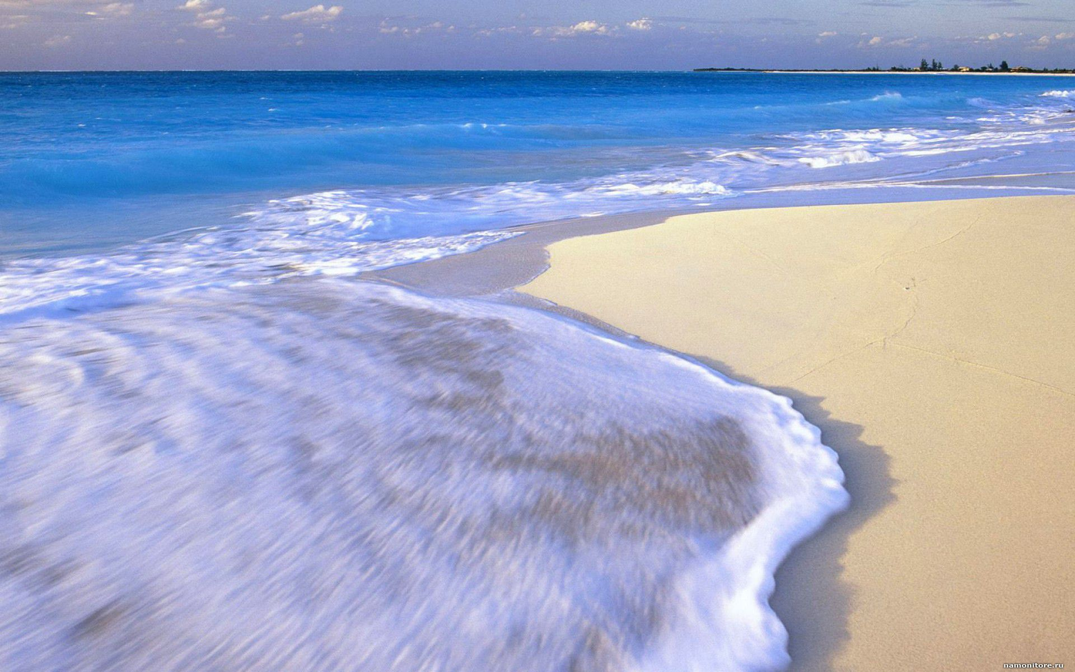
.

Slide 8
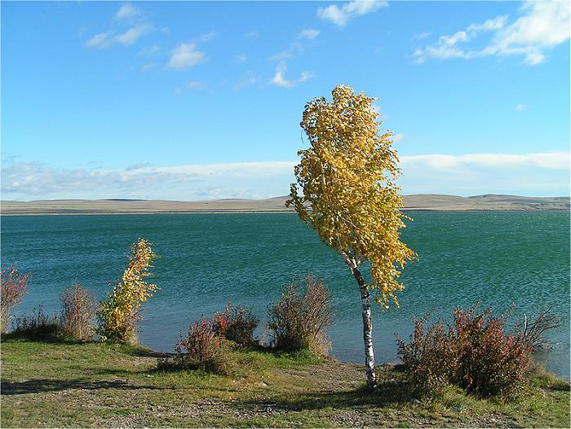
.

Slide 9
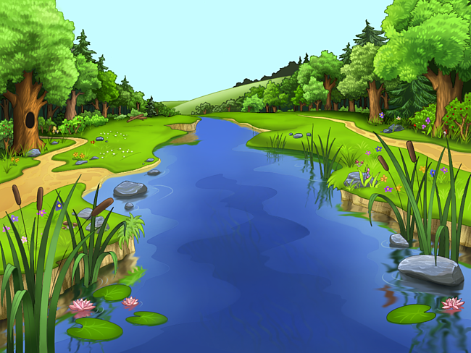
.

Slide 10
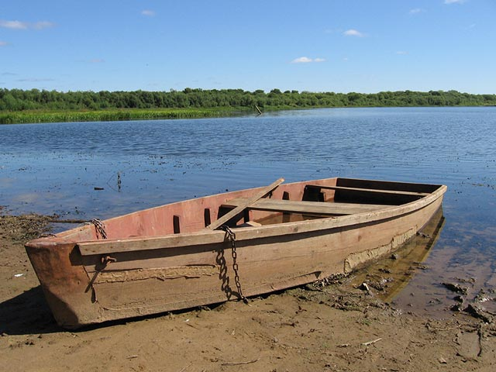
.

Slide 11
.
The 23 th of April.
flamingo [flə’miʖgǝu] фламинго
house [ haus ] дом
pet wolf [‘pet ,wulf] домашний волк

Slide 12
.
Let’s have a rest !

Slide 13
. There is
Употребляется в единственном числе:
There is a boy in the room.

Slide 14
There are
Употребляется перед существительным во множественном числе:
There are pupils in the class.

Slide 15
Образование отрицательных предложений
There is no flower in the vase.
There are no cats on the roof

Slide 16
.
There is a mouse in the house.
There is a cat in the flat.
There is a fox in the box.
There is a bee in the tree.

Slide 17
.
There are bees in the tree.
There are cats in the flats.
There are flags in the bags.
There are foxes in the boxes.

Slide 18

.

Slide 19


Slide 20
.
There are many big seas on the map.
There are big and small islands on the map.
There is a black and yellow wigwam on the map.
There is a little house on the map.
There is a blue river on the map.
There is a pink flamingo on the map.

Slide 21
.
1) y , s ,u , a , n , d.
2) m , y , d , a , o , n .
3) w , a , y , e , s , e , d, n.
4) f , y , a , r , d , i .
5) s , a , u , d , y, r , t , a .
6) t , u , s , e , y , a , d .
7) t , h , d , a , u , r , s , y .

Slide 22
.
good bye

