Slide 1
Present Continuous:
глаголы-исключения
Урок английского языка в 5 классе
УМК под ред. Биболетовой М.З.

Slide 2
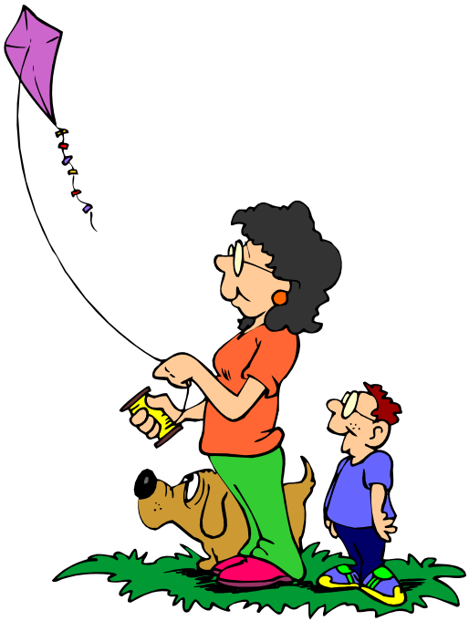
[ai]
The kite went higher and higher in the bright blue sky.

Slide 3
столица
capital

Slide 4
население
population

Slide 5
финансовый
financial

Slide 6
много заводов
many factories

Slide 7
символ Лондона
the symbol of London

Slide 8
London is Great Britain, its political, economic and cultural centre.
Its is more than 11 000 000 people.
London the river Thames.
It more than two thousand years ago.
London several parts: the City, the Westminster, the West End and the East End.
There are and the Port of London.
The famous Tower Clock Big Ben is London.
The best way to know London is it.
the capital of
population
is situated on
was founded
is divided into
many factories
the symbol of
to visit

Slide 9
hate
see
need
like
love
want
have
Present Simple
или
Present Continuous?

Slide 10
Используйте глаголы в скобках в форме Present Continuous или Present Simple
I __________English exercises twice a week. (to write)
My friend ________ his homework in the afternoon as a rule. (to do)
My sister __________ her homework now. (to do)
Don’t shout! The baby _________ . (to sleep)
The baby always___________ after dinner. (to sleep)
What_______ you _________ now? (to read)
write
does
is doing
is sleeping
sleeps
are
reading

Slide 11
Выберите правильный вариант
Listen! My friend ......................the song, ( sings, sing).
2.I...……..some problems at school, ( , has, am having)
3. They ............. to visit galleries and museums, (likes, are liking, )
4. Where is Mum? She ............................ (cooks, cooking, is cooking).
5. Will you go to the shop? We ..........some bread and butter, (need, needs, needed)
is singing
have
like
is cooking
need

Slide 12
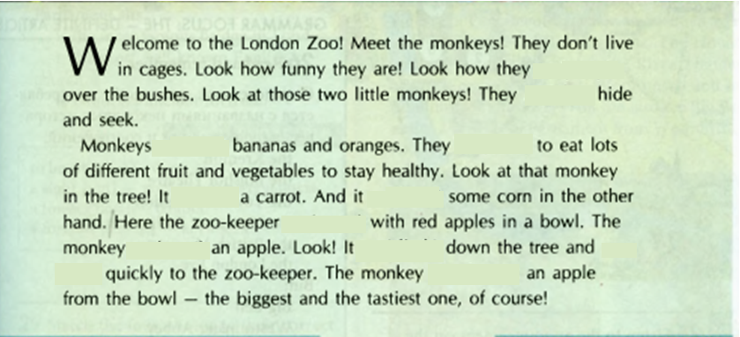
are jumping
are playing
love
need
is eating
has
is coming
wants
is climbing
is running
is choosing
11-10 | 9-7 | 6-5 | 4-0
5 | 4 | 3 | 2

Slide 13
Write down your homework:
ex.5 p.73 – письменно

Slide 14
Сегодня на уроке
Я узнал…
Было интересно…
Было трудно…
Я понял, что…
У меня получилось…
Меня удивило…
Мне захотелось…
Я научился…

