Slide 1
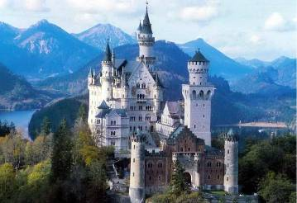

Путешествие в страну Знаний
5
4
3
2
1

Slide 2
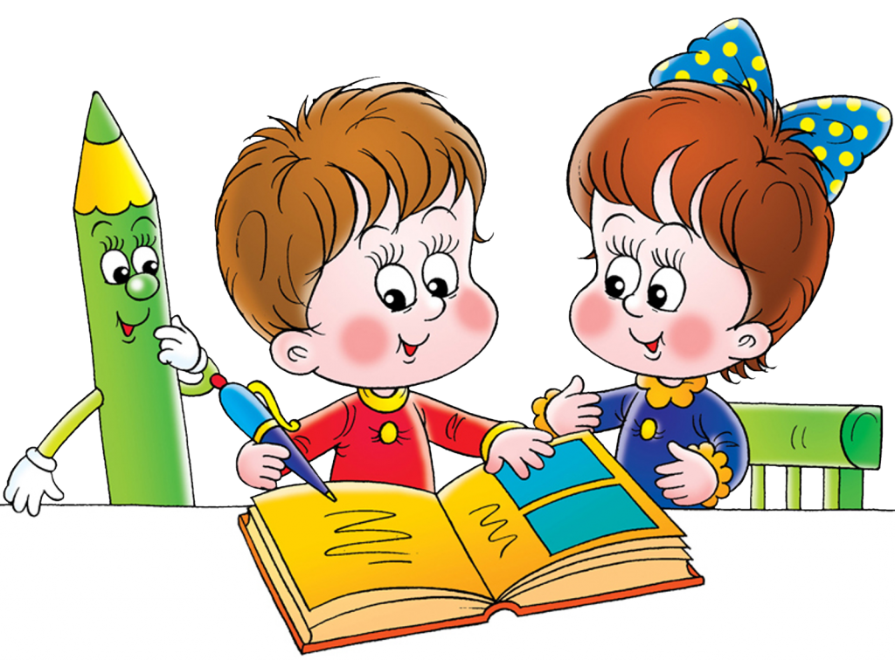
The 25th of October.

Slide 3
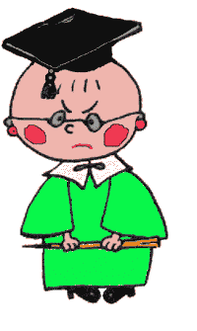
Fill in the gaps with am, is, are
I … a student.
We … friends.
He …a doctor.
They… pupils.
My mother … a teacher.
She … my sister.

Slide 4
Station 1
Translate
Fantastic, beautiful, mountain, zoo, forest, river, lake, bridge, region, country, picture, parents, grandparents

Slide 5

Find the correct translation
1.What’s your name?
2.How are you?
3.What country are you from?
4.How old are you?
1.Как дела?
2.Из какой вы страны?
3.Сколько тебе лет?
4.Как тебя зовут?

Slide 6
Write numbers
four, six, five, eleven, seventeen, ninety, ten, seven, one hundred,
sixty-two, fifty-seven, two

Slide 7
Write down on 2 columns
name, cat, fat, cave, camp, game, tale, place, flag, lake, map

Slide 8
Read!
Like, twins, bicycle, Liz, girl, twenty, birds, little, five, ship, pig .

Slide 9
Numerals
3, 5, 8, 10, 11, 1, 14, 18, 20, 22,
30, 35, 40, 90, 94, 76, 58, 65,
99, 145, 187, 195, 165, 264,
44, 55, 67, 78, 16, 12, 7, 100.

Slide 10
Out odd word
1.mother father pen brother
2.red yellow black green river
3.eleven five nine picture

Slide 11
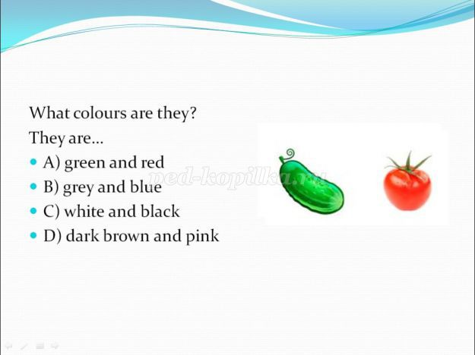

Slide 12
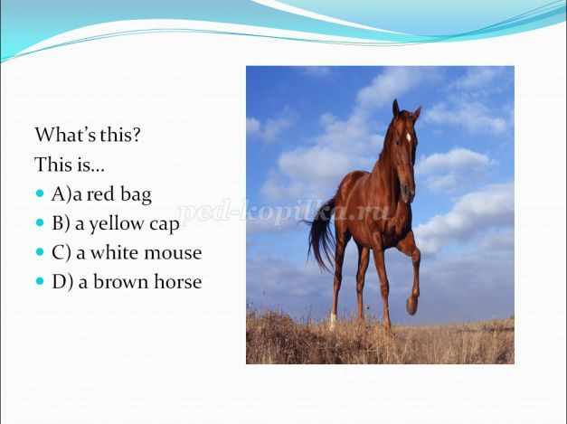

Slide 13
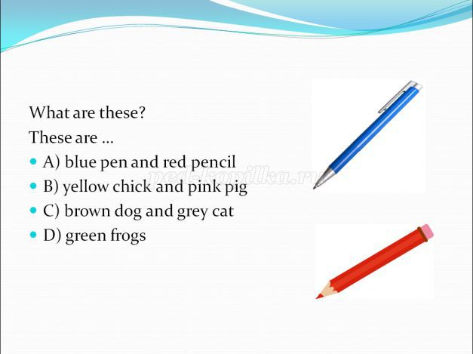

Slide 14
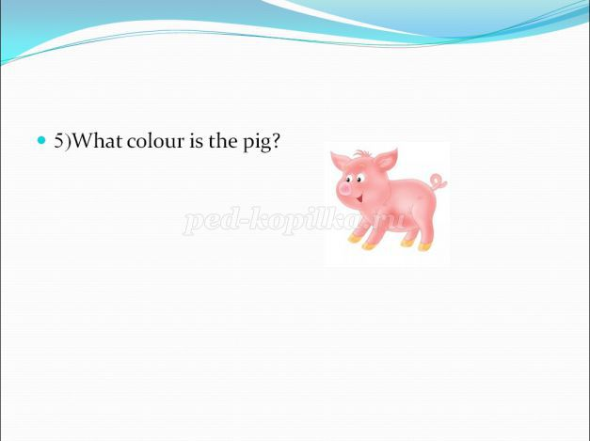

Slide 15
The captains’ competition
1)Reading rules the letter “Ii”
2)Reading rules the letter “Aa”

Slide 16
