Slide 1
professions

Slide 2
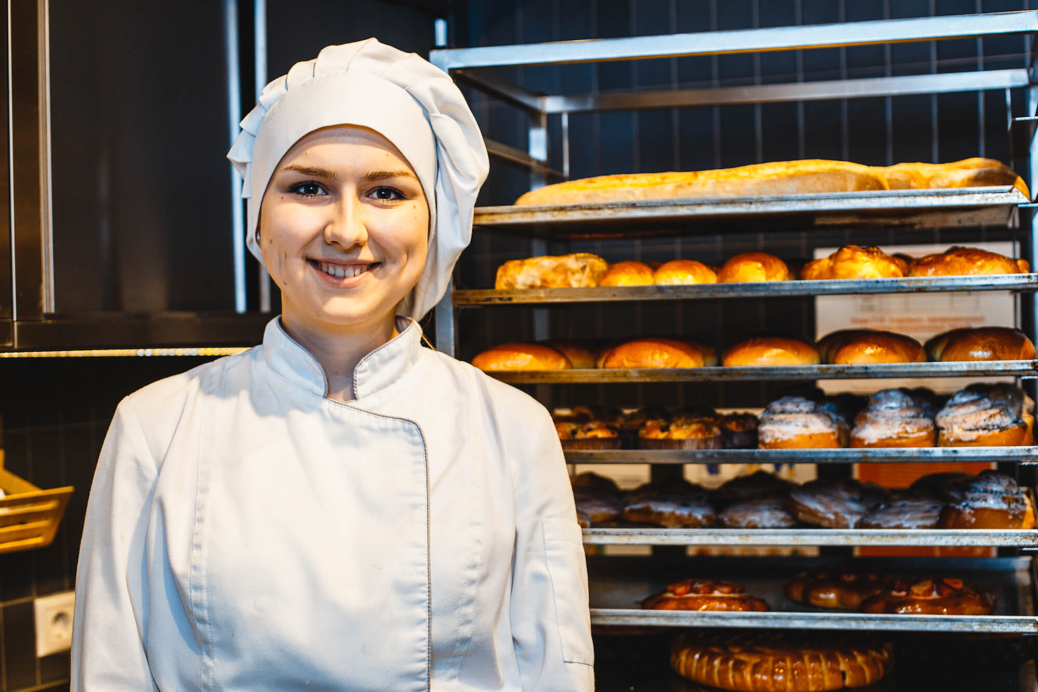

Slide 3
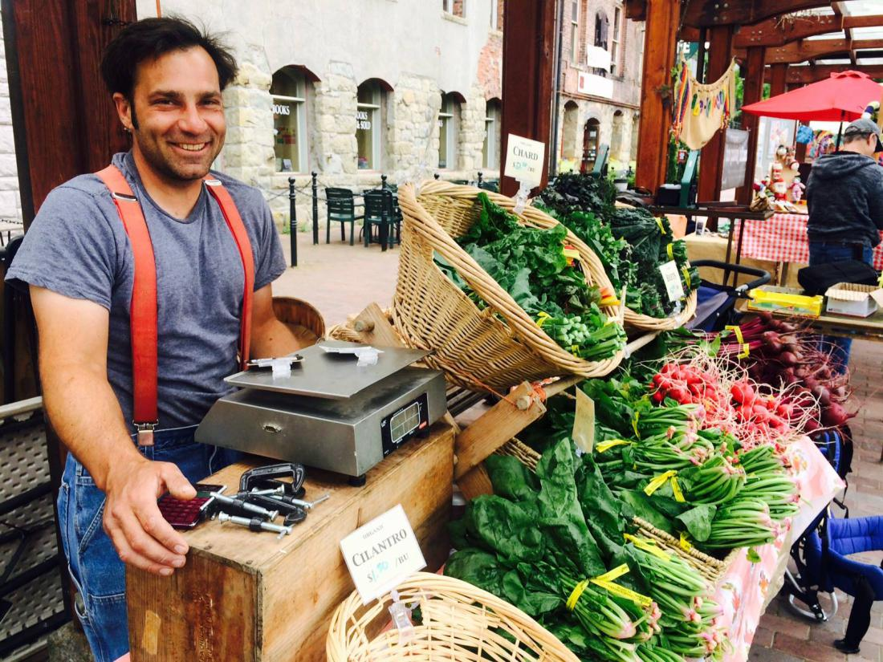

Slide 4
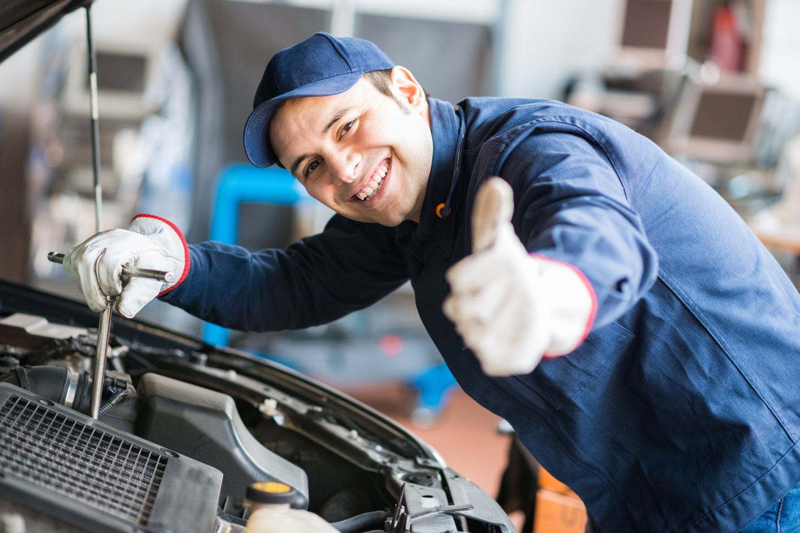

Slide 5


Slide 6
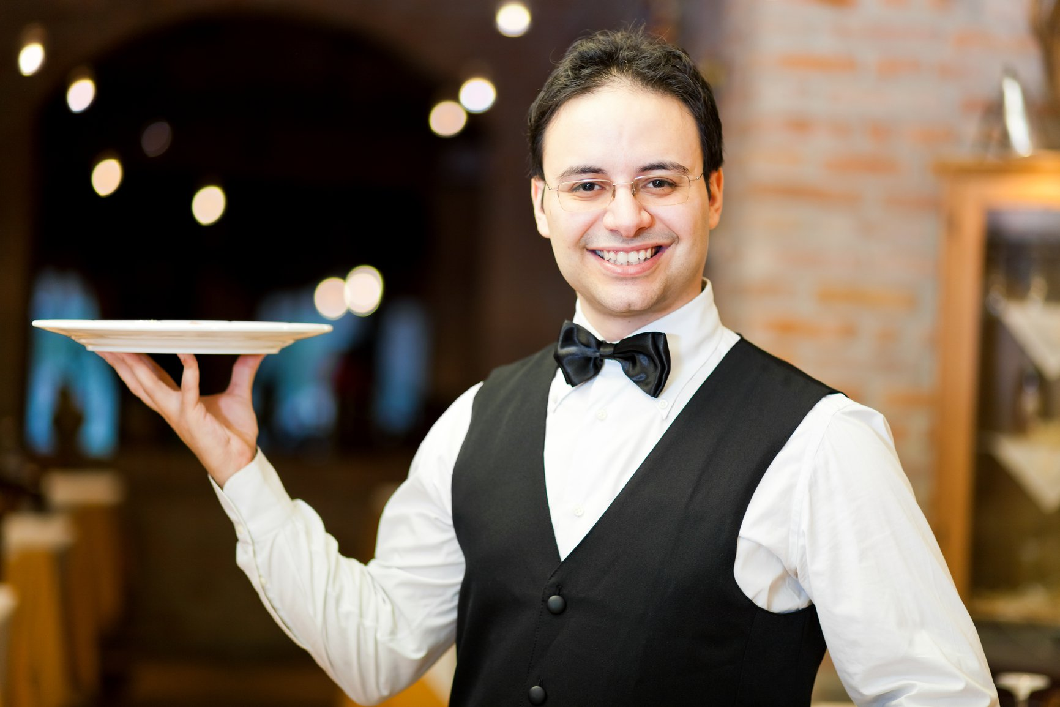

Slide 7


Slide 8
baker
greengrocer
mechanic
postman
waiter
nurse

Slide 9
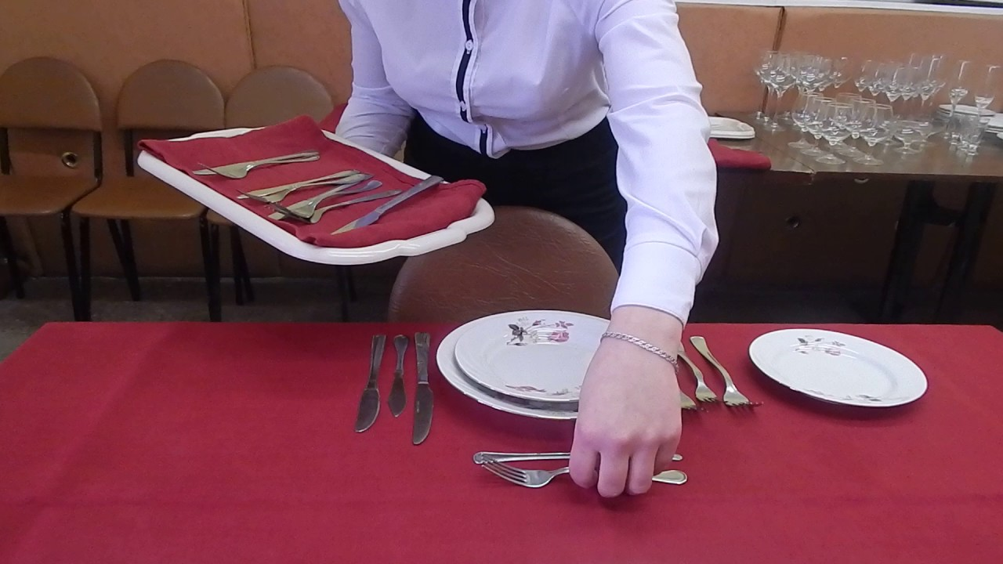
serve

Slide 10
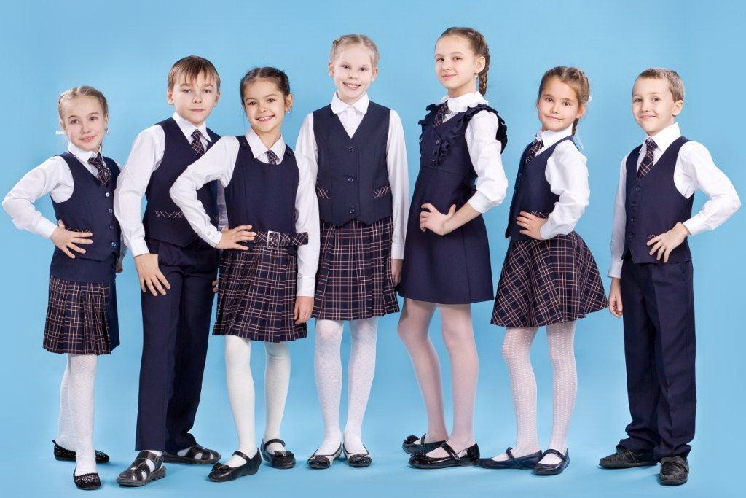
wear a uniform

Slide 11
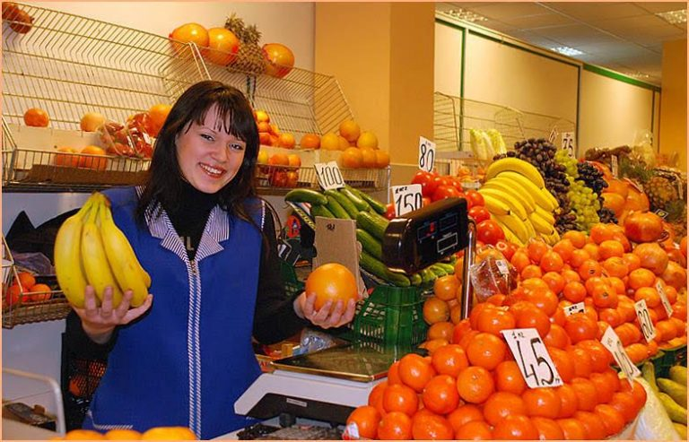
Sell fruit and vegetables

Slide 12
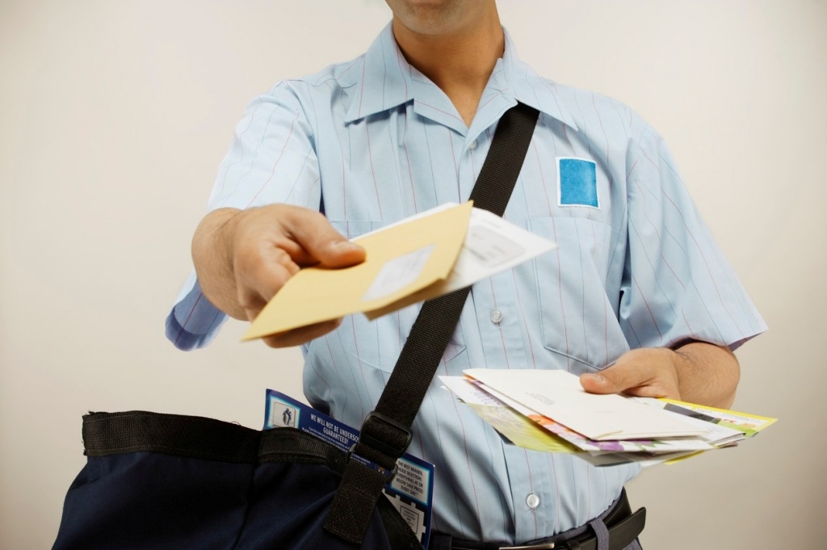
Take letters

Slide 13
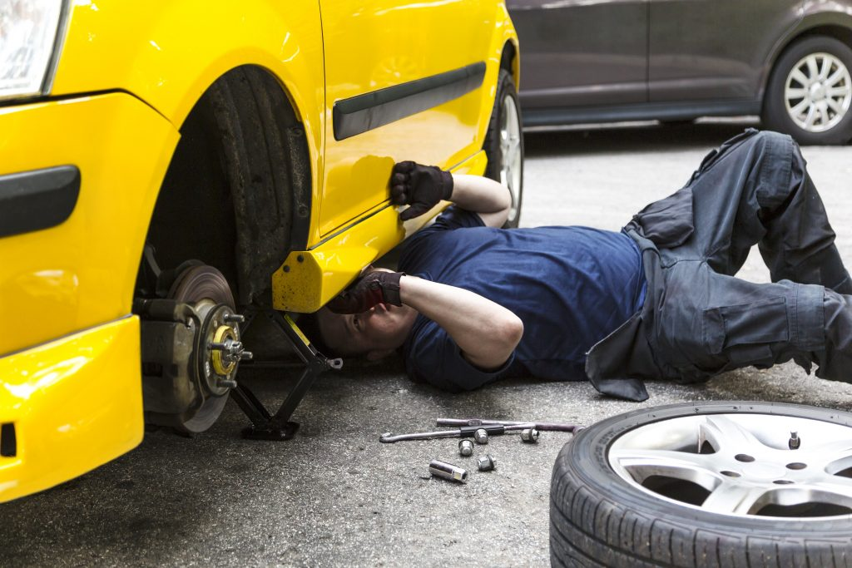
Fix cars

Slide 14

help

Slide 15
Wear a uniform | носить форму
Help sick people | помогать больным людям
Take letters | доставлять письма
Sell fruit and vegetables | продавать фрукты и овощи
Bake bread | печь хлеб
Fix cars | чинить машины
Work | работать

Slide 16
№2
A: What do you do?
B: I’m a nurse. I help sick people.
A: Where do you work?
B: At a hospital.

Slide 17
Thank you
for your
attention!

