Slide 1

i
Автор: Зубык Г.В. МБОУ «Экимчанская СОШ»
Амурская обл.
Christmas Card

Slide 2


Let’s paint the Christmas postcards for the best friends ourselves!

Slide 3


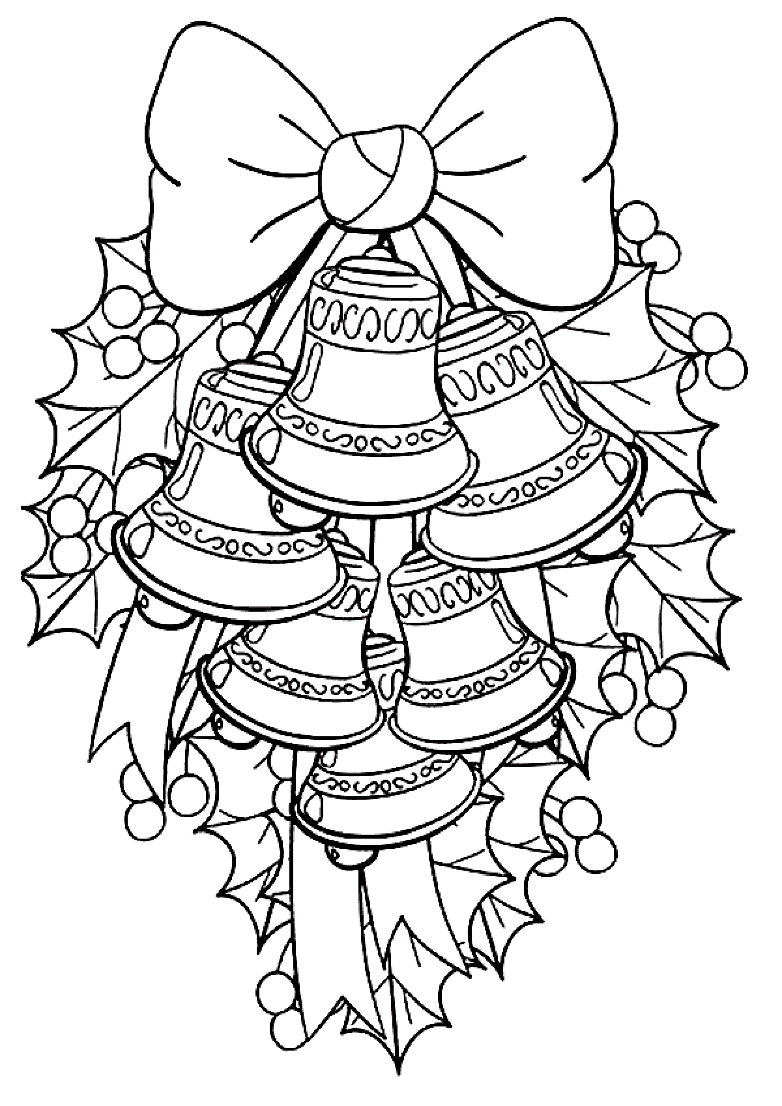
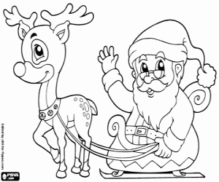


Choose the drawing for your card

Slide 4
What is the traditional dessert in England on December 25th?
An apple pie
A pudding
A tart

Slide 5
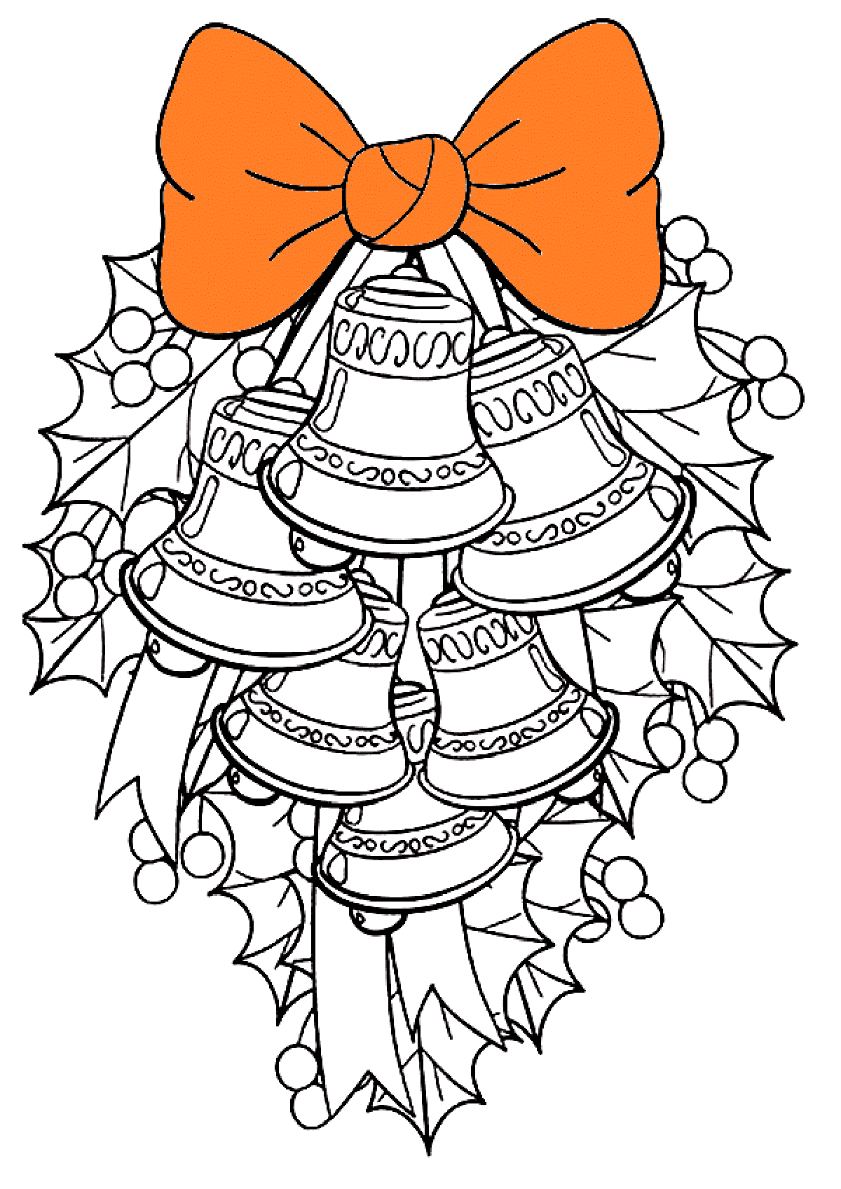
Where does Christmas tree come from originally?
Germany
Norway
Russia

Slide 6
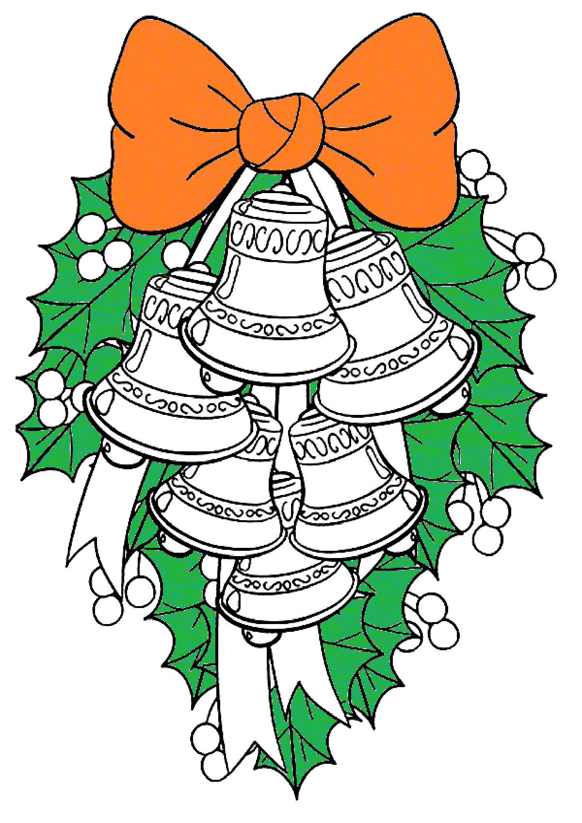
What plant is traditional to kiss under on Christmas day?
Holly
Ivy
Mistletoe

Slide 7

Which of the following was not a gift from magi?
Gold
Diamonds
Myrrh

Slide 8

When was the first Christmas card sent in England?
1920
1805
1843

Slide 9

What day is ‘Boxing day’?
December 26th
December 25th
December 24th

Slide 10
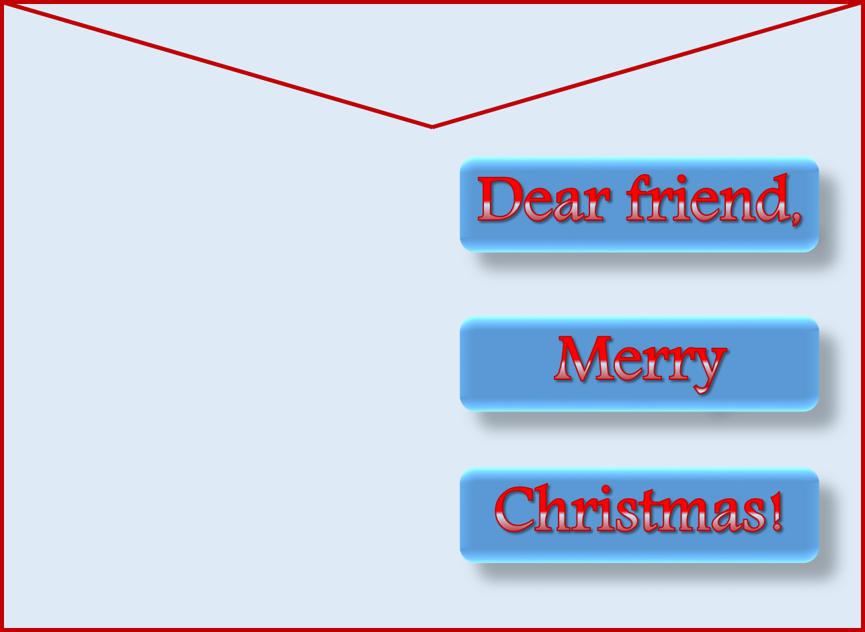


Slide 11

Choose the drawing for your card

Slide 12
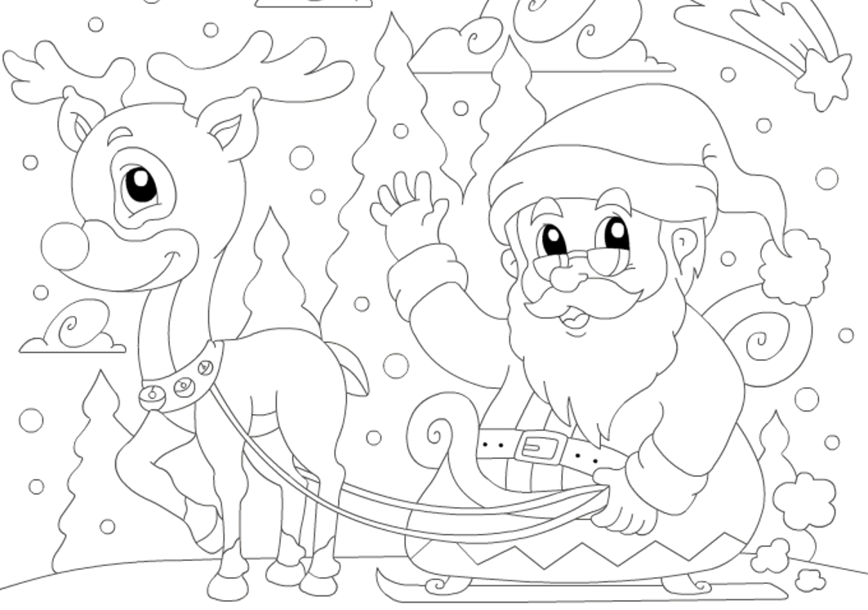
What colour was Rudolph the Reindeer’s nose?
Black
Red
Brown

Slide 13
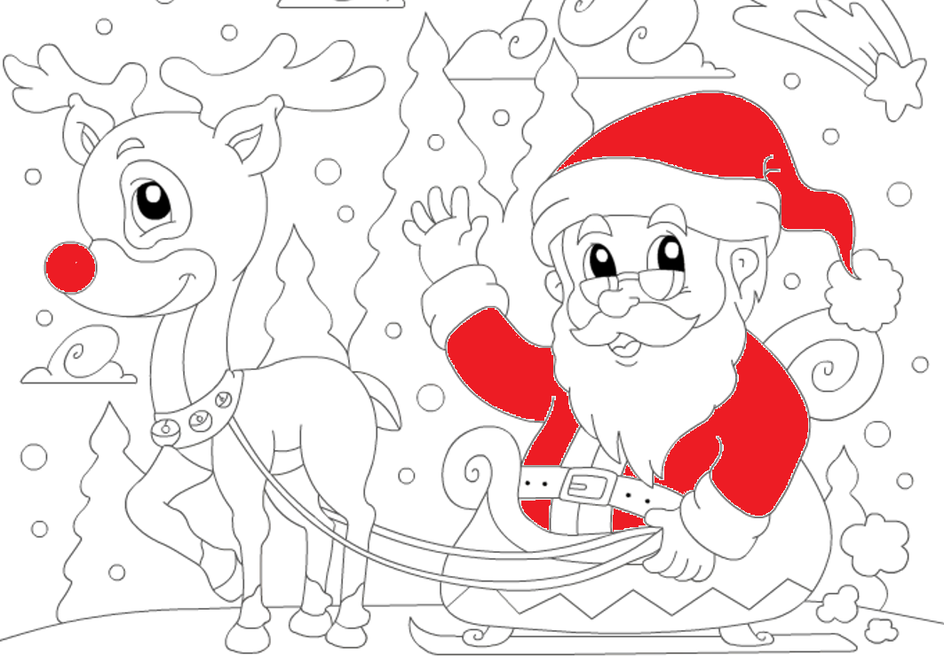
Which of these is NOT one of Santa's reindeer?
Dixen
Cupid
Dasher

Slide 14
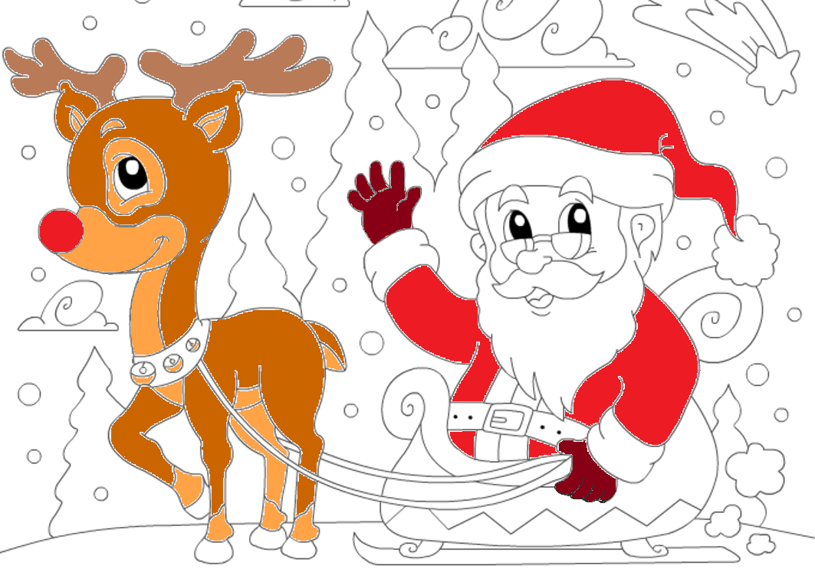
How many reindeer does
Santa Claus have?
12
24
9

Slide 15
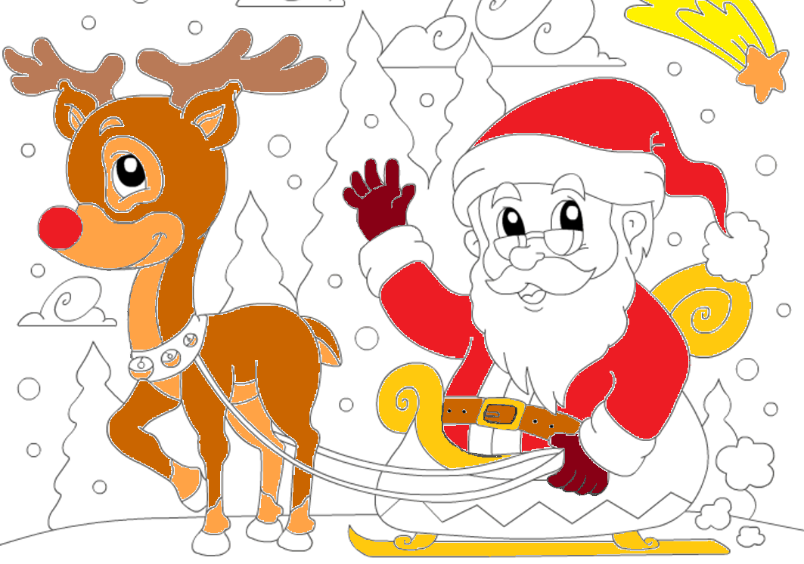
How many sides does a snowflake have?
12
6
8

Slide 16
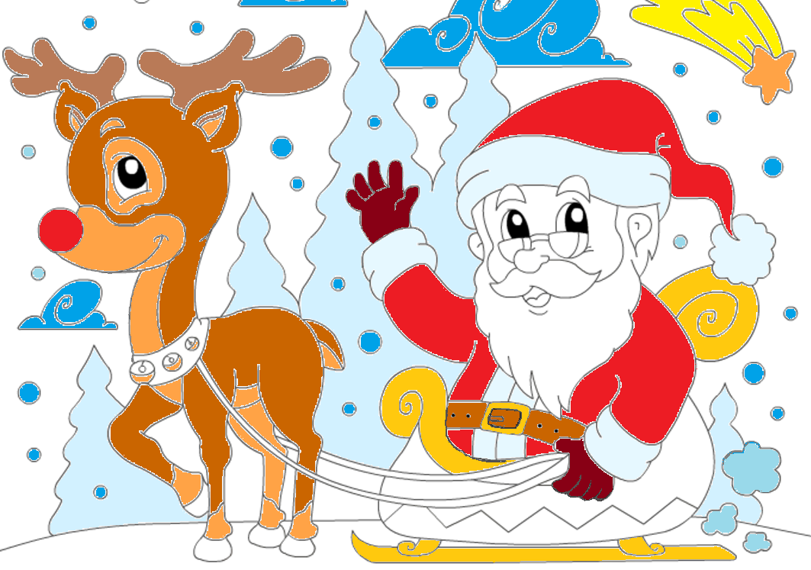
In the Christmas song 'Jingle Bells' what was fun to ride in?
A sleigh
A plane
A train

Slide 17
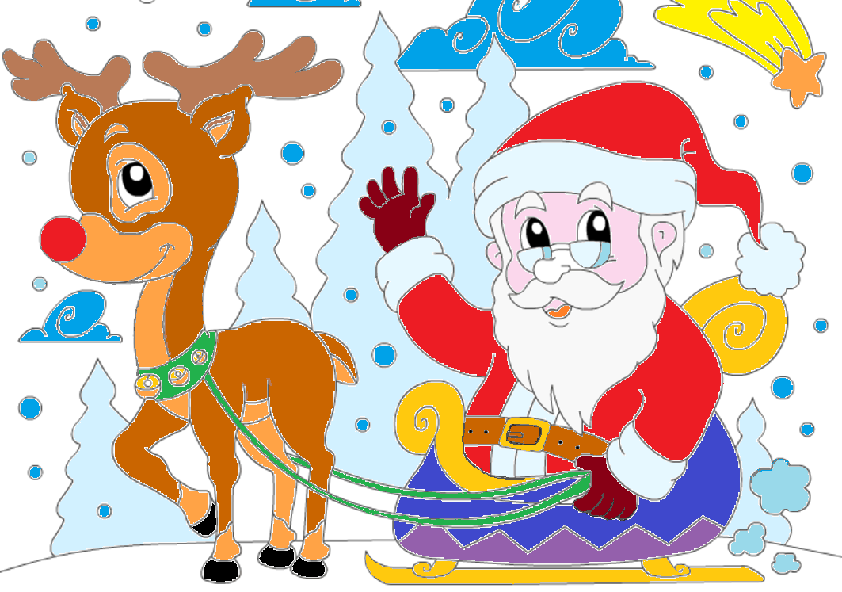
Where does Santa Claus live?
In Lapland
In Scotland
In Iceland

Slide 18

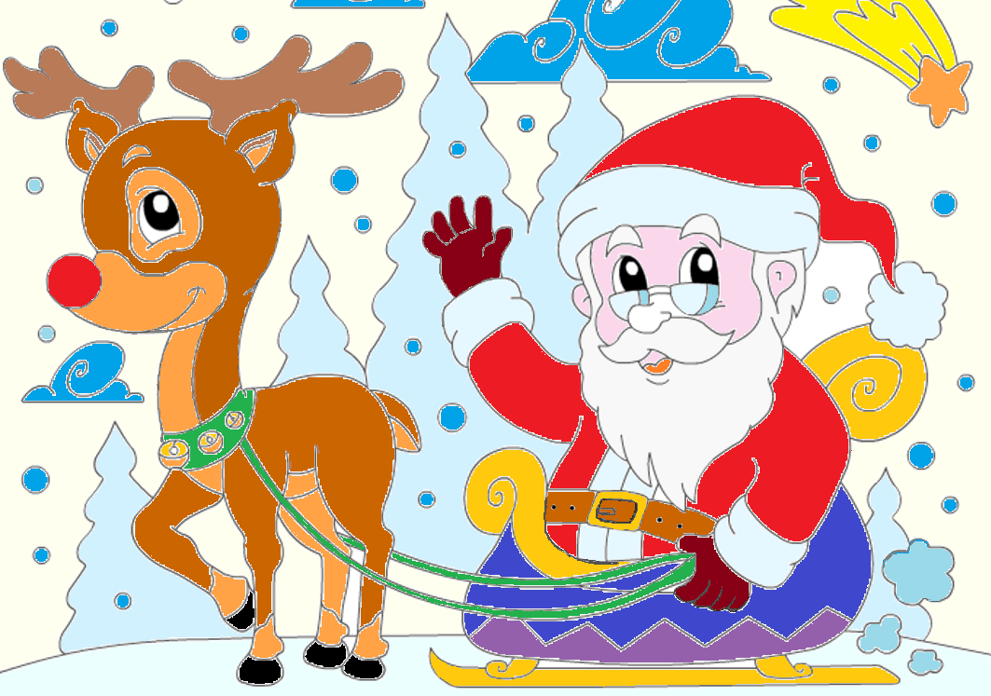

Slide 19
Choose the drawing for your card

Slide 20


Thank you for your Christmas Card!

Slide 21
Источники
http://www.dvaporosenka.ru/images/prazdniki-raskraski/novogodnie-igrushki/novogodnie-igrushki2.gif трафарет колокольчики
http://img.xn--kxadfld7dtbug.com/Άγιος-Βασίλης-με-το-έλκηθ_50a4abade633c-p.gif трафарет Санта Клаус
http://i46.tinypic.com/t5hfh3.jpg фон - открытка
http://www.geographics.com/images/48837-Christmastime-Letterhead-Geographics-L.jpg рамка
http://batonrougemoms.com/wp-content/uploads/2016/10/Transparent_Christmas_Pine_Garland_with_Mistletoe_Clipart-1024x201.png элементы дизайна
http://www.akadem-edu.ru/images/banners/354633463-min.jpg элементы дизайна
https://nybox.ru/slotmachine/10.png свеча
http://img11.hostingpics.net/pics/54058808bb33766f6679XXL.png украшение
http://www.playcast.ru/uploads/2014/12/27/11303568.png ёлка
http://us.cdn3.123rf.com/168nwm/sarahdesign/sarahdesign1410/sarahdesign141000806/32211045-Кнопка-домой-символ-знак.jpg
Notes:
Источники

