Slide 1
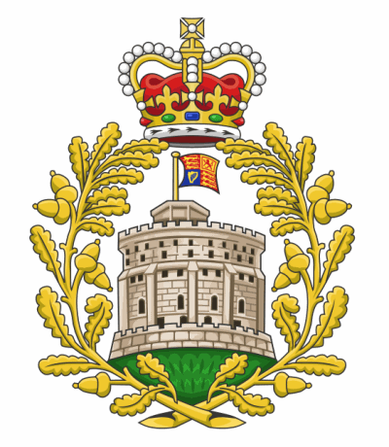
МАОУ «СОШ» №14 им. А.Ф. Лебедева г.Томска
Презентация к уроку английского языка «The Royal Family»
Презентацию составила
Астафьева Ксения Николаевна,
Учитель английского языка.

Slide 2
The Royal Family
(The House of Windsor)

Slide 3
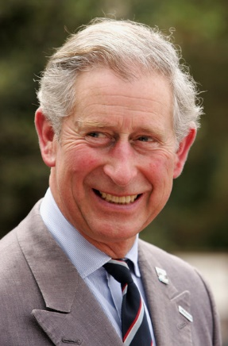
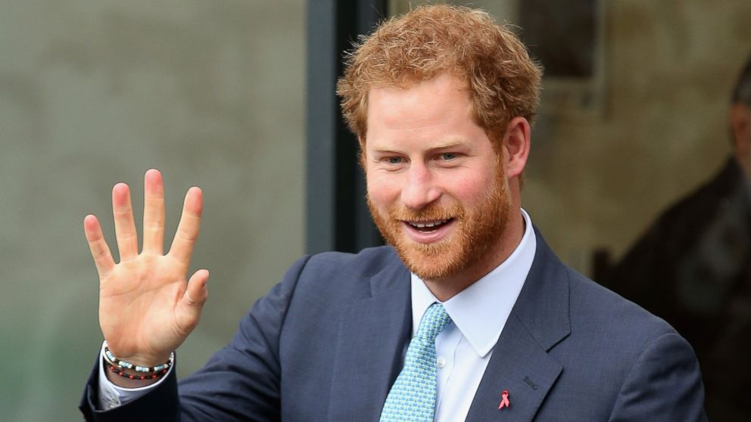
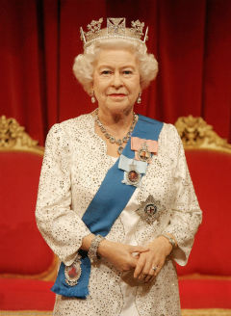
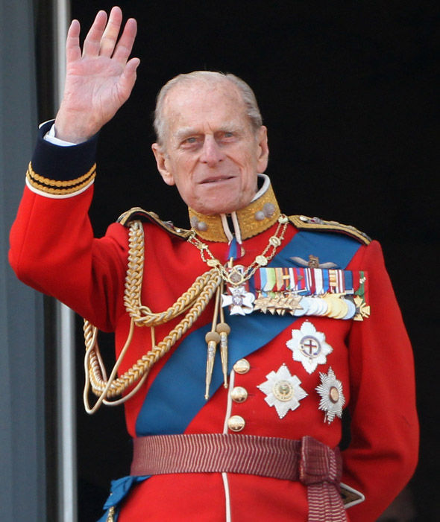
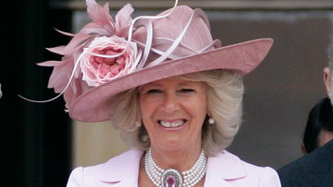
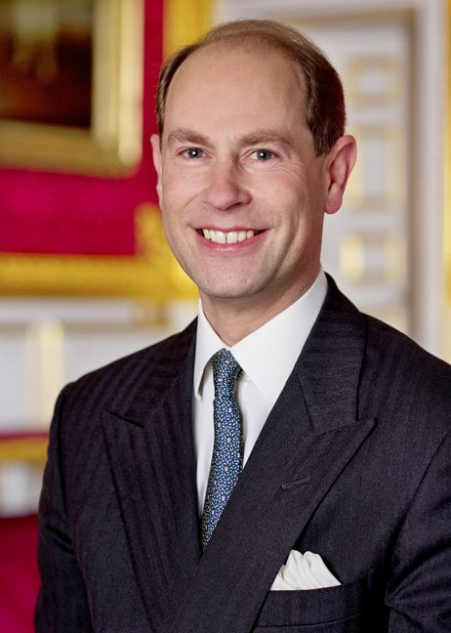
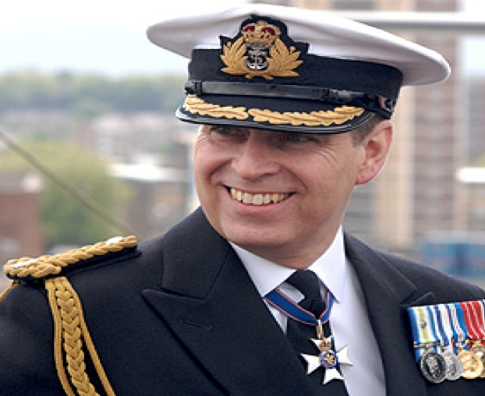
The Royal Family
From left to right, the people in the photo are:
Charles,
Prince of Wales
Prince Philip,
Duke of Edinburgh
Harry,
Prince Henry of Wales
Queen Elizabeth II
Andrew, Duke of York
Camilla,
Dutchess of Cornwall
Prince Edward, Earl of Wessex

Slide 4
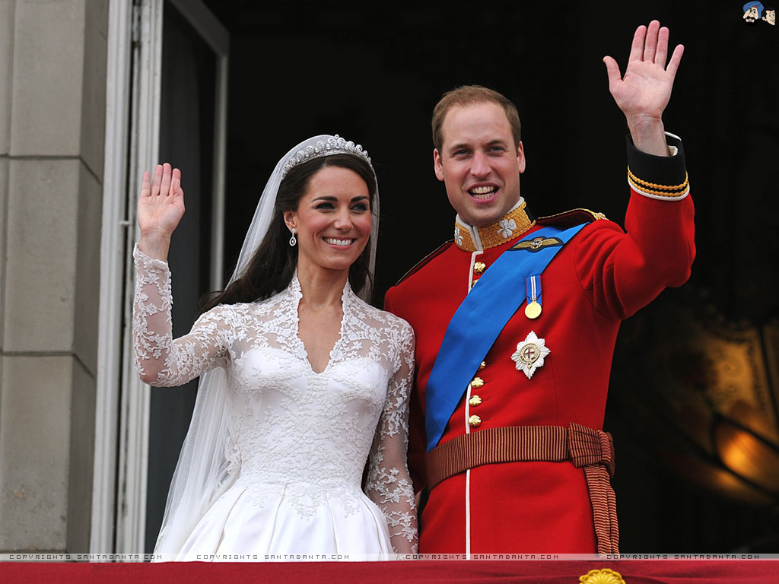
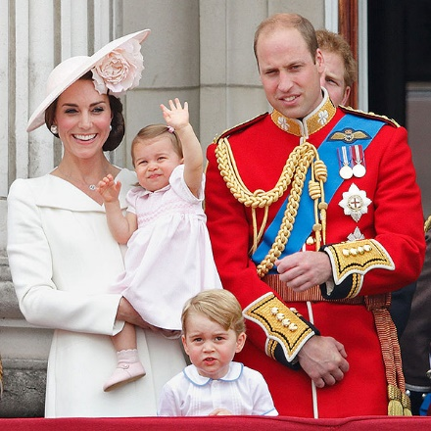
The Royal Family
Prince William, The Duke of Cambridge
Kate Middleton, The Duchess of Cambridge

Slide 5
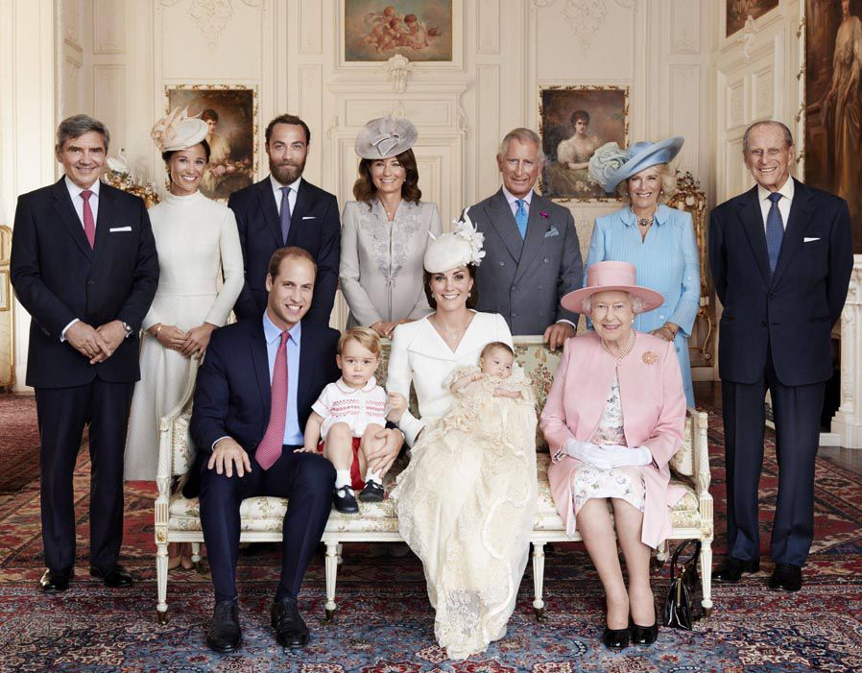
The Royal Family

Slide 6
The Royal Family
royal - a member of the royal family
royal - belonging or connected to a king or queen or a member of their family
A system of government by a king or a queen (monarch) is called monarchy
republic – a country that is governed by a president and politicians elected by the people

Slide 7
Monarchy
Constitutional (parliamentary)
Absolute
The monarch has limited powers and acts within the constitution (ustav) of their country
rules along with a parliament (Prime Minister holds the maximum power)
The monarch rules with absolute and total powers

Slide 8
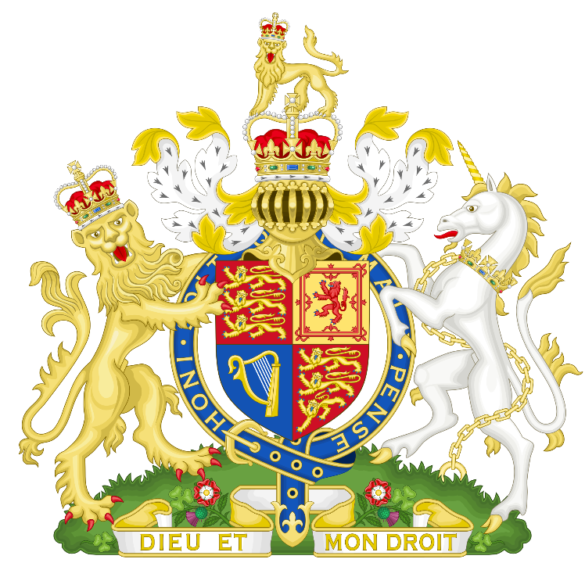
The British Monarchy
Constitutional
PM is appointed by the Queen
It is usually the leader of the party which
holds the majority in the parliament
Royal coat of arms

Slide 9
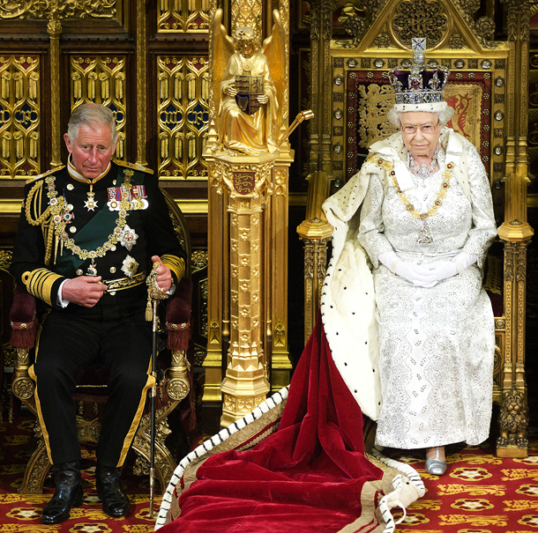
The Queen’s role
Head of state
Head of the armed forces
Head of the Church of England
Represents the Nation

Slide 10
How does one become a monarch?
hereditary rule
an individual rules for life and passes the crown
to an heir or heiress
If there is more than one heir to the throne – rules of succession should be followed

Slide 11
Succession to the British throne
The crown is inherited by an individual’s children (firstborn son) and by a childless individual’s nearest collateral line (iz paralelne linije)
Queen Elizabeth II
Prince Charles,
heir

Slide 12
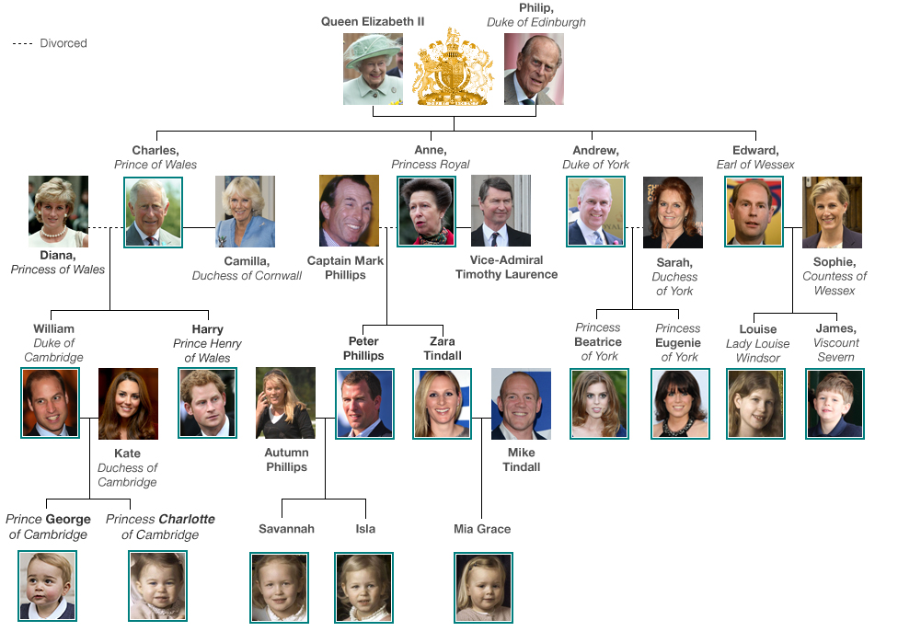
The Royal Family Tree
1
6
9
2
5
8
7
3
4

Slide 13
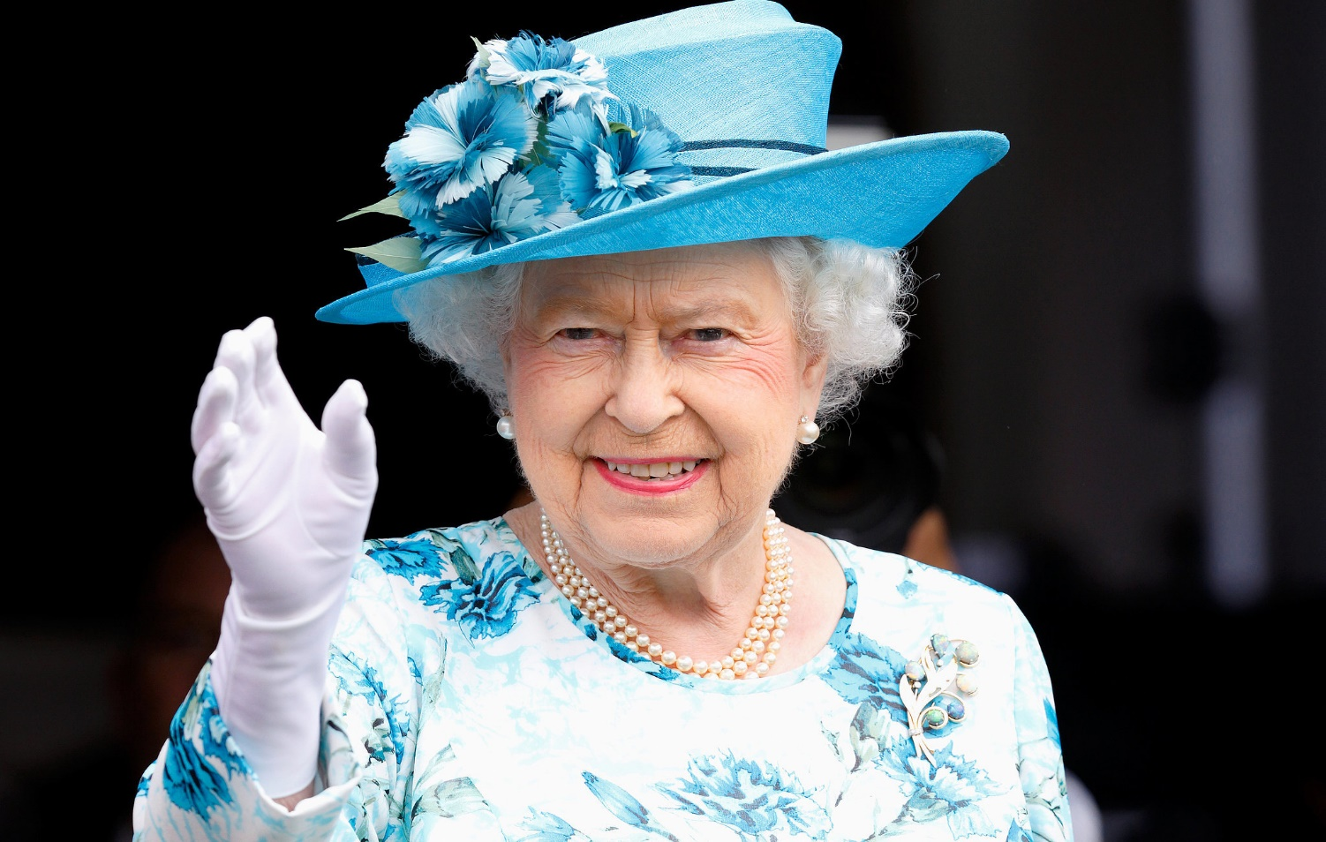
Queen Elizabeth II
(April 21, 1926)
Queen since February 6, 1952
Accessed the throne upon the death of her father King George VI – for 64 years now!
Coronation (krunidba) on June 2, 1953
Addressed as ‘Her Majesty’

Slide 14
Queen Elizabeth II
(April 21, 1926)
Is the queen of the United Kingdom, Canada , Australia and New Zealand. She is also the Head of the Commonwealth and the queen of 12 countries that have become independent since her accession: Jamaica, Barbados, the Bahamas, Grenada, Papua New Guinea, Solomon Islands, Tuvalu, Saint Lucia, Saint Vincent and the Grenadines, Belize, Antigua and Barbuda, and Saint Kitts and Nevis.

Slide 15
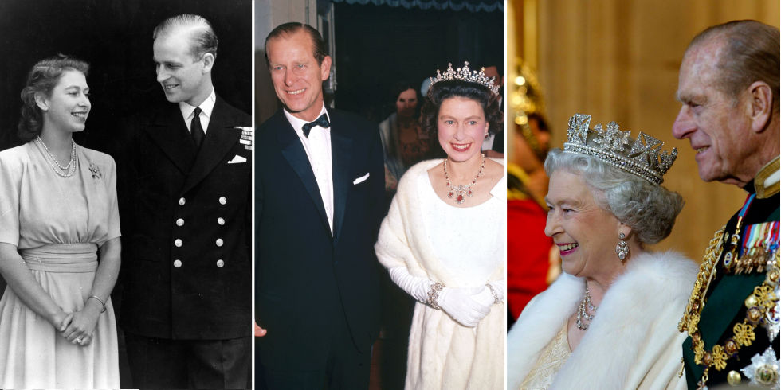
Queen Elizabeth II
(April 21, 1926)
Is married to Prince Philip, Duke of Edinburgh. They married in 1947 and have 4 children.

Slide 16
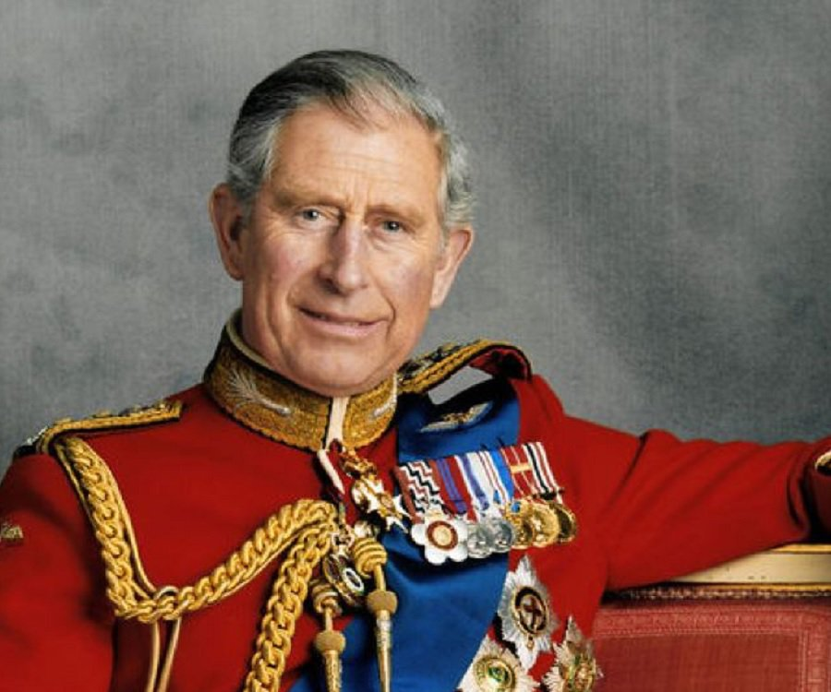
Prince Charles, Prince of Wales
(November 14, 1948)
The oldest child and heir to Queen Elizabeth II
The second oldest serving Prince of Wales - if he became monarch today he would be the oldest person to do so (68 years old!)
Addressed as HRH – His Royal Highness

Slide 17
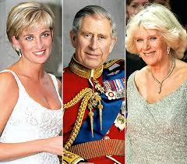
Prince Charles, Prince of Wales
Married to Camilla (2005), The Duchess of Cornwall
Has two children, William, Duke of Cambridge (1982) and Harry (1984) with his former wife Lady Diana Spencer (divorced 1992, died 1997)

Slide 18
THANK YOU
FOR
ATTENTION!

