Slide 1
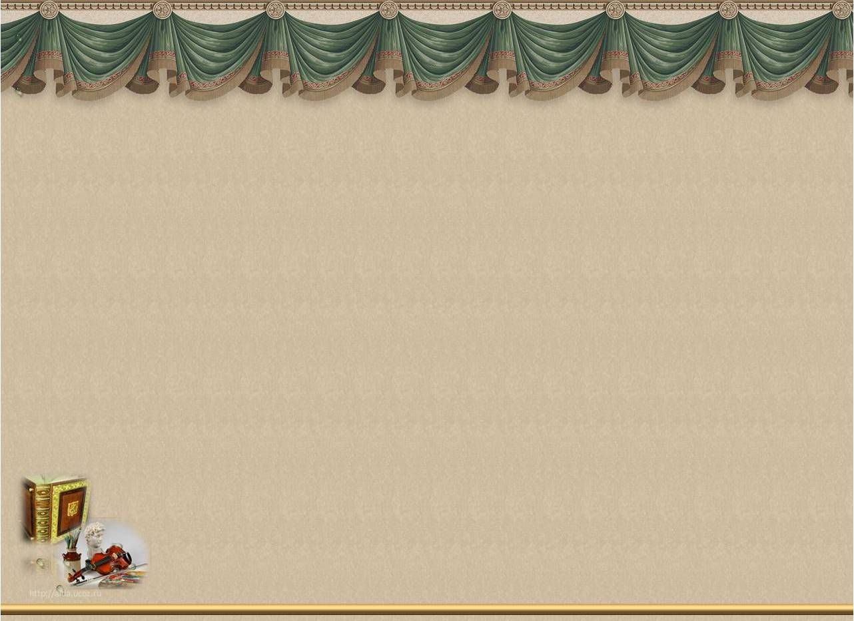
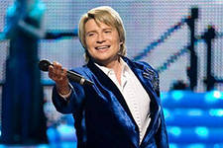
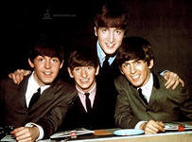
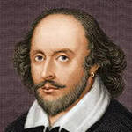
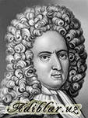
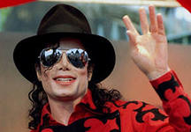
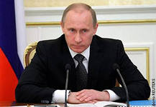
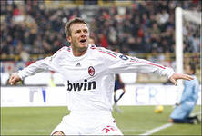
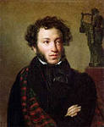
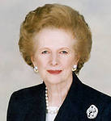
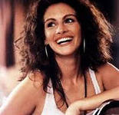
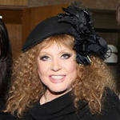
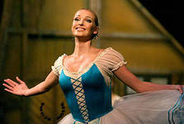
Baskov
The Beatles
W.Shakespeare
D.Defoe
M.Jackson
V.Putin
D. Beckham
A.Pushkin
M.Thatcher
J.Roberts
A.Pugacheva
A.Volochkova

Slide 2
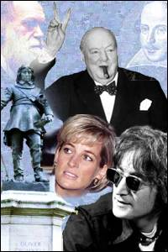
FAMOUS
PEOPLE

Slide 3
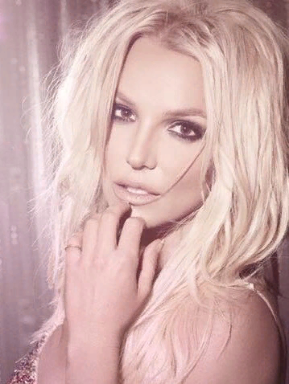
FAMOUS PEOPLE
Today:
we will read texts
We will translate texts
We will listen to the texts
We will speak
about famous people

Slide 4
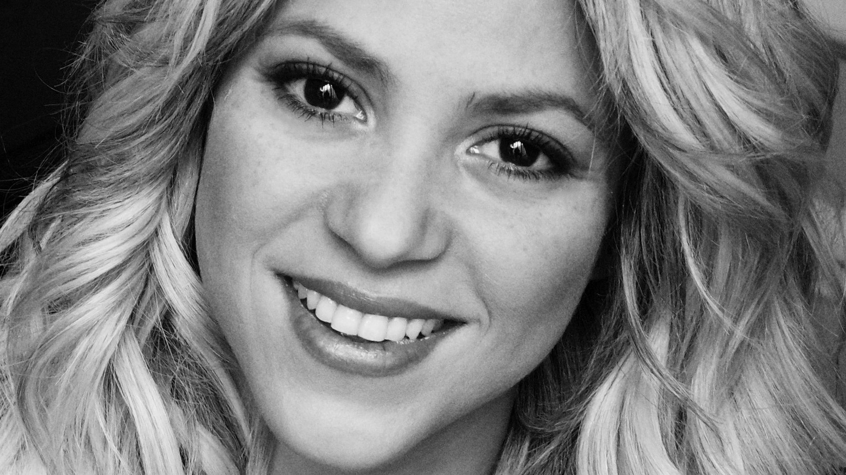
Read the afticle and complete the profile

Slide 5
Four furious friends fought for the phone.

Slide 6

Listen and check

Slide 7
Try to remember as many facts as you can about Shakira
Shakira’s full name is………………………
She is from……………………………………
Her birthday is on the………………….
She has got…………………………………….
Her hobby is…………………………………..
She can……………………………………………

Slide 8

Let’s have a rest

Slide 10
Questions,that help you to find out the information
What is his/her full name?
Where is he/she from?
When is his/her birthday?
Has he/she got brothers or sisters?
What is his/her hobby?
What can he/she do?

Slide 12
Questions to interview smb:
How are you?
What is your full name?
Where are you from?
When is your birthday?
Have you got brothers or sisters?
What is your hobby?
What can you do?

Slide 13


Write down your home task:
Write the profile of your favourite famous
person. Use Shakira’s profile as a model
( EX .6 p.60)

Slide 14
Now you can:
Write the profile about a famous person
Tell about the famous person
Interview the famous person

Slide 15
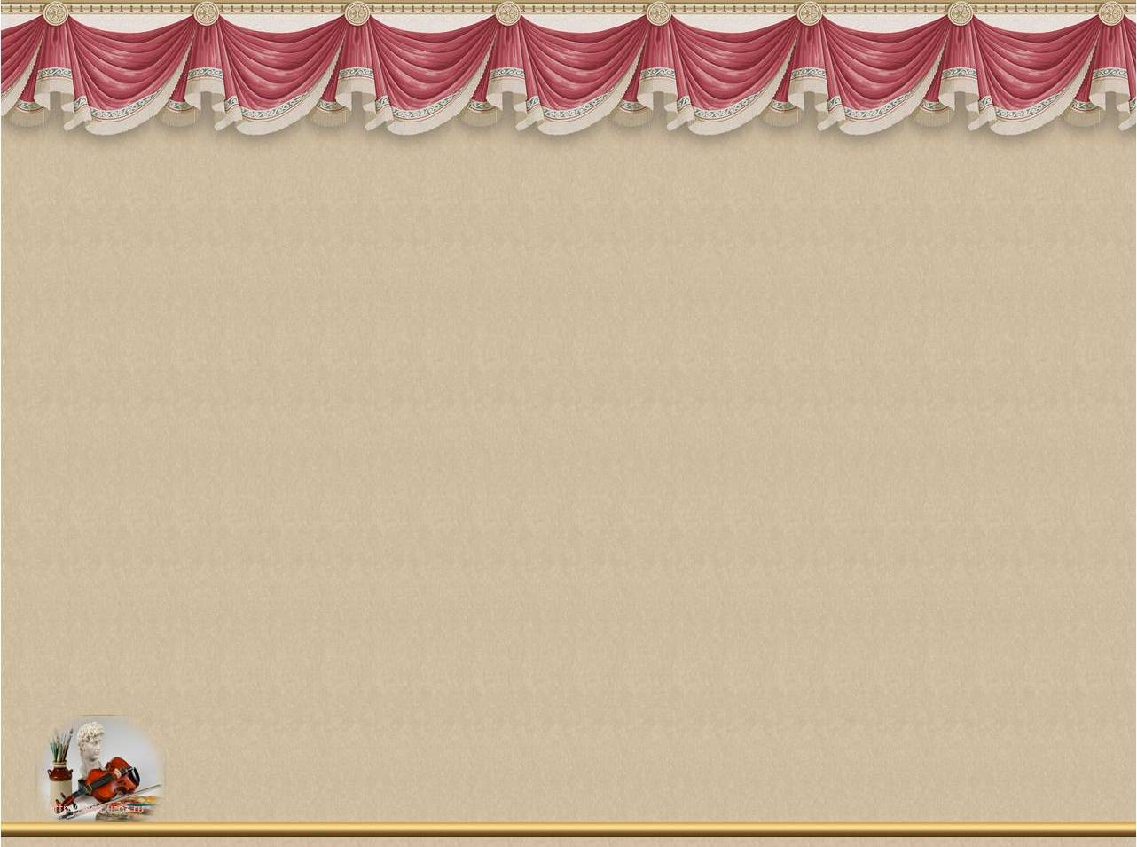

THANKS
FOR YOUR
GOOD JOB!

